Slide 1
Intro to shiny App development
Resbaz 2020
A. Ponsero

Slide 2
Introduction: What is a Shiny App ?
Intro to Shiny - Resbaz 2020

Slide 3

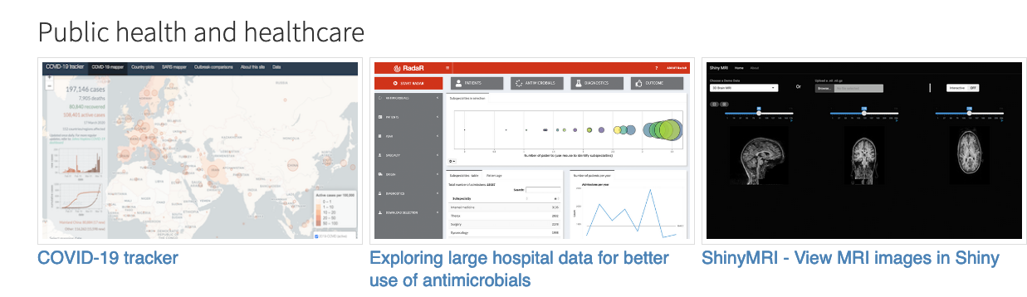
What is a Shiny App?
Shiny is
an R package
to build interactive web
Shiny can be used:
In a standalone apps on a webpage
Embed in R Markdown documents
In a Shiny Dashboard
Shiny App Gallery:
https://shiny.rstudio.com/gallery/
Intro to Shiny- Resbaz 2020

Slide 4
Why do I want a Shiny App?
Shiny Apps allows for
Interactive visualizations
Users can explore the datasets
Shiny Apps are:
Easy to build if you know R
Reactive layout that is easily portable to any screen
Not too painful to deploy (especially on Shiny.io)
Intro to Shiny- Resbaz 2020

Slide 5
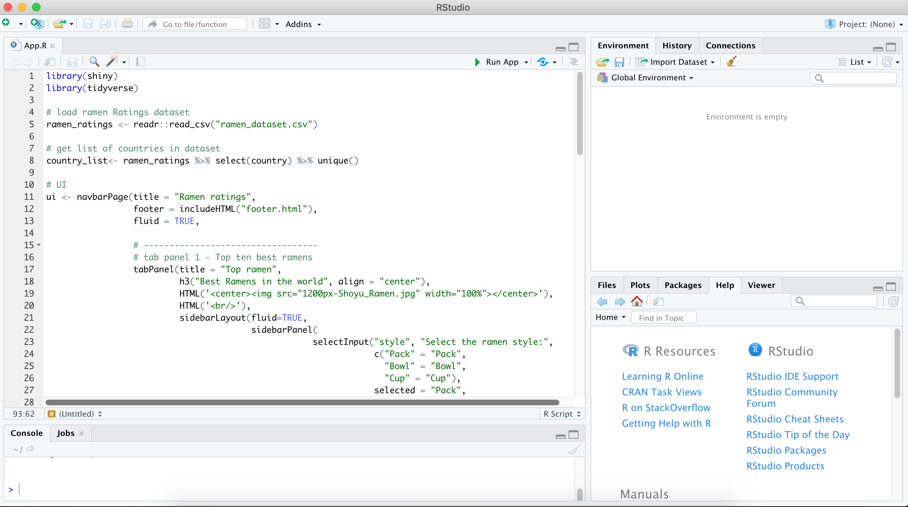
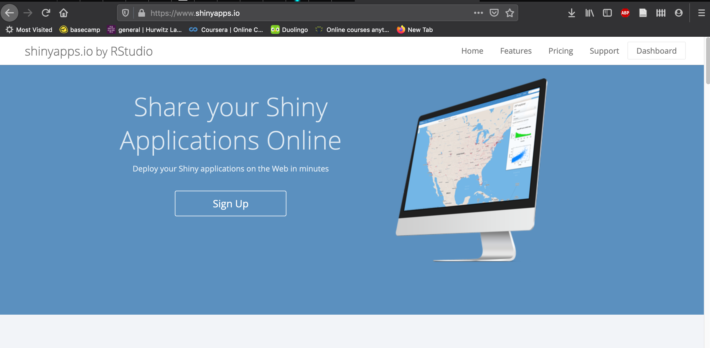
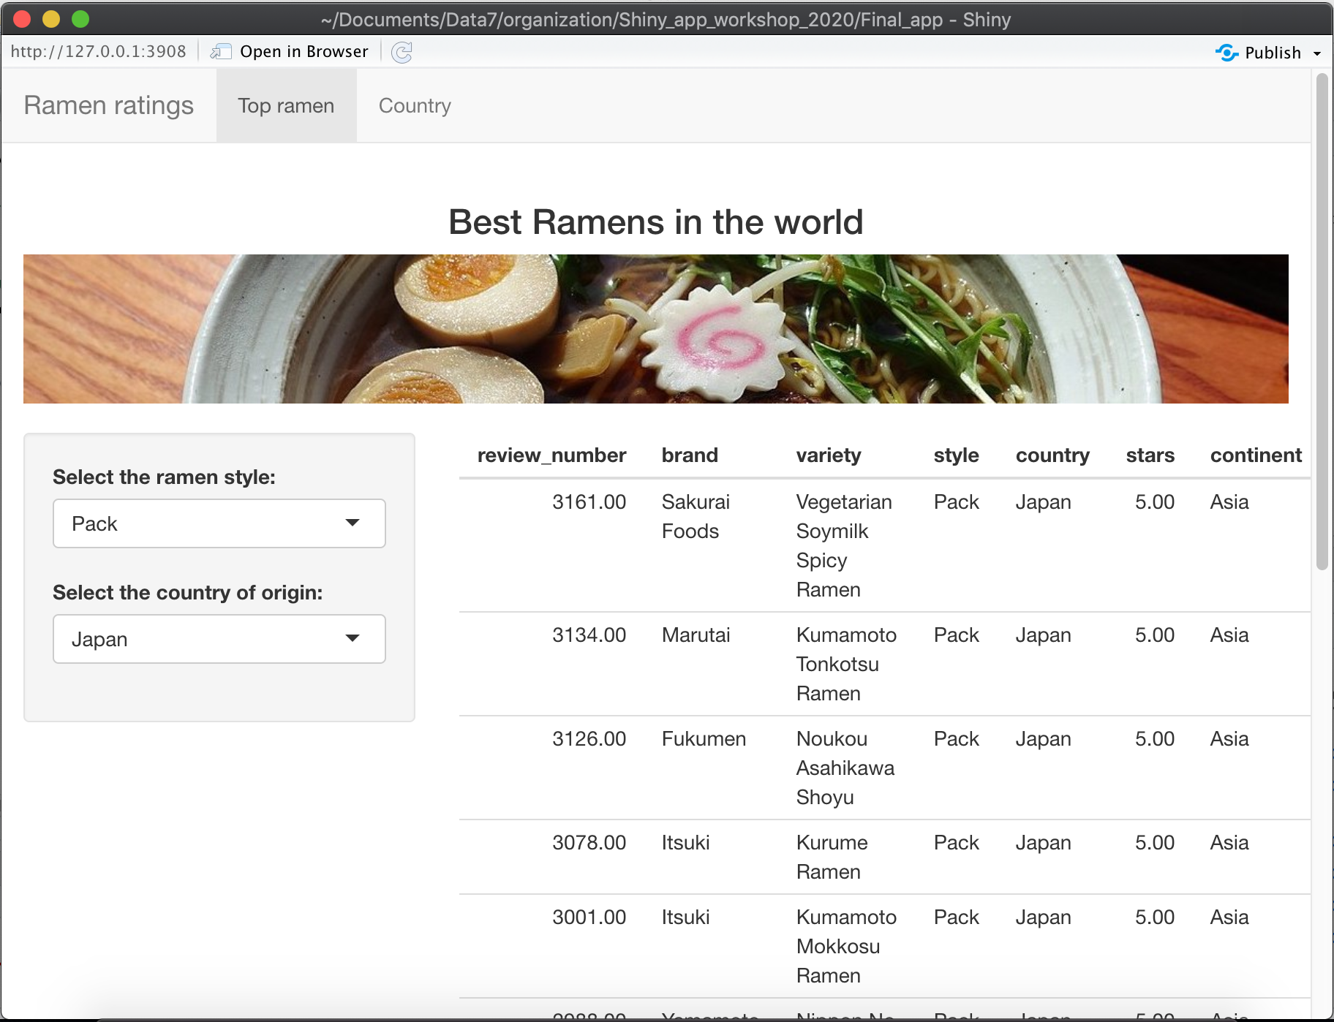
How to develop a Shiny App?
Develop locally using RStudio
Share online on a server
Intro to Shiny- Resbaz 2020

Slide 6
Overview of this workshop
1 – Architecture of a Shiny app
Global overview of a Shiny App
First step in running an App on RStudio
2 – Create the user interface
User Interface layout and main areas
Dealing with images, HTML elements and widgets
3 – Make your app reactive
The Shiny Server function
Reactive values and events
4 – Deploy your app online
Make your app live on Shinyapps.io
Goal: Creation and deployment of the Ramen Rating app
Intro to Shiny- Resbaz 2020

Slide 7




Prerequisite of this workshop
To follow along this workshop you’ll need installed on your local computer:
R and Rstudio
The Tidyverse library
The Shiny library
Create an account in Shinyapps.io
To fully enjoy this workshop it is recommended for you to have :
Some basic experience using Rstudio
Some basic experience using Tidyverse packages
Intro to Shiny- Resbaz 2020

Slide 8
Part 1: Architecture of a Shiny App
Intro to Shiny - Resbaz 2020

Slide 9

The Architecture of a Shiny App
User Interface
Server
Intro to Shiny- Resbaz 2020

Slide 10
The Architecture of a Shiny App
User Inputs
User Interface
Server
Intro to Shiny- Resbaz 2020

Slide 11
The Architecture of a Shiny App
User Inputs
Updates the interface
User Interface
Server
Intro to Shiny- Resbaz 2020

Slide 12
The Architecture of a Shiny App
User Inputs
Updates the interface
User Interface
Server
Locally : your own laptop
Deployed : Web server
Intro to Shiny- Resbaz 2020

Slide 13

The Architecture of a Shiny App
User Inputs
Updates the interface
User Interface
Server
HTML page directly generated by R
Locally : your own laptop
Deployed : Web server
Intro to Shiny- Resbaz 2020

Slide 14
The Architecture of a Shiny App
Ui function
Creates the User interface
App.R
Server function
Specify the server behavior to user inputs
Shiny App script
Always named app.R
Intro to Shiny- Resbaz 2020

Slide 15
The Architecture of a Shiny App
Ui function
Creates the User interface
App.R
Server function
Specify the server behavior to user inputs
Shiny App script
Always named app.R
Example of a simple App in Iris_app folder
Intro to Shiny- Resbaz 2020

Slide 16
The simplest Shiny App
App.R
library(shiny)
ui <- fluidPage()
server <- function(input, output){}
shinyApp(ui = ui, server=server)
Intro to Shiny- Resbaz 2020

Slide 17
Part 2: User Interface
Part 3: Server side
Part 4: Deploy your app online
Intro to Shiny - Resbaz 2020

Slide 18
The Ramen Rating Shiny App
The final app that we’ll create today is accessible:
The complete code for this app can be found here
The dataset for this app is derived from the Tidytuesday Ramen Rating dataset
This hands-on is also available as a step by step document in the Github repo :
Intro to Shiny- Resbaz 2020

Slide 19
Final thoughs: Want more Shiny in your life?
Intro to Shiny - Resbaz 2020

Slide 20
To go further:
Intro to Shiny- Resbaz 2020

