Slide 1
Intro to shiny App development
Resbaz 2020
A. Ponsero
The code, presentation and tutorial for this workshop is accessible at:
https://github.com/aponsero/Shiny_app_workshop_2020

Slide 2
Introduction: What is a Shiny App ?
Intro to Shiny - Resbaz 2020

Slide 3

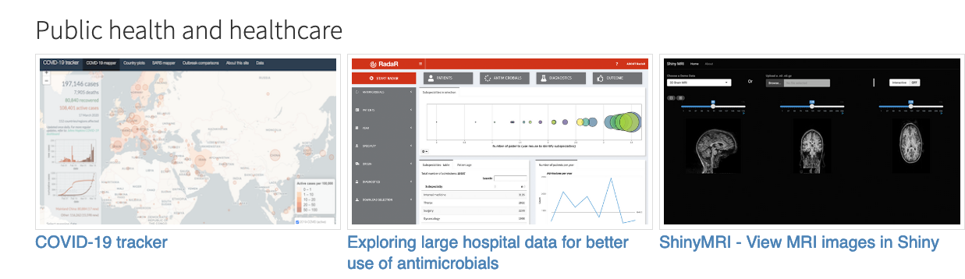
What is a Shiny App?
Shiny is
an R package
to build interactive web applications
Shiny can be used:
In a standalone apps on a webpage
Embed in R Markdown documents
In a Shiny Dashboard
Shiny App Gallery:
https://shiny.rstudio.com/gallery/
Intro to Shiny- Resbaz 2020

Slide 4
Why do I want a Shiny App?
Shiny Apps allows for
Interactive visualizations
Users can explore the datasets
Shiny Apps are:
Easy to build if you know R
Reactive layout that is easily portable to any screen
Not too painful to deploy (especially on Shinyapps.io)
Intro to Shiny- Resbaz 2020

Slide 5
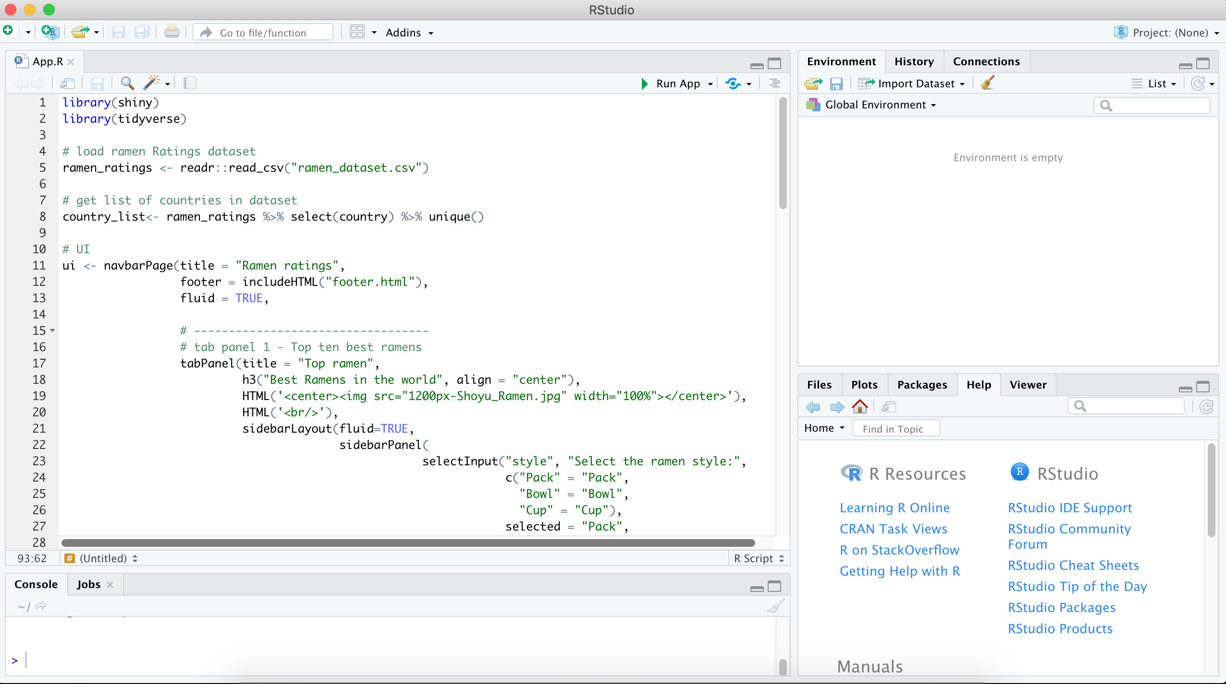
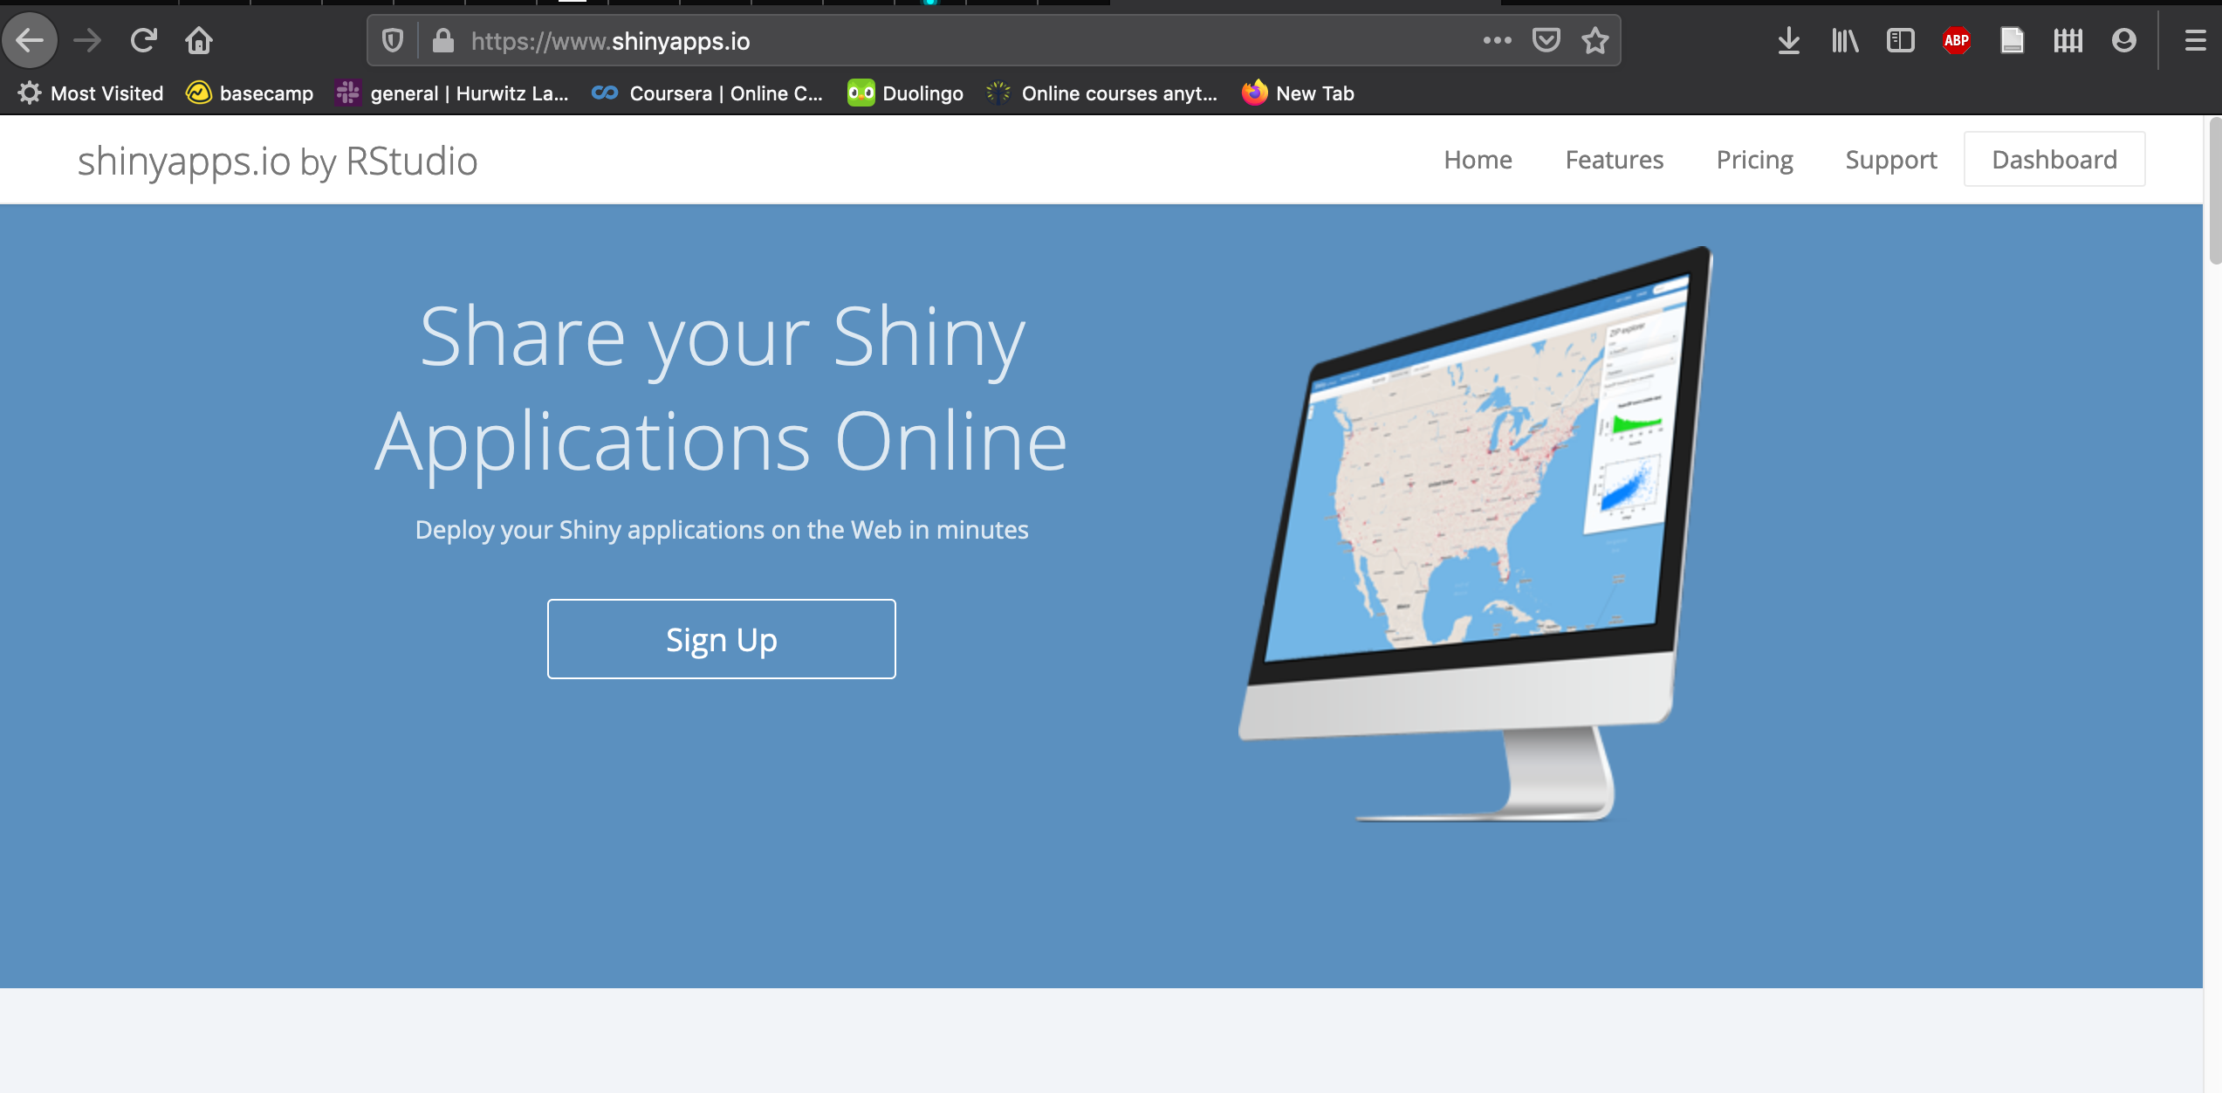
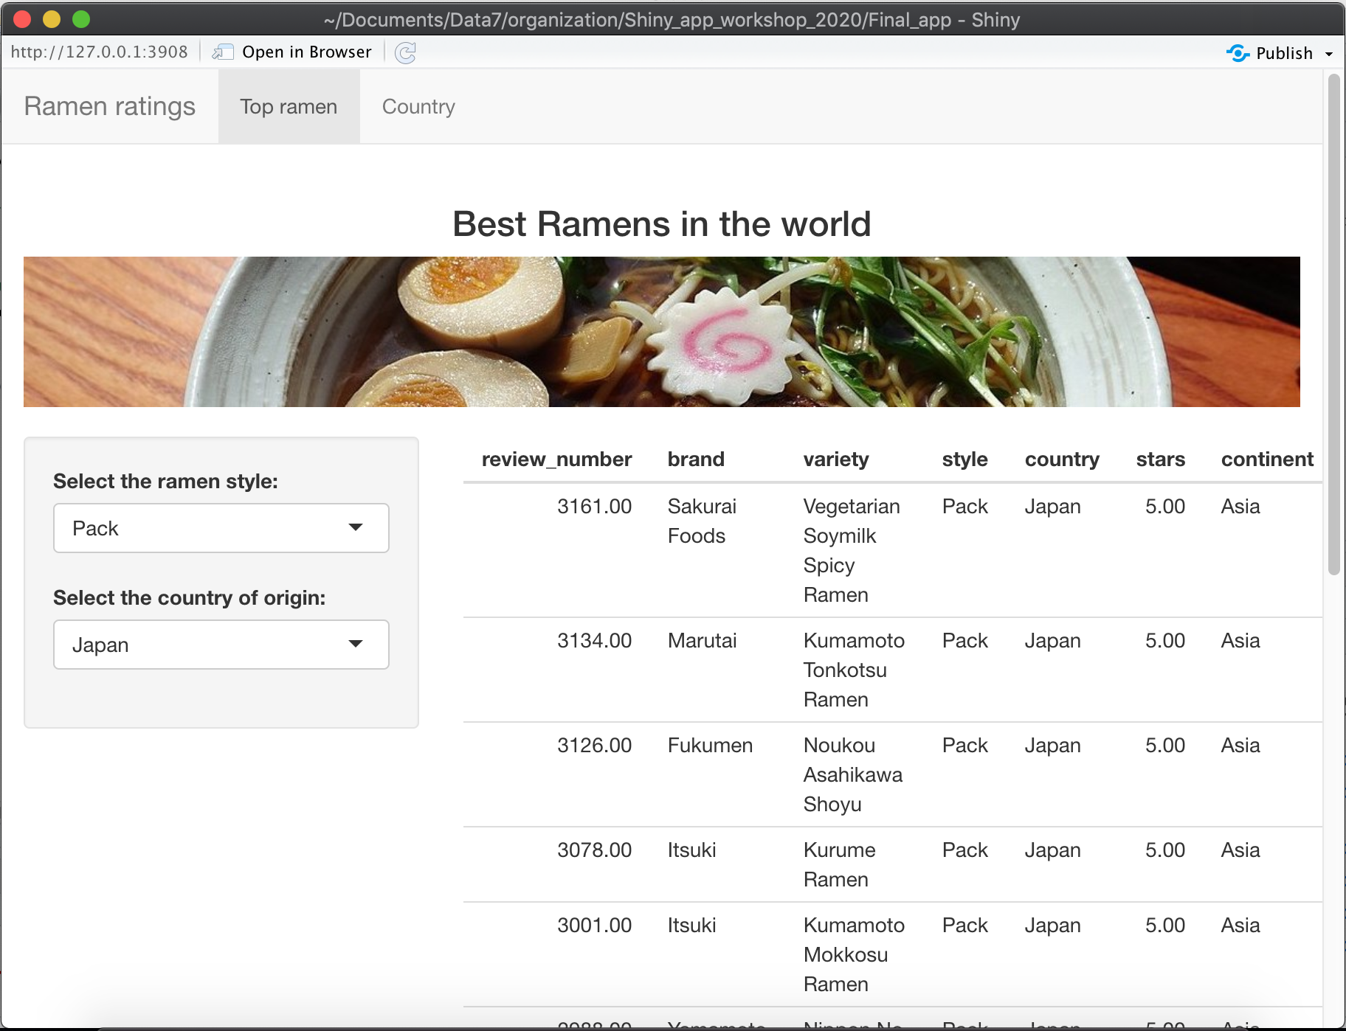
How to develop a Shiny App?
Develop locally using RStudio
Share online on a server
Intro to Shiny- Resbaz 2020

Slide 6
Overview of this workshop
1 – Architecture of a Shiny app
Global overview of a Shiny App
First step in running an App on RStudio
2 – Create the user interface
User Interface layout and main areas
Dealing with images, HTML elements and widgets
3 – Make your app reactive
The Shiny Server function
Reactive values and events
4 – Deploy your app online
Make your app live on Shinyapps.io
Goal: Creation and deployment of the Ramen Rating app
Intro to Shiny- Resbaz 2020

Slide 7




Prerequisite of this workshop
To follow along this workshop you’ll need installed on your local computer:
R and Rstudio
The Tidyverse library
The Shiny library
Create an account in Shinyapps.io
To fully enjoy this workshop it is recommended for you to have :
Some basic experience using Rstudio
Some basic experience using Tidyverse packages
Intro to Shiny- Resbaz 2020

Slide 8
Part 1: Architecture of a Shiny App
Intro to Shiny - Resbaz 2020

Slide 9

The Architecture of a Shiny App
User Interface
Server
Intro to Shiny- Resbaz 2020

Slide 10
The Architecture of a Shiny App
User Inputs
User Interface
Server
Intro to Shiny- Resbaz 2020

Slide 11
The Architecture of a Shiny App
User Inputs
Updates the interface
User Interface
Server
Intro to Shiny- Resbaz 2020

Slide 12
The Architecture of a Shiny App
User Inputs
Updates the interface
User Interface
Server
Locally : your own laptop
Deployed : Web server
Intro to Shiny- Resbaz 2020

Slide 13

The Architecture of a Shiny App
User Inputs
Updates the interface
User Interface
Server
HTML page directly generated by R
Locally : your own laptop
Deployed : Web server
Intro to Shiny- Resbaz 2020

Slide 14
The Architecture of a Shiny App
Ui function
Creates the User interface
App.R
Server function
Specify the server behavior to user inputs
Shiny App script
Always named app.R
Intro to Shiny- Resbaz 2020

Slide 15
The Architecture of a Shiny App
Ui function
Creates the User interface
App.R
Note: It is possible to store the UI and Server as two separate scripts. But this is not recommended anymore.
Server function
Specify the server behavior to user inputs
Shiny App script
Always named app.R
Intro to Shiny- Resbaz 2020

Slide 16
The Architecture of a Shiny App
Ui function
Creates the User interface
App.R
Server function
Specify the server behavior to user inputs
Shiny App script
Always named app.R
Example of a simple App in Iris_app folder
Intro to Shiny- Resbaz 2020

Slide 17
Part 2: User Interface
Part 3: Server side
Part 4: Deploy your app online
Intro to Shiny - Resbaz 2020

Slide 18
The Ramen Rating Shiny App
The dataset for this app is derived from the Tidytuesday Ramen Rating dataset
The final app that we’ll create today is accessible: https://aponsero.shinyapps.io/Ramen_app/
The complete code for this app can be found in the Ramen_App folder
This hands-on is also available as a step by step document in the Github repo :
https://github.com/aponsero/Shiny_app_workshop_2020
Intro to Shiny- Resbaz 2020

Slide 19
Part 2: User Interface
Intro to Shiny - Resbaz 2020

Slide 20
UI:
Define Layouts to organize your app
Include HTML elements
Shiny tags
HTML()
IncludeHTML()
Add widgets for user inputs
Intro to Shiny- Resbaz 2020

Slide 21
Part 3: Server side
Intro to Shiny - Resbaz 2020

Slide 22
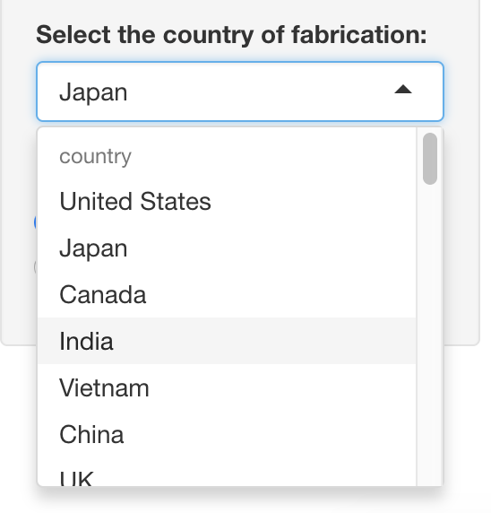
Cascade of updates: Case 1
Input$country = Japan
Intro to Shiny- Resbaz 2020

Slide 23
Cascade of updates: Case 1
Input$country = India
Intro to Shiny- Resbaz 2020

Slide 24
Cascade of updates: Case 1
Input$country = India
# Title main area
# ----------------------------------
output$toptitle <- renderText({
paste("Best ramens in ", input$country)
})
The renderText function invalidated
Intro to Shiny- Resbaz 2020

Slide 25

Cascade of updates: Case 1
Input$country = India
# Title main area
# ----------------------------------
output$toptitle <- renderText({
paste("Best ramens in ", input$country)
})
The renderText function updated
Intro to Shiny- Resbaz 2020

Slide 26
Cascade of updates: Case 1
Input$country = Japan
Intro to Shiny- Resbaz 2020

Slide 27
Cascade of updates: Case 2
Input$country = India
Intro to Shiny- Resbaz 2020

Slide 28
Cascade of updates: Case 2
# ----------------------------------
# Reactive elements
display_dataset <- reactive({
ramen_ratings %>% filter(style %in% input$style & country == input$country)
})
Input$country = India
Display_dataset reactive element is invalidated
Intro to Shiny- Resbaz 2020

Slide 29
Cascade of updates: Case 2
# ----------------------------------
# Reactive elements
display_dataset <- reactive({
ramen_ratings %>% filter(style %in% input$style & country == input$country)
})
Input$country = India
Display_dataset reactive element is re-run
Intro to Shiny- Resbaz 2020

Slide 30
Cascade of updates: Case 2
# ----------------------------------
# Reactive elements
display_dataset <- reactive({
ramen_ratings %>% filter(style %in% input$style & country == input$country)
})
Input$country = India
# ----------------------------------
# Table output
output$top3 <- renderTable({
display_dataset() %>% arrange(desc(stars, review_number)) %>% slice(1:3) %>% select(-continent, -review_number)
})
renderTable element is invalidated
Intro to Shiny- Resbaz 2020

Slide 31
Cascade of updates: Case 2
# ----------------------------------
# Reactive elements
display_dataset <- reactive({
ramen_ratings %>% filter(style %in% input$style & country == input$country)
})
Input$country = India
# ----------------------------------
# Table output
output$top3 <- renderTable({
display_dataset() %>% arrange(desc(stars, review_number)) %>% slice(1:3) %>% select(-continent, -review_number)
})
renderTable element is
re-run
Intro to Shiny- Resbaz 2020

Slide 32
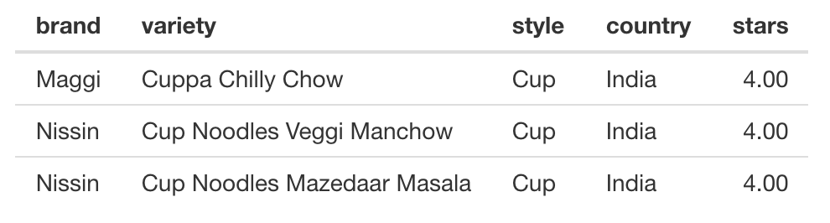
Cascade of updates: Case 2
# ----------------------------------
# Reactive elements
display_dataset <- reactive({
ramen_ratings %>% filter(style %in% input$style & country == input$country)
})
Input$country = India
# ----------------------------------
# Table output
output$top3 <- renderTable({
display_dataset() %>% arrange(desc(stars, review_number)) %>% slice(1:3) %>% select(-continent, -review_number)
})
Intro to Shiny- Resbaz 2020

Slide 33
Cascade of updates: Case 1
Input$country = Japan
Intro to Shiny- Resbaz 2020

Slide 34

Cascade of updates: Case 3
Input$country = India
Input$go=0
Intro to Shiny- Resbaz 2020

Slide 35
Cascade of updates: Case 3
# Title main area
# ----------------------------------
ntext <- eventReactive(input$go, {
input$country
})
Input$country = India
eventReactive element is invalidated
Input$go=1
Intro to Shiny- Resbaz 2020

Slide 36
Cascade of updates: Case 3
# Title main area
# ----------------------------------
ntext <- eventReactive(input$go, {
input$country
})
Input$country = India
eventReactive element is re-run
Input$go=1
Intro to Shiny- Resbaz 2020

Slide 37
Cascade of updates: Case 3
# Title main area
# ----------------------------------
ntext <- eventReactive(input$go, {
input$country
})
Input$country = India
output$toptitle <- renderText({
paste("Best ramens in ", ntext())
})
renderText element is
invalidated
Input$go=1
Intro to Shiny- Resbaz 2020

Slide 38
Cascade of updates: Case 3
# Title main area
# ----------------------------------
ntext <- eventReactive(input$go, {
input$country
})
Input$country = India
output$toptitle <- renderText({
paste("Best ramens in ", ntext())
})
renderText element is
re-run
Input$go=1
Intro to Shiny- Resbaz 2020

Slide 39
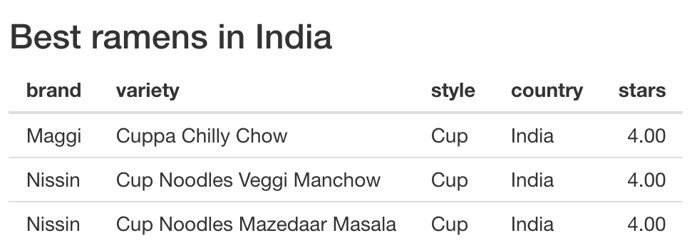
Cascade of updates: Case 3
# Title main area
# ----------------------------------
ntext <- eventReactive(input$go, {
input$country
})
Input$country = India
output$toptitle <- renderText({
paste("Best ramens in ", ntext())
})
renderText element is
re-run
Input$go=1
Intro to Shiny- Resbaz 2020

Slide 40
Server:
Adding interactive vizualizations
Use renderText, renderPlot and renderTable to create outputs
Place them in the UI using the TextOutput, TableOutput and PlotOutput
Use reactive() to create internal reactive elements
Add conditional Panels to hide outputs
Optional: adding buttons and dealing with events
Intro to Shiny- Resbaz 2020

Slide 41
Final thoughs: Want more Shiny in your life?
Intro to Shiny - Resbaz 2020

Slide 42
To go further:
Get inspiration from the Shiny Gallery
https://shiny.rstudio.com/gallery/
Shiny provides good tutorials (video and articles)
https://shiny.rstudio.com/tutorial/
A great (and very long) blog post that covers basically everything about shiny
http://zevross.com/blog/2016/04/19/r-powered-web-applications-with-shiny-a-tutorial-and-cheat-sheet-with-40-example-apps/#eventreactive-used-to-prevent-unwanted-reactions-in-a-reactive-function
To create interactive documents in Rmarkdown using Shiny
https://blog.rstudio.com/2014/06/19/interactive-documents-an-incredibly-easy-way-to-use-shiny/
Intro to Shiny- Resbaz 2020

