Slide 1




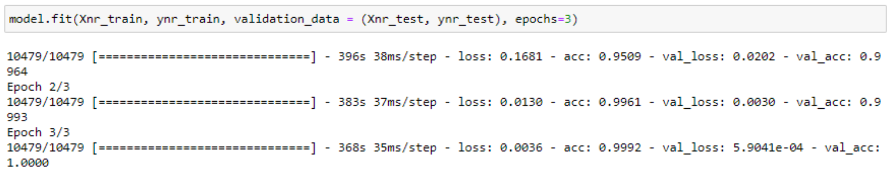
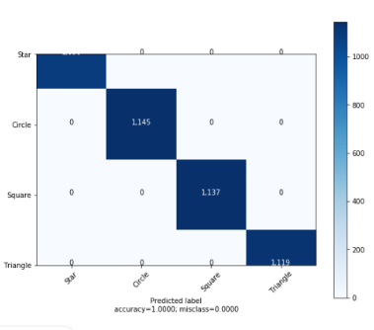

Maja Andersen, Trung Thai, Mikkel Carstensen
Introduction
We want our algorithm to detect differences in the shapes and be able to show the user what kind of shape it’s detecting.
Results
The system can identify Shapes on its own.
We have drawn images of the shapes, which aren’t a part of the dataset.
Self drawn pictures
Model results and score
Normalized Confusion matrix with heat plot
Model precision
Conclusions
For this project, we were able to achieve a score of 0.99 by using the CNN algorithm.
Materials and methods
The dataset consists of black and white images picturing different shapes. The images are extracted, preprocessed and rotated into different positions.
As Methods we used the CNN algorithm and the grid search algorithm
Literature cited
Hans On Machine Learning with Scikit-Learn
Geron Aurelien
https://towardsdatascience.com/building-a-convolutional-neural-network-cnn-in-keras-329fbbadc5f5

