Slide 1

JOIN, LEARN & EARN
Martin Lynov
Christian Bøgvad Ruusunen
Mikkel Emil Grøndahl Hansen
Business Economics and IT
Copenhagen School of design and technology

Slide 2

Upon completion of this coure the student will gain knowledge, and skills to navigate as a freelancer.
The following course will contain
Introduction to Project Management
Budgeting as a new freelancer
How to negotiate with potential clients

Slide 3
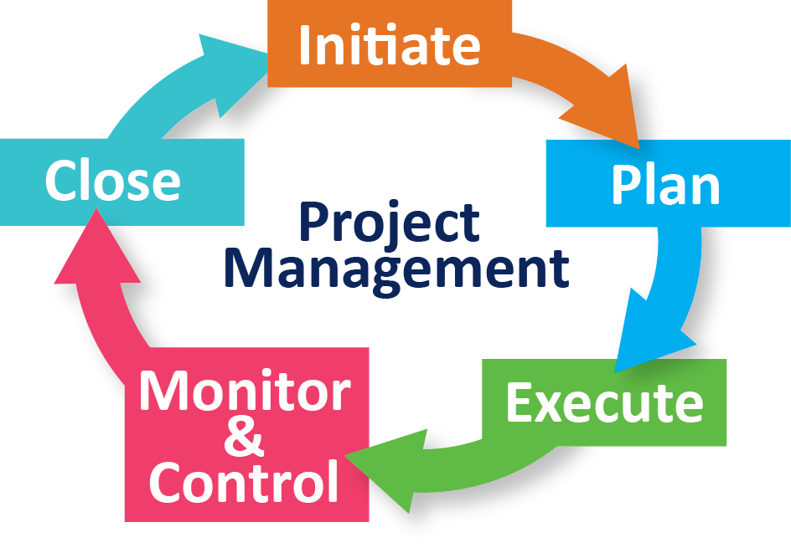

Introductions to Project Management
Project planning Gives the student a more detailed overview, of all aspect of the scope project. Moreover it gives the tools to navigate through activities, resources, timelines, and deliverables, as well as project boundaries.
Project budgeting.
Gives the student the tools and skills to navigate through financial priorities, the 50/30/20 rule. Excel templates, savings, and taxes.
Outsourcing
Gives the student the knowledge regarding outsourcing, specialist, experts in certain areas of the project, and the opportunity to gain more focus on the activity of a project as well as to improve overall efficiency
Project communication
Gives the student the importance’s of communication, and coordination, as well as follow up of various project, clients and stakeholders.

Slide 4

Budgeting as a new freelancer
In this part of the course the students will get the essential knowledge to set up a budget in Excel. The course will contain:
Revenue
Profit
Expenses
Fixed Cost
Variable Cost
Taxes
Insurance & Savings
Break-even
Service pricing
By the end of this course, the student will be able to build a basic budget using Excel. The student will use a template to add, delete, edit, and format a budget to meet the needs of their personal, as a freelancer.

Slide 5

How to negotiate with potential clients
This part of the course will learn the students the importance of how to negotiate their salary to best match their abilities. It also touches on how to maintain good communication, including how to land more clients and best maintain current ones.

Slide 6
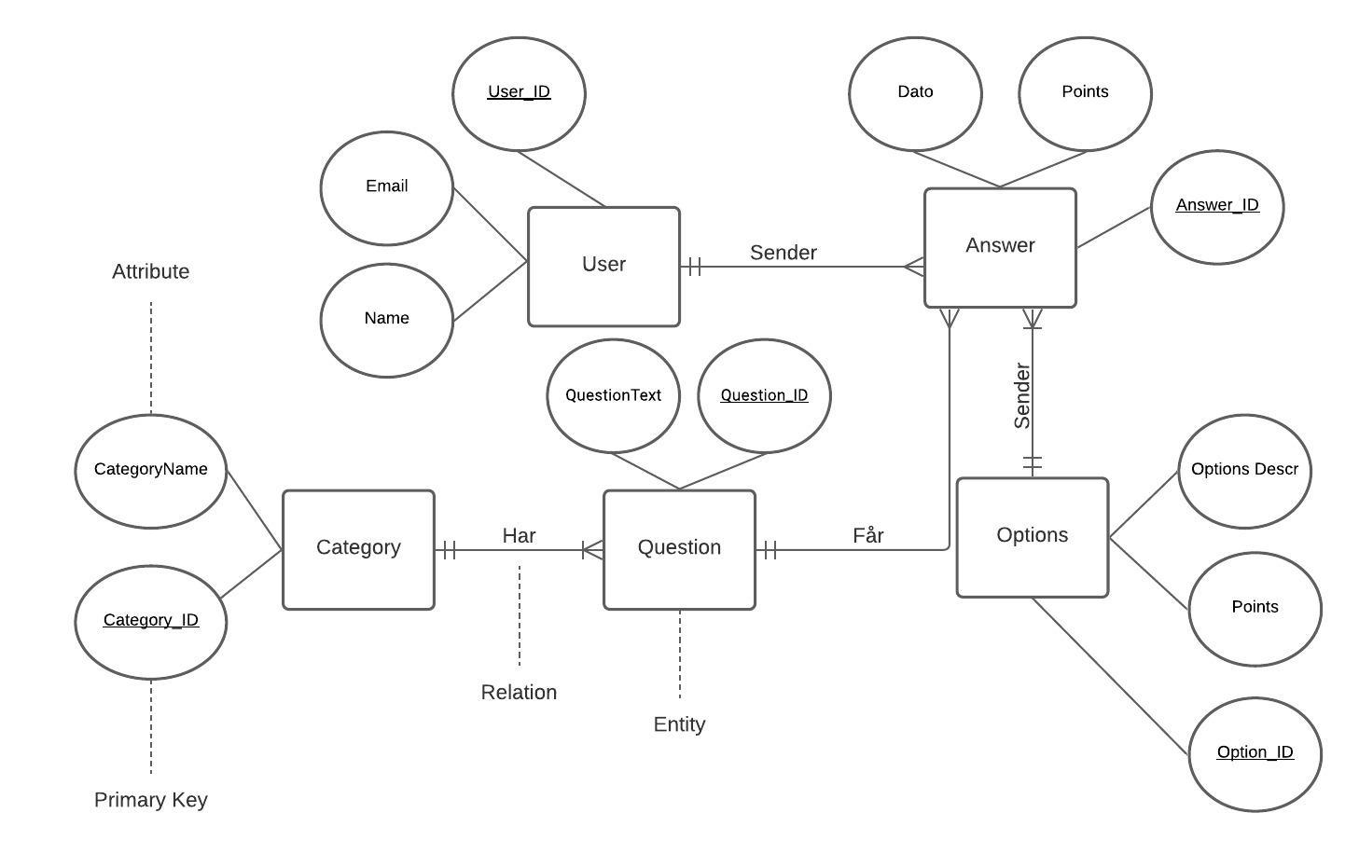
Database
Visual Model
This provides a visual layout of the database and the functionality between each entity and their functions. This layout is used to provide a better overview of the databases relations and functionality.

Slide 7
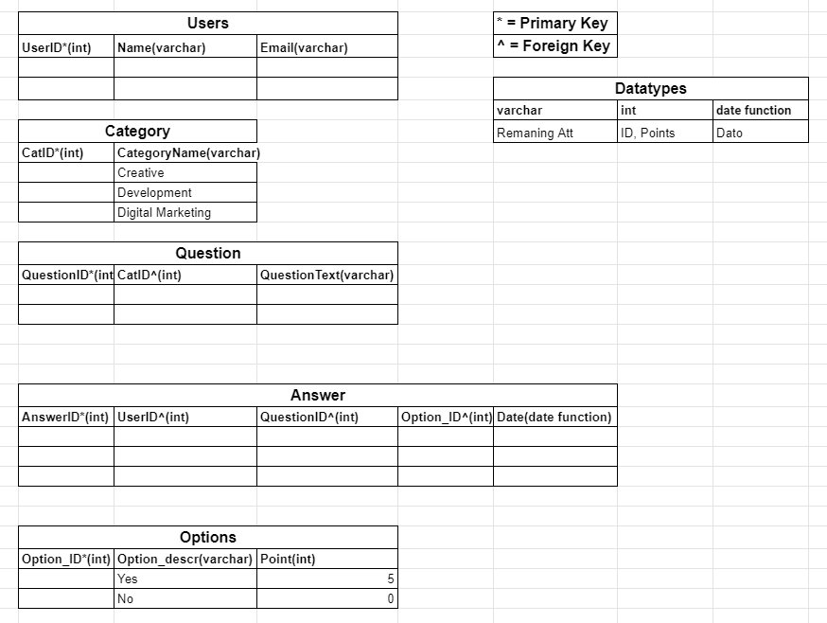
Database
Rational Model
This model shows the rational relationship in an Excel sheet layout. It like the last visual layout helps map out the database by making it more manageable.

Slide 8

Database Functionality
The database has the functionality of handling 1 or several quizzes by sorting users answers into the answer column and subsequently sorting their answers into the corresponding category. This could provide a future programmer the ability to calculate what percentage the user has in each category, and therefore be able to send out an email suggesting the correct courses for the corresponding student. An idea could be to provide the coming student an overview of what percentage they scored in each category and suggest the courses accordingly.
The Database was designed with the quiz Coderstrust provided in mind however, this can be changed at any given time.

Slide 9

Database Access
The scripts for the database has been uploaded to GitHub it can be accessed by using the link provided below.
a readme file is also present in link and informs the user how to open and manage the database in MySQL.
LINK: https://github.com/MikkelGroendahl/CT-kea-2021-gr20

