Slide 1
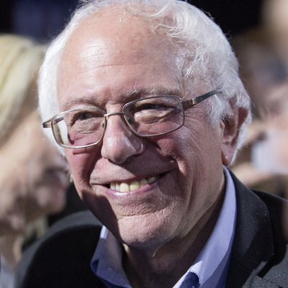
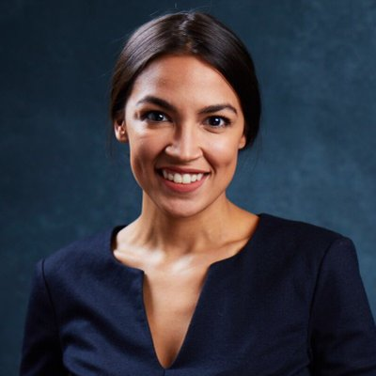
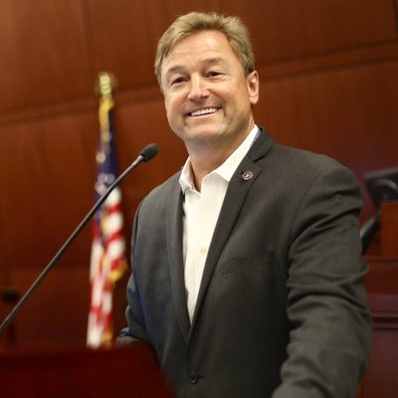
Bernie Sanders
Alexandria
Ocasio-Cortez
Dean Heller

Slide 2
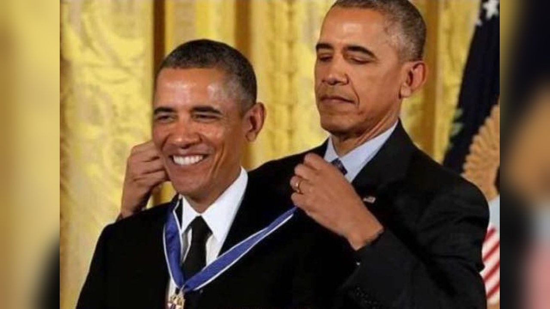
Jim Cooper
Jim Cooper

