Slide 1
Small Angle Neutron Scattering
Small-angle neutron scattering (SANS) uses elastic neutron scattering at small scattering angles to investigate the structure at a mesoscopic scale of about 1 - 100 nm.
http://www.ncnr.nist.gov/staff/hammouda/the_SANS_toolbox.pdf

Slide 2
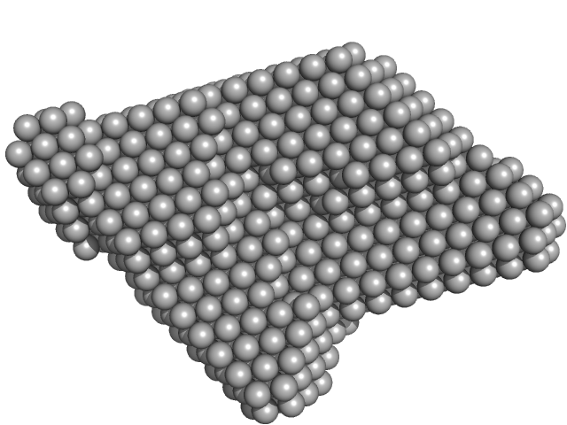
What can SANS tell me?
SANS provides information about:
Size of particle
Shape of particle
Inter-particle interactions
Morphological characteristics
Surface area-to-volume ratios
Orientation

Slide 3
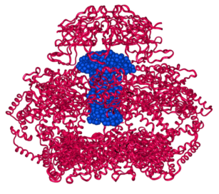
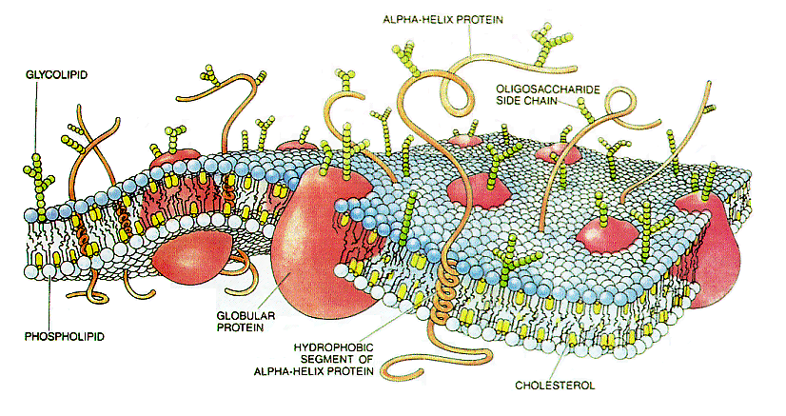

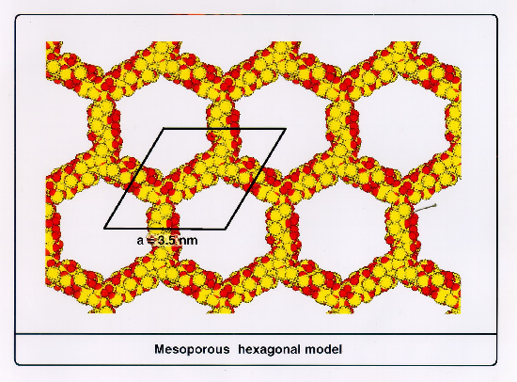
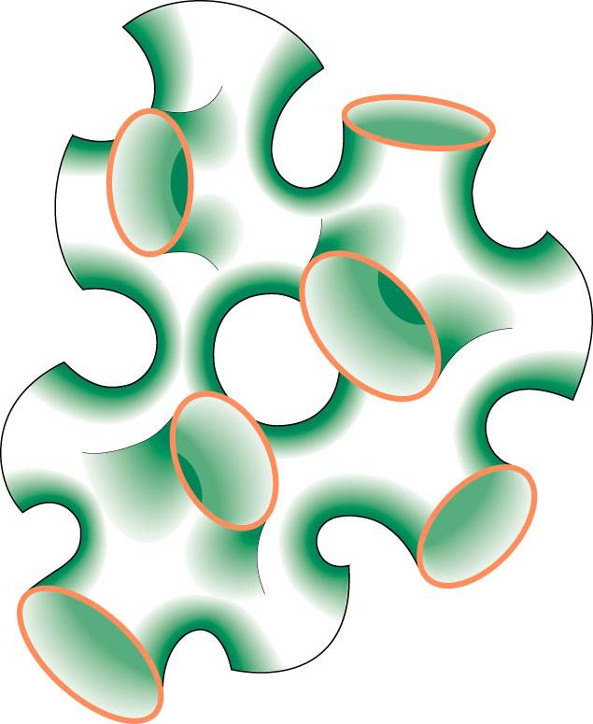
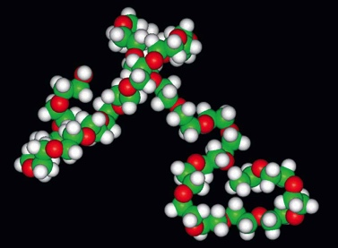
What can we study with SANS?
Mesoporous structures
Biological structures
Polymers
Colloids and surfactants
Magnetic films and nanoparticles
Modified from Paul Butler’s slide

Slide 4
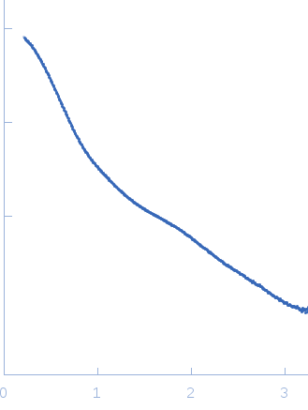
SasView Design Goals
Operates on reduced data and thus should be instrument agnostic.
Performs modeling in inverse space
Data analysis toolbox:
Fitting models to data
P(r) inversion
Model-independent analysis
Plus some other useful tools
logI
SasView
Q
Reduced Data

Slide 5
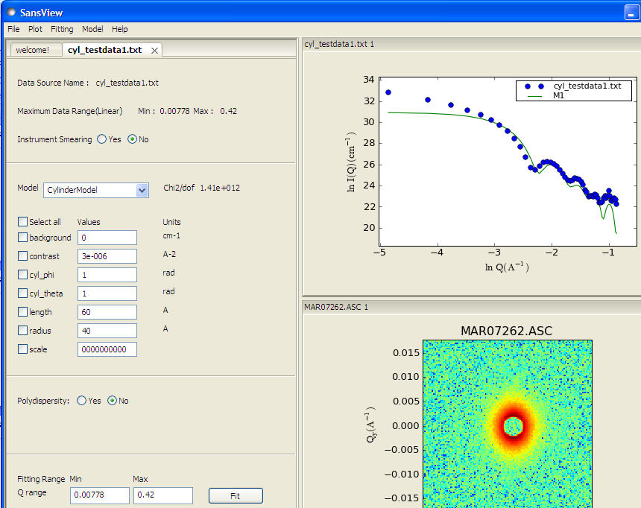


SasView - Fitting
Handles 1D and 2D data
Form and structure factors for various particle shapes
Different optimizers (Bayesian Statistics)
Allows polydispersity
Simultaneous and batch fitting
Addition of custom models
https://github.com/SasView/documents/Tutorial.pdf

Slide 6
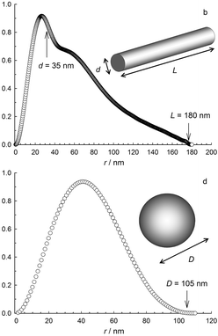
SasView – P(r) inversion
Calculates a real-space pair-distance distribution function
Allows for estimation of background and regularization constant
Dmax can be explored with respect to χ²
P(r)
P(r)
F. Grrohn, Soft Matter, 2010,6, 4296-4302
https://github.com/SasView/documents/Tutorial.pdf

Slide 7
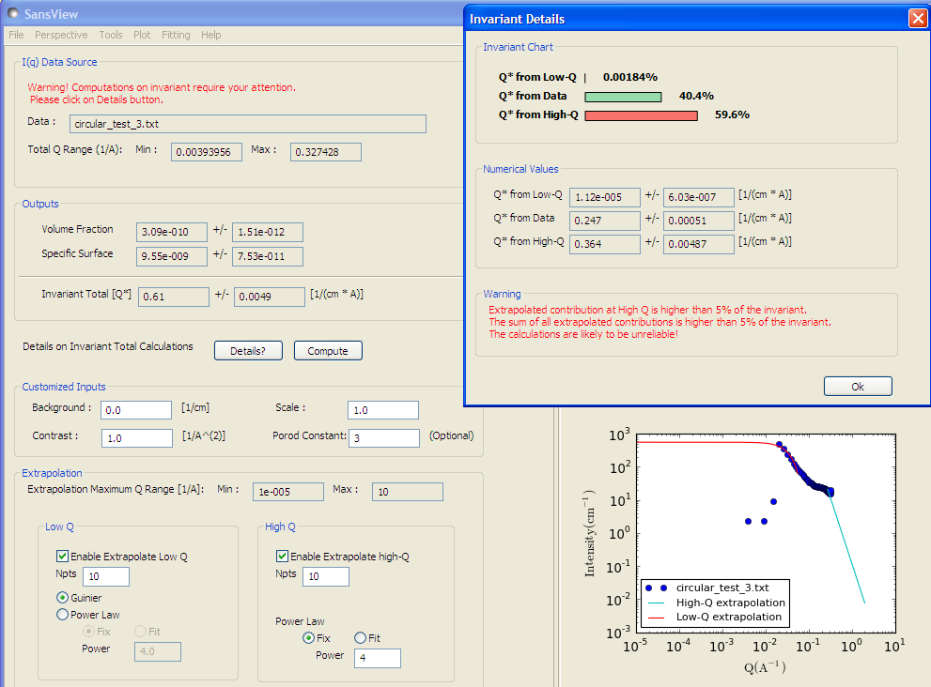
SasView – Model Independent Analysis
Model independent quantities
The scattering invariant
The volume fraction
The specific surface area
https://github.com/SasView/documents/Tutorial.pdf

Slide 8
SasView components
SasView
SasModels
Bumps
SasGui
SasCalc
In ideal SasView world they are fully independent

Slide 9
SasCalc
Back-end calculations for sasgui perspective
Data fitting:
src/sas/sascalc/fit/
Pr inversion
src/sas/sascalc/pr/
Data loader:
src/sas/sascalc/dataloader/loader.py

Slide 10
SasCalc

Slide 11
SasModels
Models located in: sasmodels/models
Three different types of models:
Python only: broad_peak.py
Python with embedded C: stickyhardsphere.py
Python and separate C: barbell.py and barbell.c

Slide 12
SasModels essential components
Model Description: Docstring
Name, title, short description
Parameters table
C files to be included during compilation
Demo parameters values
Unit tests

Slide 13
SasModels functions
Iq - 1D scattering intensity functions for the case where the scatterer is randomly oriented
Iqxy - the 2D scattering intensity functions provide I(Q,φ) for an oriented system as a function of a Q
Form_volume - calculates the volume of particle V, which is used to normalize form factor.
ER – calculates effective radius
VR - calculate particle volume/total volume for shape models
INVALID(v) returns False if v.parameter is invalid for some parameter or other (e.g., v.bell_radius < v.radius).

Slide 14
SasModels core modules
Model computation:
sasmodels/sasview_model.py – interface to sasview
sasmodels/kernel.py -interface to all kernel models
sasmodels/kerneldll.py –dll driver for c kernels
sasmodels/kernelpy.py – python driver
sasmodels/kernelcl.py – opencl driver
sasmodels/core.py - prepares the model for the execution
sasmodels/generate.py – generates model file based on the template

Slide 15
Sasmodels compare
Computes model and compares between different platforms (opencl, dll)
Allows for comparison with old sasview version
./compare.sh modelname -1d
./compare.sh modelname -2d
Multiple precision, q ranges options

