Slide 1
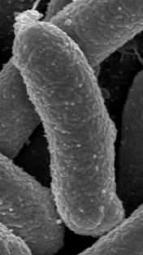
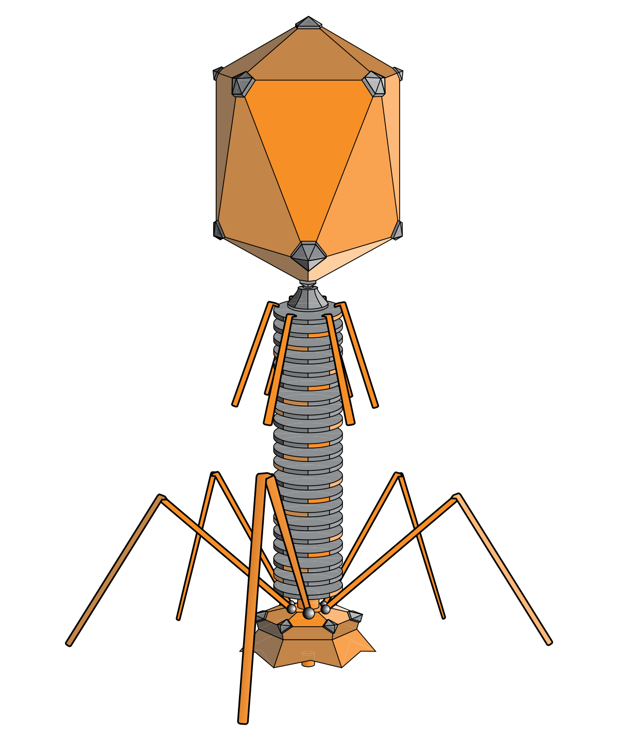
Many body model of bacteria and viruses
Agent based simulation
→ Every cell and phage modeled individually

Slide 2
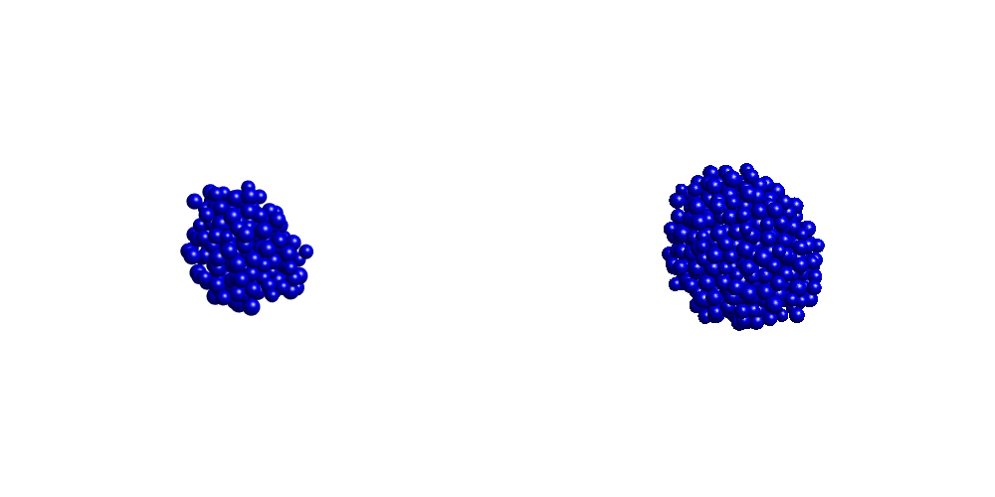
Many body model of bacteria and viruses

Slide 3
Many body model of bacteria and viruses

Slide 4
Many body model of bacteria and viruses

Slide 5
Many body model of bacteria and viruses
Currently implemented (inefficiently) in sequential C++ code
Primary goal is to rewrite to CUDA code
Possibility for real time visualization
… + what we can think of.
The number of agents grows exponentially

Slide 6
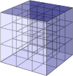
Lattice model of bacteria and viruses
Create 3D lattice of size N x N x N.
Stochastic Poisson process
Things happen locally within box.
Diffusion moves particles from one
box to neighboring boxes

Slide 7
Lattice model of bacteria and viruses

Slide 8
Lattice model of bacteria and viruses
Currently implemented (inefficiently) in sequential C++ code
Primary goal is to rewrite to CUDA code
Problem is essentially a solved using a stencil structure.

