Slide 1

How to use generative pretrained transformer (GPT) models as reliable second screeners of titles and abstracts in systematic reviews
Mikkel H. Vembye, PhD.
Researcher – The Danish Center for Social Science Research.
IRM 2026, Cologne, April 24

Slide 2
Workshop Objectives
Introduction to title and abstract screening with GPT (API) models.
Discuss quality assessment and reliable implementation of AI screening
Discuss future direction for using AI for literature screening
Showcase the R package AIscreenR
Find all material behind this presentation at: https://github.com/MikkelVembye/SRMA-SIG-presentation

Slide 3
Why Use AI for Screening in Systematic Reviews?
Improve quality
Reduces missed studies and human error. While double-screening is the gold standard, it is costly and not always feasible.
Enables broader, less restrictive database searches
Increase efficiency
Reduce manual and tedious workload and accelerate the review process
Some reviews remain incomplete due to the sheer volume of studies—and this challenge is growing as databases expand.
Notes:
Human screeners overlook relevant studies for various reasons. Therefore, state-of-the-art is to conduct human double-screening. However, this is costly and many research groups cannot afford double-screening.
Overlooking relevant studies at this initial review stage can be consequential, leading to substantially biased results.
AI tools can accommodate both type of issues

Slide 4
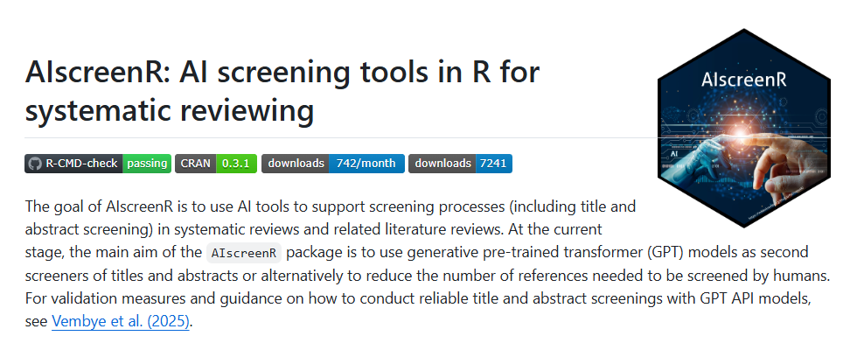
What we have tested and developed
We have tested the use of OpenAI’s GPT (Generative Pre-trained Transformer) API (Application Programming Interface) models to screen titles and abstracts. As you will see in a moment, this is NOT the same as using ChatGPT! Let me show you.
Our results show that GPT API models perform at least on par with human screeners performances, even in very complex reviews with many inclusion criteria. I will come back to these results later in the presentation.
To conduct this type of screening, we have developed the R package AIscreenR (Vembye, 2025).
Based on this, we suggest that GPT API models can be used as full second screeners in state-of-the-art reviews

Slide 5
What are common human screener performances?
Notes:
Before discussing the screening performance of AI tools, I will spent some time embarking the question how good are human at screening title and abstract.

Slide 6
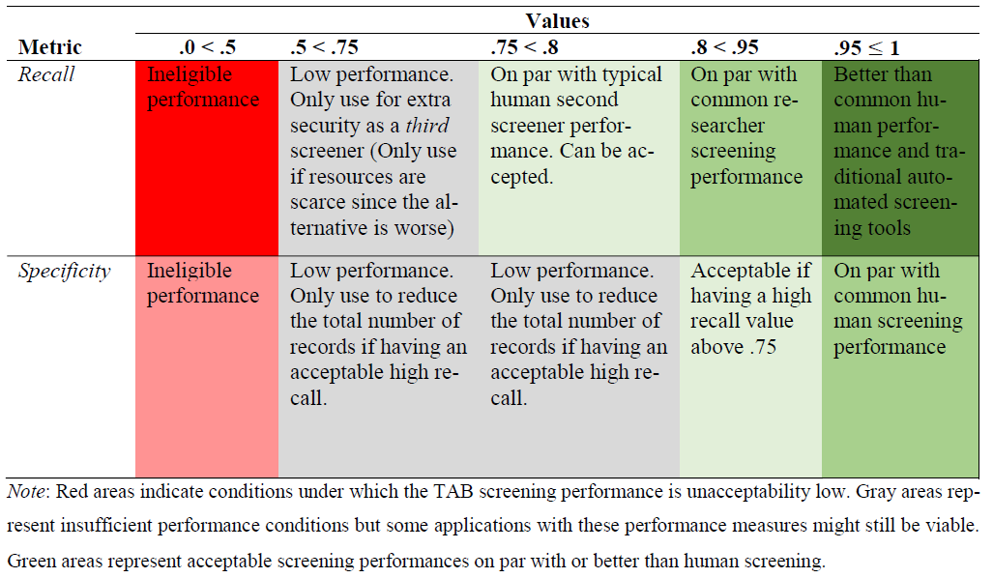
Quality assessment via benchmarking
We have developed a benchmark scheme based on our and our Campbell students' typical screening performances, which can be used to ensure the quality of title and abstract screenings.
In general, we recommend that GPT screenings should yield recalls above 75% to be usable in high-quality reviews.
Content-experts/researchers typically have recalls around 83%.
It is more challenging to set good guidelines for specificity. If recall is high, specificity matters less. It is simply an extra safeguard.

Slide 7
Why we consider benchmarking all-important
Guards against bad and biased screenings that are inferior to human screening.
It allows for context-specific assessments of the efficacy of using GPT API models as second screeners.
As we cannot control model developments, the benchmark scheme ensures that we can monitor model performances over time. Meaning that if we experience that a model suddenly cannot live up to our benchmarks we can stop using it.
Avoids the wild-west and ensures standardization of this screening approach.

Slide 8
How generalizable is this approach?
We have conducted three large-scale classification experiments with different levels of complexity in terms of the number of inclusion criteria. Herein we found that:
GPT API models can perform on par with or in some cases even better typical human second screeners in high-quality systematic reviews (Vembye et al., 2024). All models yield recalls above 80% in all of our experiments while showing high exclusion rate as well.
GPT-4 model can be rather over-inclusive in complex review settings.
The GPT-4 model outperforms the GPT-3.5-turbo model. We therefore recommend primarily using GPT-4 models for title and abstract screening.
Moreover, our newest results suggest that GPT-4o-mini, which is 200 times cheaper than GPT-4, can perform on par the GPT-4, when using 10 screenings. This is a game-changer in order to reduce the cost of this screening approach.

Slide 9
How generalizable is this approach?
We have conducted three large-scale classification experiments with different levels of complexity in terms of the number of inclusion criteria. Herein we found that:
GPT API models can perform on par with or in some cases even better typical human second screeners in high-quality systematic reviews (Vembye et al., 2024). All models yield recalls above 80% in all of our experiments while showing high exclusion rate as well.
GPT-4 model can be rather over-inclusive in complex review settings.
The GPT-4 model outperforms the GPT-3.5-turbo model. We therefore recommend primarily using GPT-4 models for title and abstract screening.
Moreover, our newest results suggest that GPT-4o-mini, which is 200 times cheaper than GPT-4, can perform on par the GPT-4, when using 10 screenings. This is a game-changer in order to reduce the cost of this screening approach.

Slide 10

Limitations
Black-box models (notice: human screening most often represent black-box operation as well)
Off-the-shelf method that change over time.
It can be prompt sensitive
Potentially large environmental impact. However, this is not easy to fully assess (Tomlinson et al., 2024) but many people have concerns about this.
Advantages
Equal treatment of all titles and abstracts
It is fast
It is cheap
Can guard against human drifting.
Extra insurance that you have found all relevant records. Can also be used as a third screener.
Agnostic to data imbalance
It’s flexible

Slide 11
Future research I
Test with local models such as the models from MistralAI. This would freeze the efficacy of this approach and increase its transparency.
Consider how to combine GPT screenings with traditional (semi)-automated screening tools such priority and classifier screening most efficiently.
Considered how can fine-tuning can support the reliability of the screening approach even further?
Implementation in standard review tools such as Meta-Reviewer, EPPI Reviewer, Covidence, etc.
  Alternately, a shiny-app could be made to ease user-friendliness.

Slide 12

AIscreenR Demo
Link to the package vignette:
https://mikkelvembye.github.io/AIscreenR/articles/Using-GPT-API-Models-For-Screening.html
Link to R codes behind the presentation:
https://github.com/MikkelVembye/SRMA-SIG-presentation/blob/main/Example%20code.R

Slide 13
References
Alshami, A., Elsayed, M., Ali, E., Eltoukhy, A. E. E., & Zayed, T. (2023). Harnessing the power of ChatGPT for automating systematic review process: Methodology, case study, limitations, and future directions. Systems, 11(7), 351. https://doi.org/10.3390/systems11070351
Campbell Collaboration. (2023). Stepping up evidence synthesis: faster, cheaper and more useful. https://www.campbellcollaboration.org/news-and-events/news/stepping-up-evidence-synthesis.html
Gargari, O. K., Mahmoudi, M. H., Hajisafarali, M., & Samiee, R. (2024). Enhancing title and abstract screening for systematic reviews with GPT-3.5 turbo. BMJ Evidence-Based Medicine, 29(1), 69 LP – 70. https://doi.org/10.1136/bmjebm-2023-112678
Guo, E., Gupta, M., Deng, J., Park, Y.-J., Paget, M., & Naugler, C. (2024). Automated paper screening for clinical reviews using large language models: Data analysis study. J Med Internet Res, 26, e48996. https://doi.org/10.2196/48996
Issaiy, M., Ghanaati, H., Kolahi, S., Shakiba, M., Jalali, A. H., Zarei, D., Kazemian, S., Avanaki, M. A., & Firouznia, K. (2024). Methodological insights into ChatGPT’s screening performance in systematic reviews. BMC Medical Research Methodology, 24(1), 78. https://doi.org/10.1186/s12874-024-02203-8
Khraisha, Q., Put, S., Kappenberg, J., Warraitch, A., & Hadfield, K. (2024). Can large language models replace humans in systematic reviews? Evaluating GPT-4’s efficacy in screening and extracting data from peer-reviewed and grey literature in multiple languages. Research Synthesis Methods. https://doi.org/10.1002/jrsm.1715
Syriani, E., David, I., & Kumar, G. (2024). Screening articles for systematic reviews with ChatGPT. Journal of Computer Languages, 80, 101287. https://doi.org/10.1016/j.cola.2024.101287
Tomlinson, B., Black, R. W., Patterson, D. J., & Torrance, A. W. (2024). The carbon emissions of writing and illustrating are lower for AI than for humans. Scientific Reports, 14(1), 3732. https://doi.org/10.1038/s41598-024-54271-x
Vembye, M. H. & Olsen, T. (2025). AIscreenR: AI screening tools for systematic reviews. (0.3.1). CRAN. https://doi.org/10.32614/CRAN.package.AIscreenR
Vembye, M. H., Christensen, J., Mølgaard, A. B., & Schytt, F. L. W. (2024). GPT API Models Can Function as Highly Reliable Second Screeners of Titles and Abstracts in Systematic Reviews: A Proof of Concept and Common Guidelines. Open Science Framework. https://doi.org/10.31219/osf.io/yrhzm

Slide 14
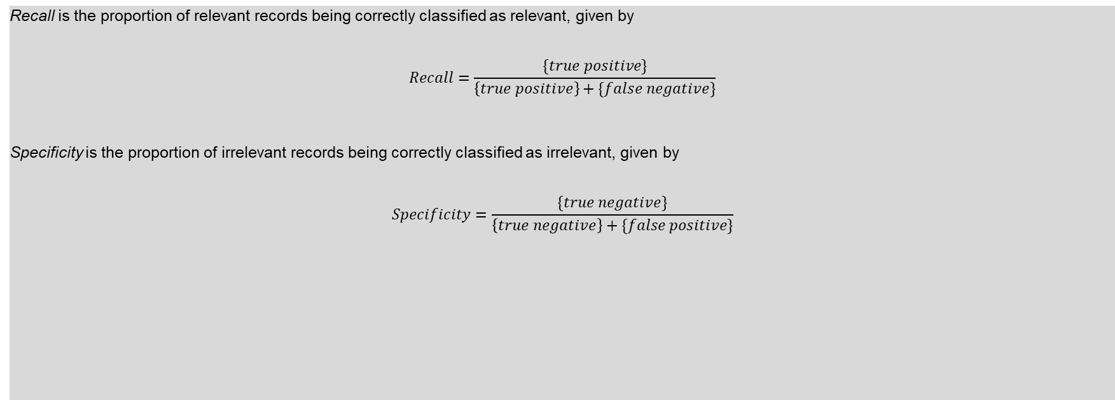

Appendix 1 - Assessment Measures
Recall is the proportion of relevant records being correctly classified as relevant, given by
$$Recall=\frac{\{true positive\}}{\left\{true positive\right\}+\{false negative\}}$$
Specificity is the proportion of irrelevant records being correctly classified as irrelevant, given by
$$Specificity=\frac{\{true negative\}}{\left\{true negative\right\}+\{false positive\}}$$

Slide 15
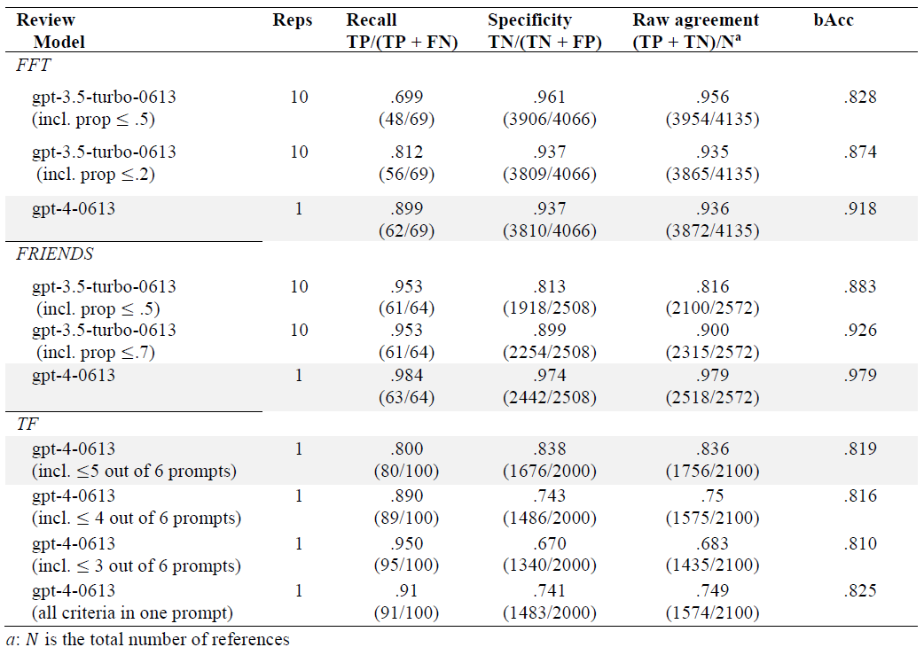
Appendix 2 – Numerical results

Slide 16
Appendix 3: What we also do: further standardization
Common guidelines for when it is (and when it is not) appropriate to use GPT API models for title and abstract screening in high-quality reviews. These guidelines are primarily based on the benchmark scheme.
A workflow for how to configure a reliable screening, including how to test and develop prompts. Hereto we introduce multiple-prompt screening, i.e., making one prompt per inclusion criteria.
According to Campbell Collaboration (2023) using AI in high-quality reviews requires:
(a) functioning tech [Outside our control]
(b) proof that it is functioning appropriately: [Our answer: Experiment results]
(c) the tech embodied in usable products: [Our answer: AIscreenR]
(d) agreed guidelines for appropriate use [Our answer: The use of benchmark schemes]
(e) training [Our answer: Assess the use with test data: Alternatively use fine-tuning]
(f) ongoing support [Our answer: Provide AIscreenR as an open-source software]
In our paper, we strive to accommodate requirements b to f.

Slide 17
Appendix 4: Other possibilities with AIscreenR
Can be combined with other (semi) automated screening tools such as priority and classifier screening.
Used to reduce the number of studies needed to be humanly double screened. This can be done by making too over-inclusive prompt on purpose.
Can be fine tuned to the specific review context

