Slide 1

How to Use Generative Pretrained Transformer (GPT) Models as Reliable Second Screeners of Titles and Abstracts in High-Quality Systematic Reviews [workshop]
Mikkel H. Vembye, PhD.
Researcher The Danish Center for Social Science Research
IRM 2026, Cologne, April 24

Slide 2
Workshop objectives
Introduction to title and abstract screening with GPT (API) models.
Discuss quality assessment and reliable implementation of AI screening.
Discuss future direction for using AI for literature screening.
Showcase the R package AIscreenR.
Find all material behind the presentation at: https://github.com/MikkelVembye/IRM2026
Link to the AIscreenR homepage: https://mikkelvembye.github.io/AIscreenR/
Find all material behind this presentation at: https://github.com/MikkelVembye/SRMA-SIG-presentation
Notes:
I expect to give you a 30-minute presentation of the background and screening framework, and then we will spend the last hour on the AIscreenR demonstration.

Slide 3
Why use AI for screening in systematic reviews?
Improve quality
Reduces missed studies and human error. While double-screening is the gold standard, it is costly and not always feasible.
Enables broader, less restrictive database searches
Increase efficiency
Reduce manual and tedious workload and accelerate the review process
Some reviews remain incomplete due to the sheer volume of studies—and this challenge is growing as databases expand.
Notes:
Human screeners overlook relevant studies for various reasons. Therefore, state-of-the-art is to conduct human double-screening. However, this is costly and many research groups cannot afford double-screening.
Overlooking relevant studies at this initial review stage can be consequential, leading to substantially biased results.
AI tools can accommodate both type of issues

Slide 4
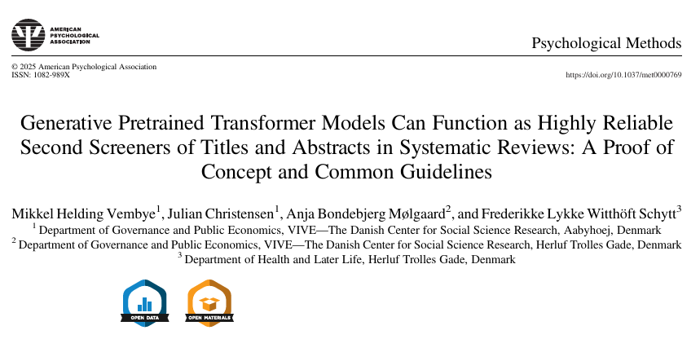
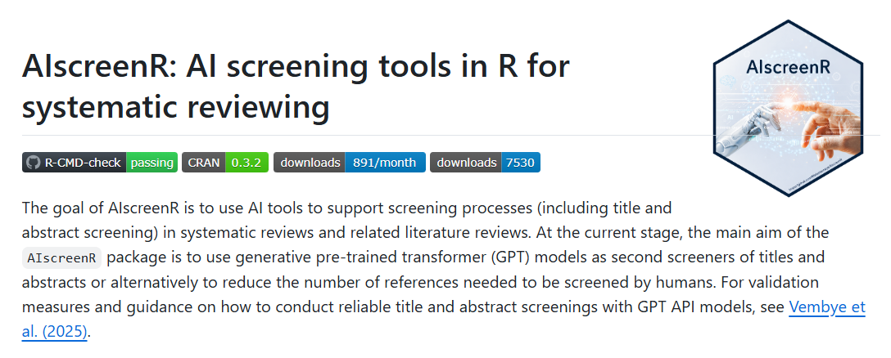

What we have tested and developed
We have tested the use of OpenAI’s GPT (Generative Pre-trained Transformer) API (Application Programming Interface) models to screen titles and abstracts and developed guidelines for how to use them reliably.
Our results show that GPT API models perform at least on par with human screeners’ performances, across many different types of social science reviews.
To conduct this type of screening, we have developed the R package AIscreenR (Vembye & Olsen, 2026).
Based on this, we suggest that GPT API models can be used as full second screeners in state-of-the-art reviews – let me show you the setup!
Notes:
As you will see in a moment, this is NOT the same as using ChatGPT!

Slide 5
Why use GPT API models and not just ChatGPT?
Overcomes copy–paste procedures; may reduce hallucination risk.
Enables systematic comparison of models and prompts.
Unclear if the ChatGPT setup is agnostic to data imbalance.
Enables the screening of a very large number of references in a short time frame—potentially up to 30,000 records per minute.
Supports multi-prompt and repeated, identical screenings, where the inclusion criteria are defined based on the frequency of selection across runs.
Evidence suggests GPT API models outperform ChatGPT for screening (Alshami et al., 2023; Gargari et al., 2024; Guo et al., 2024; Issaiy et al., 2024; Khraisha et al., 2024; Syriani et al., 2024)..
Our setup has been scientifically validated.
Notes:
With a sufficiently powerful computer, you can screen up to 30,000 per minute.

Slide 6
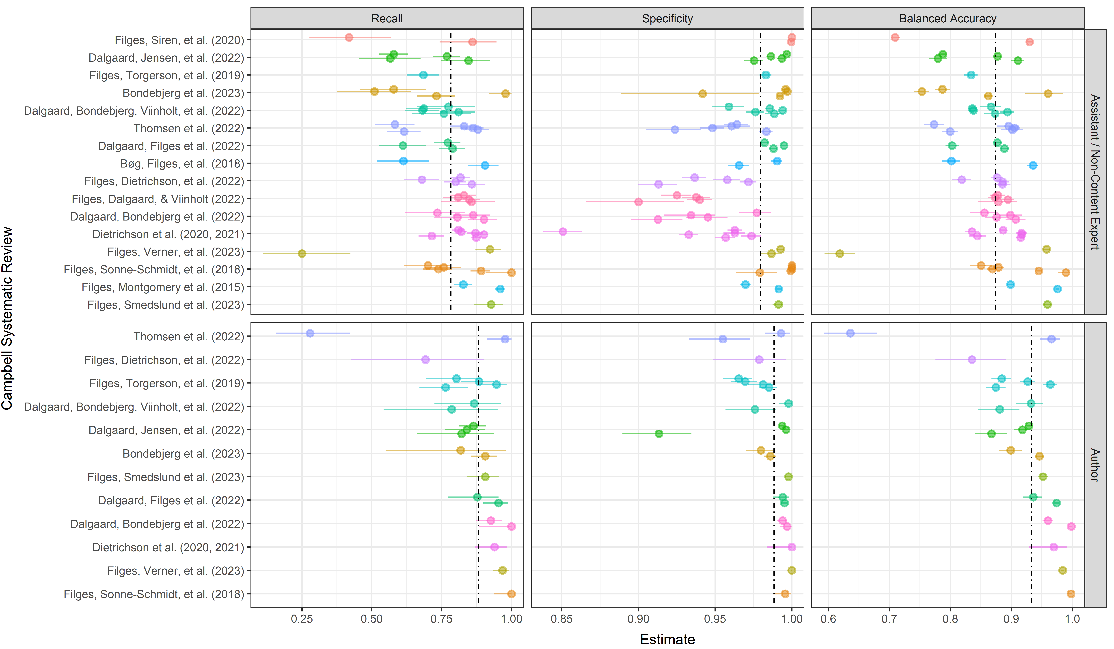
Quality assessing AI screenings
A precondition for quality assessing AI screening is to know common human screening behavior/performance
We find that our assistant/student screeners, on average, have a recall = 0.782, 95% CI[0.747, 0.817]
Notes:
With a sufficiently powerful computer, you can screen up to 30,000 per minute.

Slide 7
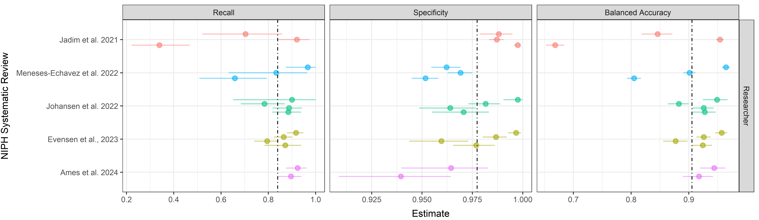
Quality assessing AI screenings (continued)
Researchers and/or content-experts have slightly higher recalls.
We find in our own group researchers have, on average, a recall = 0.881, 95% CI [0.823, 0.931]
Using data from the Norwegian Institute for Public Health, comparing researcher-researcher screenings only, we find that the average recall drops to 0.839, 95% CI [0.737, 0.920].
Notes:
With a sufficiently powerful computer, you can screen up to 30,000 per minute.

Slide 8
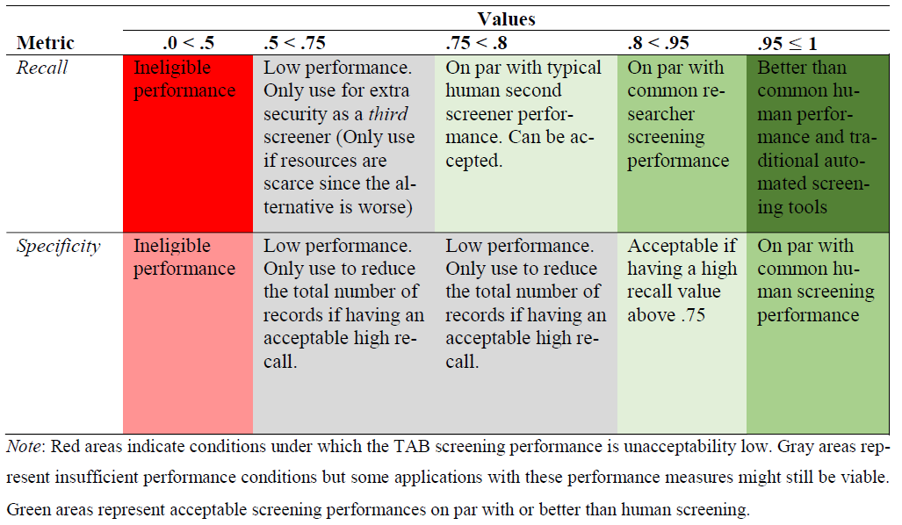
Quality assessment via benchmarking
Based on the above-presented results, we have developed a benchmark scheme, which can be used to ensure the quality of title and abstract screenings.
In general, we recommend that GPT screenings must yield recalls above 75% to be usable in high-quality reviews.
It is more challenging to set good guidelines for specificity. If recall is high, specificity matters less. It is simply an extra safeguard.

Slide 9
Why we consider benchmarking all-important
Guards against bad and biased screenings that are inferior to human screening.
Play a key role in testing the accuracy of using AI as a second screener.
It allows for context-specific assessments of the efficacy of using GPT API models as second screeners.
As we cannot control model developments, the benchmark scheme ensures that we can monitor model performances over time. Meaning that if we experience that a model suddenly cannot live up to our benchmarks, we can stop using it.
Avoids the wild-west and ensures standardization of this screening approach.

Slide 10
How generalizable is this approach?
We have conducted three large-scale classification experiments with different levels of complexity in terms of the number of inclusion criteria. Here we found that:
GPT API models can perform on par with or in some cases even better than typical human second screeners in high-quality systematic reviews (Vembye et al., 2025).
All models yield recalls above 80% in all of our experiments while showing a high exclusion rate as well.
GPT-4 model can be rather over-inclusive in complex review settings.
The GPT-4 and GPT-5 models outperform the GPT-3.5 models. We therefore recommend primarily using GPT-4 or GPT-5 models for title and abstract screening.
Moreover, we find that smaller models such as GPT-4o-mini and GPT-5-mini can be used for conducting reliable screenings. This has been a game-changer in order to reduce the cost of this screening approach.

Slide 11
Limitations
Black-box models (notice: human screening most often represents a black-box operation as well)
Off-the-shelf method changing over time.
It can be prompt sensitive
Potentially large environmental impact
Hard to keep up with new model developments
Supporting American and Chinese Big Tech companies.
Advantages
Equal treatment of all titles and abstracts
It is most often accurate
It is fast
It is cheap
Can guard against human drifting.
Extra insurance that you have found all relevant records. It can also be used as a third screener.
Agnostic to data imbalance
It’s flexible. That is, it can rapidly be fitted to many different situations.

Slide 12
Future research
Test with local models such as the models on Ollama or from MistralAI. This would freeze the efficacy of this approach and increase its transparency.
Consider how to combine GPT screenings with traditional (semi)-automated screening tools, such as priority and classifier screening, most efficiently.
Consider how fine-tuning can support the reliability of the screening approach even further?
Implementation in standard review tools such as EPPI Reviewer, Covidence, Meta-Reviewer etc.
Alternatively, a shiny app could be made to ease user-friendliness.

Slide 13
Future perspectives beyond title and abstract screening
We need local models to overcome legal issues. Extremely important when conducting full-text screening, data extraction, and risk-of-bias assessment.
Many countries’ licensing agreements with publishers do not allow uploading PDF/full text to remote commercial AIs. Even if they do, it might be problematic due to the European AI Act.
THE FUTURE IS AI! I project that screening, as we know it today, will be largely eradicated within the next 10 years → I believe that the relevancy of AIscreenR will be short-lived.
Notes:
AI act

Slide 14

AIscreenR Demo
Link to the package vignette:
https://mikkelvembye.github.io/AIscreenR/articles/Using-GPT-API-Models-For-Screening.html
Link to R codes behind the presentation:
https://github.com/MikkelVembye/IRM2026/blob/main/Test%20screening.R

Slide 15
References
Alshami, A., Elsayed, M., Ali, E., Eltoukhy, A. E. E., & Zayed, T. (2023). Harnessing the power of ChatGPT for automating systematic review process: Methodology, case study, limitations, and future directions. Systems, 11(7), 351. https://doi.org/10.3390/systems11070351
Campbell Collaboration. (2023). Stepping up evidence synthesis: faster, cheaper and more useful. https://www.campbellcollaboration.org/news-and-events/news/stepping-up-evidence-synthesis.html
Gargari, O. K., Mahmoudi, M. H., Hajisafarali, M., & Samiee, R. (2024). Enhancing title and abstract screening for systematic reviews with GPT-3.5 turbo. BMJ Evidence-Based Medicine, 29(1), 69 LP – 70. https://doi.org/10.1136/bmjebm-2023-112678
Guo, E., Gupta, M., Deng, J., Park, Y.-J., Paget, M., & Naugler, C. (2024). Automated paper screening for clinical reviews using large language models: Data analysis study. J Med Internet Res, 26, e48996. https://doi.org/10.2196/48996
Issaiy, M., Ghanaati, H., Kolahi, S., Shakiba, M., Jalali, A. H., Zarei, D., Kazemian, S., Avanaki, M. A., & Firouznia, K. (2024). Methodological insights into ChatGPT’s screening performance in systematic reviews. BMC Medical Research Methodology, 24(1), 78. https://doi.org/10.1186/s12874-024-02203-8
Khraisha, Q., Put, S., Kappenberg, J., Warraitch, A., & Hadfield, K. (2024). Can large language models replace humans in systematic reviews? Evaluating GPT-4’s efficacy in screening and extracting data from peer-reviewed and grey literature in multiple languages. Research Synthesis Methods. https://doi.org/10.1002/jrsm.1715
Syriani, E., David, I., & Kumar, G. (2024). Screening articles for systematic reviews with ChatGPT. Journal of Computer Languages, 80, 101287. https://doi.org/10.1016/j.cola.2024.101287
Tomlinson, B., Black, R. W., Patterson, D. J., & Torrance, A. W. (2024). The carbon emissions of writing and illustrating are lower for AI than for humans. Scientific Reports, 14(1), 3732. https://doi.org/10.1038/s41598-024-54271-x
Vembye, M. H. & Olsen, T. (2026). AIscreenR: AI screening tools for systematic reviews. (0.3.2). CRAN. https://doi.org/10.32614/CRAN.package.AIscreenR
Vembye, M. H., Christensen, J., Mølgaard, A. B., & Schytt, F. L. W. (2025). Generative Pretrained Transformer Models Can Function as Highly Reliable Second Screeners of Titles and Abstracts in Systematic Reviews: A Proof of Concept and Common Guidelines. Psychological Methods. https://doi.org/10.1037/met0000769

Slide 16
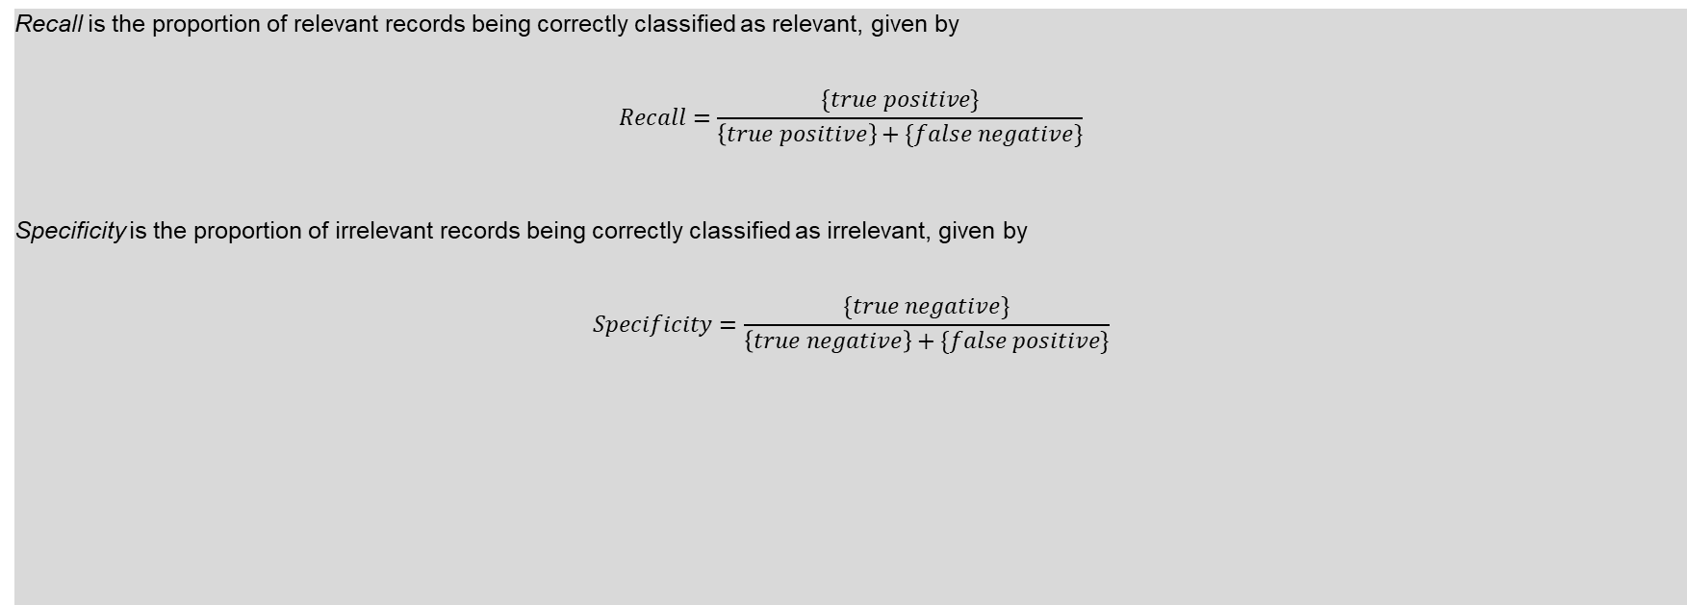

Appendix 1 - Assessment Measures
Recall is the proportion of relevant records being correctly classified as relevant, given by
$$Recall=\frac{\{true positive\}}{\left\{true positive\right\}+\{false negative\}}$$
Specificity is the proportion of irrelevant records being correctly classified as irrelevant, given by
$$Specificity=\frac{\{true negative\}}{\left\{true negative\right\}+\{false positive\}}$$

Slide 17
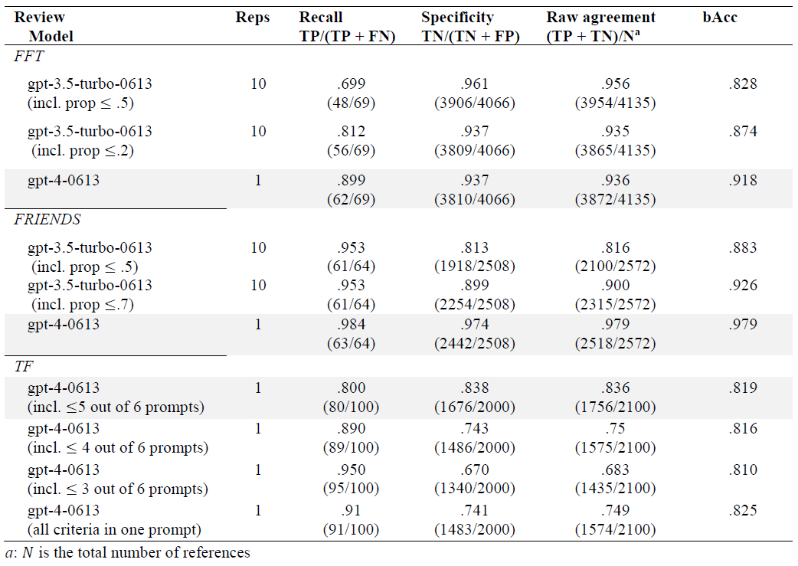
Appendix 2 – Numerical results

Slide 18
Appendix 3: What we also do: further standardization
Common guidelines for when it is (and when it is not) appropriate to use GPT API models for title and abstract screening in high-quality reviews. These guidelines are primarily based on the benchmark scheme.
A workflow for how to configure a reliable screening, including how to test and develop prompts. Hereto we introduce multiple-prompt screening, i.e., making one prompt per inclusion criteria.
According to Campbell Collaboration (2023) using AI in high-quality reviews requires:
(a) functioning tech [Outside our control]
(b) proof that it is functioning appropriately: [Our answer: Experiment results]
(c) the tech embodied in usable products: [Our answer: AIscreenR]
(d) agreed guidelines for appropriate use [Our answer: The use of benchmark schemes]
(e) training [Our answer: Assess the use with test data: Alternatively use fine-tuning]
(f) ongoing support [Our answer: Provide AIscreenR as an open-source software]
In our paper, we strive to accommodate requirements b to f.

