Slide 1
FIR, linearphase and group delay

Slide 2
IIR til FIR
Fordele:
Få artmetriske operationer
Approx af analog filter
Ulæmper:
Potentiel ustabil
Fasen kan ikke "justeres"

Slide 3
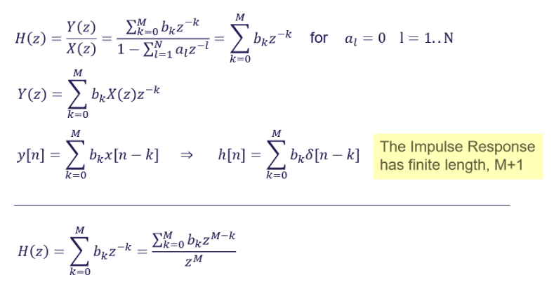
FIR

Slide 4
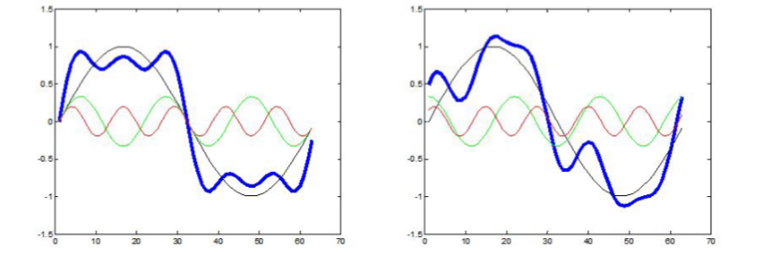
Constant GroupDelay
Non constant Group Delay

Slide 5
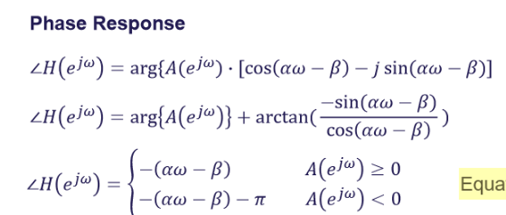
Linear phase

Slide 6
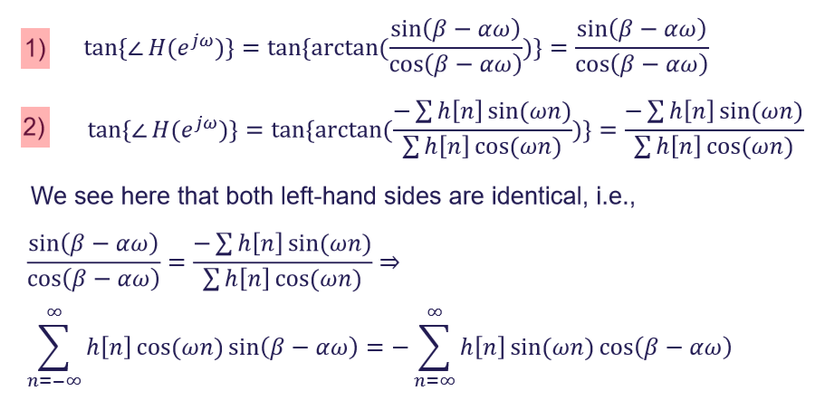

Symmetric impulse response

Slide 7
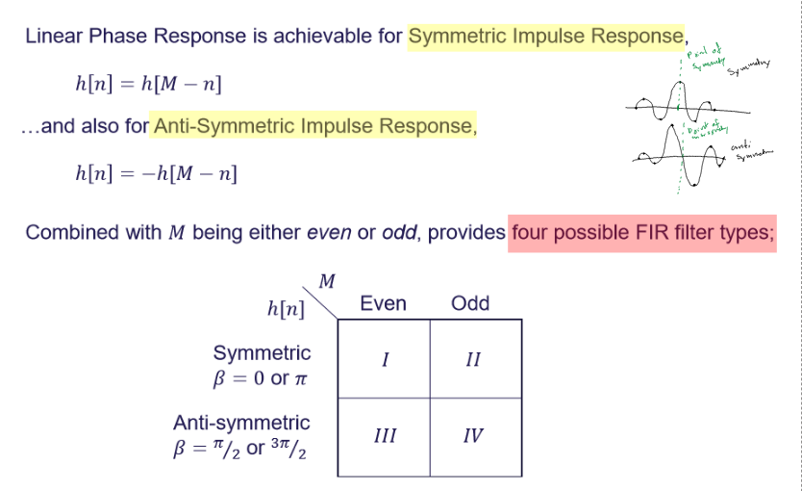

Slide 8
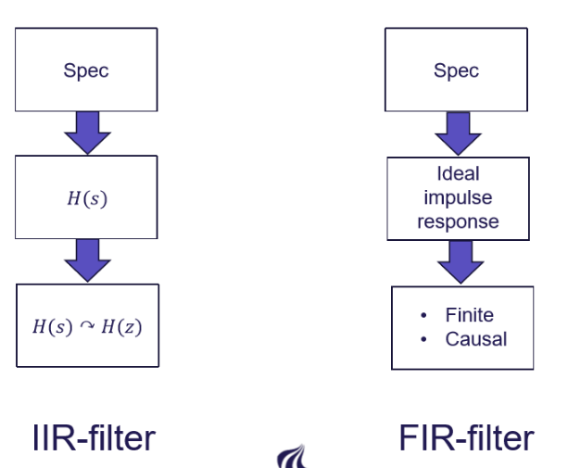

Slide 9
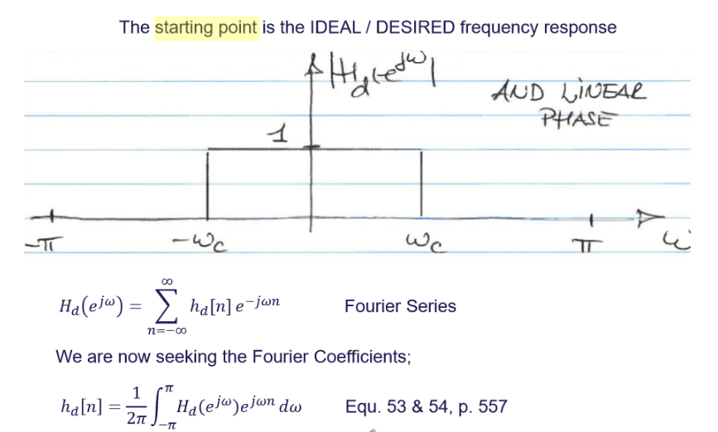

Slide 10
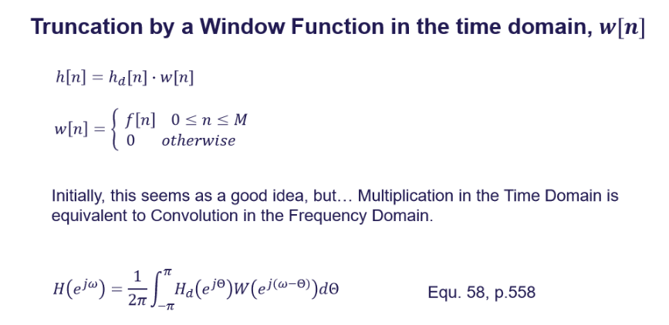

Slide 11
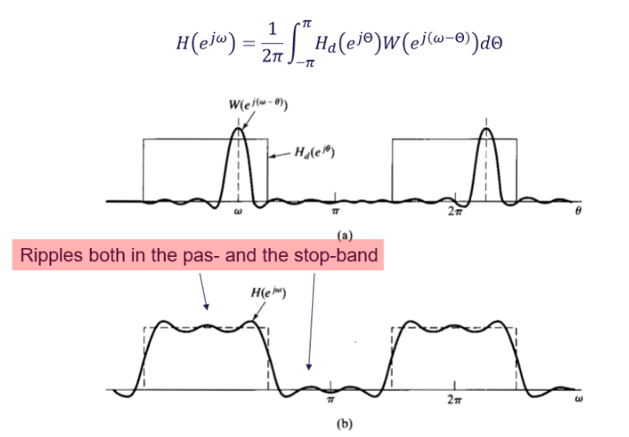

Slide 12
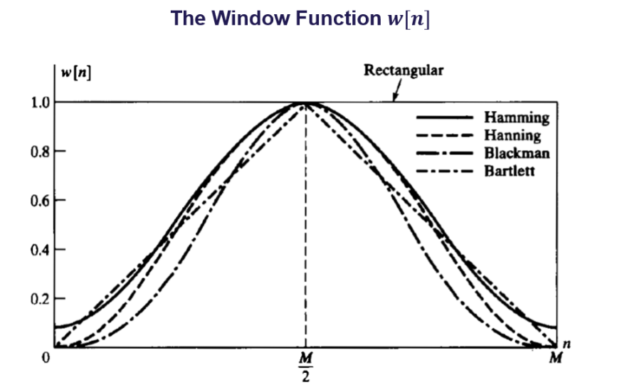

Slide 13
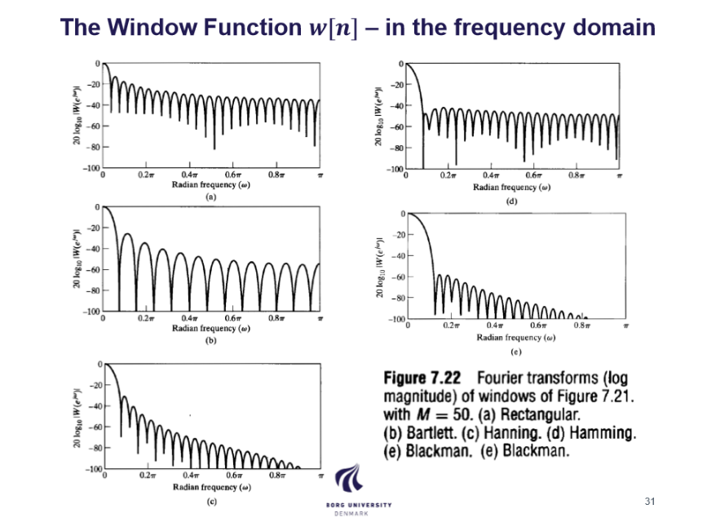

Slide 14
