Slide 1
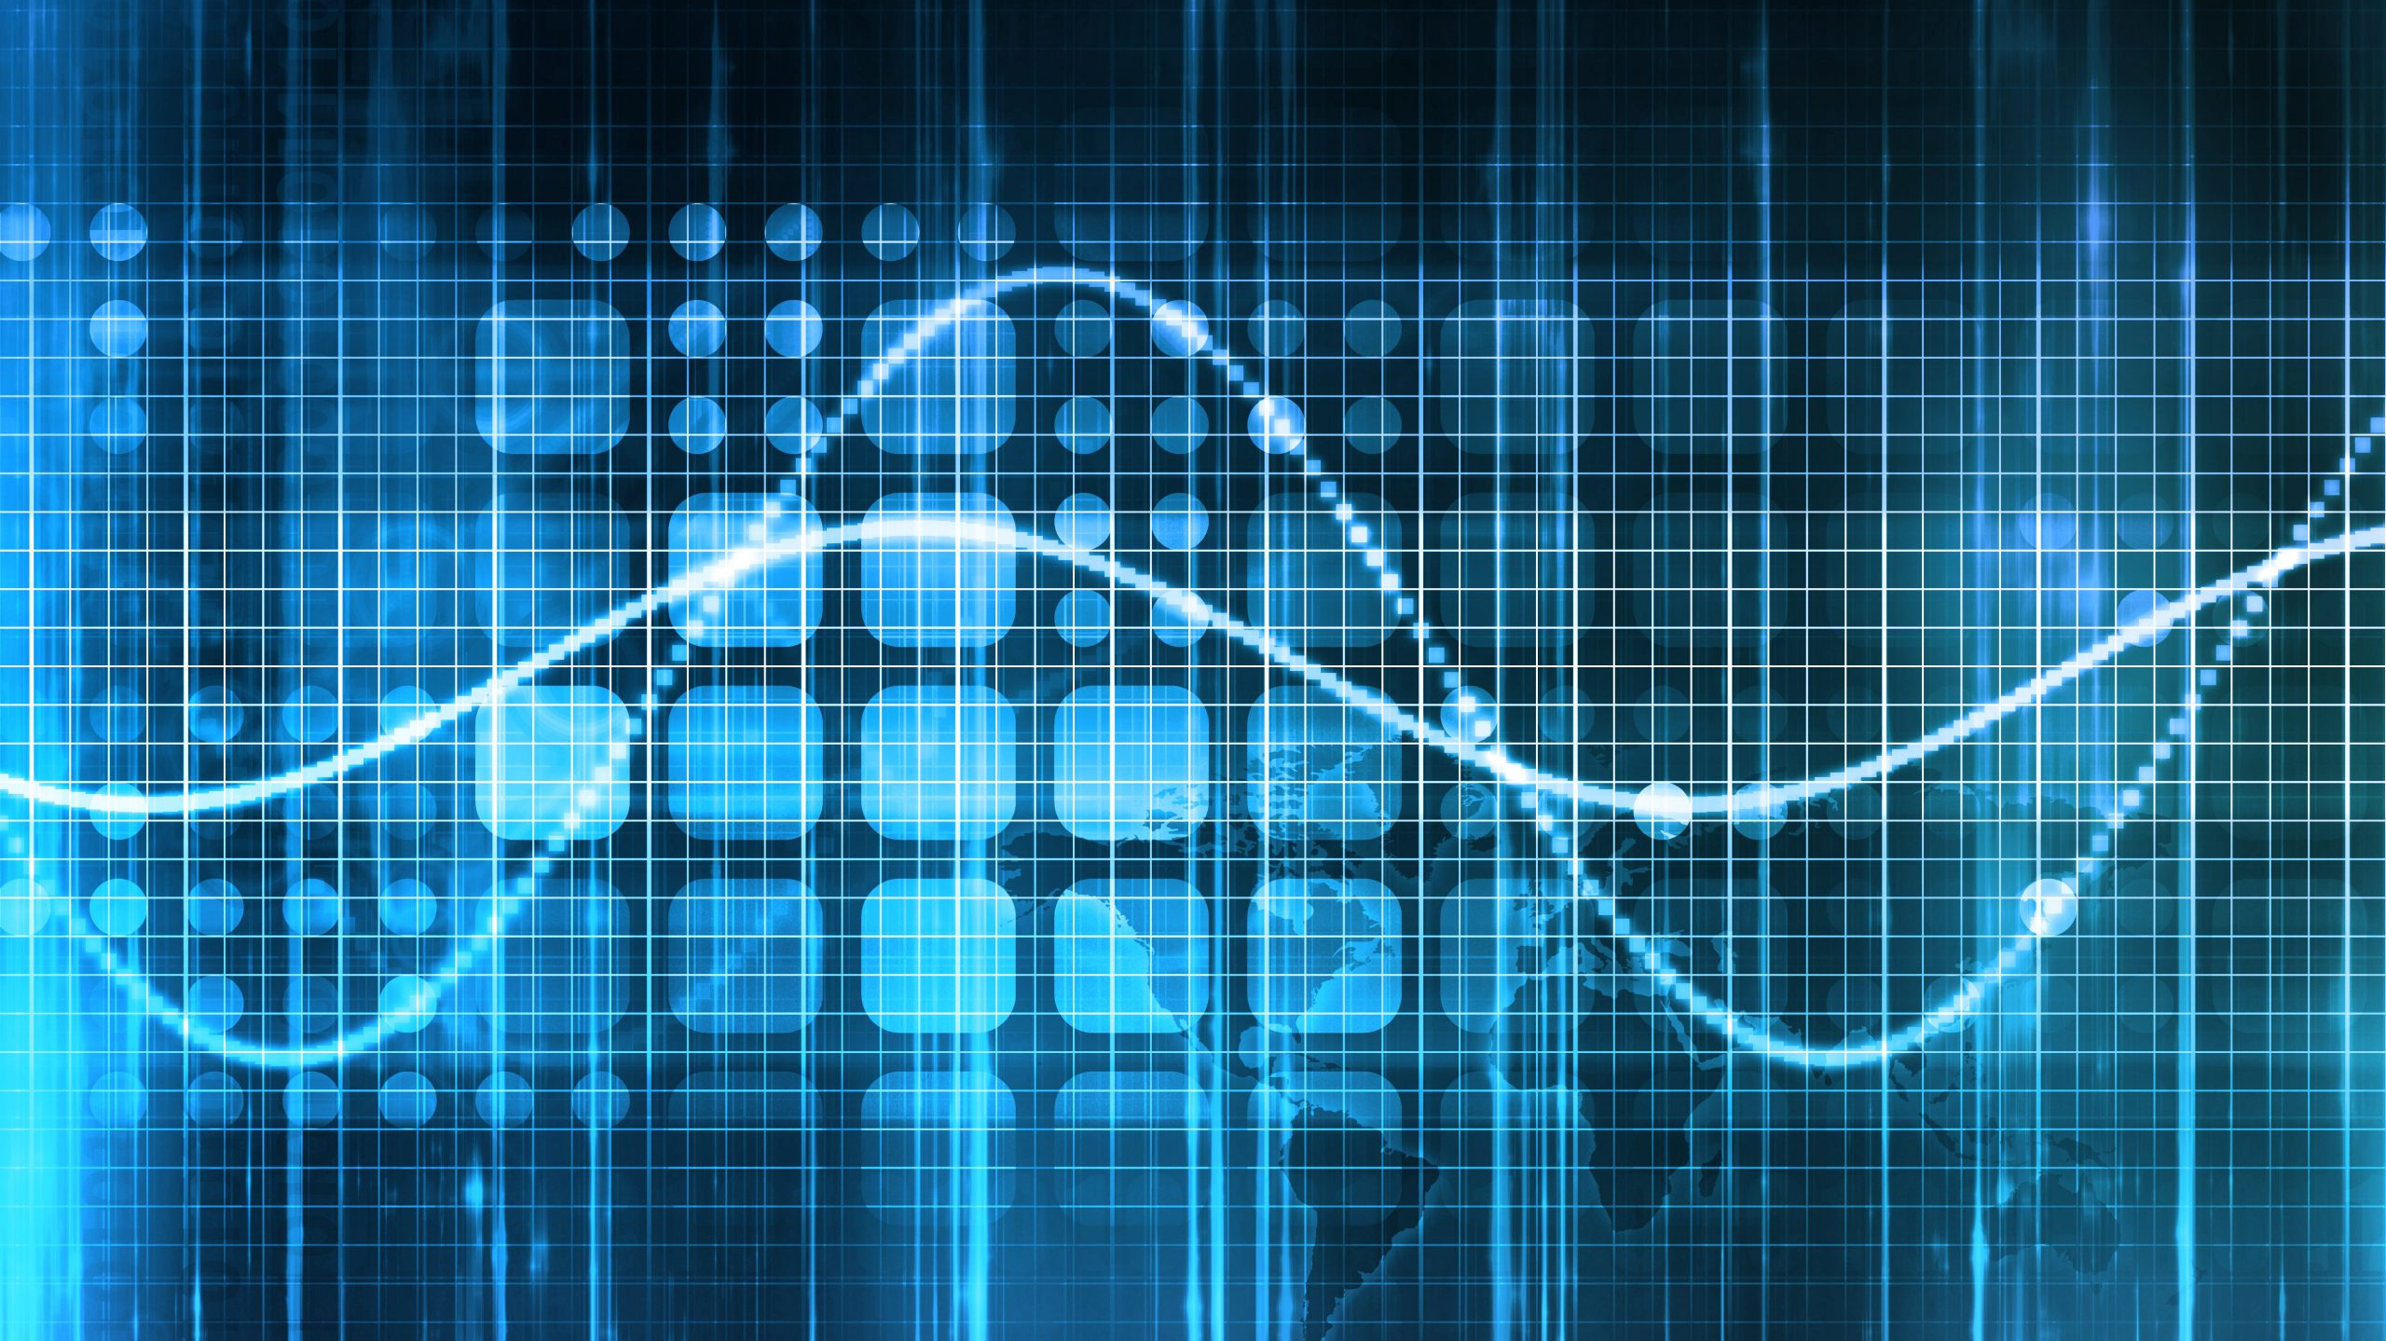
DSP Q8
Den hurtige Fourier transformation (FFT), den fundamentale ide i denne algoritme

Slide 2
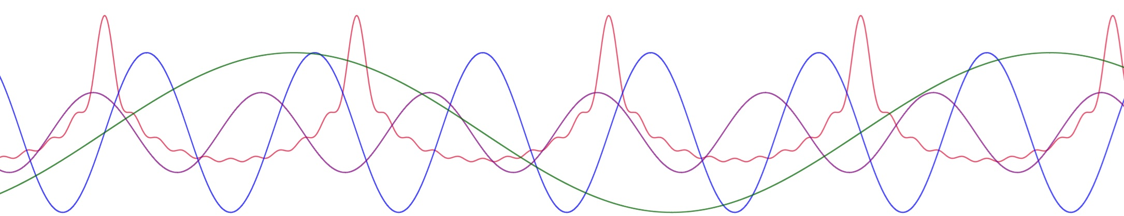
Outline
DFT til FFT
Symetrien af Twiddle factor
FFT, blutterfly computation
Computation time for DFT vs FFT

Slide 3
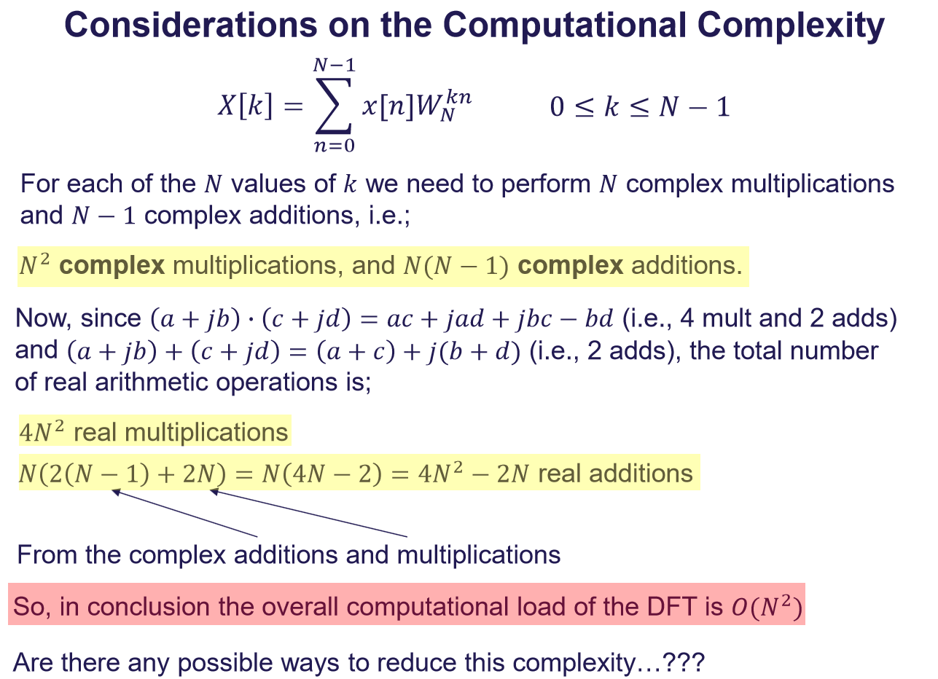
DFT til FFT
2 approaches
Goertzel Algorithm
Filter bank approach, N filters in parallel
Can’t start calculations immediately
FFT
Using the symmetry and periodicity of the Twiddle Factor

Slide 4
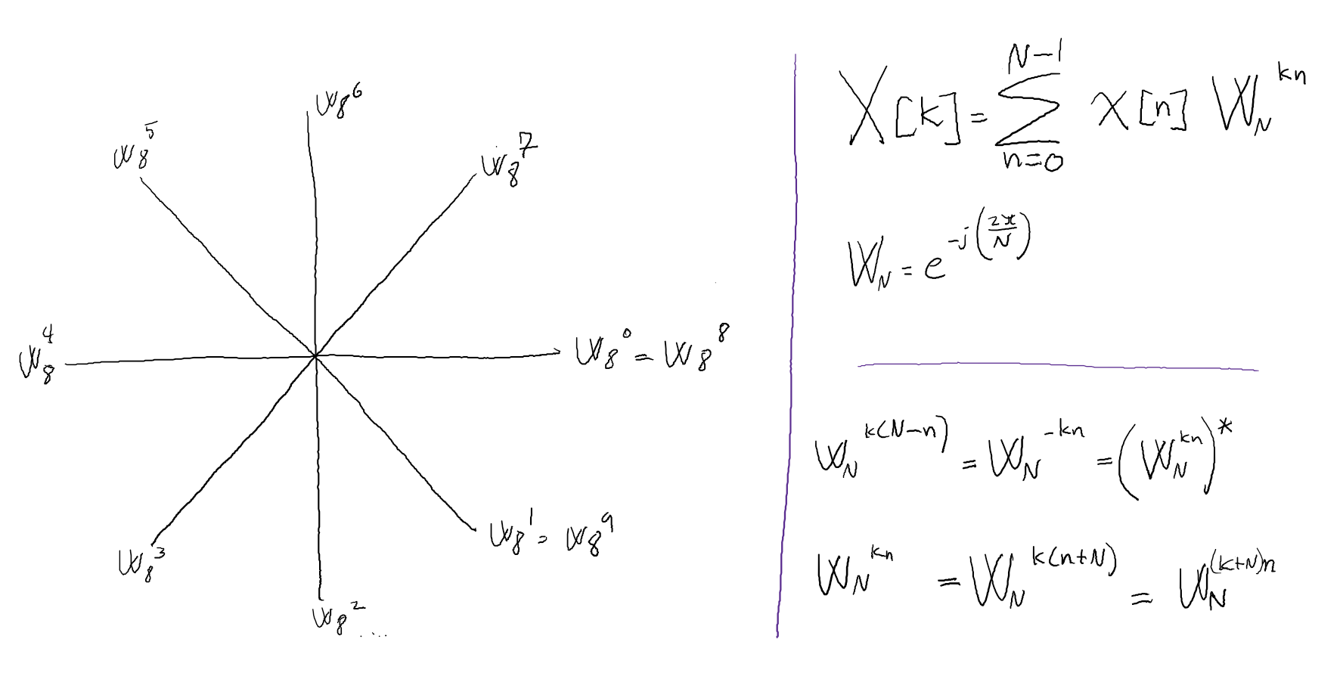

Slide 5
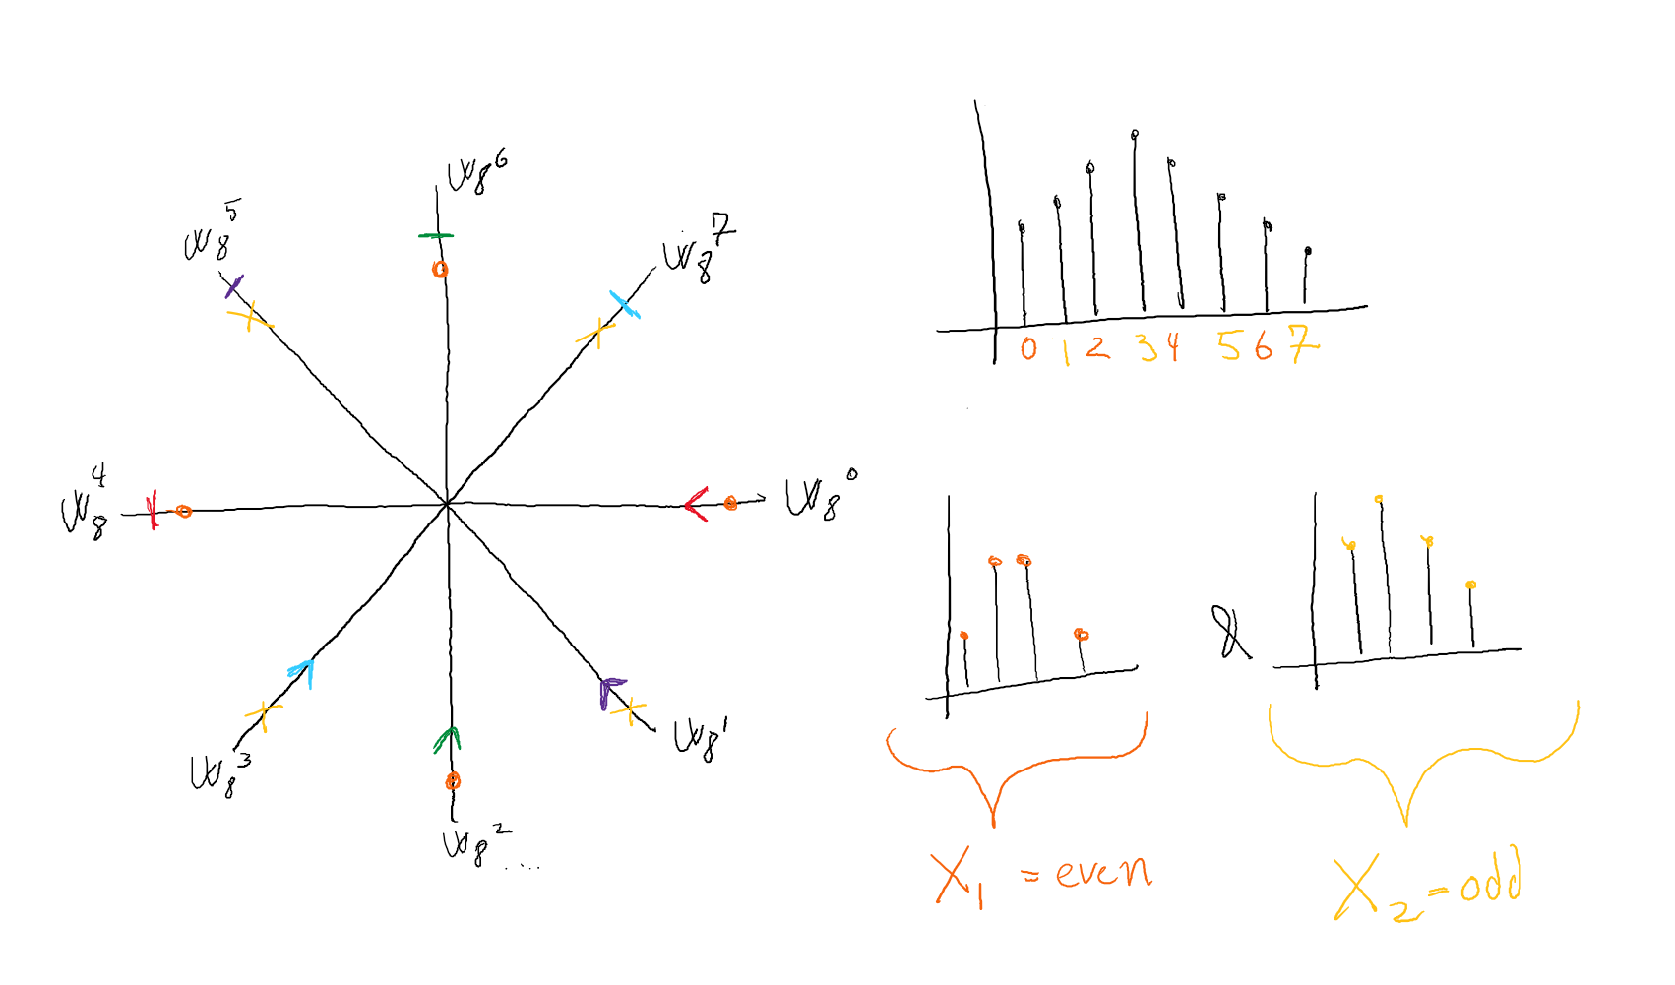

Slide 6
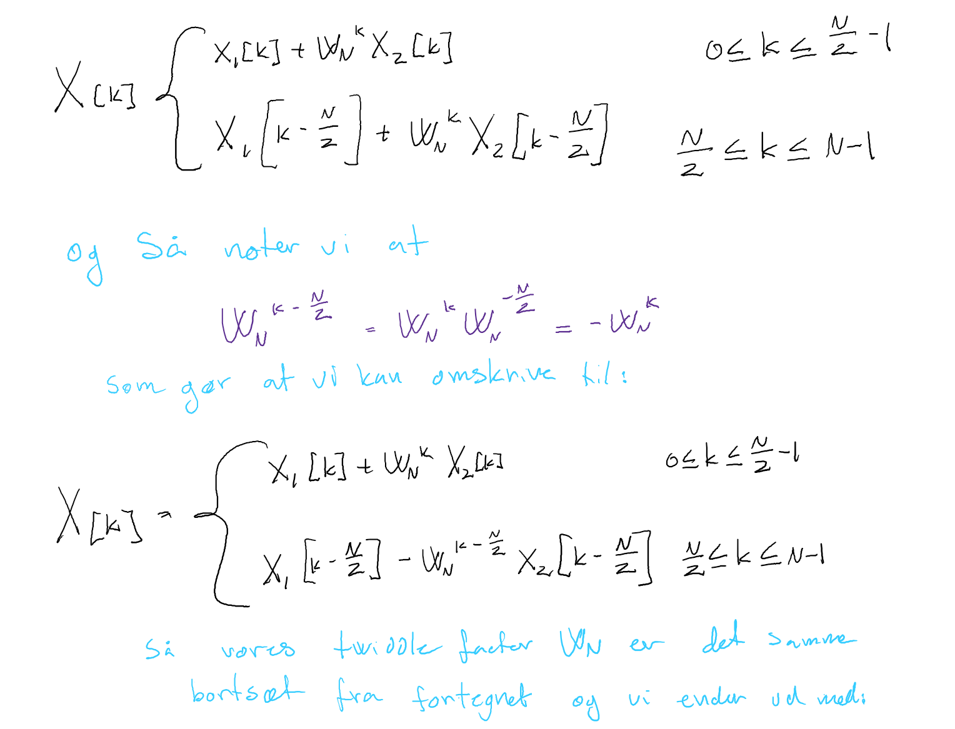

Slide 7
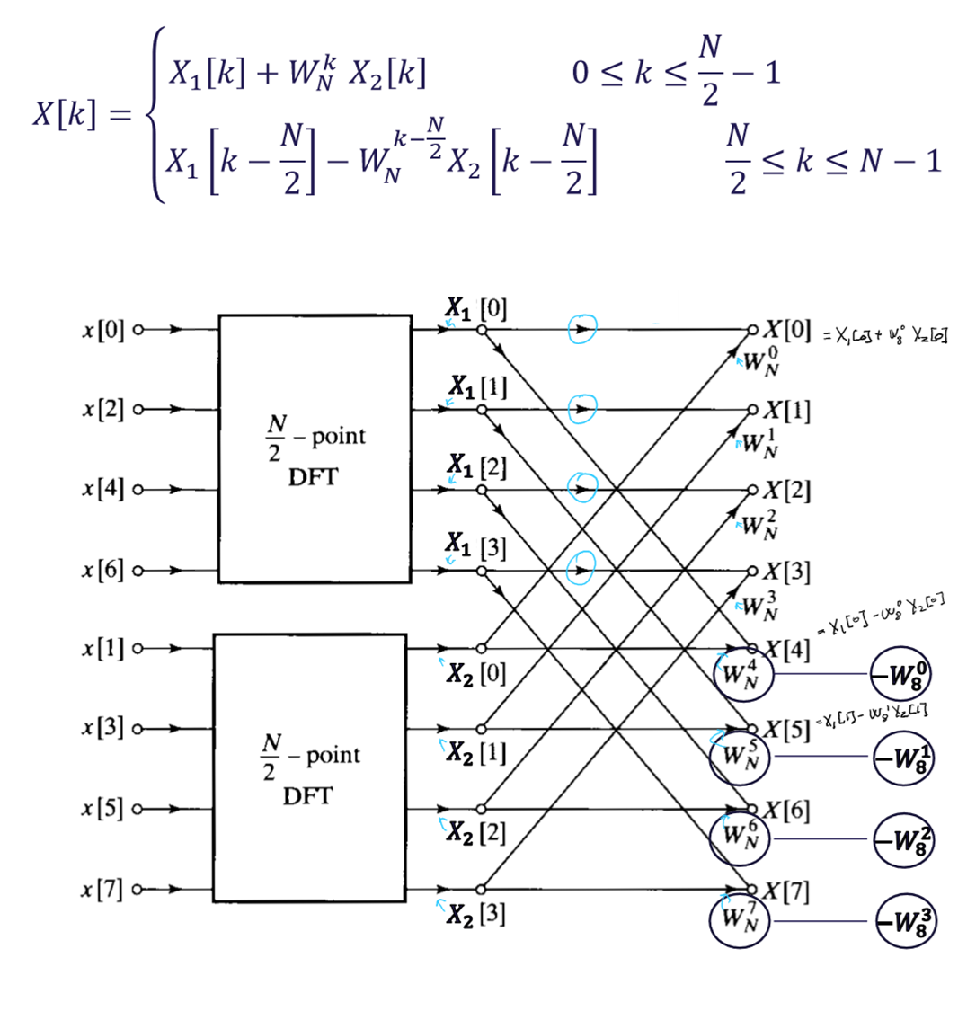

Slide 8
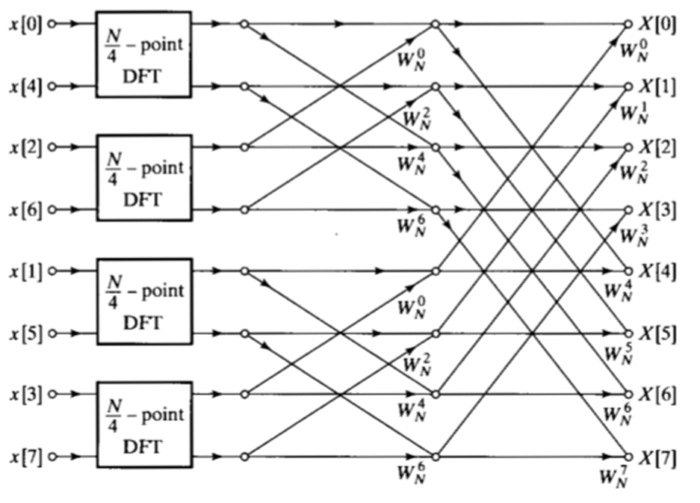

Slide 9
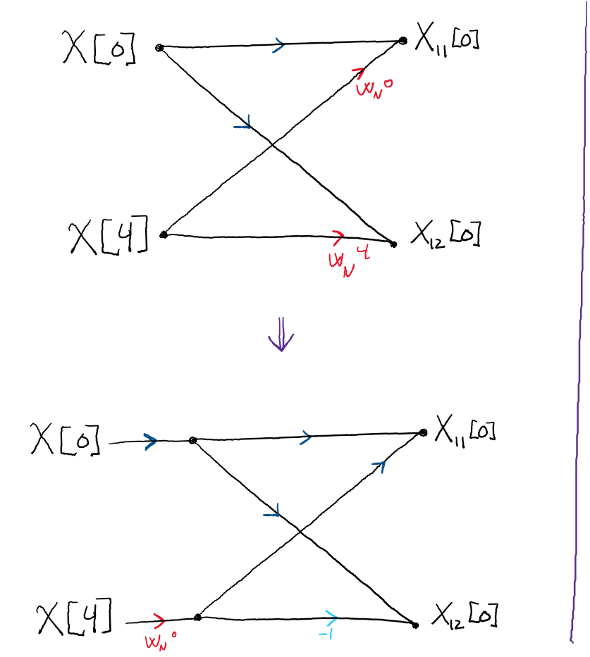
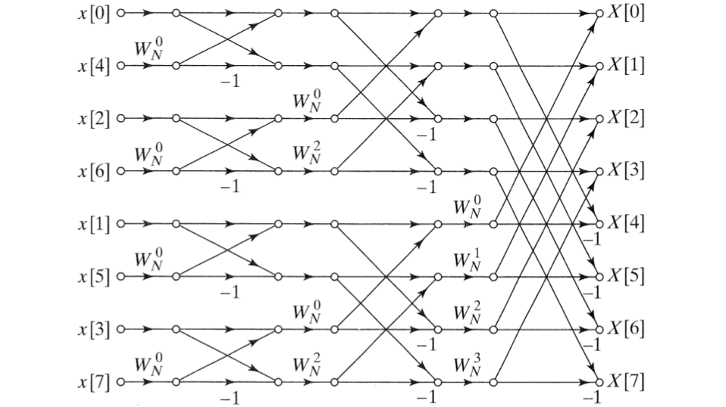

Slide 10
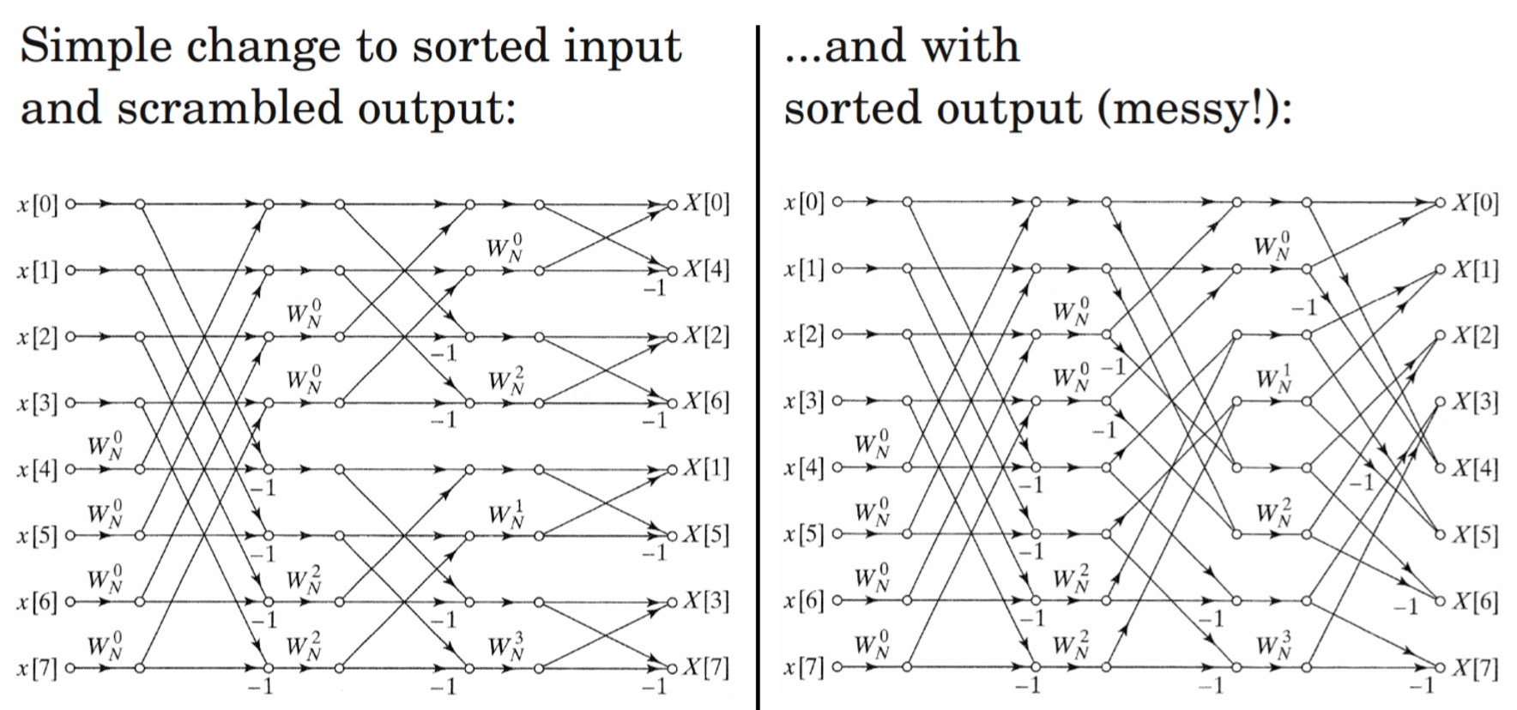

Slide 11
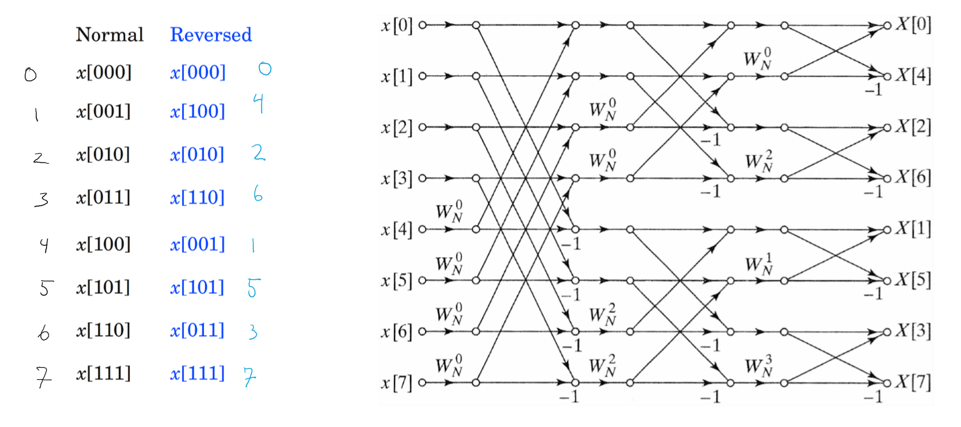

Slide 12
