Slide 1
Web app with PHP/SqL
Design Specification
Mikko Niskanen

Slide 2
In My Application it is possible for users to create accounts and upload images to a server and then view them. They can also Upvote and downvote pictures that are available in the gallery. Users can also edit their own information, whether its changing username, password, email or they can even delete their own user account.
I was unable to do a image delete function, where you could delete one image at a time. Now you can only delete all the images you have uploaded.

Slide 3
User Stories: Un-registered user
Unregistered users must register for the application in order to view the gallery or anything else.

Slide 4
User stories: Registered users
Users can login with their credentials
Users can browse different images
Users can upload their own images
Users can change their profile information
Users can delete all the imaes they have uploaded

Slide 5
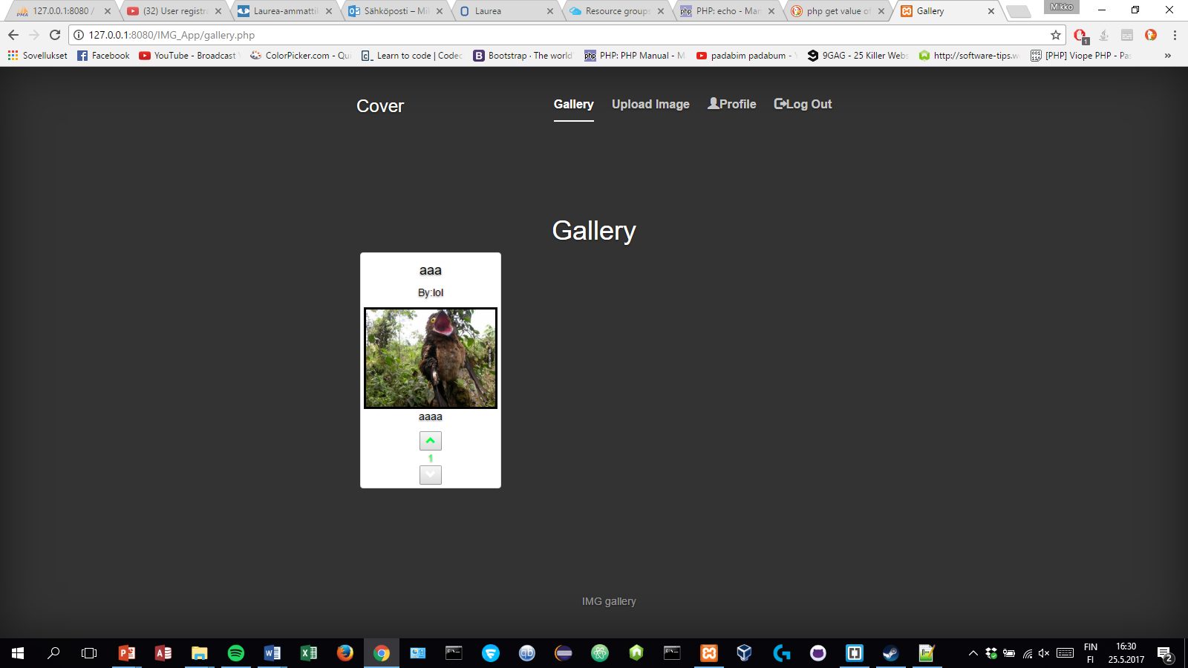
If you want to cast your vote on a different account you have to close the browser tab first, i was unable to do it so that you just logout and login with a different user, so first 1.close browser tab then 2. log in on a different user and you can vote.

