Slide 1
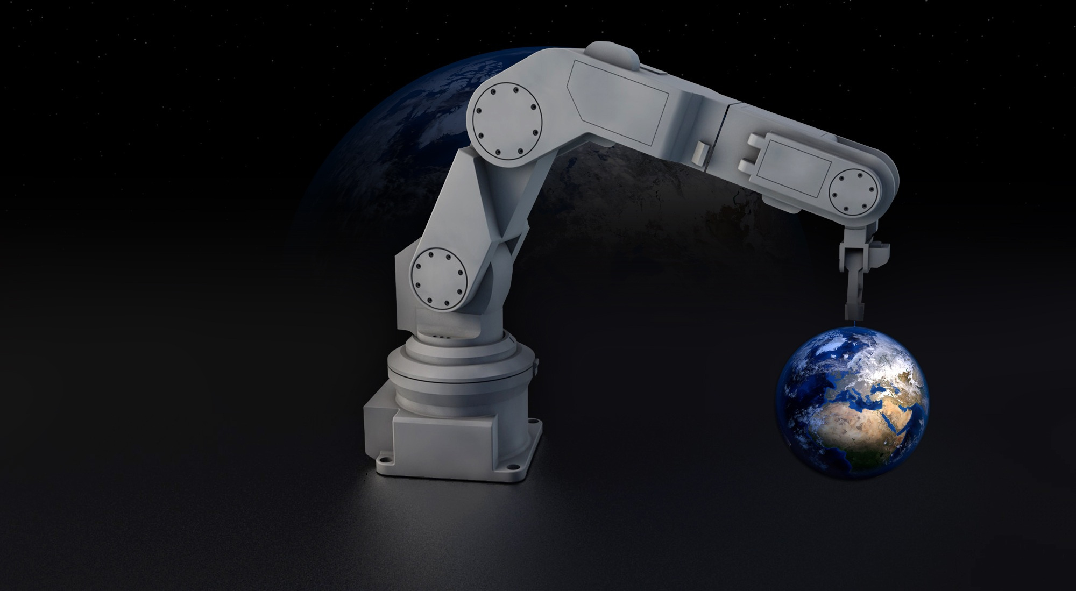

Multilingual Chatbot for Industrial Robotics Support with ROS Integration
Engr. Mikko A. De Torres
Mechatronics Engineer
MSAI

Slide 2
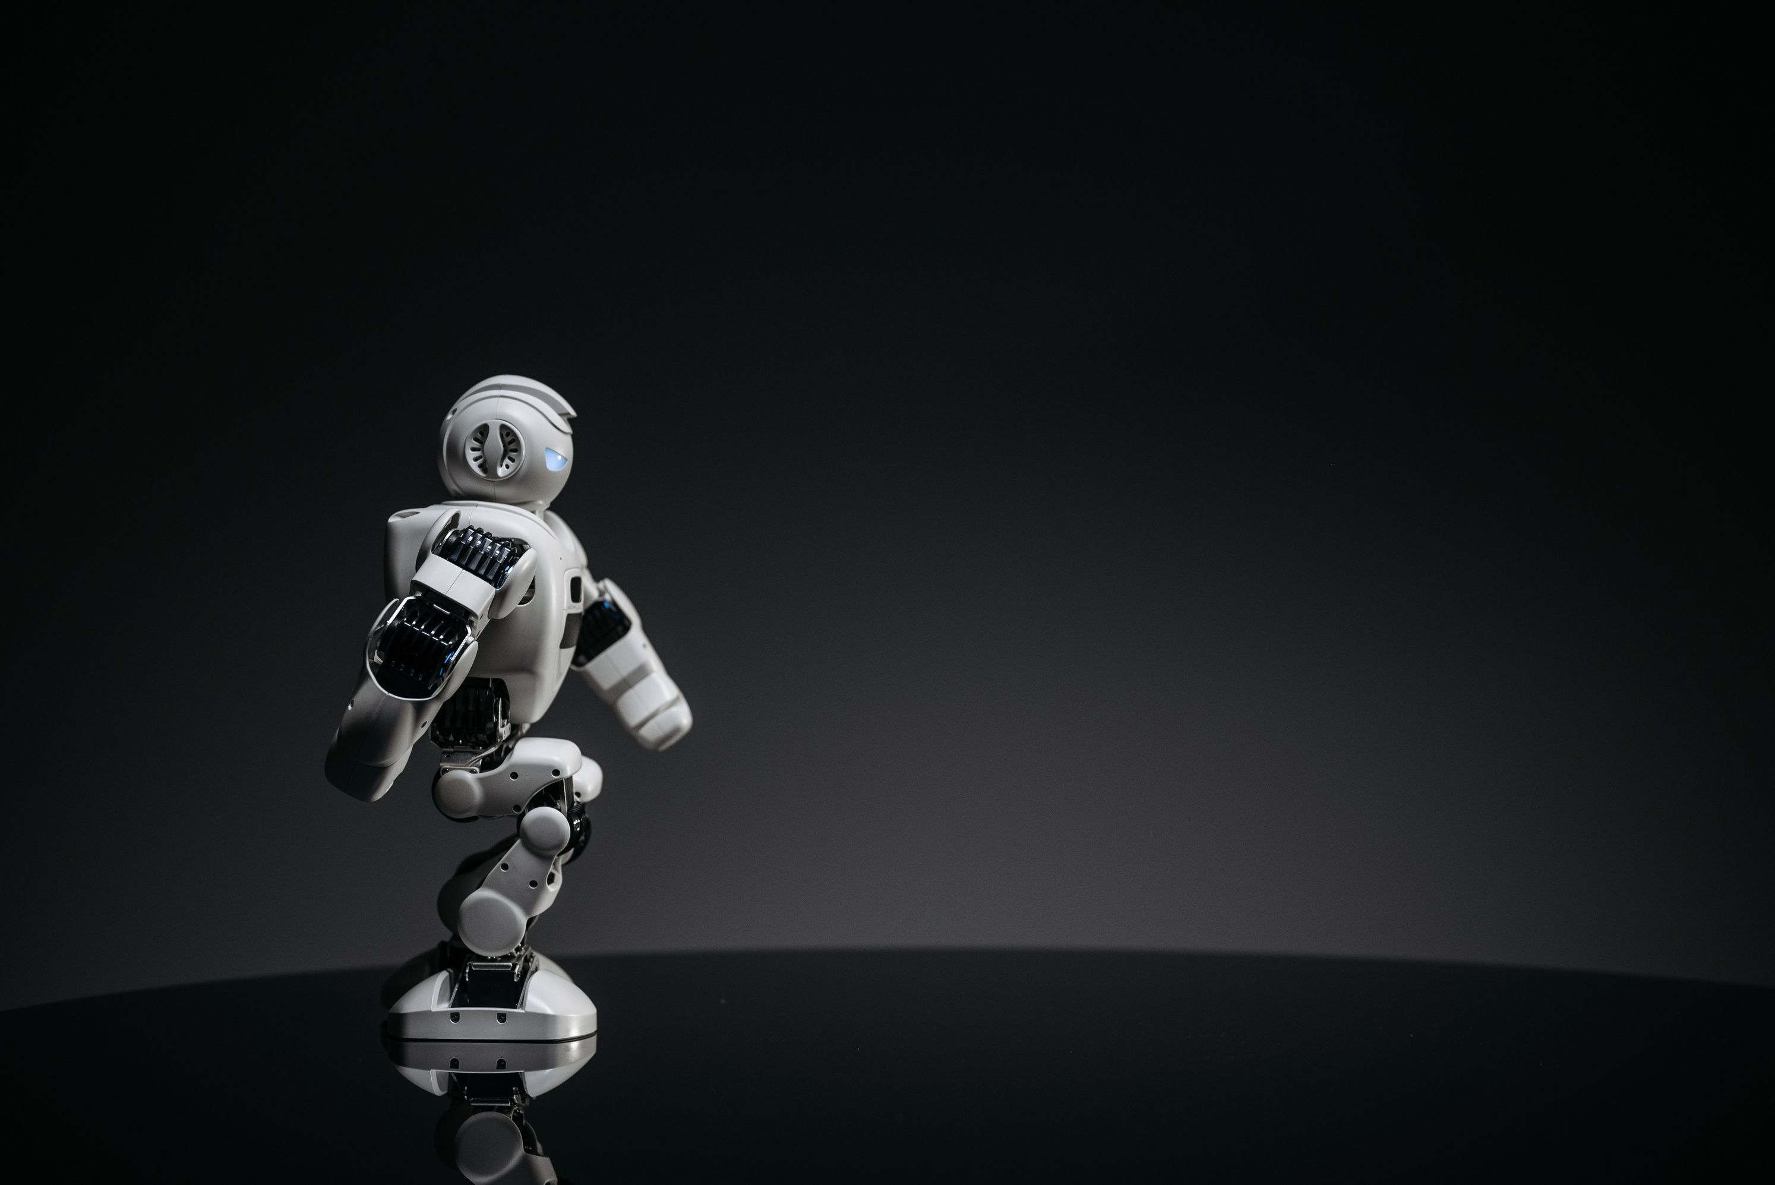
Introduction
The increasing complexity of industrial robotics necessitates efficient and accessible technical support. This project proposes a multilingual chatbot capable of assisting users in Filipino/Tagalog, English, and Japanese. The chatbot will provide text-based support for troubleshooting, system diagnostics, and operational guidance. By integrating with the Robot Operating System (ROS), the chatbot will also assist in tasks related to robot kinematics and dynamics, making it a valuable tool for engineers and operators.
Industrial robots are widely used in manufacturing and automation, but language barriers and complex documentation often hinder efficient troubleshooting and maintenance. Inspired by advancements in multilingual NLP models and intelligent assistants in industrial settings, this project aims to provide real-time, language-adaptive support, enhancing user engagement and operational efficiency.

Slide 3
Methodology
NLP Model Selection: Evaluate and fine-tune an appropriate NLP model (e.g., GPT, mBERT, or Transformer-based) for multilingual support in industrial robotics.
Chatbot Development: Implement a conversational AI system trained with domain-specific datasets (e.g., IRWoZ, technical documentation, and ROS manuals).
ROS Integration: Establish real-time communication between the chatbot and ROS to provide robot kinematics and dynamics assistance.
Deployment: Develop a user-friendly web/desktop interface using frameworks like Flask, FastAPI, or Electron.
Testing and Evaluation: Conduct usability studies, benchmarking against chatbot performance metrics (e.g., BLEU scores, accuracy, task success rate).

Slide 4
Expected Outcomes
A functional multilingual chatbot tailored for industrial robotics support.
Seamless integration with ROS for enhanced robot diagnostics and operational assistance.
Improved accessibility for engineers and operators through an intuitive interface.
Contribution to multilingual AI research in industrial applications.

Slide 5
Resources and Tools
Software: Python, Hugging Face Transformers, TensorFlow/PyTorch, ROS, Flask/FastAPI
Hardware: GPU-enabled systems for training, robotic hardware for testing (if available)
Datasets: Public NLP datasets, technical manuals, and industrial robotics documentation

Slide 6
Risk Management and Challenges
Data Issues: Limited availability of domain-specific multilingual datasets, mitigated by synthetic data generation.
Model Performance: Ensuring accurate translations and intent recognition in highly technical queries.
Technical Challenges: ROS integration complexities, requiring iterative development and debugging.

Slide 7
Conclusion
This project aims to bridge the communication gap in industrial robotics by providing a robust multilingual chatbot integrated with ROS. By leveraging AI and automation, the system will enhance productivity and ease technical support for industrial robots. Future improvements may include speech recognition, expanded language support, and adaptive learning based on user interactions.

