Slide 1


Sentiment Analysis of Avengers Movie Reviews
Subtitle: Using Python NLP in Google Colab
Engr. Mikko A. De Torres
Mechatronics Engineer
MSAI

Slide 2

Introduction
Objective: Analyze and compare audience sentiments for Avengers 2012 and 2015
Method: Natural Language Processing (NLP) with Python (VADER Sentiment Analysis)

Slide 3
Tools & Libraries Used
Pandas, Matplotlib, WordCloud, NLTK, VADER
Google Colab as the development platform

Slide 4
Data Source
Dataset: Rotten Tomatoes Extended MCU Movie Reviews
Source: Kaggle https://www.kaggle.com/datasets/bwandowando/rotten-tomatoes-extended-mcu-movie-reviews
Contents: User reviews and ratings of MCU movies including The Avengers (2012) and Avengers: Age of Ultron (2015)

Slide 5
Data Preprocessing
Convert text to lowercase
Remove stop words and punctuation
Tokenization
Lemmatization

Slide 6
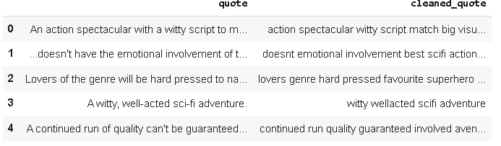
Data Preprocessing

Slide 7
Model & Training
Model Used:
Multinomial Naive Bayes
Train-Test Split: 80–20%
Reason: Fast and efficient for text classification

Slide 8
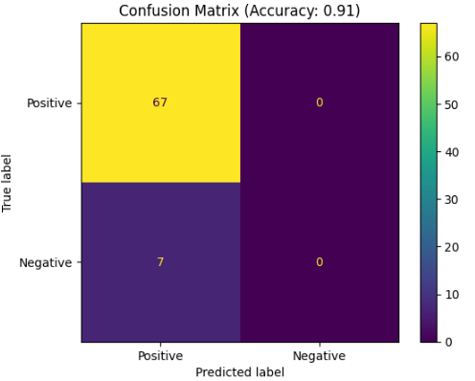
Results & Evaluation
Avengers 2012 Review Accuracy:
91%

Slide 9
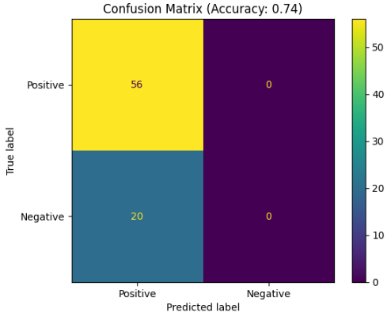
Results & Evaluation
Avengers 2015 Review Accuracy:
74%

Slide 10
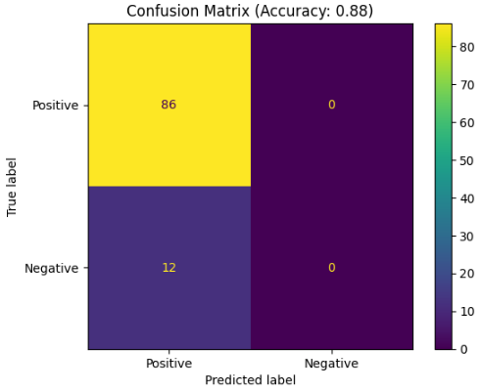
Results & Evaluation
Avengers 2018 Review Accuracy:
88%

Slide 11
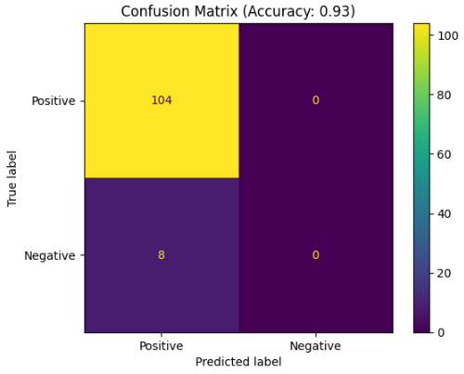
Results & Evaluation
Avengers 2019 Review Accuracy:
93%

Slide 12
Improvements & Future Work
Use lemmatization
Try SVM or Logistic Regression
Explore deep learning: Word2Vec + LSTM
Include emojis/sarcasm handling

Slide 13
Conclusion
NLP is effective in extracting audience sentiment
Future: Compare with other Avengers movies, use more advanced models like BERT

