Slide 1

II. Data Visualization with Python
MEXEE 402
Data science, machine learning and ai

Slide 2
1. Introduction to Data Visualization with Python
The Pivotal Role of Data Visualization
Benefits:
Transforms complex datasets into clear visual stories
Acts like a detective’s tool: organizing scattered clues into solutions
Real-world impact:
Healthcare → heat maps reveal disease spread
Business → line graphs show sales trends
Quickly absorb information
Spot patterns, correlations, and trends
Enable data-driven decisions
Communicate findings effectively

Slide 3
1. Introduction to Data Visualization with Python
Python’s Data Visualization Libraries
Beyond Python
Matplotlib → Flexible, powerful 2D/3D plots; steep learning curve
Seaborn → Simplifies plotting; excellent for statistical visualization
Plotly → Interactive plots; higher complexity, but engaging visuals
Pandas Visualization → Simple plots; integrates with data workflows
Plotnine → Inspired by R’s ggplot2; effective for layered graphics
Altair → Declarative, clean, and user-friendly statistical graphics
Tableau, Power BI, D3.js, R’s ggplot2 → Other effective visualization tools

Slide 4
1. Introduction to Data Visualization with Python
Getting Started with Google Colab
Google Colab – A free, browser-based coding environment requiring no setup and offering free computing power. To get started:
Visit the Google Colab website.
Click on 'File' > 'New notebook' to create a new notebook.
You are now in a Python environment. You can write code in the cells and run them by clicking the play button on the left or by pressing Shift+Enter.

Slide 5
1. Introduction to Data Visualization with Python
Getting Started with Google Colab
As a test run, paste the following simple Python code into a cell:
Running the cell prints: “Hello, Data Visualization!”
Google Colab will be the primary tool for this course
Used to interact with Python
Employ data visualization libraries

Slide 6
2. Data Visualization with Google Colab, Pandas, and Matplotlib
Getting Acquainted with Google Colab
Cloud-based Python environment
Runs in the browser, no setup needed
Works like a Python notebook powered by Google
Setting Up Your First Notebook
Writing & Executing Code
Go to Google Colab website
Click File → New notebook
Use a code cell (click + Code)
Type Python code
Run with Shift+Enter → output shown below cell

Slide 7
2. Data Visualization with Google Colab, Pandas, and Matplotlib
Saving & Sharing Notebooks
Harnessing Pandas for Data Manipulation
Saved directly to Google Drive
File → Save to store work
Share button → invite via email or link
Option to download for offline sharing
Core Python library for data analysis
Provides DataFrames (spreadsheet-like structures)
Uses in Workflow:
Load datasets (CSV, Excel, SQL, etc.)
Filter data with simple conditions (e.g., Age > 30)

Slide 8
2. Data Visualization with Google Colab, Pandas, and Matplotlib
Utilizing Pandas in Your Data Science Workflow
Performing basic data analysis: Pandas allows statistical analysis, e.g., df.describe() gives descriptive statistics of a DataFrame.
Go to this link:
https://github.com/MikkoDT/MexEE402_AI/blob/main/Python_Visualization/Pandas_for_Data_Manipulation.ipynb
In this code:
Import Pandas library
Load dataset from URL into a DataFrame
Print column names of the DataFrame
Filter data based on conditions
Use describe() for descriptive statistics
Prepares and structures data for effective visualization

Slide 9
2. Data Visualization with Google Colab, Pandas, and Matplotlib
Matplotlib—Your Tool for Effective Data Visualization
Go to this link:
https://github.com/MikkoDT/MexEE402_AI/blob/main/Python_Visualization/Creating_Basic_Plots_with_Matplotlib.ipynb
Matplotlib Overview
Versatile Python plotting library
Supports static, animated, and interactive plots
Works seamlessly with Pandas DataFrames
Basic Plots with Matplotlib
Line Chart (plot) → Track changes over time
Bar Chart (bar) → Compare categorical data
Histogram (hist) → Show data distribution
Each plot reveals unique insights into beer servings, highlighting the importance of data visualization for understanding data.

Slide 10
3. Unraveling Data Distribution Using Histograms
Understanding Histograms
Key Insights from Histograms:
Graphical representation of data grouped into bins
Bins = value ranges; height = frequency of data points
Provides a clear view of data distribution
Frequency of values in specific ranges
Detection of outliers
Identification of skewness (how the data distribution leans or tilts on a histogram)
Symmetrical (no skew): Data is evenly distributed around the center (bell-shaped).
Positive skew (right-skewed): Long tail extends to the right → more values concentrated on the lower end.
Negative skew (left-skewed): Long tail extends to the left → more values concentrated on the higher end.

Slide 11
3. Unraveling Data Distribution Using Histograms
Real-World Example
Go to this link:
Teacher analyzing exam scores
Create bins (0–10, 11–20, etc.)
Visualize class performance distribution
Creating Histograms in Google Colab
Use Matplotlib to generate histograms
Steps:
Open Google Colab
Start a new notebook
https://github.com/MikkoDT/MexEE402_AI/tree/main/Python_Visualization/Scores
Importing Necessary Libraries
import pandas as pd
import matplotlib.pyplot as plt

Slide 12
3. Unraveling Data Distribution Using Histograms
Real-World Example
Save the CSV file "scores.csv"
Creating and Loading Your Data
For our illustration, we'll use a CSV file containing the final exam scores of a class. You'll need to create this file. Follow these steps: 1. Open a text editor on your computer, such as Notepad on Windows or TextEdit on Mac. Or in Microsoft excel. 2. Copy and paste the following lines into your text editor:
scores
85
90
78
92
88
76
95
89

Slide 13
3. Unraveling Data Distribution Using Histograms
Real-World Example
Upload the CSV file to Google Colab:
In Google Colab, click the folder icon (left sidebar)
Click Upload to session storage (upward arrow icon)
Select scores.csv from your local files
File is uploaded to your Colab session
Load the data into a pandas DataFrame:
Finally, load the data into a pandas DataFrame using the following code:
Generates a histogram of final exam scores
Bins = score ranges
Height of bins = number of students in each range

Slide 14
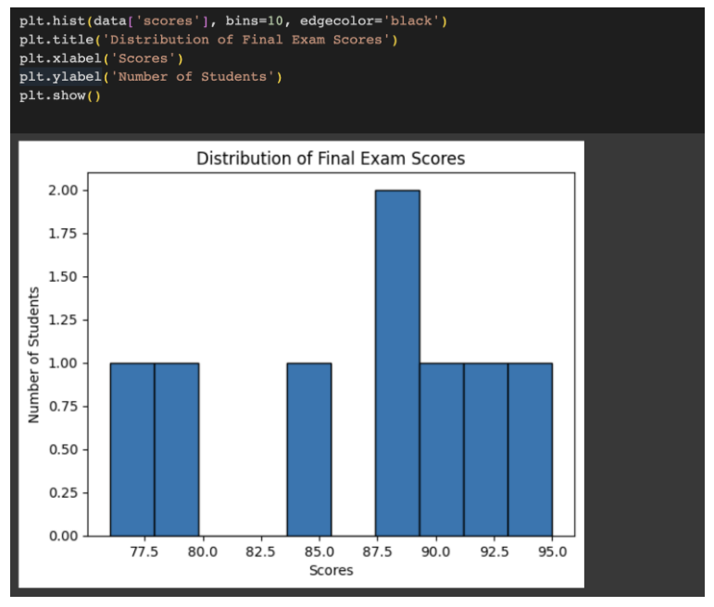
3. Unraveling Data Distribution Using Histograms
Real-World Example
Generates a histogram of final exam scores
Bins = score ranges
Height of bins = number of students in each range

Slide 15
4. Mastering Time Series Visualization with Line Charts in Google Colab
Understanding Time Series Data
Visualizing Time Series Data
Collection of data points over time (chronological order matters)
Example: Hourly temperature readings form a time series
Applications:
Finance → stock trends
Weather → forecasting patterns
Healthcare → tracking patient vitals
E-commerce → analyzing website traffic
Key Value:
Explains the past and provides insights into the future
Line charts → simple & effective for time series
Reveal patterns, trends, and outliers (data points that deviate significantly from the overall pattern)
Appear as unusually high or low values in a time series
May indicate errors, rare events, or important anomalies

Slide 16
4. Mastering Time Series Visualization with Line Charts in Google Colab
Importing Libraries
We will need to import two Python libraries, pandas and matplotlib.pyplot, to get started with data manipulation and visualization respectively. You can import these libraries by running the following code in a new cell:
import pandas as pd
import matplotlib.pyplot as plt
Go to this link:
https://github.com/MikkoDT/MexEE402_AI/tree/main/Python_Visualization/Line_Charts

Slide 17
4. Mastering Time Series Visualization with Line Charts in Google Colab
Creating and Loading Data
Save the CSV file “temperature.csv"
For the purpose of this tutorial, we'll consider a dataset representing the daily temperature of a city for a month. Let's walk through the steps to create this data in a CSV file and subsequently load it into our notebook. Begin by creating a CSV file with the following content, which includes the date and corresponding temperature:
Date,Temperature
2023-01-01,15
2023-01-02,18
2023-01-03,20
2023-01-04,17
2023-01-05,16
2023-01-06,19
2023-01-07,21
2023-01-08,16
2023-01-09,17
2023-01-10,18

Slide 18
4. Mastering Time Series Visualization with Line Charts in Google Colab
Saving the CSV File
Save as temperature_data.csv
Ensure extension is .csv (not .txt)
Uploading to Google Colab
Click folder icon → Upload (up arrow)
Select temperature_data.csv to upload
Using Pandas
data = pd.read_csv("temperature_data.csv")
Plotting the Data
Use plt.plot() to create a line chart
Customize with:
Title → “Daily Temperature Over a Month”
X-axis → Date (rotated 45° for clarity)
Y-axis → Temperature
plt.tight_layout() → ensures labels fit properly
Output: Line chart showing daily temperature trends
Helps identify patterns and anomalies for deeper analysis/forecasting

Slide 19
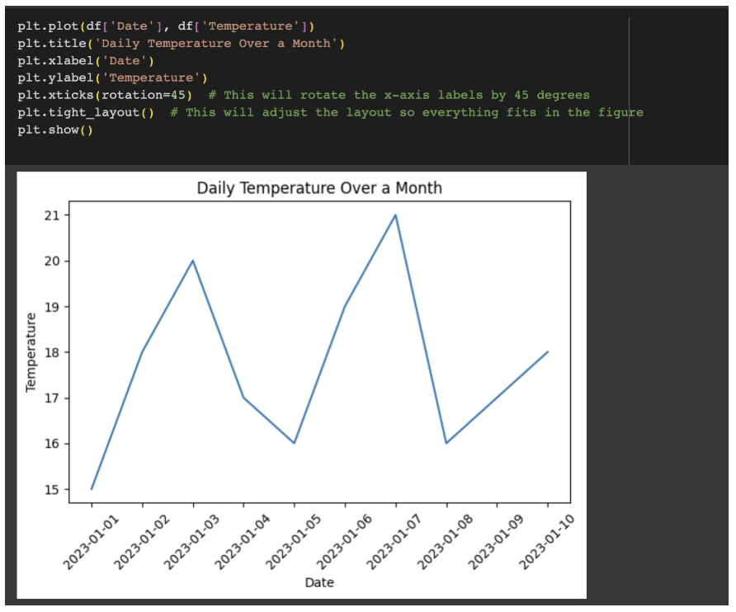
4. Mastering Time Series Visualization with Line Charts in Google Colab
plt.plot(df['Date'], df['Temperature'])
plt.title('Daily Temperature Over a Month')
plt.xlabel('Date')
plt.ylabel('Temperature')
plt.xticks(rotation=45) # Rotates the x-axis labels by 45 degrees
plt.tight_layout() # Adjusts the layout so everything fits in the figure
plt.show()

Slide 20
5. Using Scatter Plots in Google Colab
Understanding Scatter Plots
Why Scatter Plots Matter
Display relationship between two variables using Cartesian coordinates
X-axis = one variable, Y-axis = another
Each point = data observation
Example:
City planner analyzing population density vs. number of parks
Scatter plot reveals possible positive correlation
Identify correlations (positive, negative, or none)
Spot trends (increases, decreases, fluctuations)
Detect outliers or anomalies in data

Slide 21
5. Using Scatter Plots in Google Colab
Go to this link:
https://github.com/MikkoDT/MexEE402_AI/tree/main/Python_Visualization/Scatter_Plot

Slide 22
6. Comparing Data with Bar Graphs in Google Colab
Understanding Bar Graphs
Bar Graphs (Bar Charts): Use rectangular bars to represent data categories.
Bar Length/Height: Proportional to value or frequency → higher value = taller bar.
Purpose: Simplifies complex data into clear, visual comparisons for better decisions.
Example (School Performance):
Categories = Subjects (Math, English, Science, History).
Values = Average student scores.
Bars show quick comparison of strengths & weaknesses.

Slide 23
6. Comparing Data with Bar Graphs in Google Colab
Creating Bar Graphs with Matplotlib in Google Colab Go to this link:
https://github.com/MikkoDT/MexEE402_AI/blob/main/Python_Visualization/Advance_DataVisualization/BarGraphs_Matplotlib_in_Google_Colab.ipynb
https://github.com/MikkoDT/MexEE402_AI/blob/main/Python_Visualization/Advance_DataVisualization/average_scores.csv
Creating Bar Graphs with Matplotlib using Seaborn's Titanic Dataset Go to this link:
https://github.com/MikkoDT/MexEE402_AI/blob/main/Python_Visualization/Advance_DataVisualization/Seaborn_Titanic_Dataset.ipynb

Slide 24
7. Advanced Data Visualization Techniques in Google Colab
Plotnine, Plotly, and Altair
Plotnine
Python clone of R’s ggplot2
Built on Matplotlib + works with Pandas
Great for complex, layered statistical graphics with simple syntax
Sample import of Plotnine:
from plotnine import ggplot, aes, stat_summary, ggtitle

Slide 25
7. Advanced Data Visualization Techniques in Google Colab
Plotnine, Plotly, and Altair
Plotly
Best for interactive visuals
Supports 3D charts, maps, and network graphs
Highly engaging for presentations & dashboards
Sample import of Plotly:
import plotly.express as px

Slide 26
7. Advanced Data Visualization Techniques in Google Colab
Plotnine, Plotly, and Altair
Altair
Declarative library based on Vega-Lite
Produces clear, concise, statistical graphics
Ideal for data exploration & interpretation
Sample import of Plotly:
import altair as alt

Slide 27
7. Advanced Data Visualization Techniques in Google Colab
Plotnine_Plotly_Altair_Titanic_Dataset Go to this link:
https://github.com/MikkoDT/MexEE402_AI/blob/main/Python_Visualization/Advance_DataVisualization/Plotnine_Plotly_Altair_Titanic_Dataset.ipynb

Slide 28
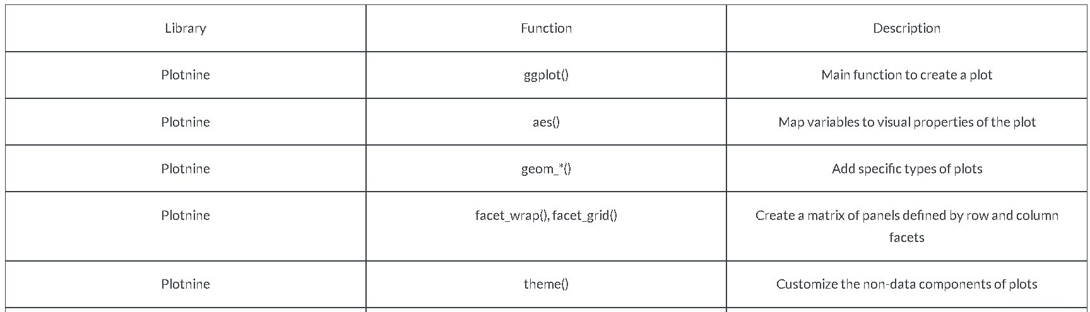
7. Advanced Data Visualization Techniques in Google Colab
Plotnine, Plotly, and Altair: Table of Common Functions

Slide 29
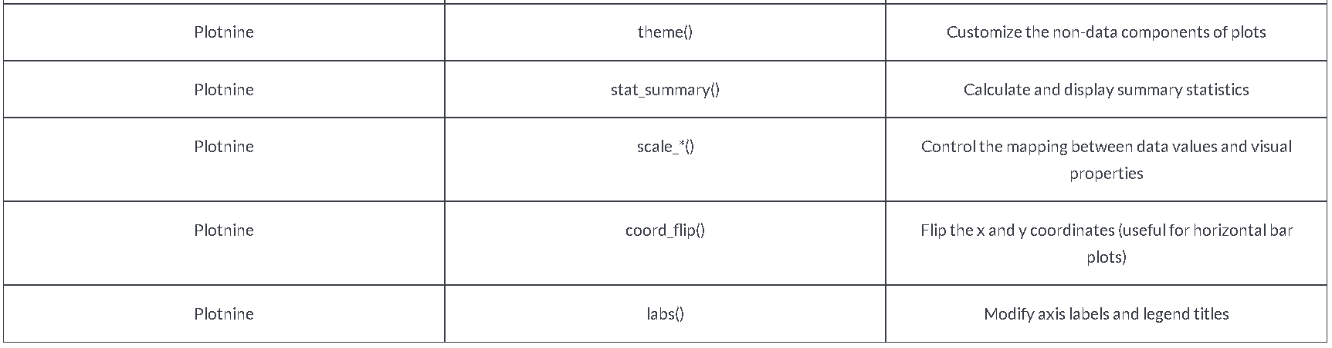
7. Advanced Data Visualization Techniques in Google Colab
Plotnine, Plotly, and Altair: Table of Common Functions

Slide 30
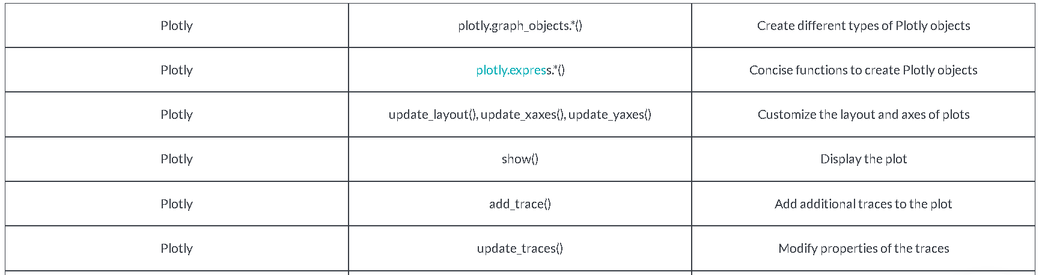
7. Advanced Data Visualization Techniques in Google Colab
Plotnine, Plotly, and Altair: Table of Common Functions

Slide 31
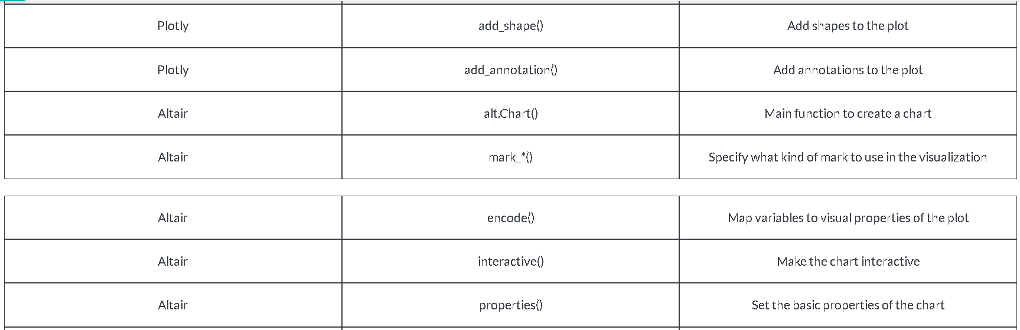
7. Advanced Data Visualization Techniques in Google Colab
Plotnine, Plotly, and Altair: Table of Common Functions

Slide 32
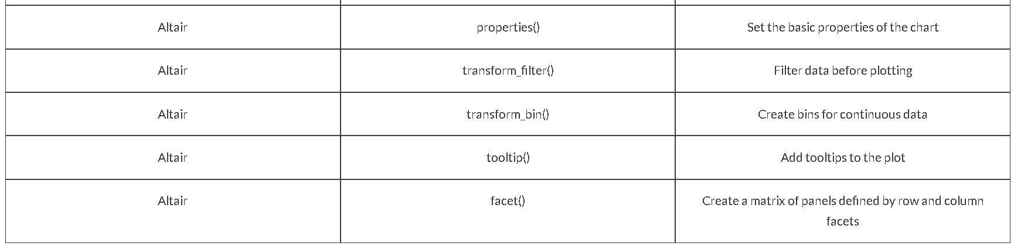
7. Advanced Data Visualization Techniques in Google Colab
Plotnine, Plotly, and Altair: Table of Common Functions

Slide 33
8. Visual Data Analysis Project in Google Colab
Iris_Data_Visualization Go to this link:
https://github.com/MikkoDT/MexEE402_AI/blob/main/Python_Visualization/Advance_DataVisualization/Iris_Data_Visualization.ipynb

