Slide 1

INTRODUCTION TO DATABASES

Slide 2





What is a database ?
File
User
Website
Database

Slide 3

FILE V/S DATABASE

Slide 4
Storing data in a file v/s database
Data stored in a file is unstructured / data stored in a database is well organised.
Databases enforce data integrity, files do not have built in mechanism to enforce data integrity.
Data stored in a file can only be accessed and manipulated through simple I/O operations.
Data stored in database can be accessed and manipulated using SQL which allows you to perform complex queries.
Databases are optimised for performance, files can be extremely slow to read.

Slide 5
What is a database ?
A database is an organised collection of structured information or data stored electronically in a computer system.
A database is controlled by a database management system.
Typically we combine them together and call it a database.

Slide 6
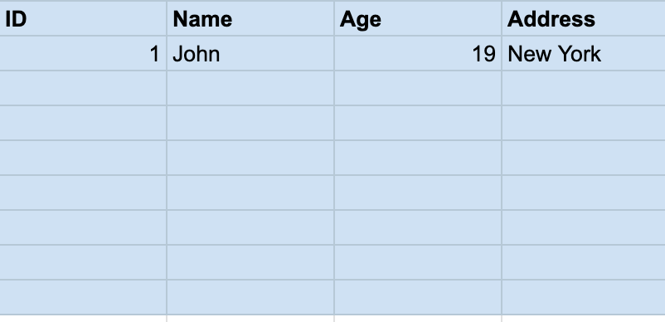

How data is stored in a database
Data in a database is stored in a tabular format.
A database contains multiple tables.
Data is stored in a table, which contains rows and columns.
Example:
Student
Student Table

Slide 7
How is data accessed from a database ?
Student Table
Structured Query Language (SQL)
SELECT age FROM student WHERE name = “John”
Output:
>> 19

