Slide 1
Robotics 2 Assignment

Slide 2
General Instructions:
From the kinematic diagram of the following Mechanical Manipulators, obtain the D-H Parametric Table and write their respective codes in MATLAB.
This is a group assignment, with al l your name written as authors of the repository in github.
The final outputs are the following:
3 D-H Parametric Tables with their labeled Kinematic Diagrams in a graphing paper posted in README file in Github
3 MATLAB scripts created thru laptop/desktop
4. Name your repository in this format.
5. Name your scripts in this format: Group#_Manipulator.

Slide 3
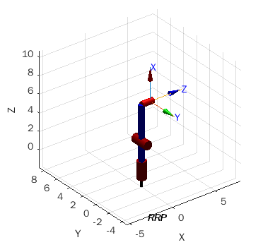
Spherical Manipulator - Modern Variant

Slide 4
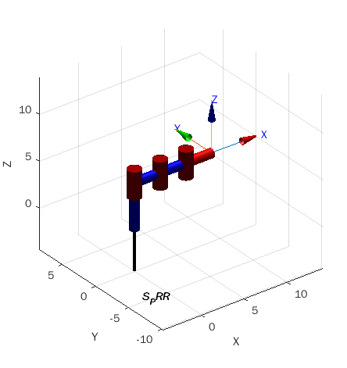
2. SCARA - PRR Variant

Slide 5
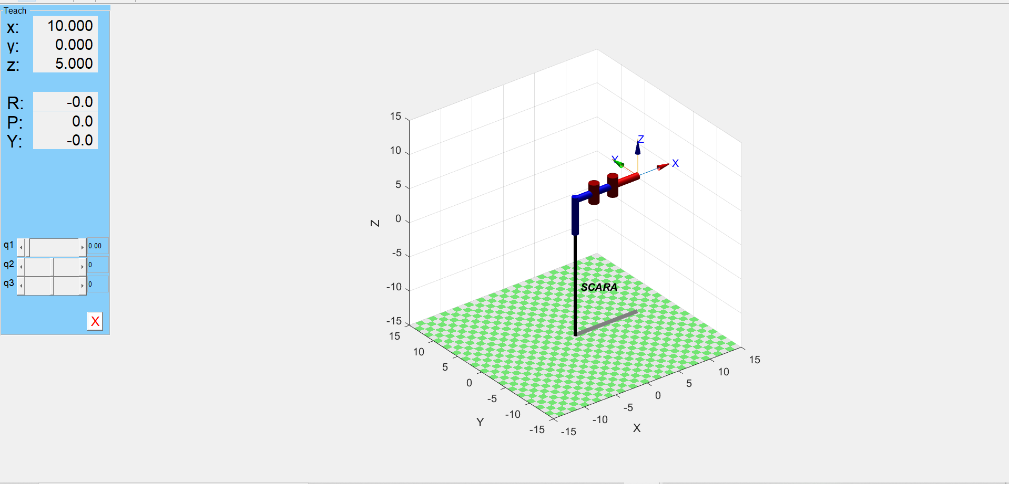
2. SCARA - PRR Variant (pwede ring ganito)

Slide 6
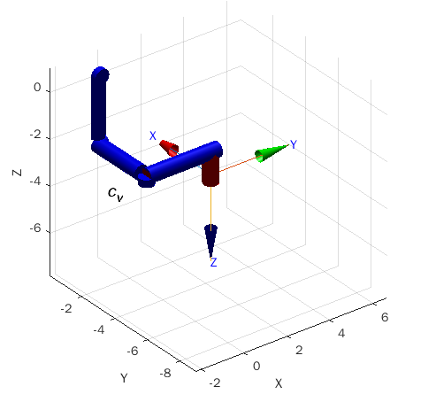
3. Cartesian Manipulator on Ceiling

