Slide 1
Nordea Data Science Recruitment Assignment
Analyzing and generating political parties
Mikko Närhi

Slide 2
Overview
The assignment involved analyzing political party data with Python
Tasks include:
Loading and preprocessing data
Dimensionality Reduction of high-dimensional data
Estimating the distribution of the 2D data and generating 10 random samples
Mapping the generated 2D samples back to high-dimensional space
Painting the valid area of the high-dimensional space into 2D space

Slide 3
Task 1: Preprocessing
Methodological choices:
Removal of certain columns from analysis (e.g. dob, gender)
Handling missing data: No imputation nor removal of missing values
Aggregation: Mean Aggregation per political party
Alternatives:
Missing Data Handling:
Imputation: Cons include altering the distribution of data
Removal of data points: Cons include having less data for analysis
Aggregation methods:
Sum aggregating
Median aggregating

Slide 4
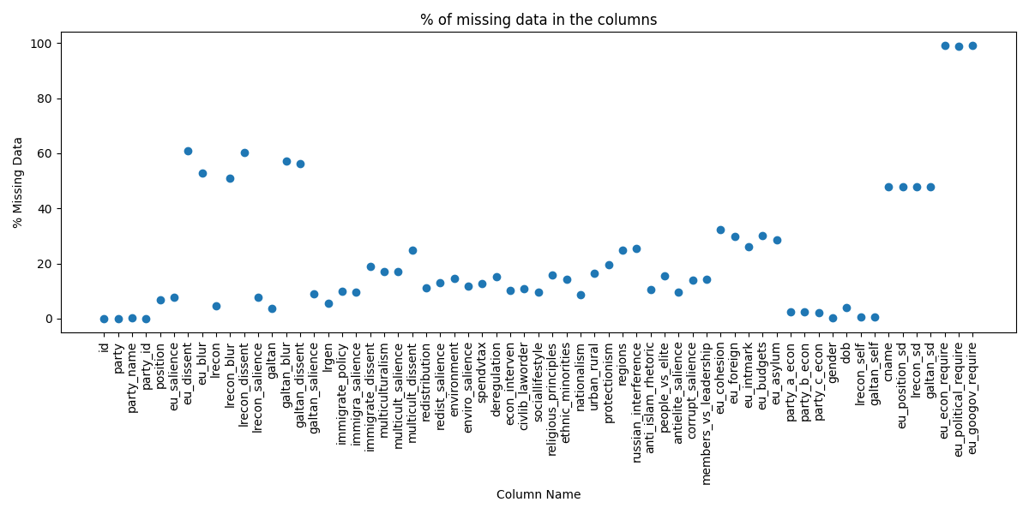
Task 1: Missing data per column

Slide 5
Task 2: Dimensionality reduction
Methodological choices:
Chosen dimensionality reduction technique: PCA
Explained Variance of the 2D data: 44.6 %
Justifications for PCA:
Familiarity: I have implemented PCA in the past and understand it well
Variance Preservation: PCA focuses on keeping the largest amount of variance possible
Simplicity and efficiency: Straightforward implementation and computational efficiency
Alternatives:
t-SNE
Pros: Can capture non-linear relationships
Cons: Computational complexity
UMAP
Pros: Preverses both global and local structure
Cons: More hyperparameters to tune
Autoencoder
Pros: Can capture non-linear relationships and complex patterns
Cons: Requires significant computational resources; complex hyperparameter training and needs a large amount of data

Slide 6
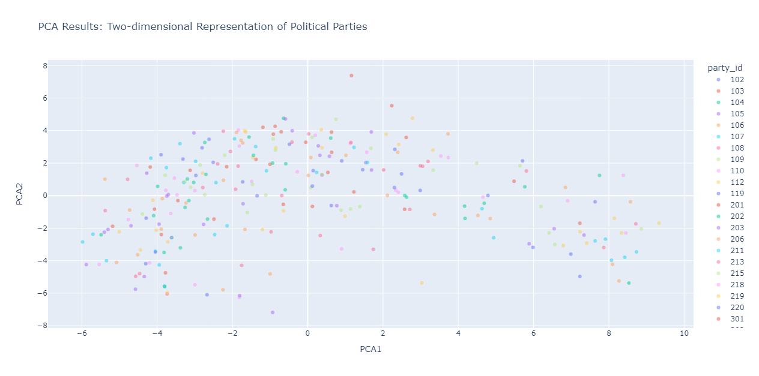
Task 2: Scatterplot of 2D data points

Slide 7
Task 3: Estimate the distribution and draw random samples
Methodological choices:
Chosen method for estimating the distribution: Gaussian Kernel Density Estimation (KDE)
Justifications for Gaussian KDE:
Flexibility: Capable of modelling complex distributions
Smoothness: Produces a smooth estimate of the probability density function
Alternatives:
Multivariate Normal Distribution
Pros: Well known and efficient to compute
Cons: Does not accurately capture the true distribution

Slide 8
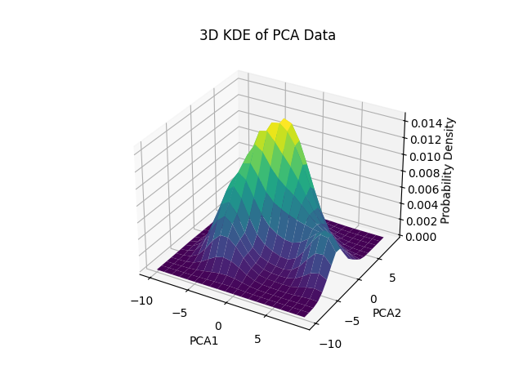
Task 3: Estimate of the Distribution

Slide 9
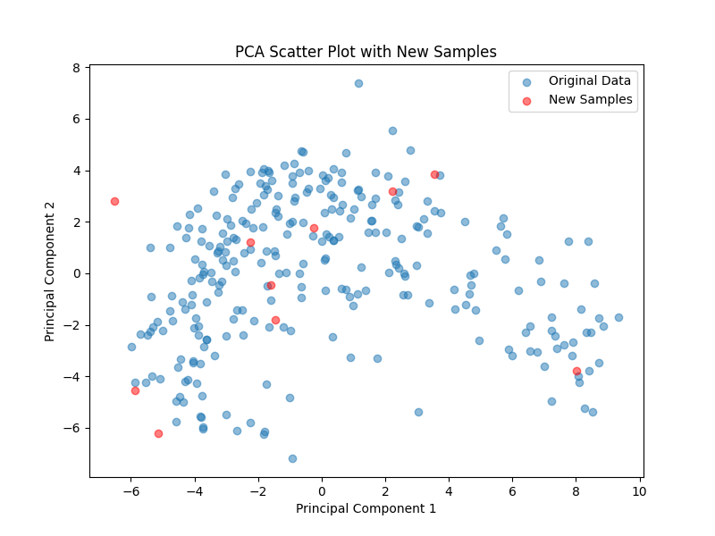
Task 3: Scatterplot with the generated samples

Slide 10
Task 4: Map 2D sampled points back to high-dimensional space
Methodological choices:
Inverse transformation using the fitted PCA-model
Inverse transformation using the fitted scaler.

Slide 11
Task 5: Paint the valid area of the high-dimensional space
Methodological choices:
Chosen method for defining the valid area: Generating a large number of extreme points
Justifications for the method:
Accuracy: Estimates the actual valid area accurately
Alternatives:
Direct approximation based on the observed 2D PCA-transformed data
Pros: Simpler and easier to implement
Cons: Does not encompass the full valid area

Slide 12
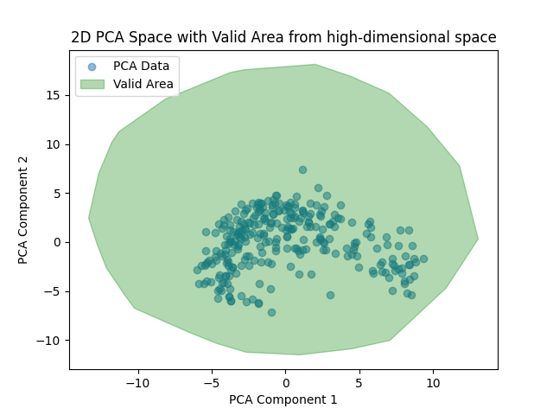
Task 5: Valid area in the 2D space

Slide 13
Explanation of the low-dimensional data
Using PCA for dimensionality reduction is like creating a simplified map of Europe's political landscape.
It helps politicians see how closely their views align with other parties on a high-level and where they stand out.
This clear, visual summary can guide strategic decisions and help in understanding of alliances and rivalries within the political sphere.
In addition, PCA helps us identify the most influential factors in the political spectrum, giving insight into what drives similarity or difference among parties.

Slide 14
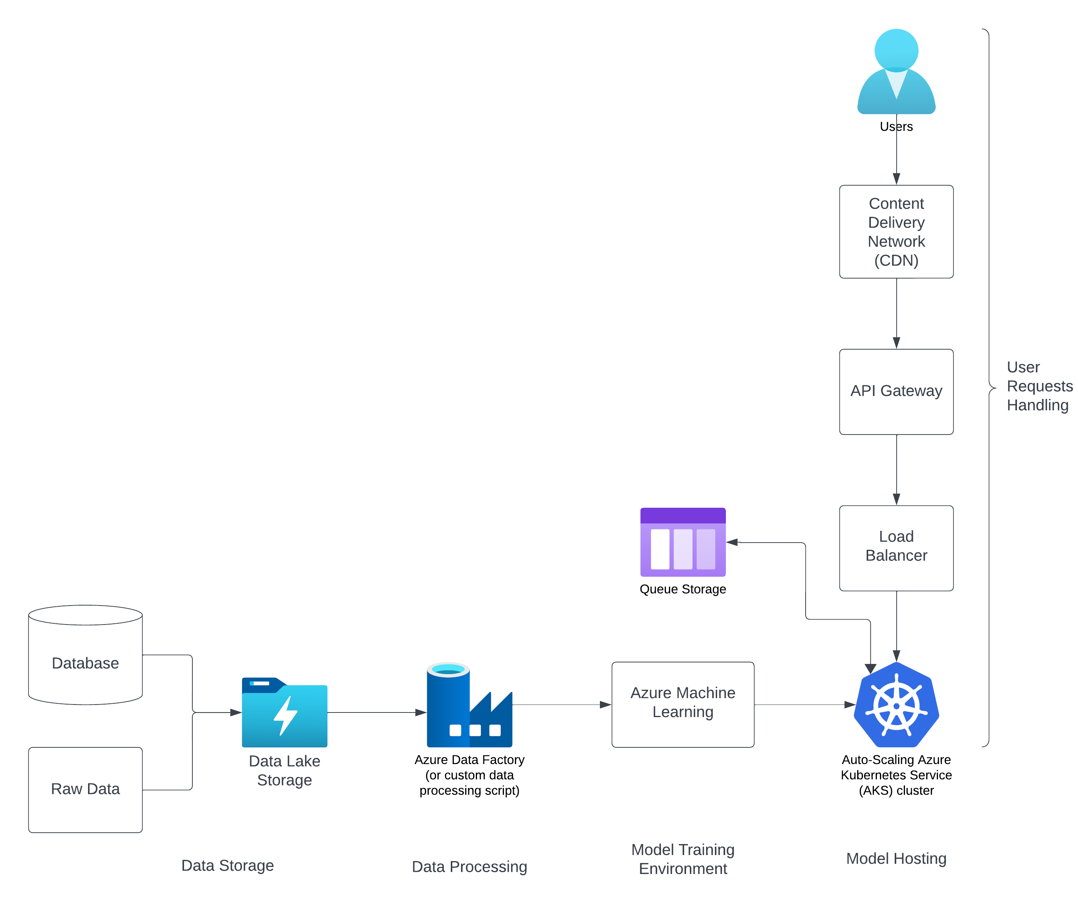
Deploying the model to cloud

Slide 16
Thank you for your consideration!

