Slide 1

Spring School
Mikko Lehtimaki
Mate Mohacsi
Alex Stasik
Eduarda Demori Susin
23/02/2018

Slide 2
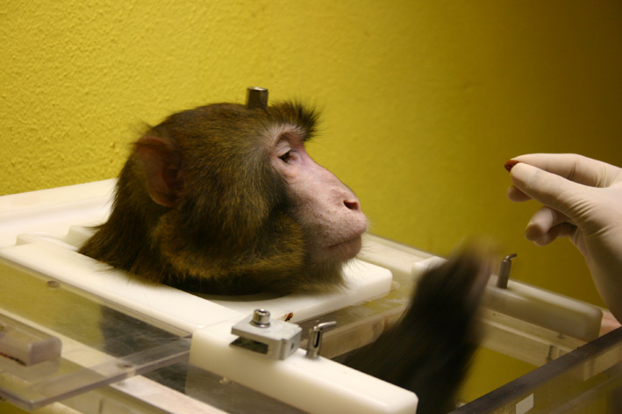

6 Data Sets: What is What?
Data from 2 macaques
motor cortex
Data generated by a point-neuron simulation

Slide 3
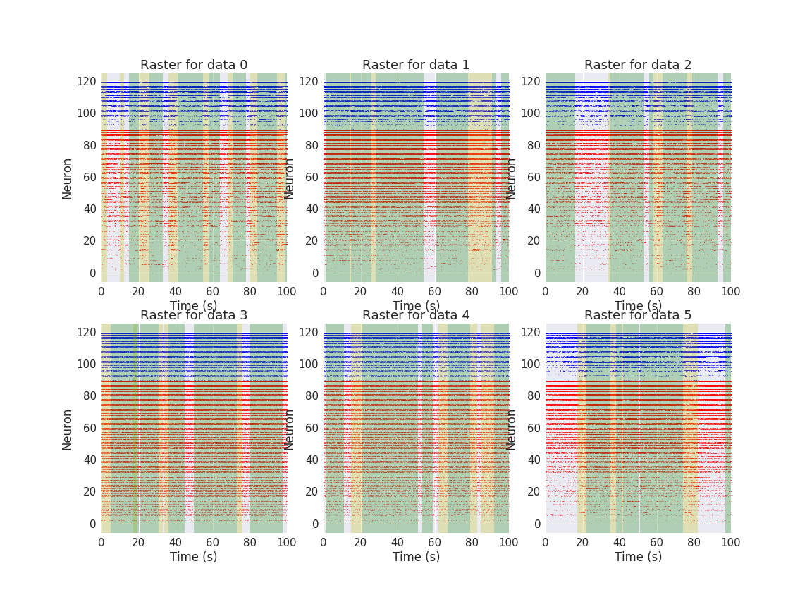
6 Data Sets: What is What?
Green: Rest Periods -Yellow: Moving Periods

Slide 4
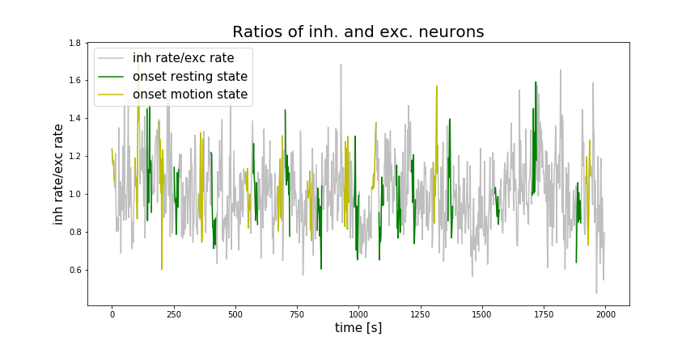
6 Data Sets: What is What?
Green: Rest Periods
Yellow: Moving Periods

Slide 5
Methods
Variables Considered:
Inter-Spike Interval
Local Coefficient of Variation
Auto and Cross-Correlations
Mean Frequency per Neuron
Attractor Reconstruction
Statistical Tests Used:
Kolmogorov-Smirnov test
Mann Whitney
Levene
T-Student Test
Pearson
Kruskal

Slide 6
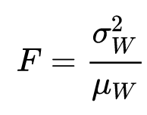
Exploring the Data:
Fano-Factors (time binned)

Slide 7
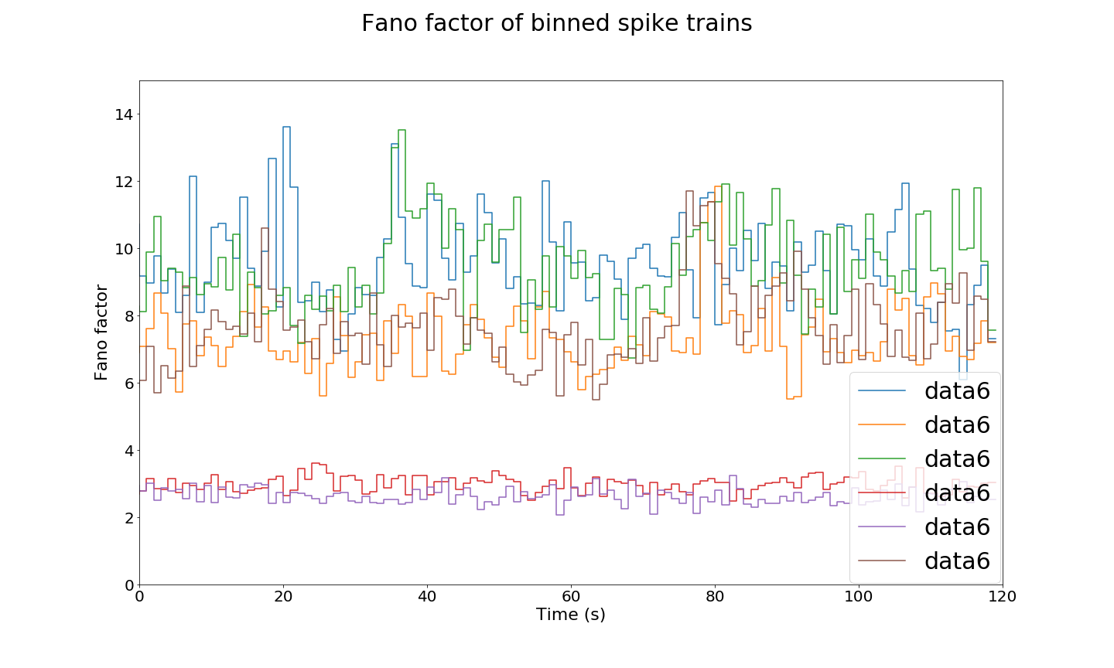
Differentiating Data Sets
Comparing Fano-Factors
0
1
2
3
4
5

Slide 8
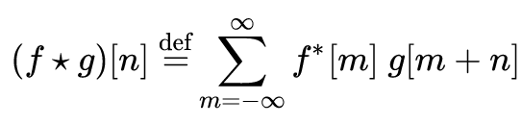
Exploring the Data:
Auto-Correlations

Slide 9
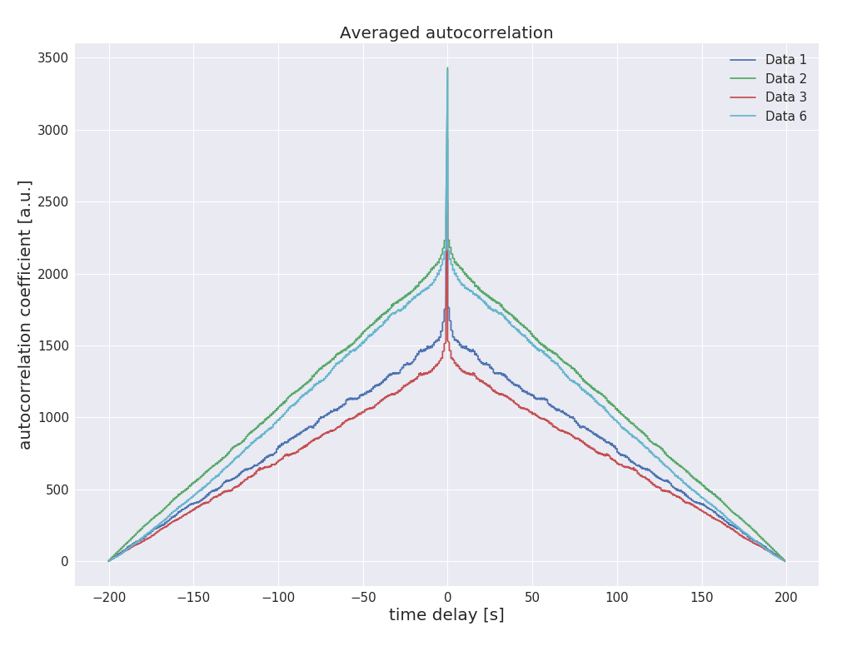
Differentiating Between Monkeys
Comparing the Auto-Correlations
→ Kolmogorov-Smirnov test not robust enough
0
1
2
5

Slide 10
Statistical tests:
Cross-Correlations Comparisons

Slide 11
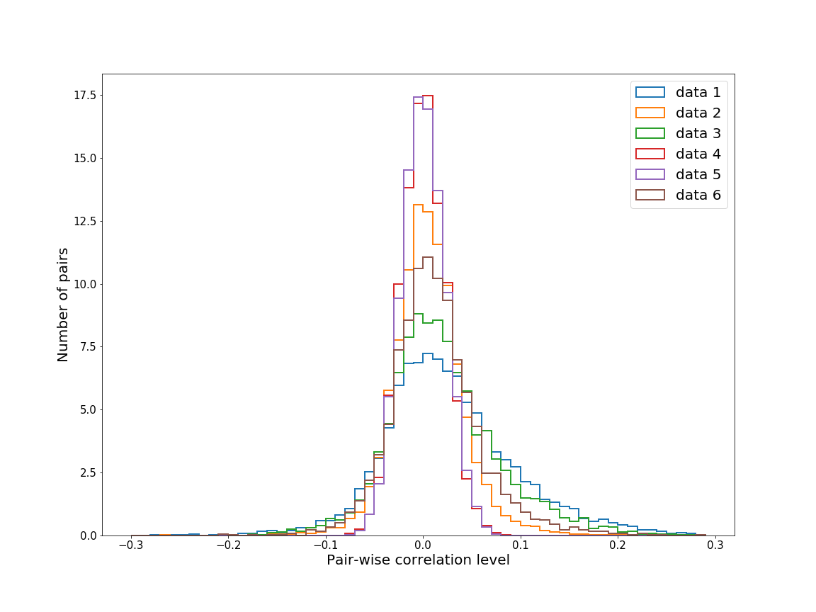
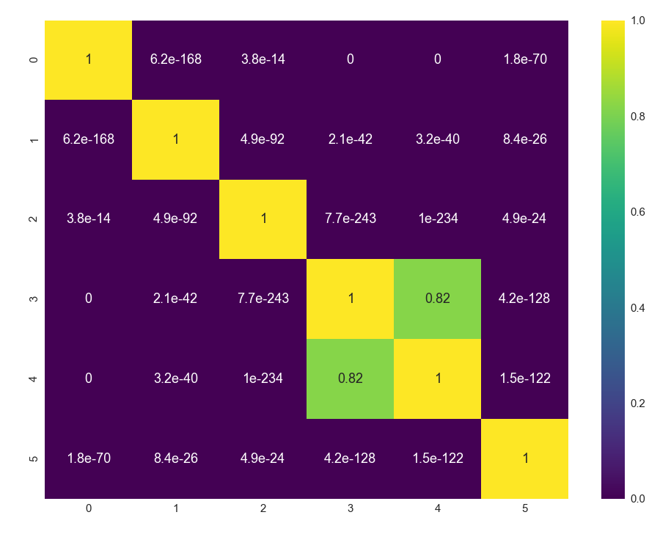
Differentiating between Simulated and Non-Simulated Data
Using Pairs-wise Correlations and the Kolmogorov-Smirnov test
0
1
2
3
4
5

Slide 12
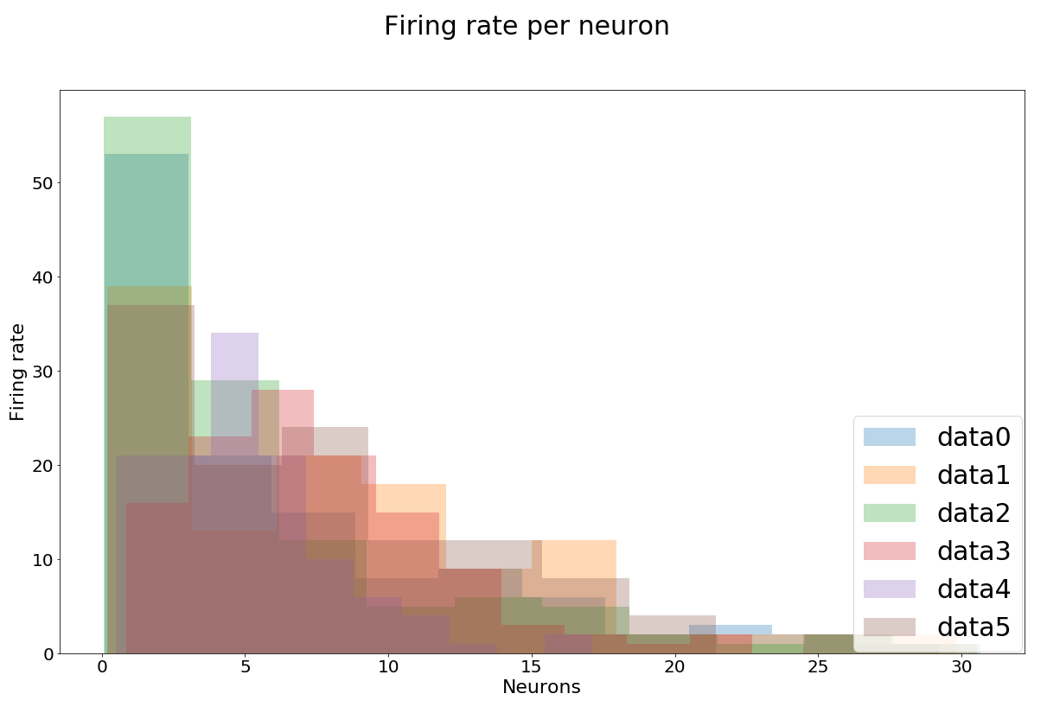
Statistical tests:
Comparing Firing Rate per Neuron

Slide 13
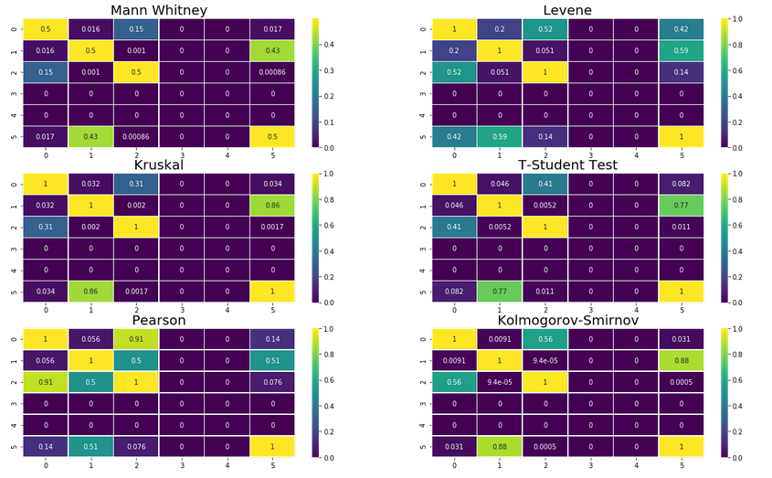
Differentiating Data between the 2 Monkeys
Using Frequency per Neuron Distribution and the different statistical tests

Slide 14
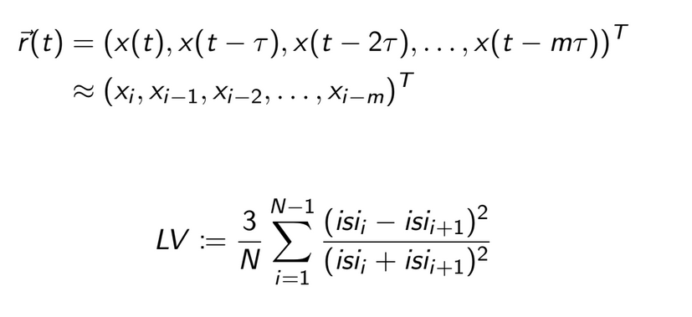
Statistical tests:
Attractor Reconstruction

Slide 15
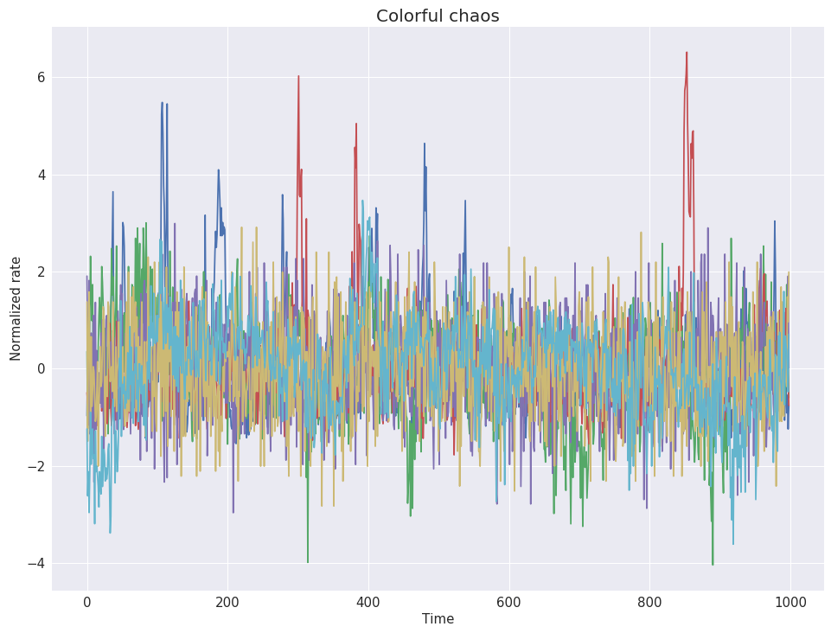
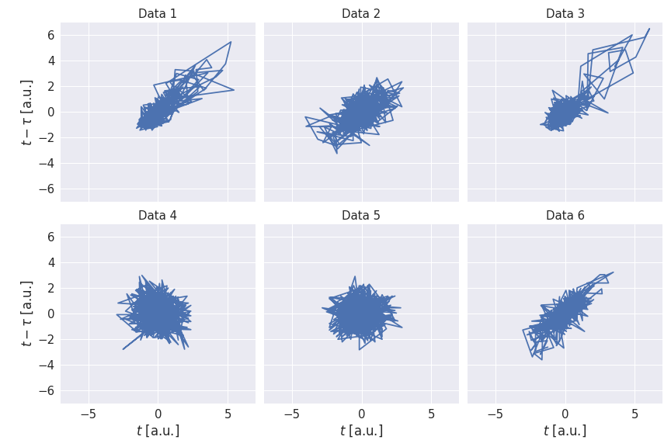
Differentiating between Simulated and Non-Simulated Data
Using Time embedding for attractor reconstruction (Taken’s Theorem)
  Parameter used: Intantaneous Firing Frequency

Slide 16
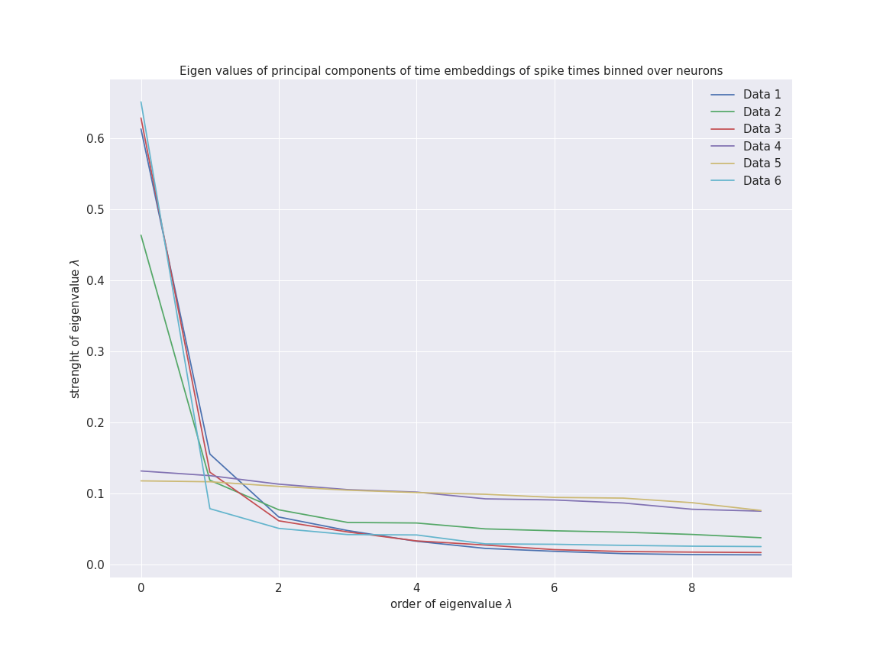
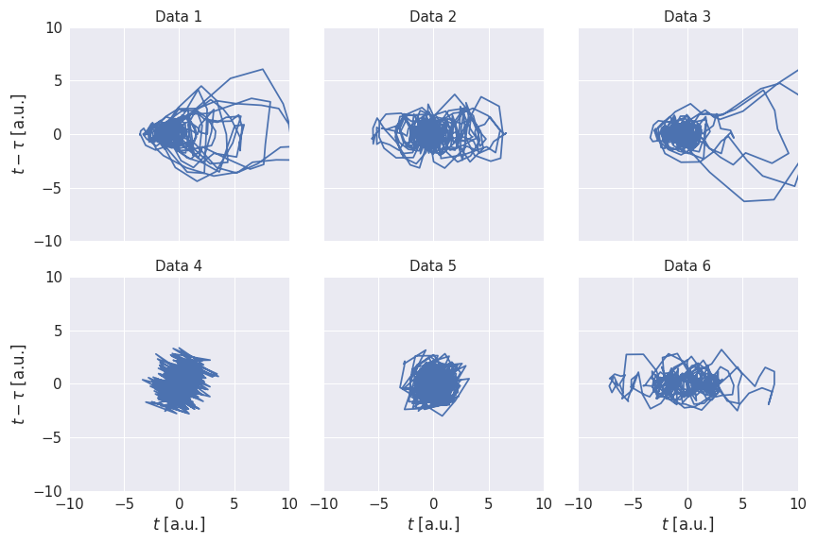
Differentiating between Simulated and Non-Simulated Data
Using Time embedding for attractor reconstruction (Taken’s Theorem)
  Parameter used: Eigenvalues (calculated through PCA analysis)

Slide 17
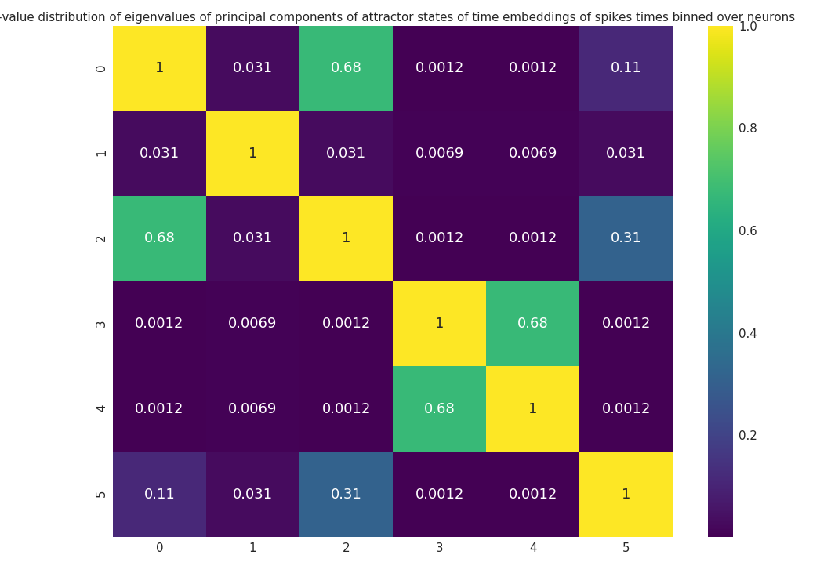
Differentiating between Simulated and Non-Simulated Data
Using Eigenvalues and the Kolmogorov-Smirnov test

Slide 18
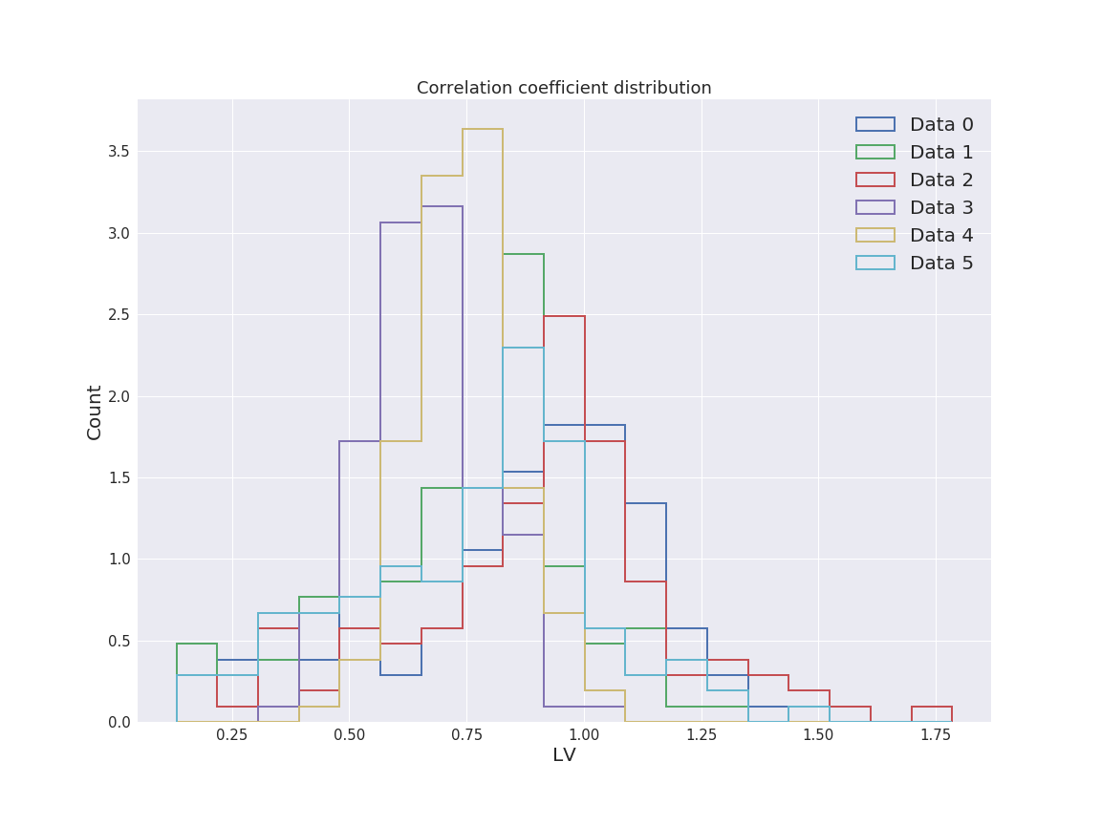
Statistical tests:
Local Coefficient Of Variations

Slide 19
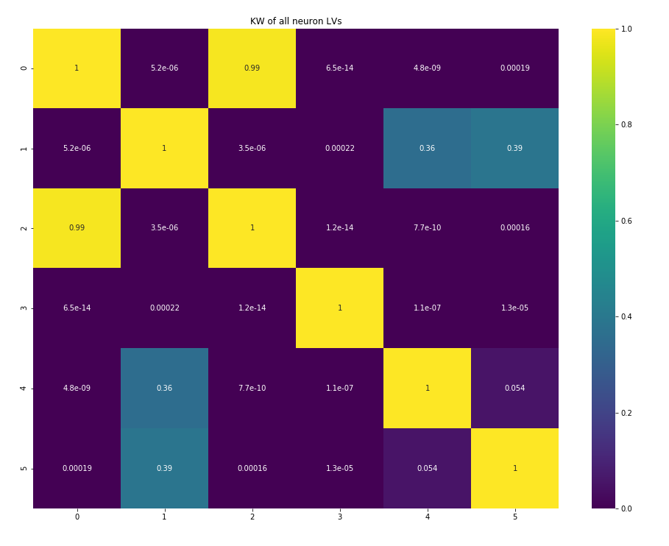
Differentiating Between Monkeys
Comparing the Local Coefficient of Variation Distribution

Slide 20
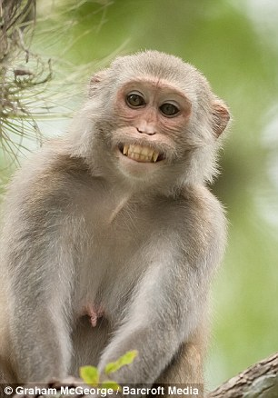
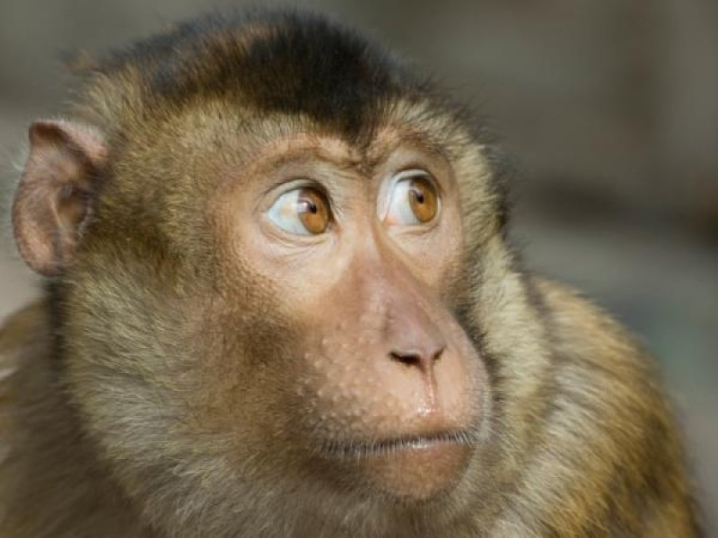
Conclusions
Data: Monkey 2
Data: Monkey 1
Data: Simulations
Data Set 3
Data Set 4
Data Set 0
Data Set 2
Data Set 1
Data Set 5

Slide 21
Conclusions
Data: Monkey 1
Data: Monkey 2
Data: Simulations
Data Set 0
Data Set 2
Data Set 1
Data Set 5
Data Set 3
Data Set 4

Slide 22
Thank you!

