Slide 1
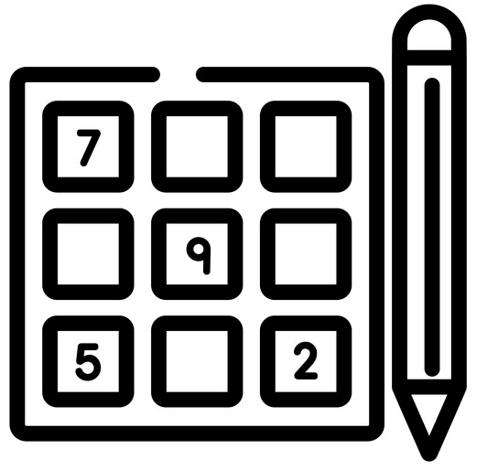
SUDOKU

Slide 2
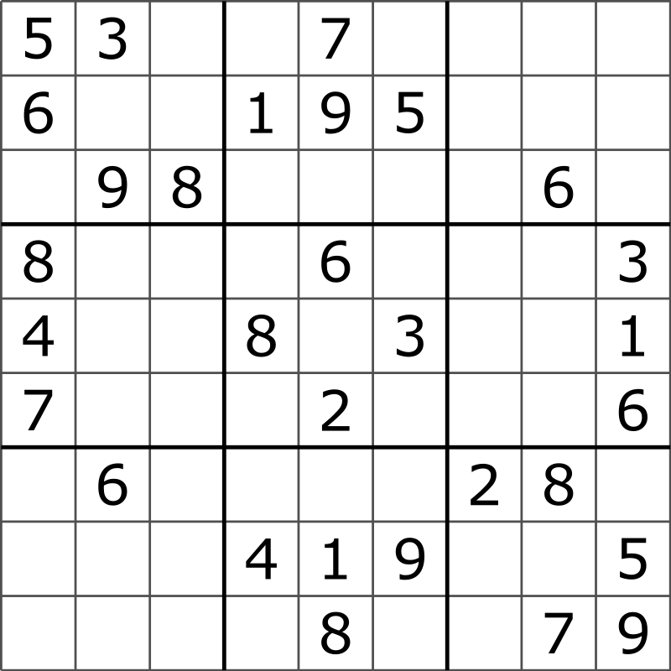
{ 1, 2, 3, 4, 5, 6, 7, 8, 9 }

Slide 3
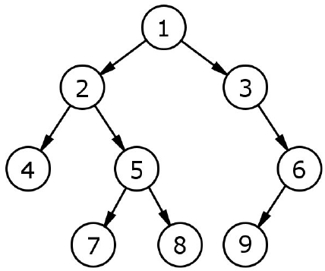

Slide 4
}
= State

Slide 5
{1 - 9} = Action

Slide 6
State + Action -> New State
1
+ {1 - 9}

Slide 7
X
{ 1, 2, 3, 4, 5, 6, 7, 8, 9 }
X
X
X
X
X
1
4
2
1
2
4

Slide 8
BFS
1
2
4
1
2
4
2
6
2
6
6
1
2
1
6
2
6
4
2
4
6

Slide 9
DFS
1
2
4
1
2
4
2
6
1
2
1
6
4
6
8
1
2
4
1
2
6
1
2
8

Slide 10
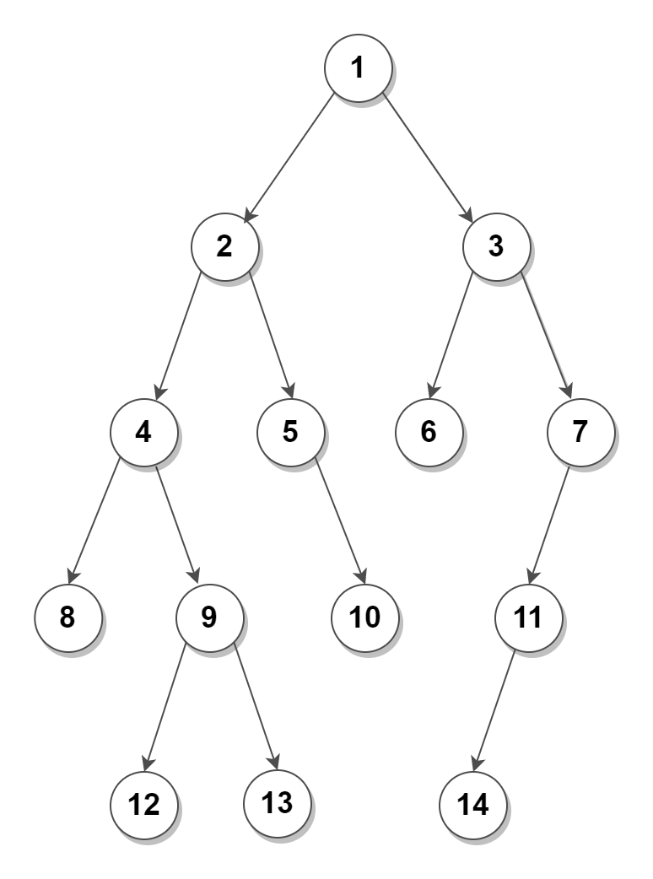
Queue -> Frontier
1

Slide 11
Queue -> Frontier
1
What is the frontier of node 1

Slide 12
Queue -> Frontier
2
3

Slide 13
Queue -> Frontier
3
4
5
2
What is the frontier of node 2

Slide 14
Stack -> Frontier
1

Slide 15
Stack -> Frontier
1
What is the frontier of node 1

Slide 16
Stack -> Frontier
3
2

Slide 17
Stack -> Frontier
3
What is the frontier of node 3
2

Slide 18
Stack -> Frontier
7
6
2

Slide 19
Goal?

Slide 20
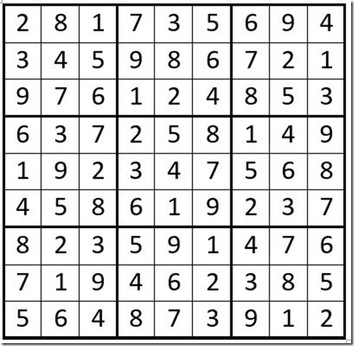
Validation
No empty

Slide 21
Goal
Goal
Goal

Slide 22
Demonstrate

