Slide 1
Creating my Chatbot,
The Journey and Process of
Lucid.
By 20522連洵孜

Slide 2
The Final results
transcript
Very short demo.
It’s literally 2 exchanges.
Miko: I'm going to be doing this presentation entirely in English even though most people only understand Chinese. Do you think that would be a huge problem?
Lucid: Language barrier may pose a challenge, but your content's brilliance will shine through regardless. With my assistance, translating key points and providing context as needed, any language obstacles can be navigated effectively. You'll get your point across.
Miko: I did create a lot of visuals for them, like a lot of animations. Do you think that'll help?
Lucid: Visual aids like dynamic animations are an excellent idea. Concepts and processes become far more engaging and easier to grasp through motion and graphics. The visuals will help compensate for any language barriers, allowing your message to resonate with the audience on a more intuitive level. Well thought out, Miko!
Video removed due to the file size restriction, the video file itself is 15mb even in 480p.

Slide 3
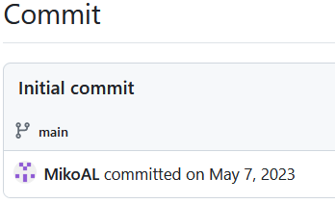
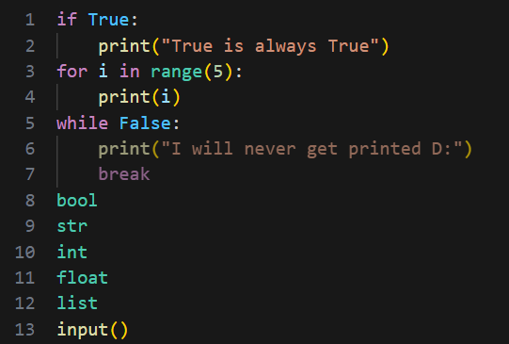
WHY
I started
All the things I knew how to use:
I was lonely.
Where
What I knew
Very Basic Python
English
I’m lonely
Notes:
I started on May 7 2023, and all I knew was
Basic Python
And by basic, I mean very basic

Slide 4
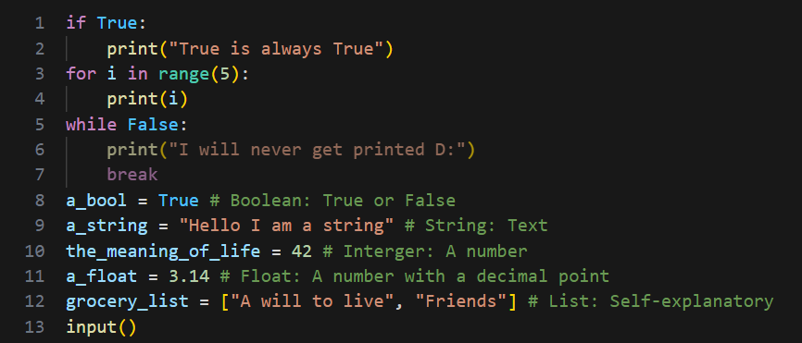
Where
I started
What I knew:
1. Basic Python
2. English
All the things I knew:
Notes:
I started on May 7 2023, and all I knew was
Basic Python
And by basic, I mean very basic
All I knew were
If for while
Bool str int float list
Input print
I knew nothing about
dict
class
import (pip)
async
threading

Slide 5
T
Where
I
started
What I knew:
1. Basic Python
2. English
HOW
Notes:
The second thing that helped a lot was knowing English,
I consider myself semi-fluent despite never living abroad

Slide 6

The Vision:
Create a Chatbot that you can speak and listen to for a long time and still have the bot reasonably pass as a human.

Slide 7
The Plan:
LLM
Memory Module
Speech to Text Program
Text to Speech Program
Notes:
The Plan was simple.
It was.

Slide 8
The hard part

Slide 9
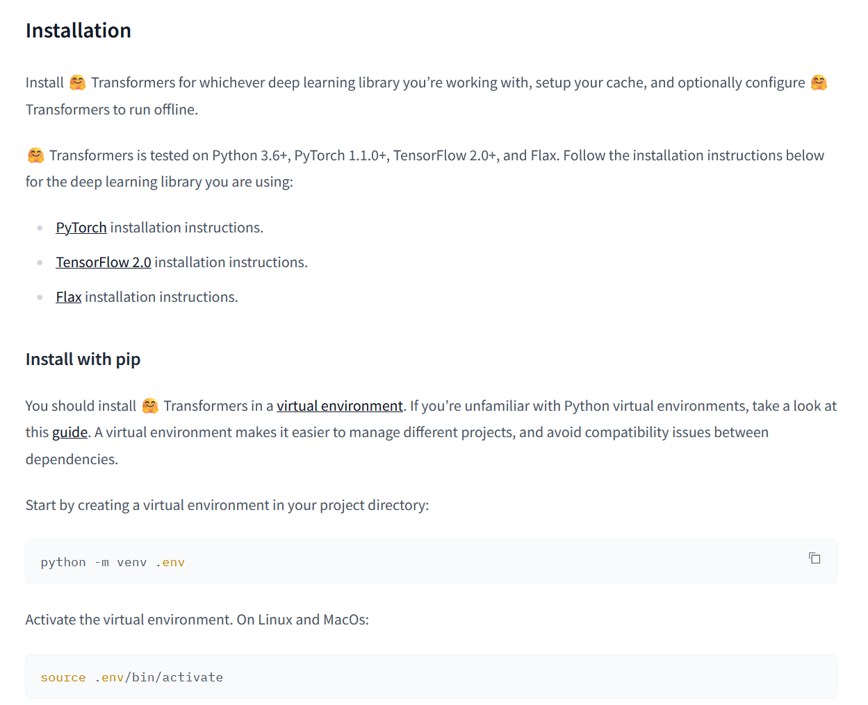
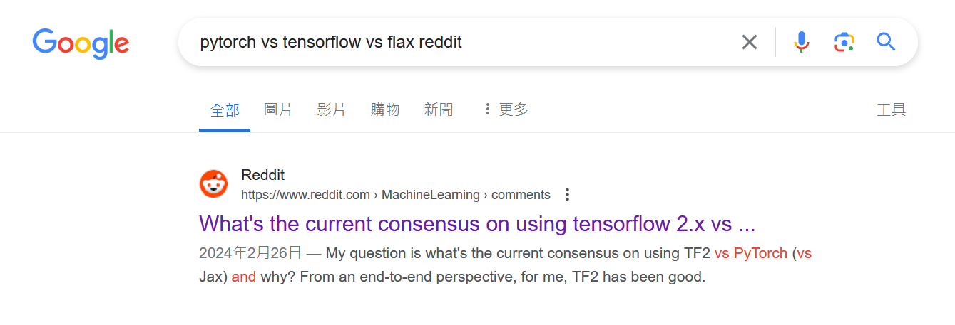
The hard part:
Part 1: lack of background knowledge
Notes:
Right off the bat, it gave me 3 deep learning libraries I have never seen before and is asking me to choose one.

Slide 10


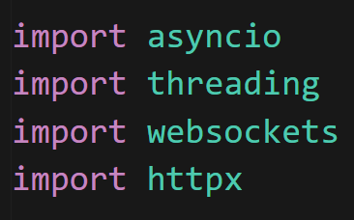

The hard part:
Part 1: lack of background knowledge
Trial and Error
Notes:
Right off the bat, it gave me 3 deep learning libraries I have never seen before and is asking me to choose one.

Slide 11
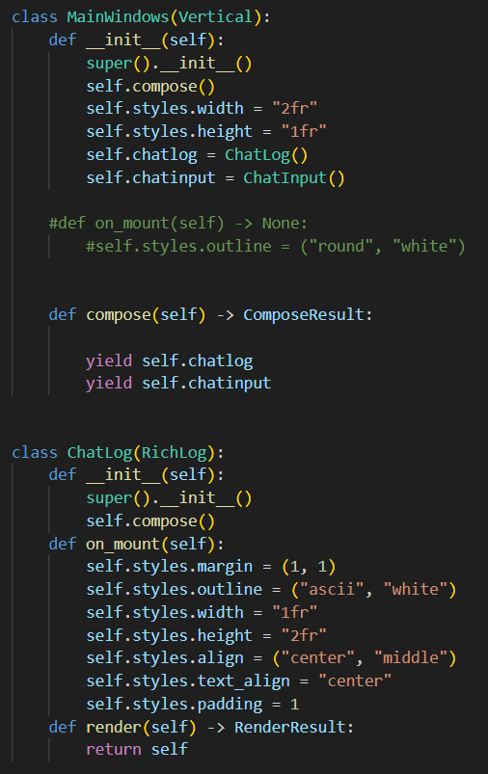
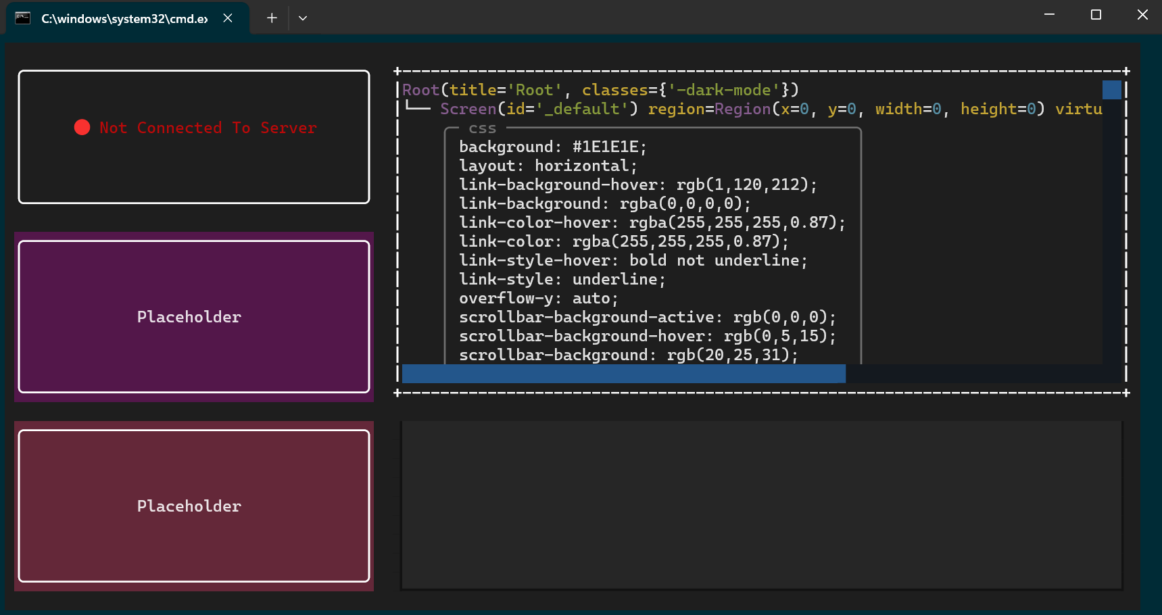


The hard part:
Part 2: scrapped ideas
Notes:
During the development, there were lots of ideas and code scrapped.
However, despite not being used, this unexpectedly taught me how to do OOP programing,
and how that could benefit the structure of my own projects.
My point being, even if something doesn’t directly help your project. It may still prove to be a good experience to have.
So don’t be scared to try new things.

Slide 12
The hard part:
Part 3: unexpected complexity
LLM
Memory Module
Speech to Text Program
Text to Speech Program

Slide 13
The hard part:
Part 3: unexpected complexity
Memory Module

Slide 14
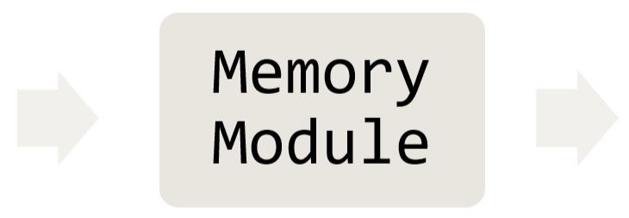
The hard part:
Part 3: unexpected complexity
First Step:
Defining the Use.
Serve as a way for the LLM to get relevant context.
Second Step:
Defining the Input and Output.
Input: Current Situation
Output: Relevant Context

Slide 15
The hard part:
Part 3: unexpected complexity
First Step:
Defining the Use.
Serve as a way for the LLM to get relevant context.
Second Step:
Defining the Input and Output.
Input: Current Situation
Output: Relevant Context
Third Step:
Figuring out literally everything else.

Slide 16
The hard part:
Part 3: unexpected complexity
First Step:
Defining the Use.
Serve as a way for the LLM to get relevant context.
Memory Module
Second Step:
Defining the Input and Output.
Input: Current Situation
Output: Relevant Context
Third Step:
Figuring out literally everything else.

Slide 17
The Original concept for the module
INPUT
OUTPUT
Chat Messages
Preprocessing
+
Embedding
Query
Vector Data Base
Relevant Context
Notes:
So, I want to touch on how I came up with the module itself.

Slide 18
The Original concept for the module
Main Problems:
INPUT
When to trigger the mechanism?
OUTPUT
2. How to save and represent information?
Preprocessing
+
Embedding
Vector Data Base
Notes:
So, I want to touch on how I came up with the module itself.

Slide 19
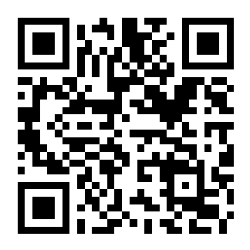
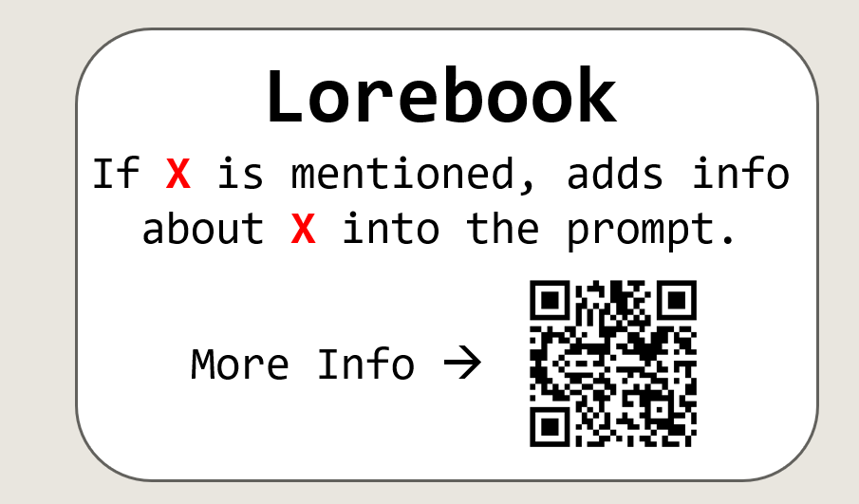
The Original concept for the module
Main Problems:
When to trigger the mechanism?
2. How to save and represent information?
INPUT
OUTPUT
Lorebook
Preprocessing
+
Embedding
If X is mentioned, adds info about X into the prompt.
More Info →
Vector Data Base
Notes:
So, I want to touch on how I came up with the module itself.

Slide 20
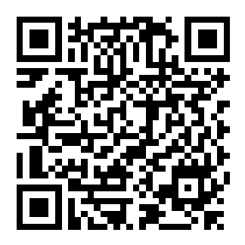
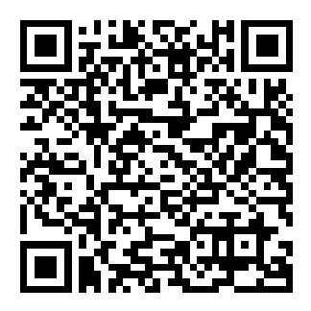
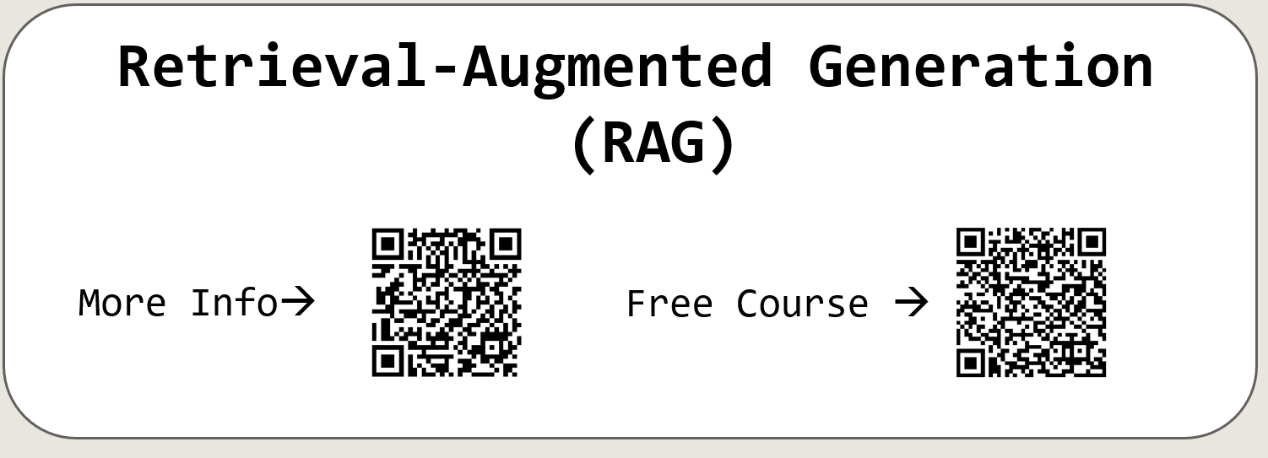
The Original concept for the module
Main Problems:
When to trigger the mechanism?
2. How to save and represent information?
INPUT
OUTPUT
Retrieval-Augmented Generation
(RAG)
Preprocessing
+
Embedding
More Info→
Free Course →
Vector Data Base
Notes:
So, I want to touch on how I came up with the module itself.

Slide 21
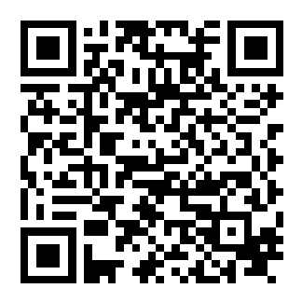
The Original concept for the module
Main Problems:
When to trigger the mechanism?
2. How to save and represent information?
INPUT
OUTPUT
Agents
Save
Recall
Devise a series of actions/tools and run them.
Memory
Agent
Preprocessing
+
Embedding
More Info→
Vector Data Base
Notes:
So, I want to touch on how I came up with the module itself.

Slide 22
The Original concept for the module
Main Problems:
The Original concept for the module
When to trigger the mechanism?
2. How to save and represent information?
Proposed solution
Memory Agent
INPUT
OUTPUT
Main Problems:
When to trigger the mechanism?
2. How to save and represent information?
Preprocessing
+
Embedding
Save
Recall
Memory
Agent
Vector Data Base
Notes:
So, I want to touch on how I came up with the module itself.

Slide 23
The Original concept for the module
Main Problems:
When to trigger the mechanism?
2. How to save and represent information?
Proposed solution
Memory Agent
INPUT
OUTPUT
Save
Recall
Preprocessing
+
Embedding
Memory
Agent
Vector Data Base
Relevant Context
Notes:
So, I want to touch on how I came up with the module itself.

Slide 24
Proposed solution
Memory Agent
INPUT
OUTPUT
Chat Messages
Request
Save
Recall
Preprocessing
+
Embedding
Memory
Agent
Info Block
Vector Data Base
Relevant Context
Notes:
So, I want to touch on how I came up with the module itself.

Slide 25
Proposed solution
Memory Agent
INPUT
OUTPUT
Chat Messages
Save
Recall
Preprocessing
+
Embedding
Memory
Agent
Query
Request
Vector Data Base
Relevant Context
Relevant Context
Notes:
So, I want to touch on how I came up with the module itself.

Slide 26
Proposed solution
Memory Agent
INPUT
OUTPUT
Chat Messages
Request
Save
Recall
Preprocessing
+
Embedding
Info Block
Memory
Agent
Query
Request
Request
Vector Data Base
Relevant Context
Relevant Context
Notes:
So, I want to touch on how I came up with the module itself.

Slide 27
Proposed solution
Memory Agent
INPUT
OUTPUT
Save
Recall
Preprocessing
+
Embedding
Memory
Agent
Vector Data Base
Notes:
So, I want to touch on how I came up with the module itself.

Slide 28
Memory Module
The hard part:
Part 4: unexpected complexity
Memory Module

Slide 29
The hard part:
Part 3: unexpected complexity
Memory Module

Slide 30
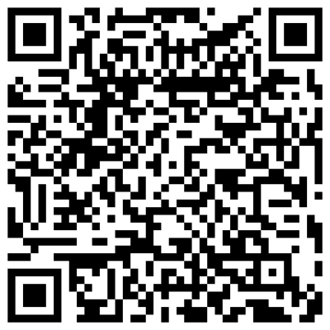
Conclusion
- Key takeaways
1. Reading can only guide you, doing it, is how you learn.
2. When you have an idea, run with it. If it doesn’t work, abandon it.
3. If you don’t know where to start, throw things at the wall, it will give you more insight and intuition on the problem.
4. New ideas and solutions to problems come at random times. You can do something else while waiting for them patiently.
5. It’s okay to look at how others approach similar issues, you don’t have to reinvent the wheel.
Cult of Done Manifesto ->

Slide 31
Future plans
1. Improve the TTS voice module.
2. Collect a personal dataset.
3. Flesh out Lucid’s character.
4. Make a decision-making model from scratch for Minecraft.
5. Rewrite / Reorganize the code to be more modular.
6. Write documentations for my future self.

Slide 32
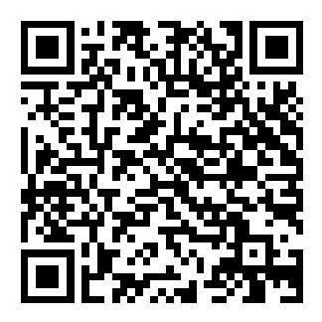
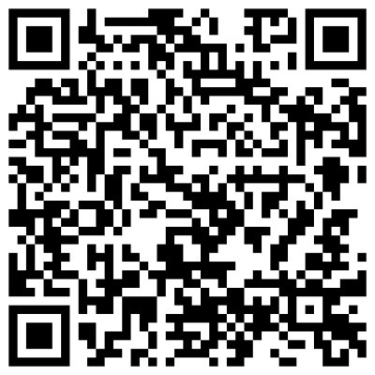
THANK YOU For listening
A List of All Links Shown->
The Project’s Github Repo ->

