Slide 1

IBM Data Science Capstone Project
Analysis on Space X Falcon 9

Slide 2

Table of contents
01
02
04
05
03
Executive Summary
Introduction
Methodology
You can describe the topic of the section here
You can describe the topic of the section here
You can describe the topic of the section here
06
Results
Conclusion
Appendix
You can describe the topic of the section here
You can describe the topic of the section here
You can describe the topic of the section here

Slide 3
01
Executive Summary

Slide 4
Executive Summary
This report mainly focuses on spacex falcon 9. Particularly, collected the data using API and webscraping, conducted data wrangling, exploratory data analysis using pandas and SQL, created visualizations and dashboard using plotly and dash, and created a model to predict if the falcon 9 will land successfully.

Slide 5
02
Introduction

Slide 6
Introduction
The cost of launching a rocket to space requires millions of dollars but aiming to lowert the cost would highly benefit the company. Providers cost more than 165 million dollars just to launch a rocket successfully, but spacex lower their cost by around 60%; the reason behind is the spacex can reuse the first stage of the process. Therefore, if we can determine if the first stage will land, the management would be able to approximately tell the cost of a launch.
This is the reason why we need to predict the successful launch using various machine learning algorithm. But before that, analysis, visualizations, and evaluations are needed to conclude.

Slide 7
03
Methodology

Slide 8
Methodology
Collected the data using API and Webscraping;
Wrangled data using Pandas;
Conducted Exploratory Data Analysis using Pandas and SQL;
Created Dashboard using Dash and Plotly;
Used Logistic Regression, SVM, Decision Tree, and KNN;
Tuned hyperparameters using GridSearch CV;
And Evaluated Machine Learning Model using Testing set and CV Scores
Data Collection
Data Wrangling
Exploratory Data Analysis
Create Dashboard for Stakeholders
Machine Learning Model Evaluation
Hyperparameter Tuning
Machine Learning Model Building

Slide 9
04
Results

Slide 10
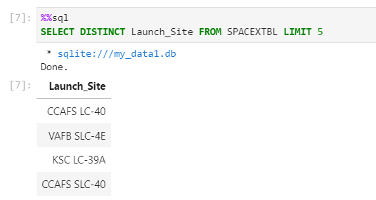
Results on the Analysis (SQL)
The spacex launch site are called, CCAFS LC -40, VAFB SLC-4E, KSC LC-39A, and CCAFS SLC-40

Slide 11
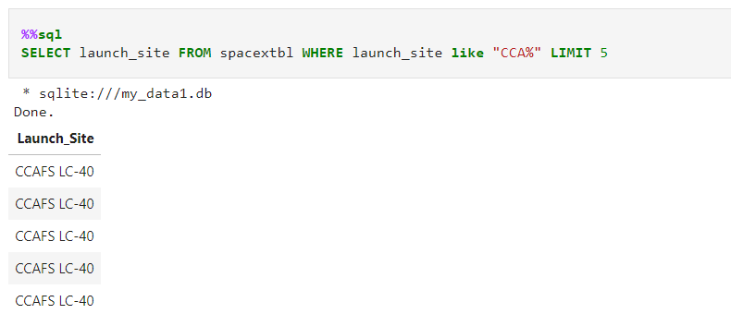
Results on the Analysis (SQL)
The first 5 observations are all CCAFS LC-40

Slide 12
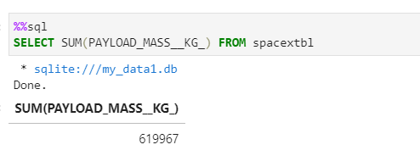
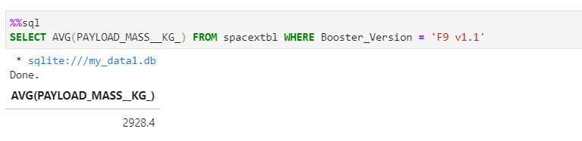
Results on the Analysis (SQL)
The total number of payload is 619967(KG)
The average payload is 2628.4 for F9 v1.1 Booster

Slide 13
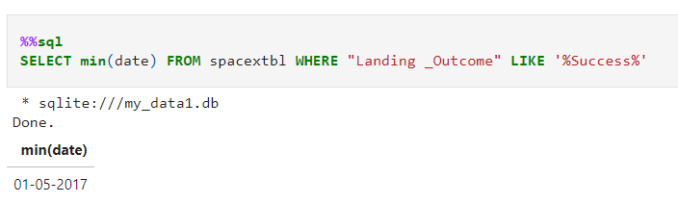
Results on the Analysis (SQL)
The very first successful landing on ground pad recorded was on january 5, 2017

Slide 14
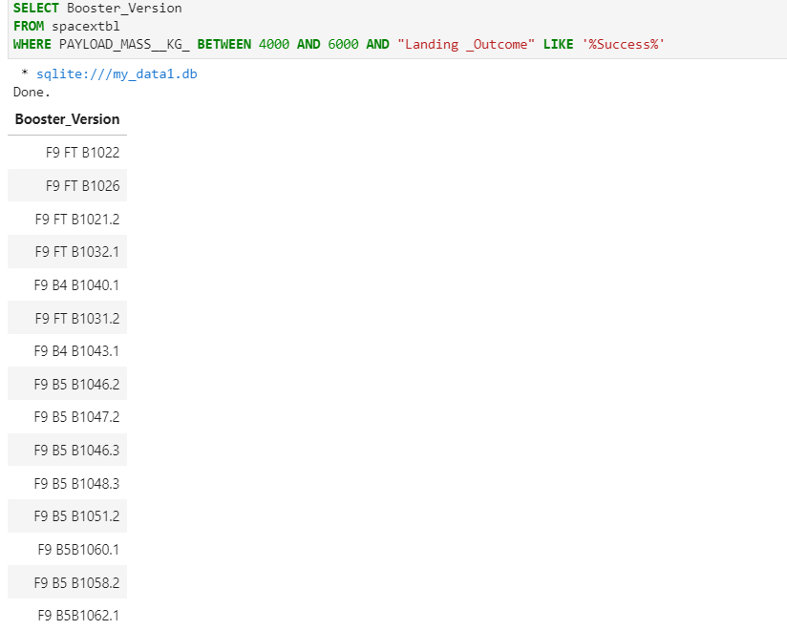
Results on the Analysis (SQL)
List of successful launch booster version between 4000-6000 payload mass in KG

Slide 15
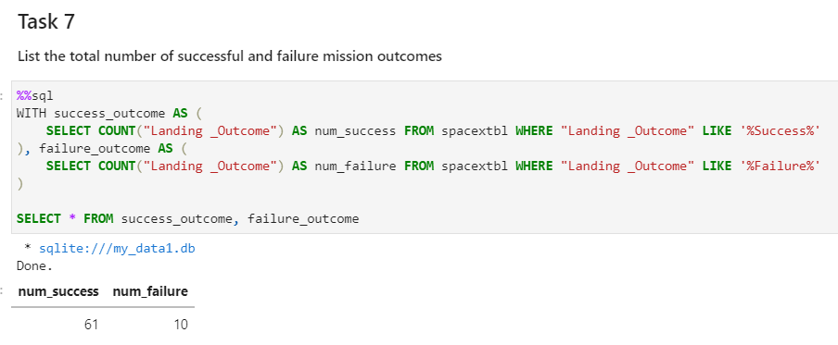
Results on the Analysis (Pandas)
There are 61 number of successful landing, while there are only 10 unsuccessful. The remaining are, controlled, prelude, and no attempt

Slide 16
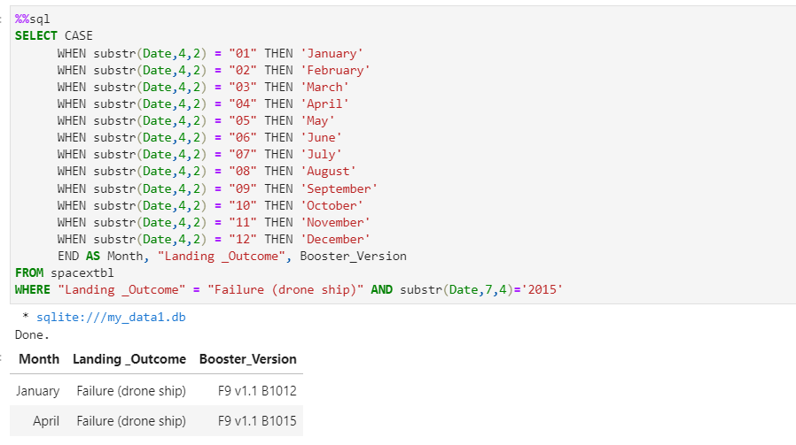
Results on the Analysis (Pandas)
The two (2) failure drone ship occurred in January and April.

Slide 17
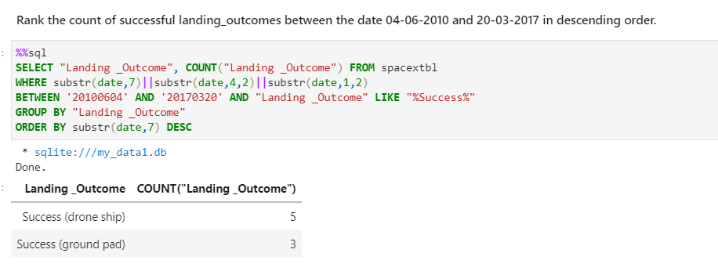
Results on the Analysis (Pandas)
Between April 06, 2010, and March 20, 2017, there are (5) successful drone ship, and three (3) successful ground pad

Slide 18
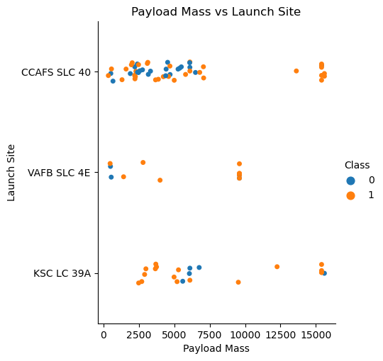
Results on the Analysis (Pandas)
There are no rocket launch in “VAFB SLC 4E” for heavy payload more than 10,000
The lower the payload mass, there’s a high probability that a launch won’t succeed
There are more successful launch in VAFB SLC 4E, and KSC LC 39 A.
There are more attempt in CCAFS SLC 40

Slide 19
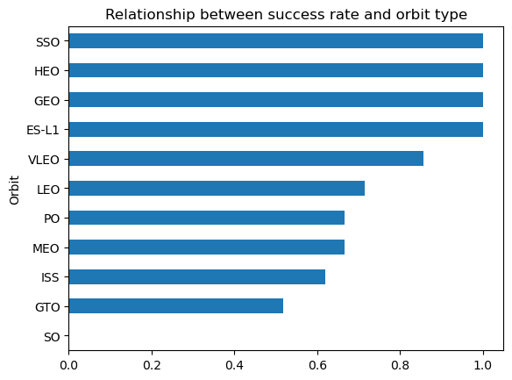
Results on the Analysis (Pandas)
SSO, HEO, GEO, and ES-L1, have a 100% launch success rate.
Success rate of GTO is only approximately 50%
LEO, PO, MEO, ISS, and VLEO’s success rate are ranging from 60% to 90%

Slide 20
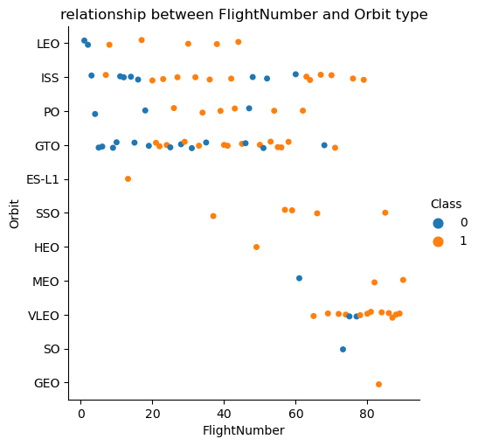
Results on the Analysis (Pandas)
LEO is related to the number of flights; as the number of flights increases LEO’s success rate also increases
However, this lack information to conclude that the orbit has relationship to the number of flights

Slide 21
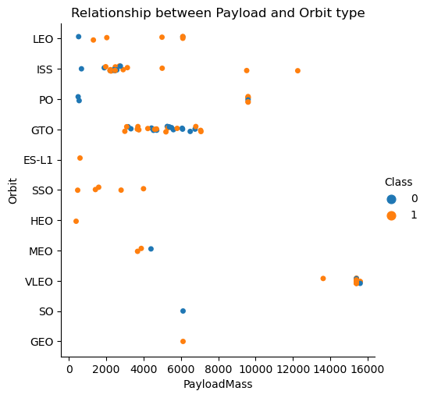
Results on the Analysis (Pandas)
With heavy payloads the successful landing rate are more for LEO, and ISS.
In GTO, the amout of payload is not a factor to determine a successful landing.

Slide 22
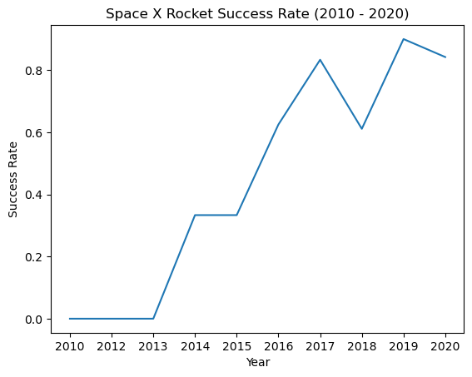
Results on the Analysis (Pandas)
After 2013, the successrate of SpaceX kept on increasing.

Slide 23
Results on the Analysis (Pandas)
With heavy payloads the successful landing rate are more for LEO, and ISS.
In GTO, the amout of payload is not a factor to determine a successful landing.

Slide 24
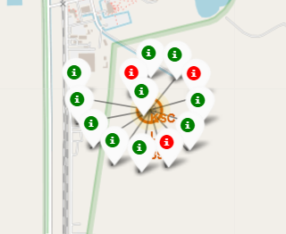
Results on the Analysis (Geographical)
KSC LC-39A Launch Site
The KSC LC-39A Has 3 unsuccessful landing but have 10 successful landings.

Slide 25
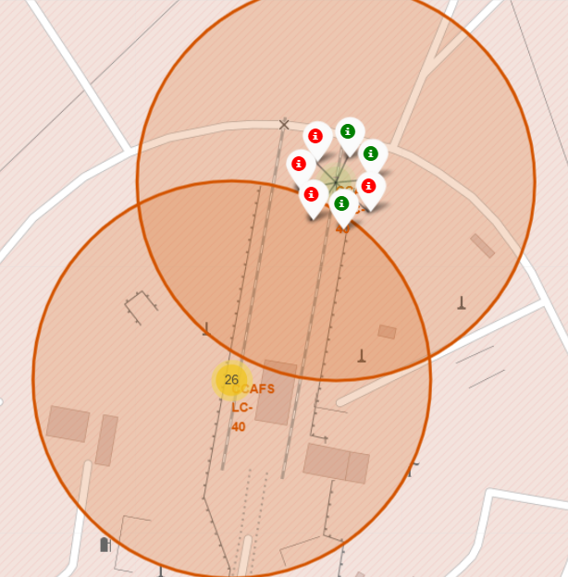
Results on the Analysis (Geographical)
The CCAFS SLC – 40 has 4 unsuccessful landings and 3 successful landings

Slide 26
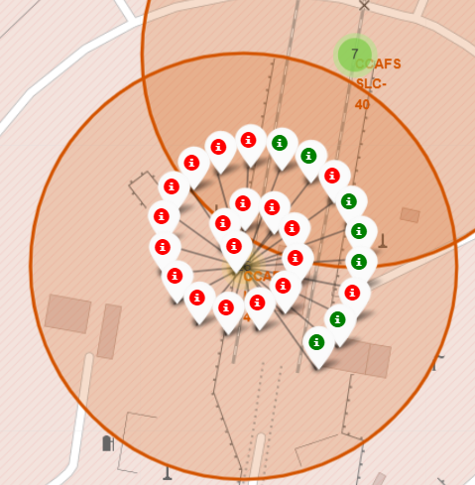
Results on the Analysis (Geographical)
The CCAFS LC – 40 has the majority of unsuccessful landings. With only seven (7) successful landings out of 26 attempts.

Slide 27
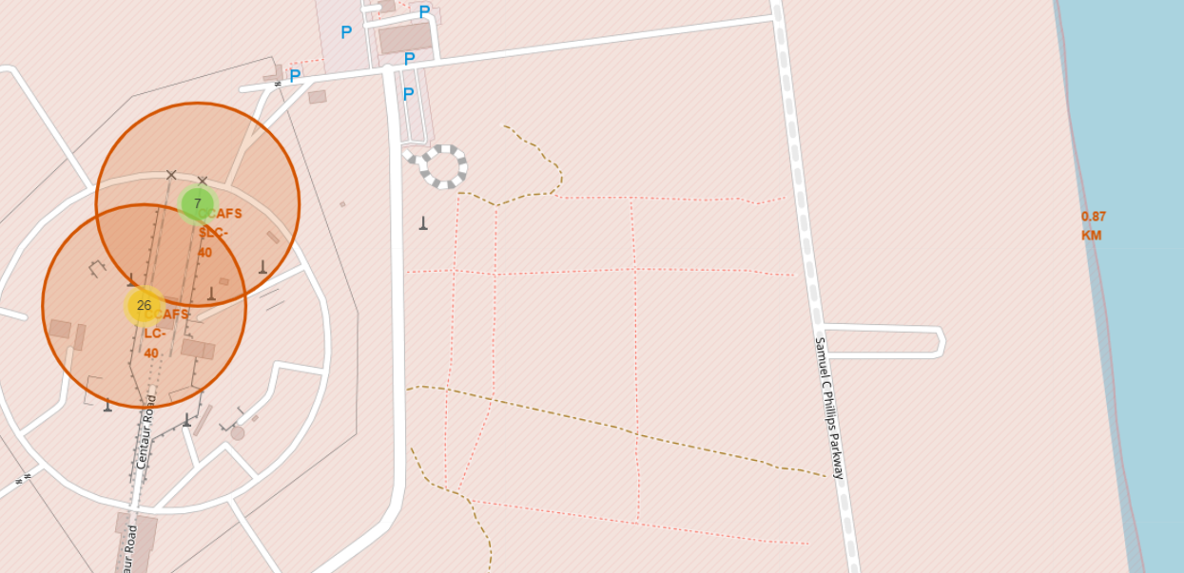
Results on the Analysis (Geographical) - CCAFS SLC-40
The coastline is only 0.87 km from East.

Slide 28
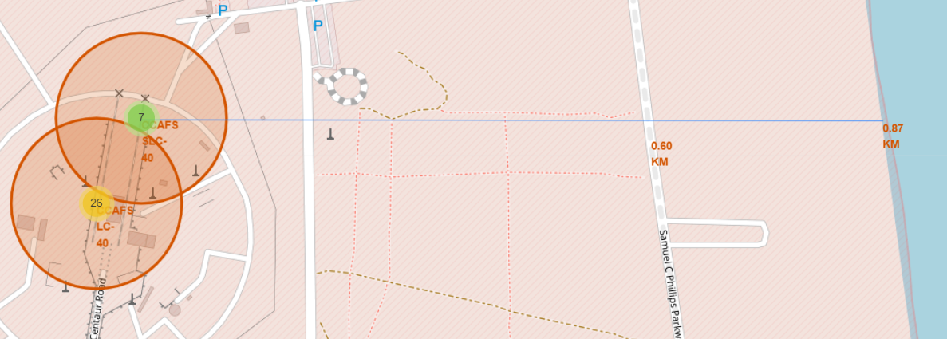
Results on the Analysis (Geographical) - CCAFS SLC-40
The nearest highway is only 0.60KM far

Slide 29
Results on the Analysis (Geographical) - CCAFS SLC-40
The nearest highway is only 0.60KM away

Slide 30
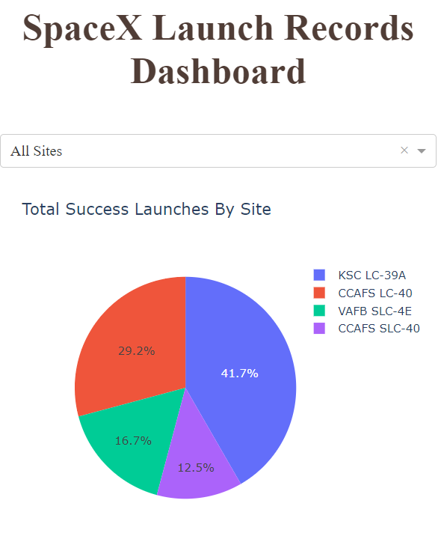
Results on the Analysis (Dashboard)
In all sites, the sites with the highest successful landing rate was the KSC LC-39A

Slide 31
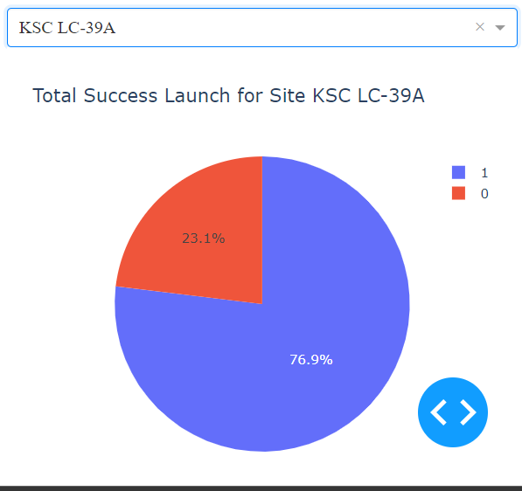
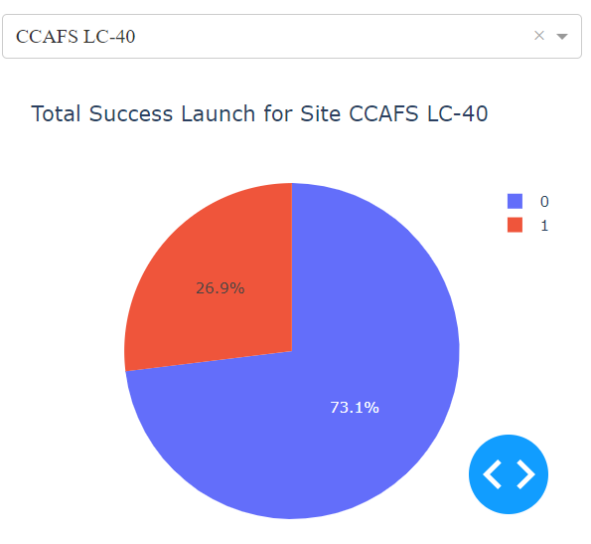
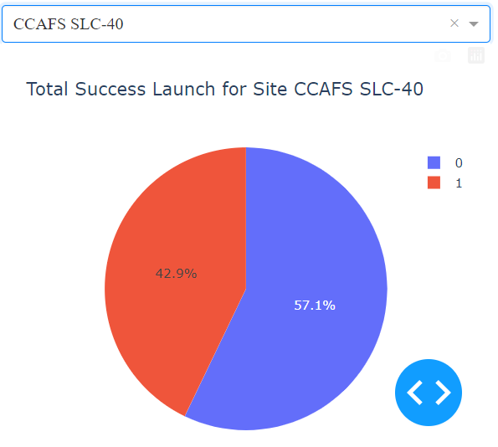

Results on the Analysis (Dashboard)
CCAFS SLC-40 has the lowest landing success rate. While the other three have over 60% success rates

Slide 32
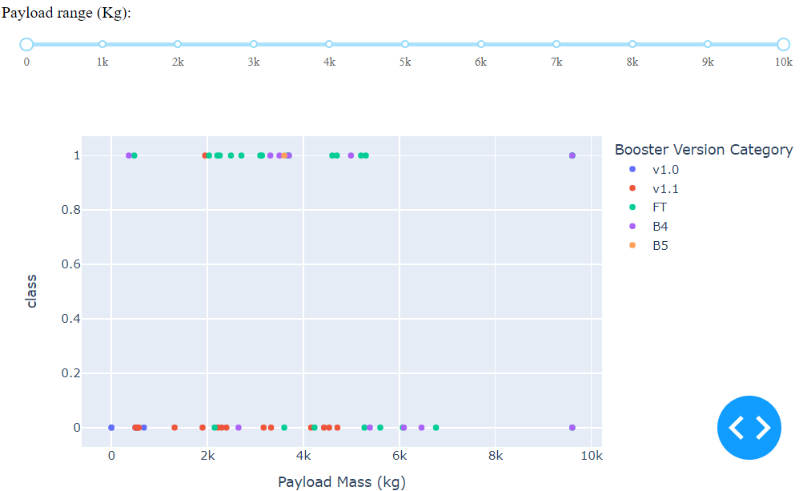
Results on the Analysis (Dashboard)
There are more attempt using low payloads
it also shows that the success for massive payloads is lower than that for low payloads.
Lastly, v 1.0, and B5 are not yet launched with massive payloads

Slide 33
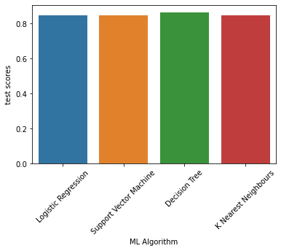
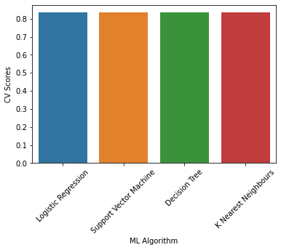
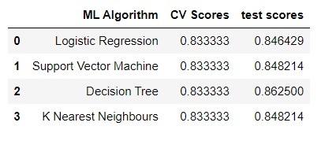
Results on Model Evaluation
The tables below shown are scores from testing and cross validation using GridSearch CV. Specifically, lookingat the CV Scores, all accuracies are the same but in testing, the decision tree yield the highest percentage (86.25% Accuracy)

Slide 34
Results on Model Evaluation (Cont.)
The best hyperparameter of the decision tree are the following:
Criterion – gini
max_depth – 6
Max_features – auto
Min_samples_leaf – 4
min_samples_split – 10
Splitter - random
This hyperparameter yield a 86.25 % accuracy for our testing data

Slide 35
05
Conclusions

Slide 36
Conclusion
Even if the decision tree has the highest accuracy on the testing or the evaluation. All confusion matrix of every model are just the same. Therefore, more data is needed to further analyze the machine learning model and to choose what is the best machine learning model for this scenario

Slide 37
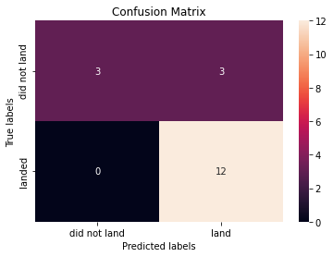
Conclusion
Moreover, there are 15 correct predictions (True Positive and True Negative) and there are 3 wrong predictions (False Negatives).
This tell us that using 18 observations, our model correctly classified 15 observations.

Slide 38
06
Appendix

Slide 39
Appendix
Machine Learning Model Link: https://jp-tok.dataplatform.cloud.ibm.com/analytics/notebooks/v2/2cf6ae47-f6c2-4f44-a1fd-51e13f0dabe1/view?access_token=62b4431f817148ceaab078215a2d44ef90d669d80cc551a32b01302a7410ed50
Github Link: https://github.com/Justinjay282/IBM-Data-Science-Certificate-Capstone-Project

