Slide 1
Warta or not?
Mikołaj Grzywacz

Slide 2
NLP
How to represent text?

Slide 3
NLP
How to represent text?
Vectorization
Bag of Words

Slide 4
Bag of words
Warta wprowadziła nową ofertą ubezpieczeń k
Warta stworzyła ofertę gwarancji środowiskowej
[[0 1 1 0 0 1 1 1 0]
[1 0 0 1 1 0 1 0 1]]
{'warta': 6,
'wprowadziła': 7,
'nową': 1,
'ofertą': 2,
'ubezpieczeń': 5,
'stworzyła': 4,
'ofertę': 3,
'gwarancji': 0,
'środowiskowej': 8}
Note:
Information is lost -> sequence

Slide 5
NLP
How to represent text?
Vectorization
Bag of Words
TF-IDF

Slide 6
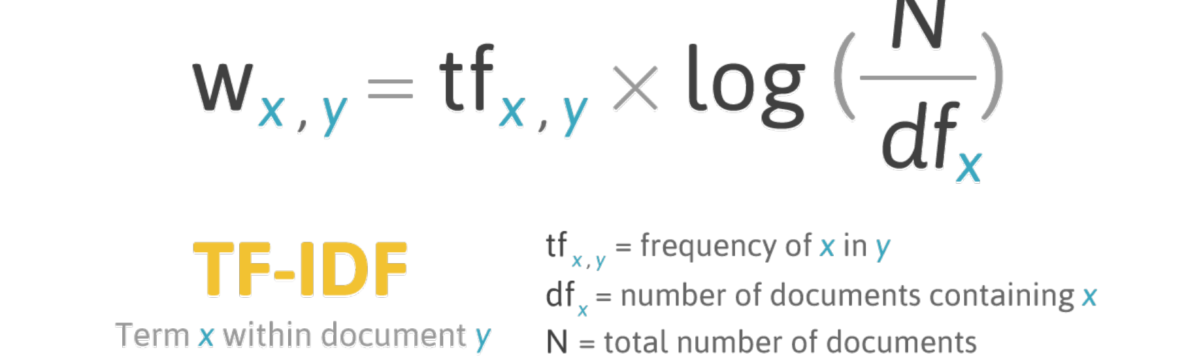
TF-IDF

Slide 7
TF-IDF
Looks at how important the word is to the document (scraped website) in a collection of documents.
Still we lose information about ordering.

Slide 8
NLP
How to represent text?
Vectorization
Bag of Words
TF-IDF
Text normalization techniques

Slide 9
Text normalization
Context-independent normalization: removing non-alphanumeric text symbols
All lowercase
Removing stop words
Canonicalization: convert data to "standard", "normal", or canonical form.
Stemming: extracts the word's root.
Lemmatization: transforms word to its lemma.

Slide 10
NLP
How to represent text?
Vectorization
Bag of Words
TF-IDF
Preprocessing techniques
Making predictions, for example:
SVM
XGBoost

Slide 11
NLP
What if we need information about word ordering?

Slide 12
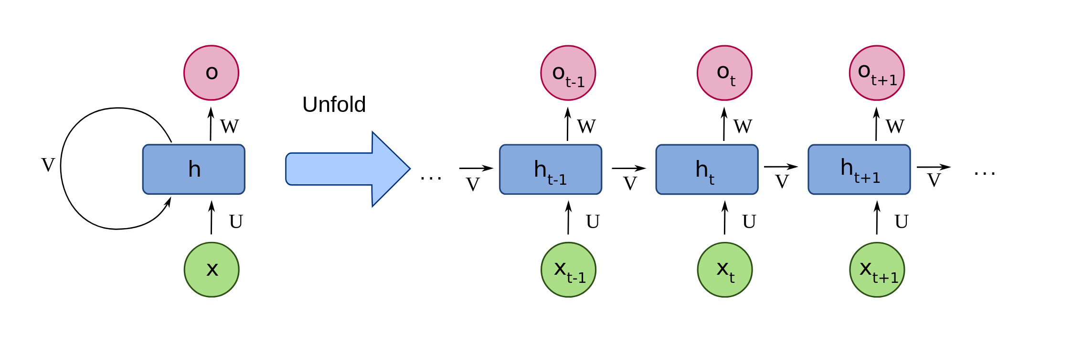
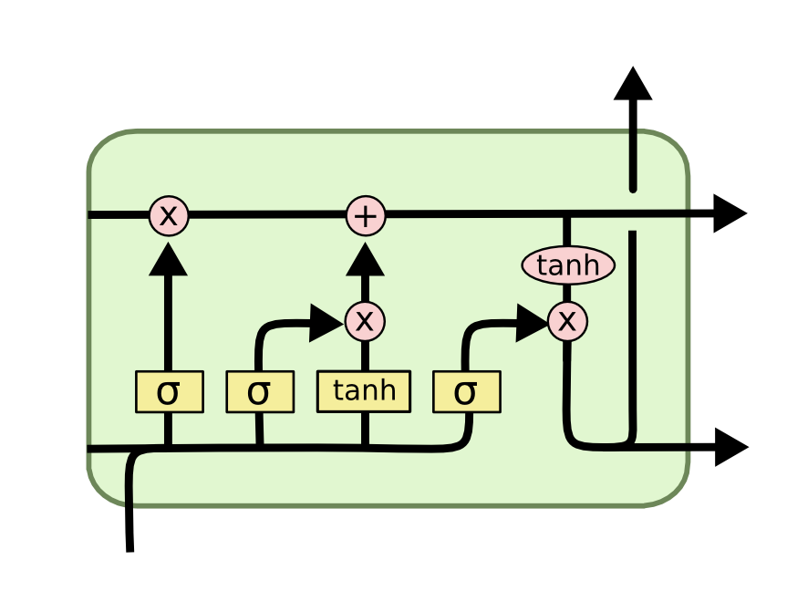
RNN
LSTM

Slide 13
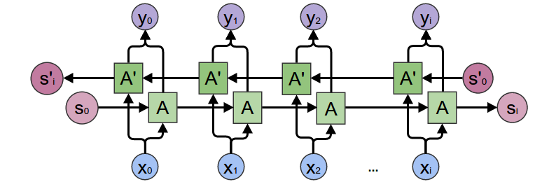
Transformers
Why LSTMs are not that great?
LSTMs are very slow
Bidirectional LSTMs are not “really bidirectional”

Slide 14
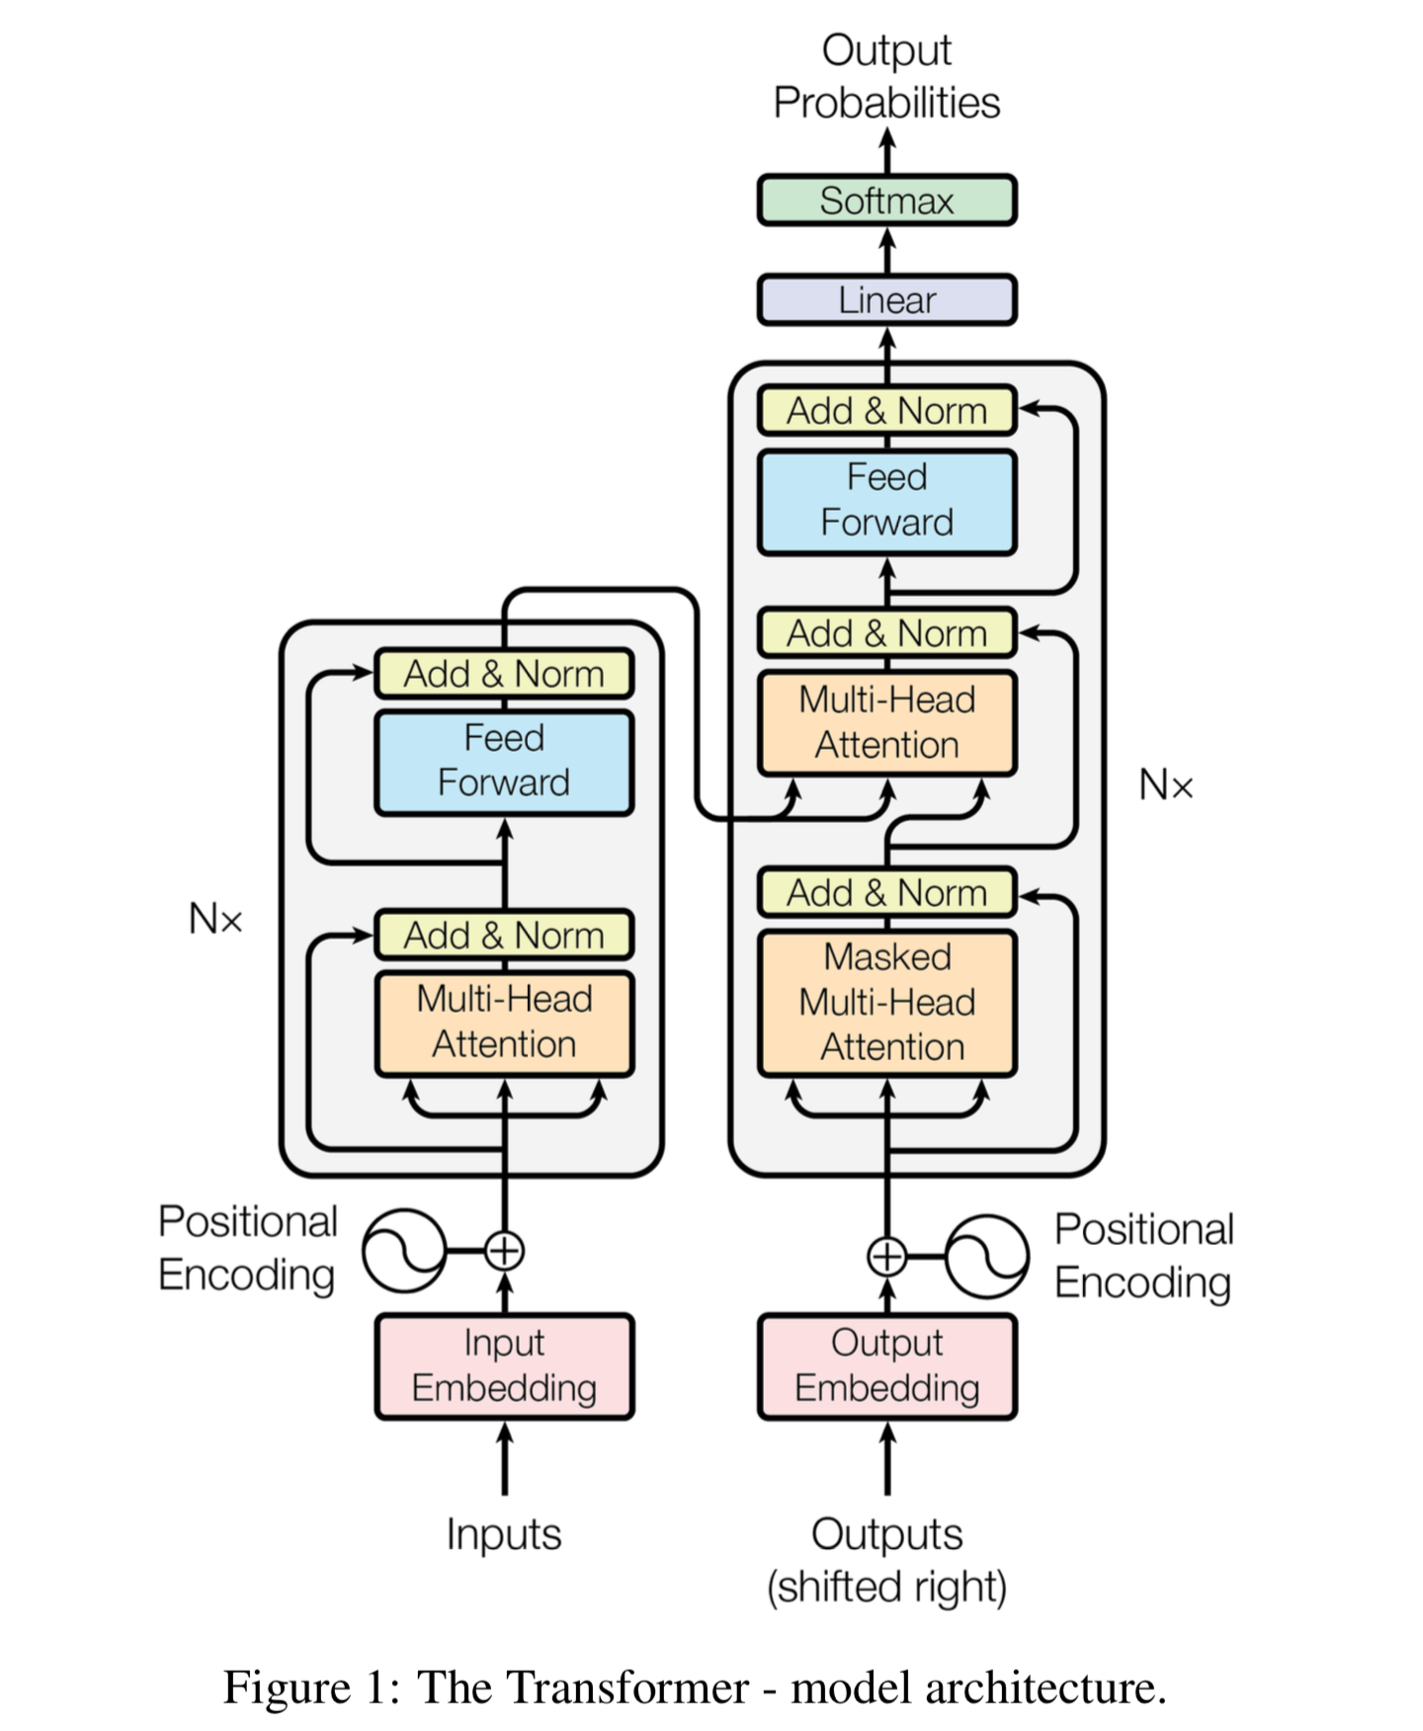
Transformer
architecture
Encoder
Decoder

Slide 15
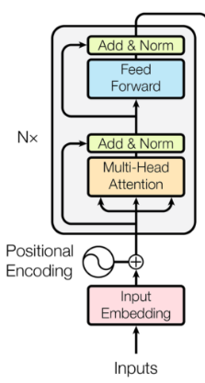
Encoder
Input Embedding
Positional encoding

Slide 16
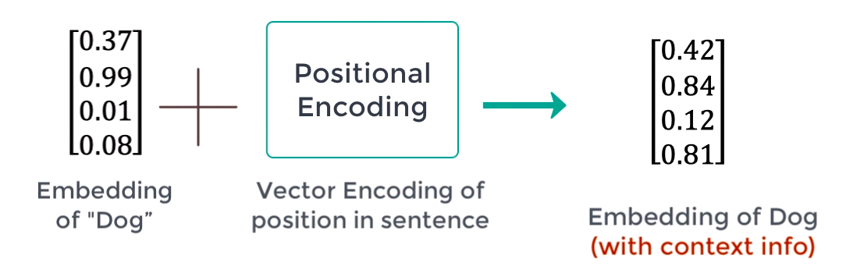
Encoder - input encoding

Slide 17
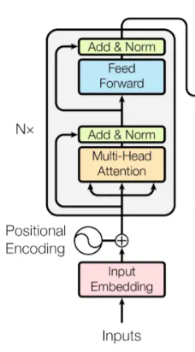
Encoder
Input Embedding
Positional encoding
Attention block

Slide 18
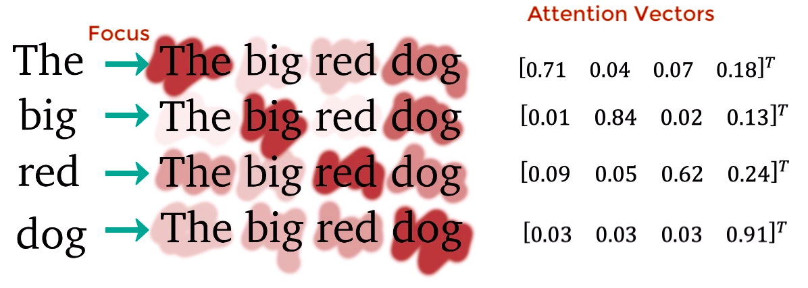
Encoder - attention

Slide 19
Encoder
Input Embedding
Positional encoding
Attention block
Feed forward

Slide 20
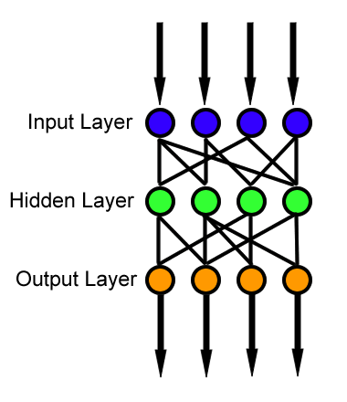
Encoder - feed forward

Slide 21
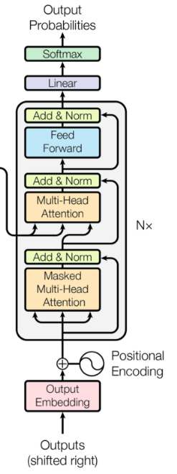
Decoder
What is the input?
Input Embedding
Positional encoding
Attention block 1 (decoder)
Attention block 2 (encoder-decoder)
Feed forward
Linear + Softmax

Slide 22
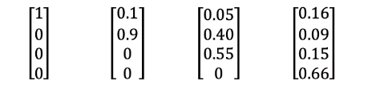
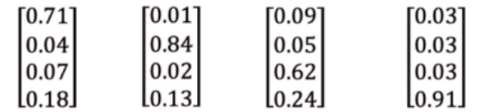
Decoder -
attention blocks
Ten duży czerwony pies
Takes encoder outputs
Takes attention last layer
Outputs attention between all words
Output - next word!
This big red dog

Slide 23
Transformers - attention (multi - head)
What is multi - head?

Slide 24
Transformers - attention (multi - head)
What is multi?
Runs through attention generation mechanism in parallel several times.
Why?

Slide 25
Transformers - attention (multi - head)
What is multi?
Runs through attention generation mechanism in parallel several times.
Why?
Intuitively it helps model to attend to different part of sentence differently
Long term vs short term dependencies
Then concatenate results

Slide 26
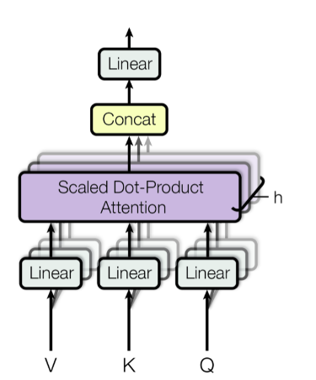
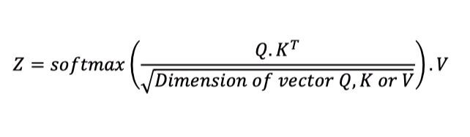
Transformers - attention (multi - head)
V K Q - different input vectors for word.
Concat is needed to bring multiple attention vectors to a single vector.

Slide 27
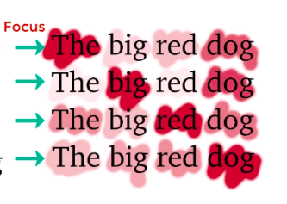
Decoder - attention (masked?)
This
big
red
dog

Slide 28
BERT
What is BERT then?

Slide 29
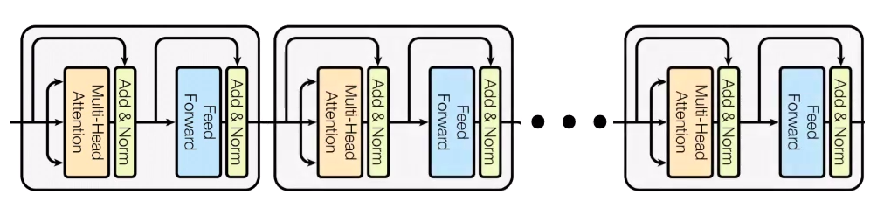
BERT
Bidirectional Encoder Representation from Transformers
Stack encoders!!!

Slide 30
BERT
Problems to solve in NLP:
Translation
Sentiment analysis
Question answering
Text summarization

Slide 31
BERT
Problems to solve in NLP:
Translation
Sentiment analysis
Question answering
Text summarization
How to solve them:
Pre train BERT to understand language
Fine Tune BERT for specific task

Slide 32
BERT - pretraining
Tries to learn: What is language? What is context?

Slide 33
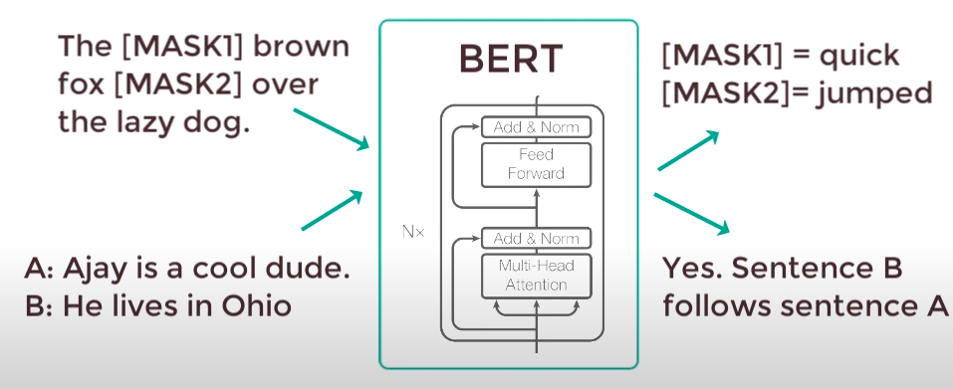
BERT - pretraining (1)
How to learn - what is language?
Masked Language Modeling - MLM Next Sentence Prediction - NSP

Slide 34
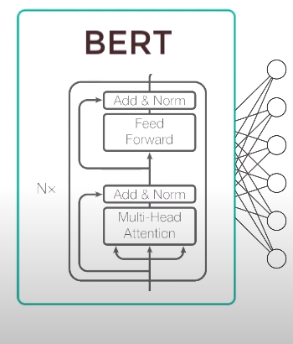
BERT - fine tuning (1)
Supervised training to specific task
Two approaches
Either way, only needs to learn new weights

Slide 35
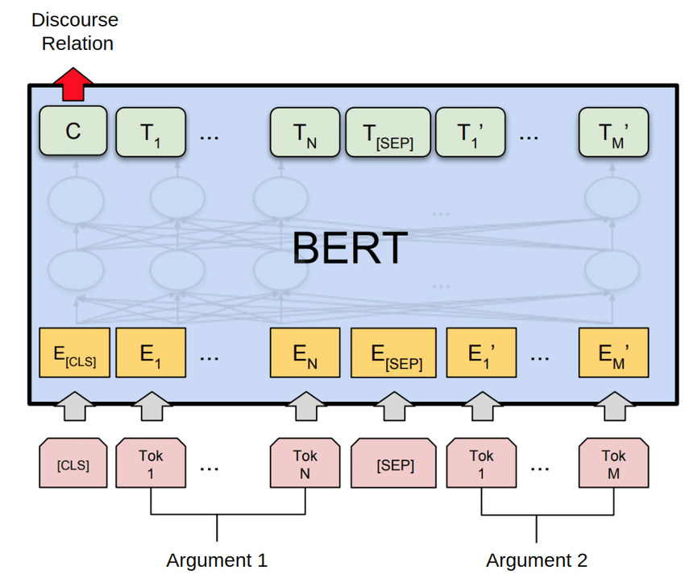
BERT - pretraining (2)
Word token inputs

Slide 36
BERT - pretraining (2)
Word token inputs
Embeddings

Slide 37
BERT - pretraining (2)
Word token inputs
Embeddings
Output (C, T)

Slide 38
BERT - pretraining (2)
NSP
Understand relationships
50% / 50%
MLM
“Deeply bidirectional”
15% masked
80% / 10% /10%
Why?

Slide 39
BERT - pretraining (2)
Word token inputs
Embeddings
Output (C, T)
What exactly are this embeddings?

Slide 40
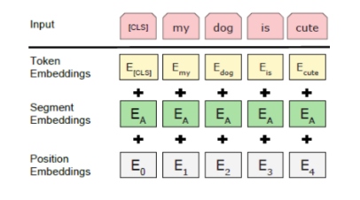
BERT - pretraining (2)
Embeddings for BERT
Uses WordPiece algorithm
Generates around 50000 tokens
Overview
Example:
text = "Here is the sentence I want embeddings for."
marked_text = "[CLS] " + text + " [SEP]"
the tokenized sentence looks like,
['[CLS]', 'here', 'is', 'the', 'sentence', 'i', 'want', 'em', '##bed', '##ding', '##s', 'for', '.', '[SEP]']

Slide 41
BERT - pretraining (2)
Word token inputs
Embeddings
Output (C, T)
What exactly are this embeddings?
Final look at result layer

Slide 42
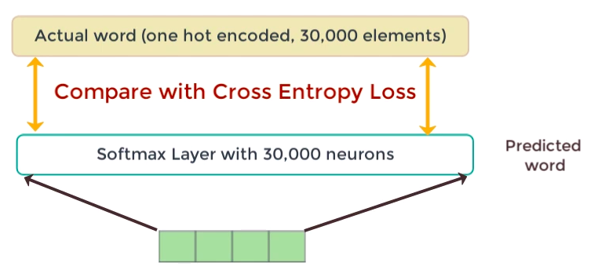
BERT - pretraining (2)
How does the single T output look like?
Calculate loss only on masked words.

Slide 43
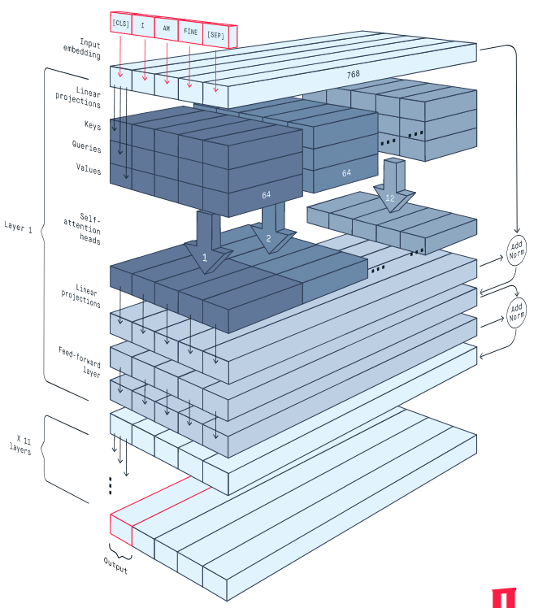
BERT - overview
12 successive transformer layers
Encoders only, no decoders
12 attention heads for each layer
The total number of parameters is 110 million
Outputs one vector for each xi (size 768)

Slide 44
ROBERTA
Robustly Optimized BERT Pre-Training Approach
Why ROBERTA is better:
More training data (16G vs 160G)
Uses dynamic masking pattern instead of static masking pattern
Replacing next sentence prediction objective with full sentences without NSP
Training on Longer Sequences

Slide 45
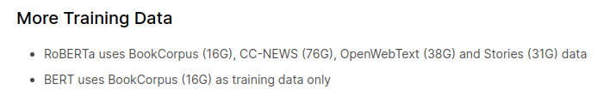
ROBERTA

Slide 46
ROBERTA - dynamic masking
In bert sequences are masked once (static masking)
Same pattern is used in all training steps.
Duplicate data 10 times -> 10 different patterns (40 epochs)
Dynamic masking -> generated every time sequence is passed

Slide 47
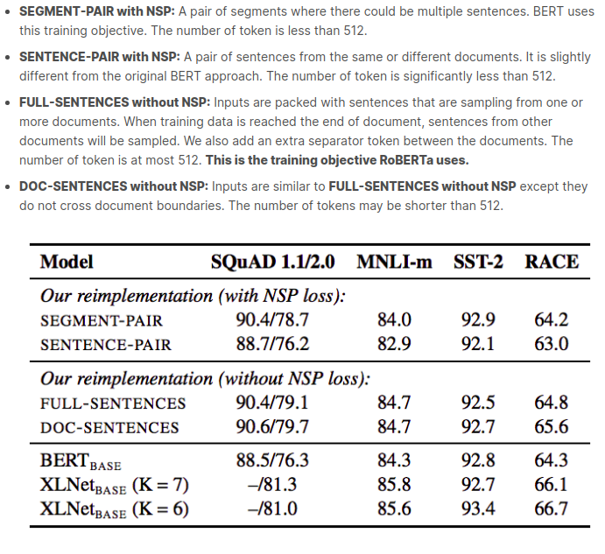
ROBERTA -
Is NSP needed?

Slide 48
ROBERTA

Slide 49
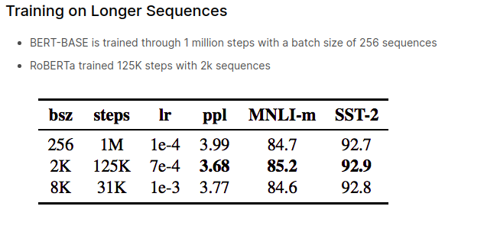
ROBERTA

Slide 50
References
https://paperswithcode.com/method/wordpiece
https://peltarion.com/knowledge-center/documentation/modeling-view/build-an-ai-model/blocks/english-bert-encoder
https://peltarion.com/knowledge-center/documentation/modeling-view/build-an-ai-model/blocks/tokenizer
https://www.datasciencecentral.com/profiles/blogs/top-nlp-algorithms-amp-concepts
https://www.youtube.com/watch?v=TQQlZhbC5ps
https://www.kaggle.com/c/tweet-sentiment-extraction/discussion/157801

