Slide 1

Types of Mobile Apps
IT Elective 4
Myk Kenneth Escala
Write your message

Slide 2
Introduction
Types of Mobile Apps
11:25 AM
You may discover if a company has a web app or a hybrid app by reading about other brands who boast about how they built their native app from the ground up. But, exactly, what do those terms imply?
I intend to explain the distinctions between the three types and examine the benefits and drawbacks of each along the road so you can make an informed decision.
Write your message

Slide 3
Types of Mobile Apps
11:25 AM
Native apps
Java, Kotlin, Python, Swift, Objective-C, C++, and React.
12:45 PM
Web Apps
HTML5, CSS, JavaScript, Ruby
1:45 PM
Hybrid Apps
Ionic, Objective C, Swift, HTML5

Slide 4
Native Apps
01
Types of Mobile Apps
9:14 AM
10:25 AM
1:17 PM
apps are built specifically for a mobile device’s operating system
Write your message

Slide 5
Pros
Cons
VS.
Native Apps
9:22 AM
12:20 PM
Faster, Better Performance
Faster, Better Performance
Native UI
Native UI
Can access device features
Can access device features
Write your message

Slide 6
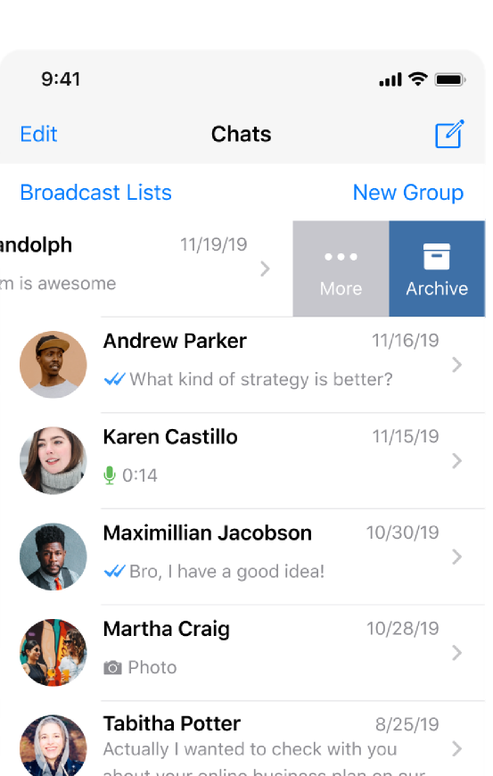
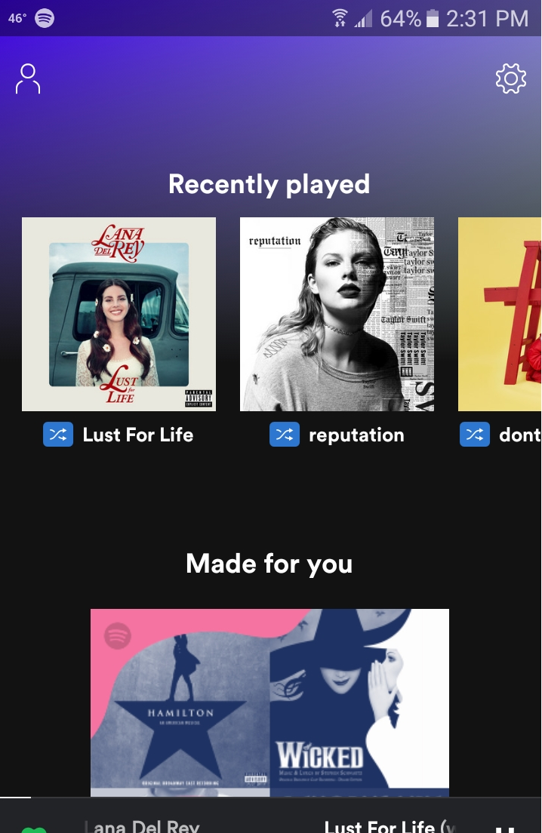
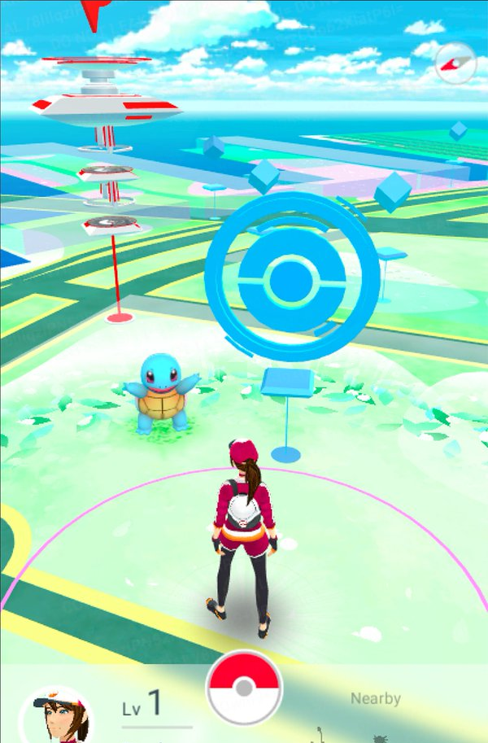
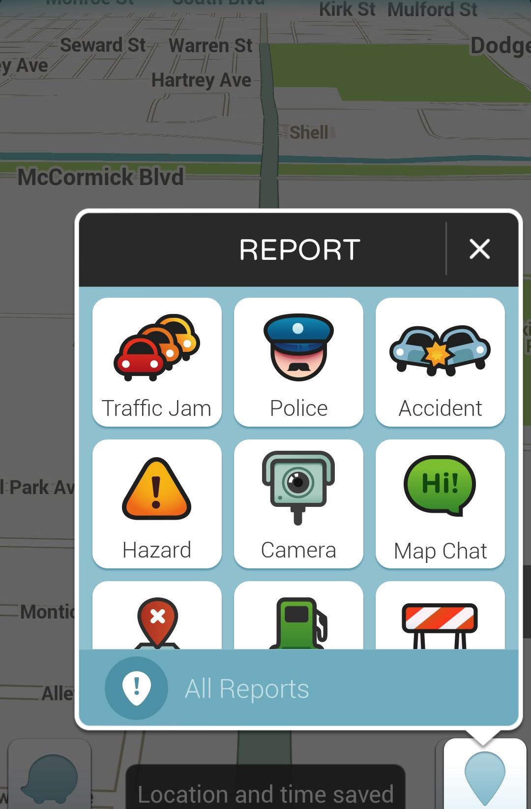
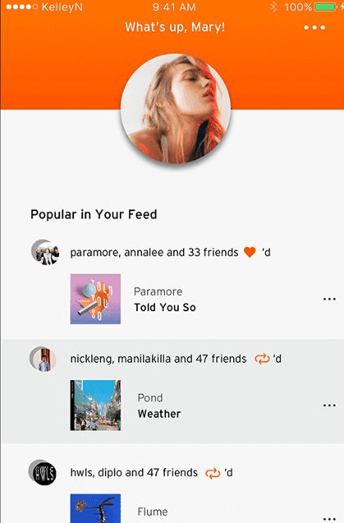
Native Apps
WhatsApp | Spotify | Pokemon Go | Waze | Sound Cloud

Slide 7
Web Apps
02
Types of Mobile Apps
9:14 AM
10:25 AM
1:17 PM
accessed via a web browser on your mobile device
Write your message

Slide 8
Pros
Cons
VS.
Web Apps
9:22 AM
12:20 PM
Performs on all devices
Browser dependent
Easier to maintain
Needs internet
Small storage usage
Device integration is optional
Write your message

Slide 9
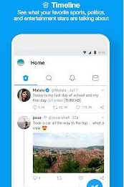

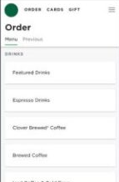
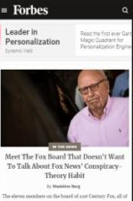
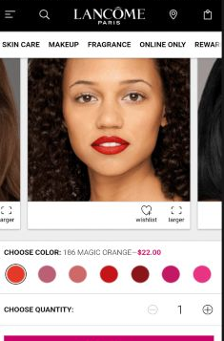
Web Apps
Twitter Lite | Trivago | Starbucks | Forbes | Lancome

Slide 10
Hybrid Apps
03
Types of Mobile Apps
9:14 AM
10:25 AM
1:17 PM
web apps that look and feel like native apps
Write your message

Slide 11
Pros
Cons
VS.
Hybrid Apps
9:22 AM
12:20 PM
Quicker/Cheaper to build
Faster, Better Performance
Load quickly
Each element is download
Less code to maintain
Some devices cant have all features
Write your message

Slide 12
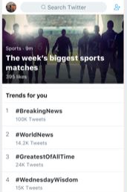
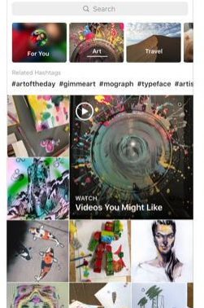
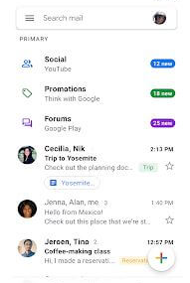
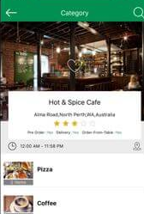
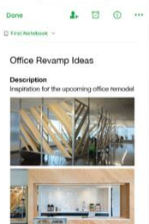
Hybrid Apps
Twitter | Instagram | GMail | Remote POS | Evernote

Slide 13
That’s it. Thanks!
IT Elective
Write your message

