Slide 1

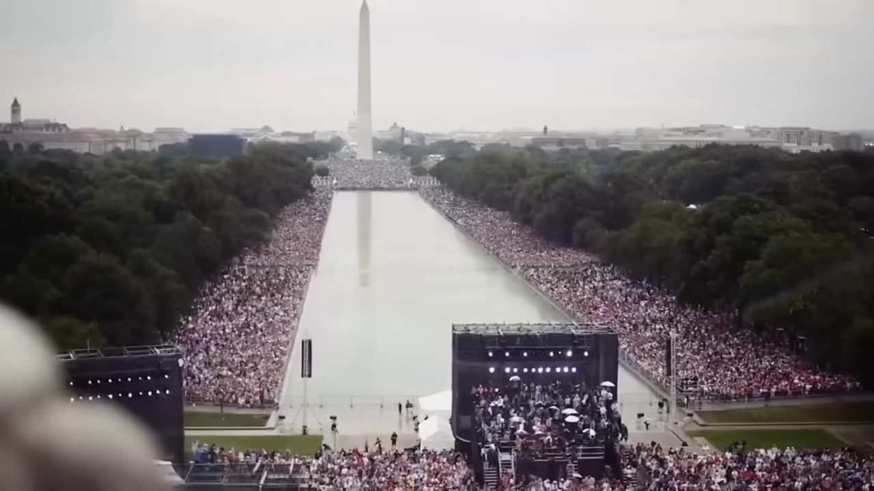


welcome
16:40
Home
Search … (with predict)
Prayer Of The Day:
“Heavenly Father, bless us with the wisdom to interpret data accurately and ethically. May our insights lead to informed decisions that benefit society and foster progress.
”
welcome
16:40
Home
Search …
What to Pray For?
- Health
- Justice
- Equity
…
My Journey So Far
- Prayers Read: 0
- Prayers Answered: 0
Prayers Resonated: 0
Completion: 0%
My rating: beginner
Prayer of the Day:
“Beloved Creator, I seek your clarity and guidance as I make important decisions in my life. Clear my mind of doubts and fears, and illuminate the path before me. Grant me the wisdom to choose wisely. Amen.
Categories
Creativity
Relationships
…
Swipe
Swipe
My Journey So Far
Swipe
The Green swipe bar changes background images. The pink swipe bar changes the menu’s for the users page
Swipe

Slide 2

welcome
16:40
Home
Search … (with predict)
My Journey So Far: Prayers Read: 0 Prayers Answered: 0 Prayers Resonated: 0 Completion: 0%
Categories: Health Relationships Protection
Prayer Of The Day: “Loving God, wrap your arms around me and comfort me in my time of need. Give me the strength to endure this trial and the hope to see a brighter tomorrow. I trust in your love and guidance. Amen.” ”
Pinned: God Bless America Prosperity A bright future ...
Recent: A Bright Future Prosperity God Bless America ...
Swipe

Slide 3

Pray 4 Me
Personalize
Home
Categories
Pray 4 Me
Pinned Prayers
Recent Prayers
My Journey So Far
Personalize
Prayer Title: Tess
Prayer Description: A prayer for the future in times of uncertainty...
Prayer Title: Tess
Prayer Description: A prayer for the future in times of uncertainty...
My Pinned Prayers
Swipe
Home
Prayer Title: Tess
Prayer Description: A prayer for the future in times of uncertainty...
Prayer Title: Tess
Prayer Description: A prayer for the future in times of uncertainty...
Prayer Title: Tess
Prayer Description: A prayer for the future in times of uncertainty...
Categories
Prayer Title: Tess
Prayer Description: A prayer for the future in times of uncertainty...
Recent Prayers
My Journey So Far
Prayer Title: Tess
Prayer Description: A prayer for the future in times of uncertainty...
Prayer Title: Tess
Prayer Description: A prayer for the future in times of uncertainty...
Landscape & Large screen mode: Swipe Left Right to view more options. Up Down changes background images. For portrait- visa versa.

Slide 4




My Background Images:
”
Swipe
Swipe

