Slide 1
Hardware and software helper
Application presentation, Daniel Selmes

Slide 2
Product Specification
After consulting with the client to obtain information about the desired product with B. Carpenter (the assignment sheet), we have concluded that the following information needs to be included in the product:
Elements of a computer system – Hardware, Software, Personnel, Procedures, Data
Functions of input, output, processing, storage and control in hardware
How different hardware achieves its purpose
Trends and developments in the hardware world
The Fetch-Execute-Decode cycle of a CPU and its inner workings
The existence of minimum hardware requirements to run software
As well as these things, the product should be neat looking, easy and intuitive to use, and contain multiple types of media including text, images and video to engage the user.

Slide 3
Screen design, and prototypes
Storyboard, Example of application use, Prototype designs and comments.

Slide 4
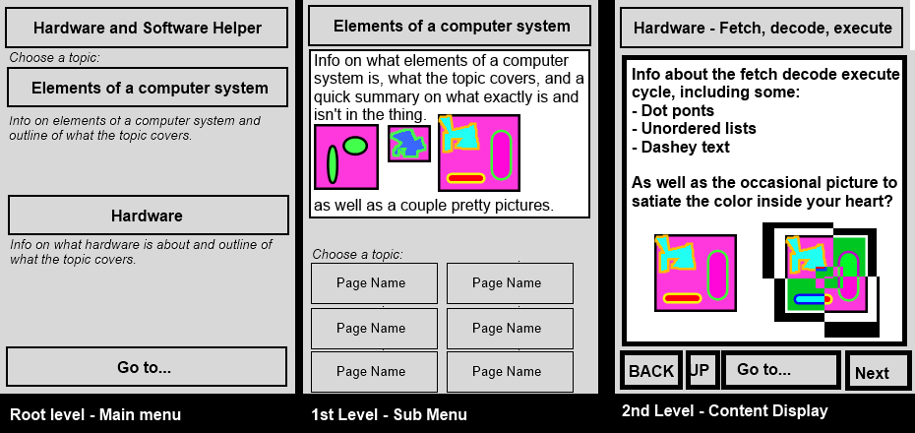
Storyboard
The aim of the design was to have a simplistic and clean approach similar to the newer Microsoft user interfaces. This meant thin sans-serif fonts, box-shaped controls and the application should be small, so it can float above other windows and be used as a reference without intruding on the screen.

Slide 5
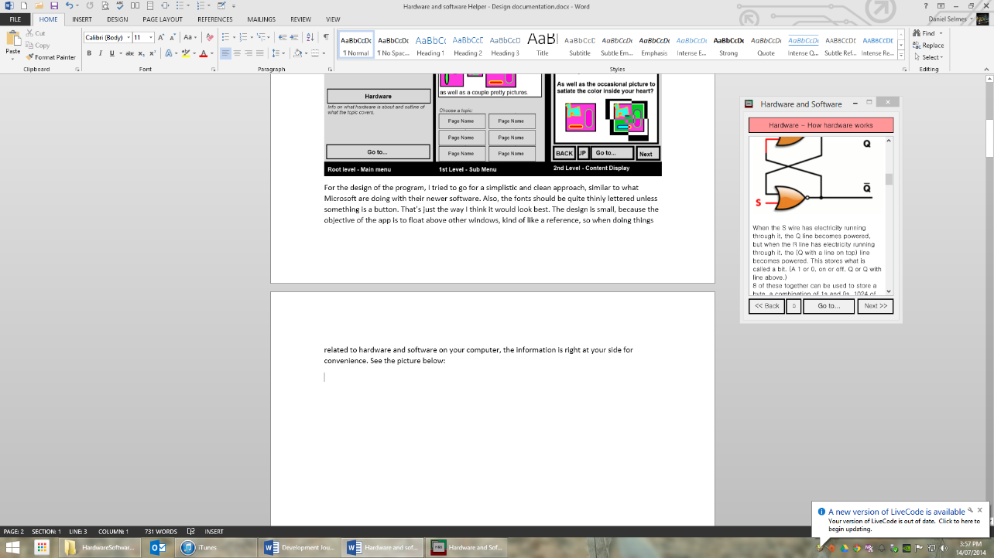
Screen design - Reference style application

Slide 6
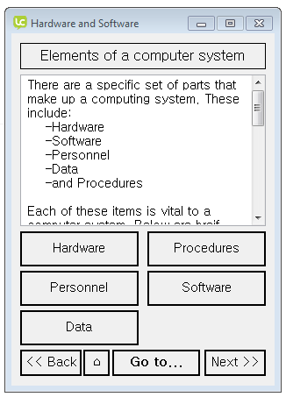
Prototype - Main Menu
This is the start-up screen, and the main menu. It is the first screen the user will see, and is designed to guide them to the section of the application they wish to go to. There is also a drop-down to jump to any screen, for users to easily find what they are looking for in only 2 clicks.

Slide 7
Prototype – Module menu
This is the module menu. It shows the user some basic info about the module that the user is viewing, and has buttons to jump to each of the pages in the module. It also has the familiar go to, back, next and home buttons for quickly navigating to where the user wants to go. It’s also designed with a similar layout to the content pages to help the user feel at home with the interface as soon as possible.

Slide 8
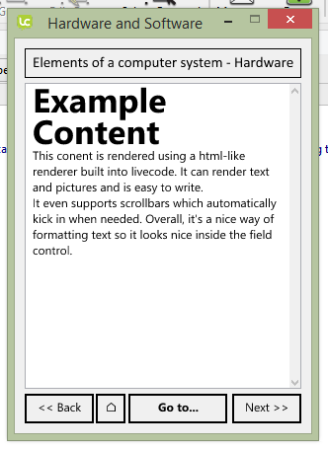
Prototype – Content Page
This screen is an example of a content page with just some text, but pictures can easily be implemented in the future. The menu pages eventually lead to this page, see the navigation hierarchy for more info.

Slide 9
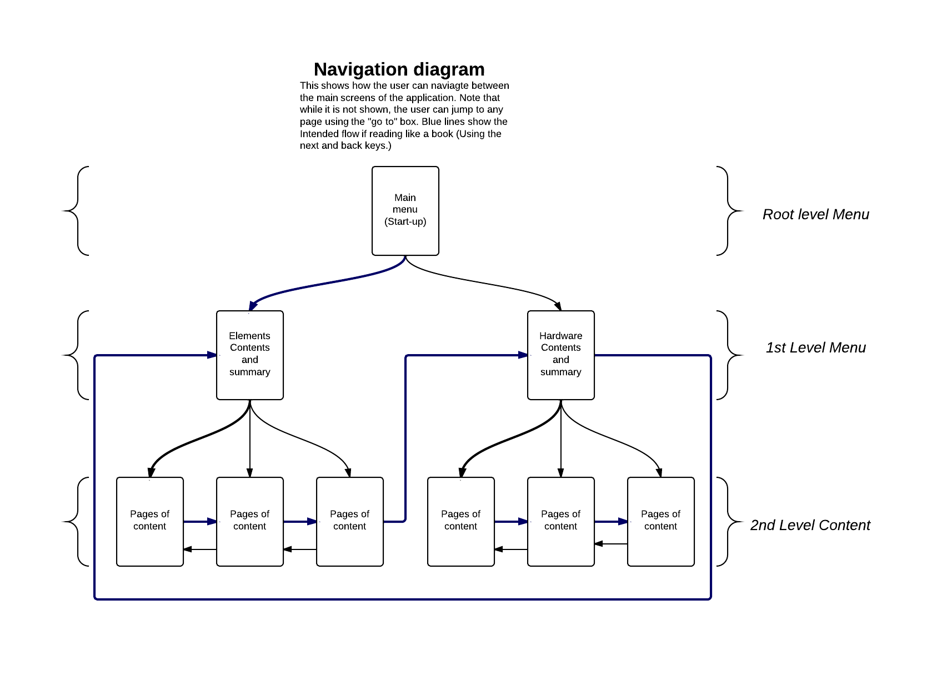
Navigation diagram
This diagram shows how the screens of the application relate to each other. The top level screen appears when the program starts, and from there, the user can either filter down the menus to the content or jump straight to the content. I opted for the tree based approach as it works well when presenting categorised information.

Slide 10
Application design notes
Text, image, whitespace, colour, layout, font,
error handling and coding notes.

Slide 11
Text, image and layout design
I opted for the layouts I used because they fill up most of the screen with content but allow titles and controls in a non-intrusive looking way.
The layouts are consistent, clean and neat for easy navigation and helping the user understand where they are in the application, as well as being aesthetically pleasing.
I also made most of the images as wide as the content box so that they would line up with the edges of the text AND be easily visible.
The colour in the title areas helps users to know where they are in the app and what to expect when browsing.
The fonts chosen were sans-serif as it’s proven that sans-serif is easier to read and display on a screen, as well as the fonts themselves looking clean.
Notes:
Try and skim this part over a little, it’s a bit dry

Slide 12
Error handling / Code Design
Error handling:
There is basic error handling now available instructing users how to report a bug and offering an email address to email the bug to.
I’ve found from testing that bugs don’t really ever happen, but if one decides to come up, we should be able to fix that quickly.
I’m also using git as a version control solution, which includes a bug and feature tracker.
Code design:
The code for this project is very simple, just setting up an animation and then changing card
It’s still coded meaningfully though, with the screen objects having meaningful names. The code is mostly readable, and comments aren’t really necessary thanks to LiveCode’s syntax and the basic nature of the code.

Slide 13
Support
User support is provided easily on the product website so users can be familiar on how to download, install and operate the application. There is also context sensitive help.
The product website: http://Mikumiku747.github.io/Hardware-Software-Helper

