Slide 1

METHODS FOR AUTOMATIC LICENSE PLATE RECOGNITION
Ho Sy Hieu - 20224271, Pham Huu Cuong - 20224303

Slide 2

OBJECTIVE
Enhance the accuracy and efficiency of ALPR systems.
Applications in intelligent transportation, security, and parking management.

Slide 3

BACKGROUND
Problem Statement: Increasing vehicular traffic results in congestion, traffic violations, and vehicle theft.
Challenges: Variations in lighting, noise, motion blur, and font diversity.
Proposal:Employ YOLOv8 and PaddleOCR to improve accuracy and processing capability.

Slide 4
RELATED WORKS
X. Ascar et al.
Used kernel density functions and binary techniques for license plate detection.
Multiplied binary and original image values for localization, followed by filtered binary processing.
Ravi Kiran et al.
Focused on Indian license plates under challenging conditions like low light and noisy environments.
Applied Gaussian smoothing, morphological transforms, and contours for segmentation.
Used K-Nearest Neighbor (KNN) for character recognition.
X. Ascar et al.
Used kernel density functions and binary techniques for license plate detection.
Multiplied binary and original image values for localization, followed by filtered binary processing.

Slide 5

OVERVIEW
Approaches:
Deep Learning Approach:
Use of YOLOv8 for precise license plate detection.
Integration with PaddleOCR for robust recognition of alphanumeric characters.
Traditional Image Processing Approach:
Edge detection, contour analysis, and optical character recognition (OCR).
Emphasis on computational simplicity.
Objectives:
Highlight the trade-offs between accuracy and computational efficiency of the two approaches.

Slide 6
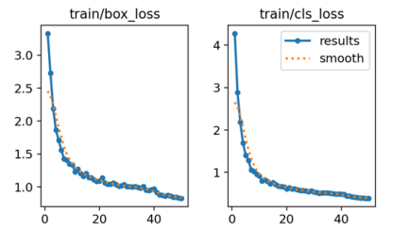
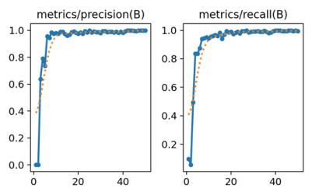
DEEP LEARNING APPROACH: DETECTION TRAINING
Dataset:
Collected from Roboflow, containing diverse license plate styles, lighting, and backgrounds.
Model Training:
YOLOv8 trained over 50 epochs with notable trends:
Initial high loss metrics (box loss, cls loss, dfl loss) that reduced steadily over epochs.
Precision and recall surpassed 99% by the final epochs.

Slide 7
DEEP LEARNING APPROACH: DETECTION TRAINING
Key Outcomes:
High generalization to unseen data, minimizing false positives and negatives.
Robustness to variations such as motion blur and diverse license plate designs.

Slide 8
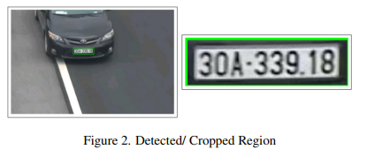
PLATE DETECTION
Process:
Load the trained YOLOv8 model and input images.
Detect license plate regions, drawing bounding boxes to highlight them.
Extract Regions of Interest (ROI) for further processing.
Outcome:
The method effectively isolates license plates from complex backgrounds, preparing them for OCR processing

Slide 9
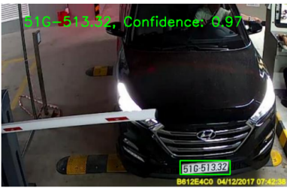
CHARACTER RECOGNITION
PaddleOCR:
Recognizes alphanumeric characters in the cropped ROI.
Handles varying text orientations and provides confidence scores for each detected character.
Result:
High accuracy in extracting license plate text, even under suboptimal conditions like motion blur or uneven lighting.

Slide 10
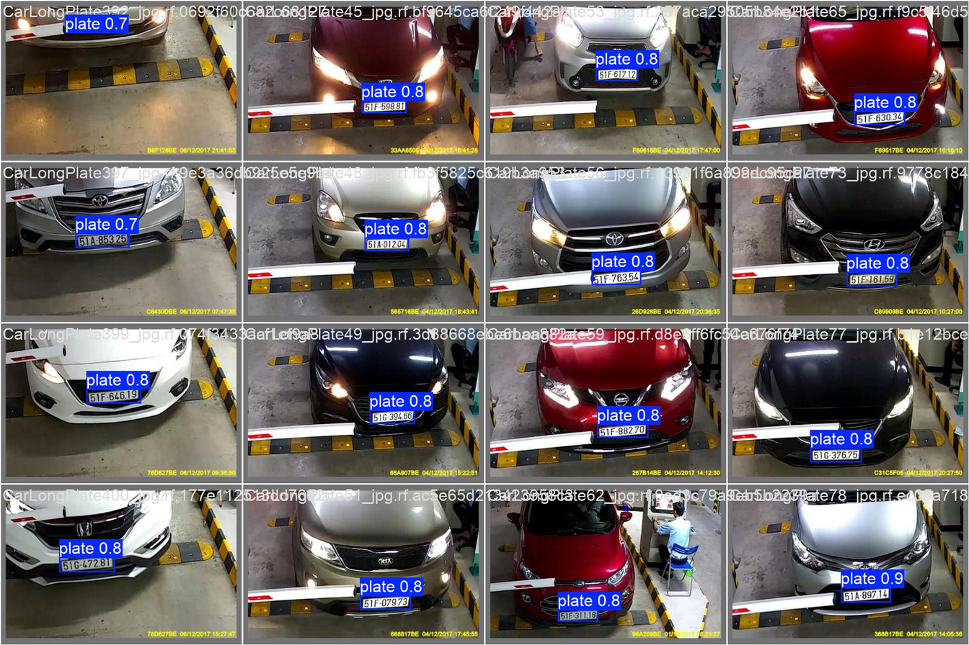
RESULT: DETECTION
Just like the training results, the model accurately detects license plates in the test images, demonstrating its robustness and reliability. These results confirm that the model effectively translates its training performance to real-world scenarios, making it suitable for practical applications.

Slide 11
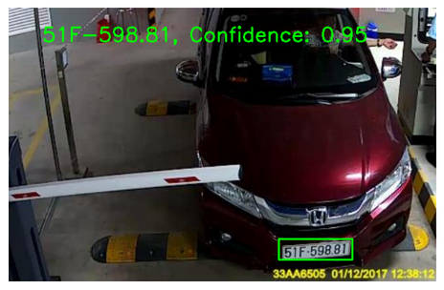
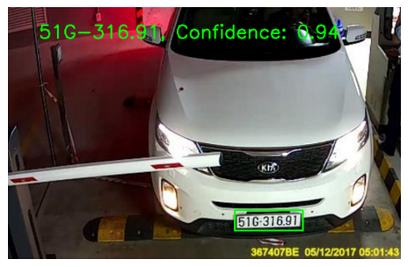
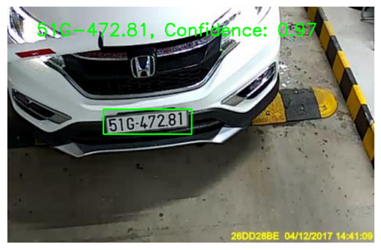
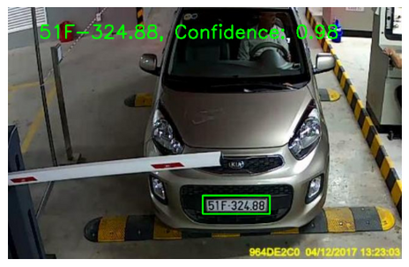
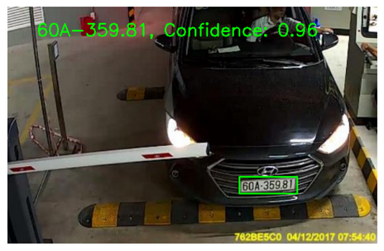
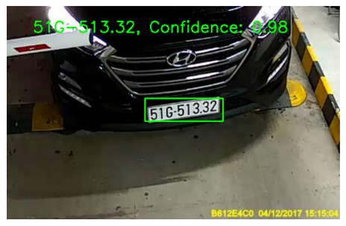
RESULT: OCR
PaddleOCR also seems to perform very well in recognizing the characters within the detected license plate regions, making it a valuable tool for automated license plate recognition systems.

Slide 12
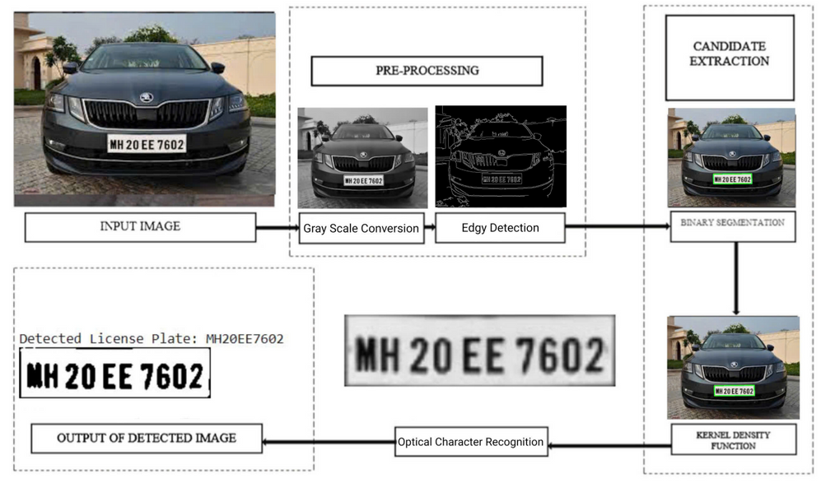
ANOTHER APPROACH: SIMPLE ALGORITHM
Overview
Objective: Present a computationally efficient alternative to deep learning by leveraging traditional image processing techniques.
Approach:
Focus on simplicity and speed, targeting scenarios where computational resources are limited.

Slide 13
IMAGE PREPROCESSING
Steps:
Convert input images to grayscale to reduce computational complexity.
Apply bilateral filtering to reduce noise while preserving edge sharpness.
Purpose:
Enhance the clarity of features critical for subsequent edge detection and contour analysis.

Slide 14
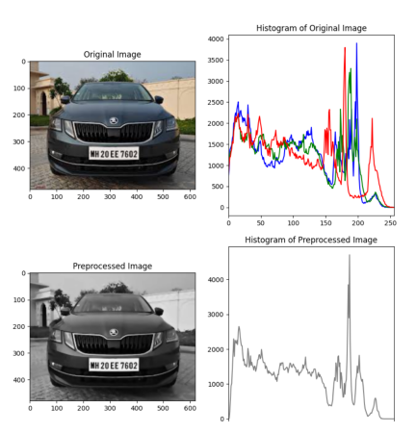
GRAYSCALE CONVERSION
Use Canny edge detection to highlight regions with significant intensity changes.
Convert the image into a binary format where edges are represented as white lines.

Slide 15
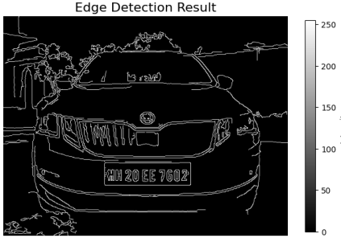
EDGE DETECTION
Significance:
Simplifies the detection of structural boundaries, aiding in contour analysis for license plate localization.

Slide 16
DETECTION ALGORITHM
Steps:
Perform contour detection on the edge-detected image.
Sort contours by area and prioritize larger regions.
Approximate quadrilateral shapes using contour approximation methods (e.g., Douglas-Peucker algorithm).
Validate contours based on their geometry (e.g., four-sided shapes) and area thresholds.

Slide 17
CONTOUR DETECTION AND APPROXIMATION
Steps:
Contour Extraction:
Use cv2.findContours to identify contours in the edge-detected image.
Sorting by Area:
Contours are sorted in descending order of area to prioritize larger regions.
Contour Approximation:
Simplify contours using cv2.approxPolyDP to reduce the number of points while preserving shape.
The Douglas-Peucker algorithm is employed to approximate quadrilaterals resembling license plates.
Filtering:
Only contours with exactly four vertices and areas above a minimum threshold are considered as candidates for license plates.

Slide 18
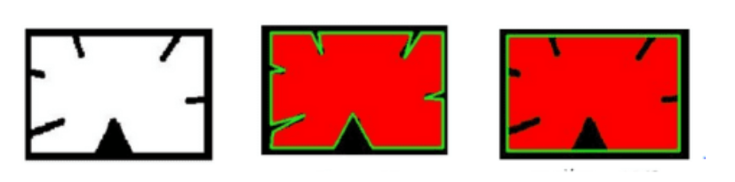
CONTOUR DETECTION AND APPROXIMATION
Outcome:
Identifies potential license plate regions based on geometry and area, ensuring irrelevant regions are excluded.

Slide 19
PLATE LOCALIZATION
Procedure:
Once a valid quadrilateral contour is identified, a binary mask is created to isolate the corresponding region.
A bitwise operation (cv2.bitwise_and) is applied to highlight the detected license plate and suppress other areas.
Bounding box coordinates of the contour are calculated to crop the license plate region from the grayscale image
Output:
A localized, cropped license plate region, ready for further processing (e.g., OCR).
Fallback:
If no valid contour is detected, the algorithm concludes that no license plate is present, ensuring robustness in error handling.

Slide 20
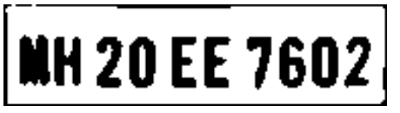
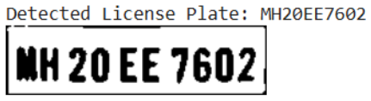
CHARACTER RECOGNITION
PaddleOCR Process:
Optical Character Recognition (OCR) is performed on the extracted ROIs.
Handles diverse text orientations and provides confidence scores for detected characters.
Output:
Recognized license plate numbers with confidence metrics, facilitating reliable use in real-world applications.

Slide 21

DOWNSIDES OF THE METHOD
While the proposed license plate detection and recognition method is simple and efficient, it has several limitations:
Inaccuracy in Complex Scenarios: The approach relies on edge detection and contour analysis, which can fail under conditions like poor lighting, motion blur, or complex backgrounds.
Lack of Machine Learning Integration: This method does not incorporate machine learning or deep learning, which offer better accuracy and robustness in dynamic environments.
Sensitivity to Noise: The method is prone to errors due to noise and image artifacts, leading to potential false positives or missed detections.
Limited Generalization: It may not perform well across different vehicle types, countries, or license plate formats.

Slide 22
REFERENCES
[1] Redmon, J., Divvala, S., Girshick, R., Farhadi, A. (2016). You Only Look Once: Unified, Real-Time Object Detection. In Proceedings of the IEEE conference on computer vision and pattern recognition (pp. 779- 788).
[2] Joseph, J., Berthold, P. (2015). Image Processing and Computer Vision: Principles and Applications. Springer.
[3] Sun, S., Wang, Z., Wang, J. (2018). A comprehensive review of optical character recognition. In Journal of Computer Science and Technology, 33(6), 1060- 1075

Slide 23

THANK YOU FOR LISTENING

