Slide 1
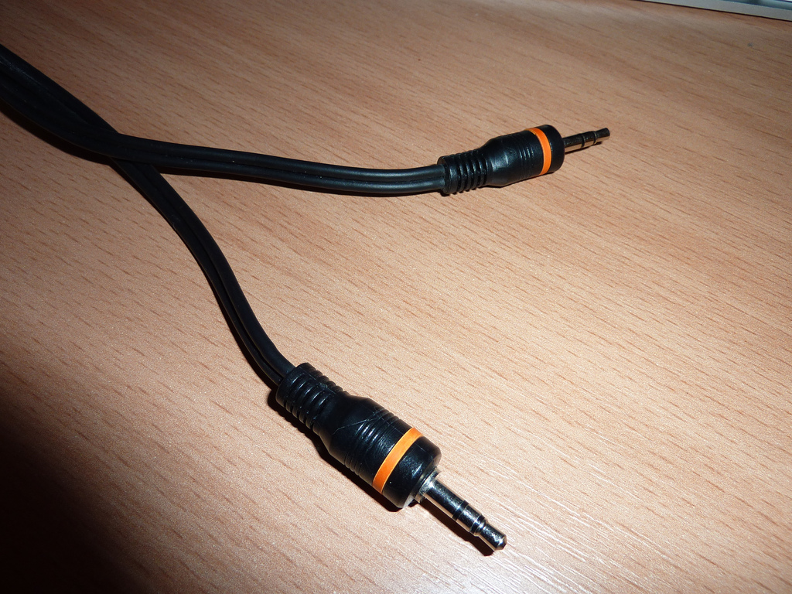
audiolib.js Browser. Audio. No plugins.

Slide 2
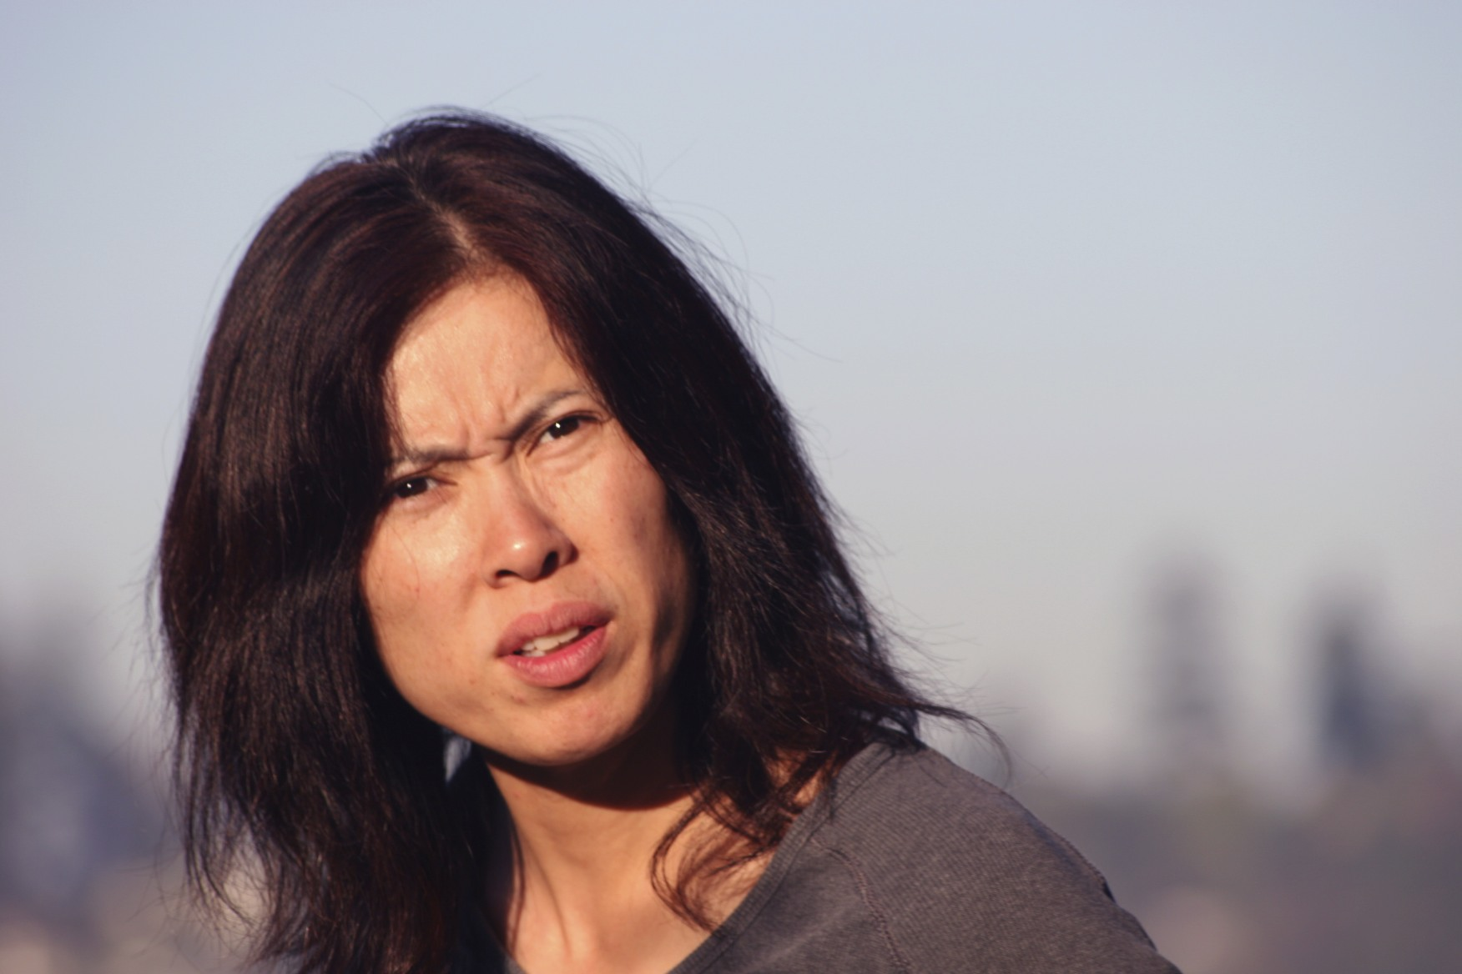
What? Why?

Slide 3
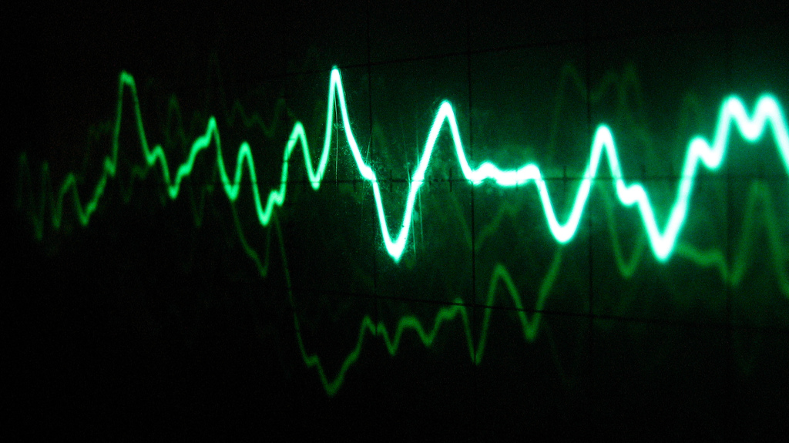
Synthesis

Slide 4
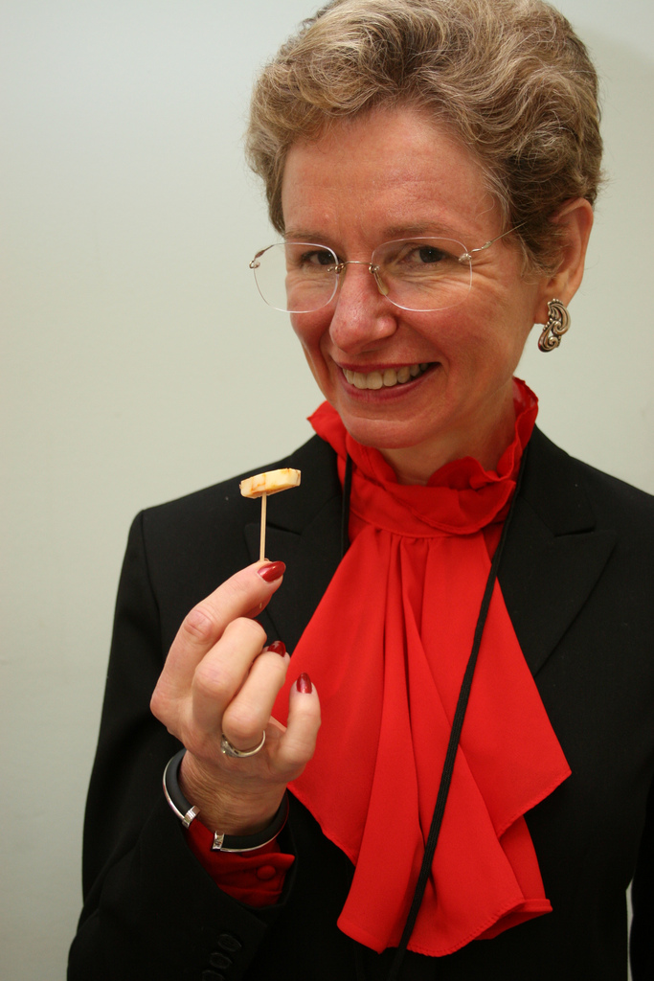
Samples

Slide 5
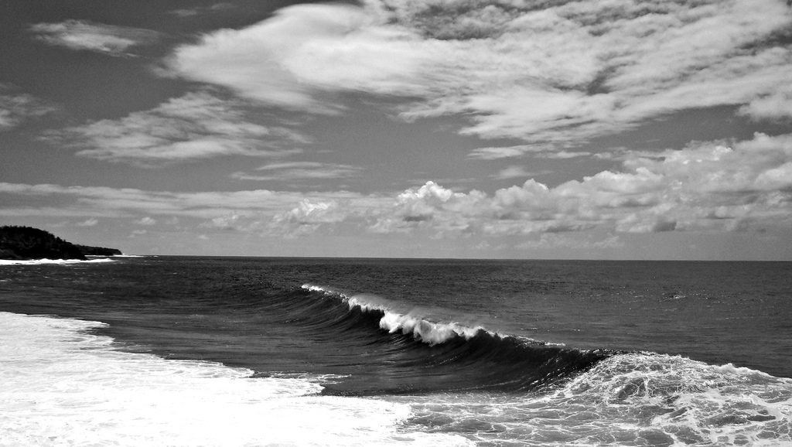
Wave data

Slide 6
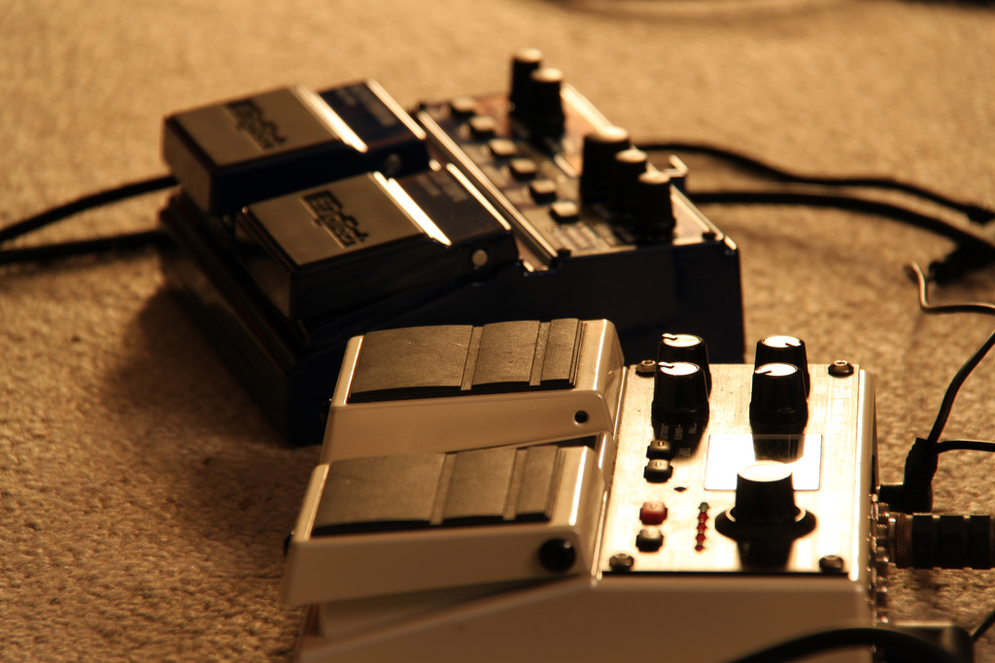
Effects

Slide 7
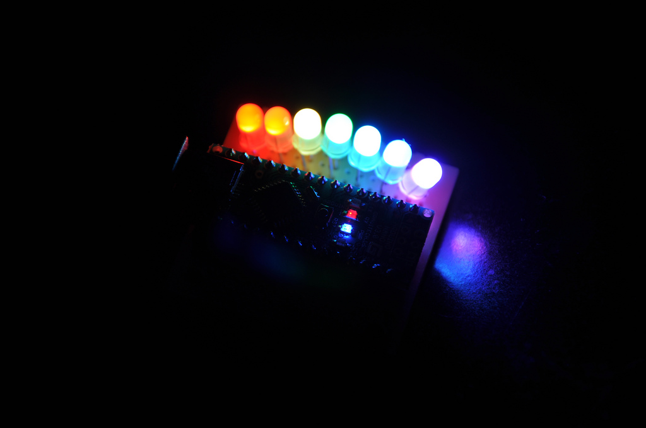
Fast Fourier Transforms

Slide 8
Images
Cables:
http://www.flickr.com/photos/smemon/5716501221/
Confused:
http://www.flickr.com/photos/panacheart/3555047568/
Oscilloscope:
http://www.flickr.com/photos/altemark/304078711/
Food Sample:
http://www.flickr.com/photos/ugacommunications/5998380363/
Wave:
http://www.flickr.com/photos/yashna13/5390477630/
Pedals:
http://www.flickr.com/photos/thegrid-ch/4901067696/
Audio Visualizer:
http://www.flickr.com/photos/etherealdawn/4564208579/

