Slide 1

Data Lake Value Proposition
Medical Data Processing Company
Alexander Milosz
Udacity IPS Version 1.0

Slide 2
Agenda
What is a Data Lake?
Components of a Data Lake
Data Lake vs Data Warehouse
Business Value of Data Lake Solution
Proposed Data Lake Architecture for Medical Data Processing system
Udacity IPS Ver. 1 2/2020

Slide 3
What is a Data Lake?
Centralized repository for all data
Data can be structured and unstructured
Purpose:
enables real-time analytics, machine-learning and ad-hoc queries
supports predictive analytics, business reporting and compliance

Slide 4
Components of Data Lake
Ingestion Layer
Storage Layer
Processing Layer
Serving Layer
collects data from Medical Facilities
near-real-time
scalable, centralized storage
backup plans
transforms data into valuable insights
supports analytics, reporting and machine learning
makes data accessible to users and applications
dashboards, queries and reports

Slide 5
Data Lake vs Data Warehouse
 | Data Lake | Data Warehouse
Data Flexibility | structured unstructured data | stores only structured pre-processed data
Cost-Effectiveness | effective for large volumes of raw data | expensive due to structured storage
Processing Capabilities | real-time machine learning ad-hoc queries | focuses on batch-processing
Scalability | easily scalable for large data volumes | limited due to schema structure

Slide 6
Business Value of Data Lake
Improved Uptime and Reliability
Real-Time Insights
Scalability for Growth
Agility and Flexibility

Slide 7
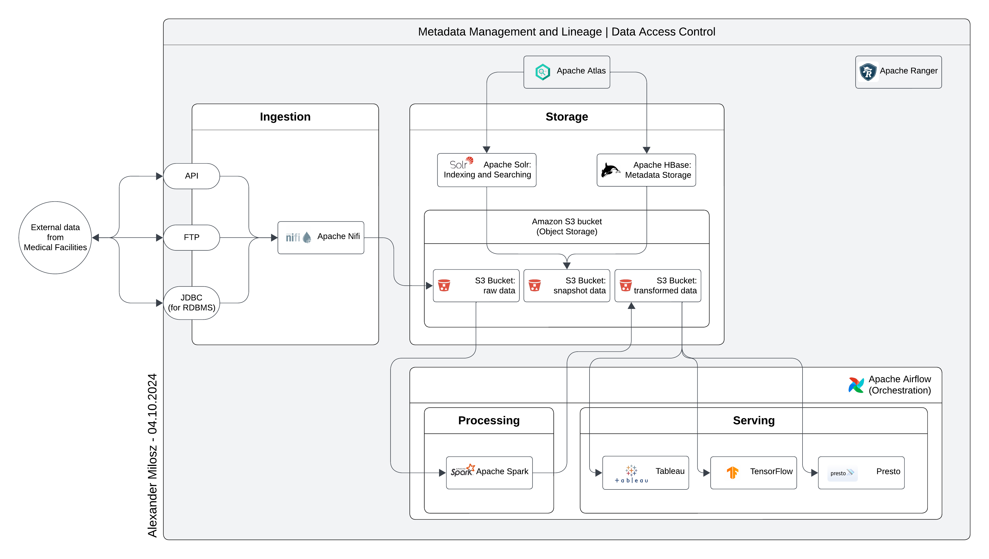
Data Lake Architecture

Slide 8
THANK YOU
Udacity IPS Version 1.0

