Slide 1


Data Governance @ SneakerPark
Prepared by: Alexander Milosz
Submitted on: 06.10.2024

Slide 2
Background
SneakerPark is an online shoe reseller that allows people to buy and sell used and new shoes. Buyers can bid for shoes or buy them outright, and sellers can set a price or sell to the highest bidder.
Each buyer and seller must have an active account in order to sell, bid, or purchase sneakers using SneakerPark’s website.
SneakerPark authenticates the shoes before shipping them to the buyer, so before listing an item, the seller must ship it to SneakerPark’s warehouse. Upon receipt, SneakerPark assigns an item number to each pair of sneakers and notifies the seller that they are now free to list their item. If the item is not listed within 45 days, SneakerPark returns it to the seller and sends an invoice to the seller for the shipping cost.
If the item is found to be inauthentic or in an unacceptable condition, it is also returned back to the seller in a similar fashion.
When the item sells, the buyer’s account is credited with the purchase price minus the SneakerPark service fee and shipping fees to deliver the item to the buyer.
Currently, SneakerPark only supports sales within the United States.

Slide 3
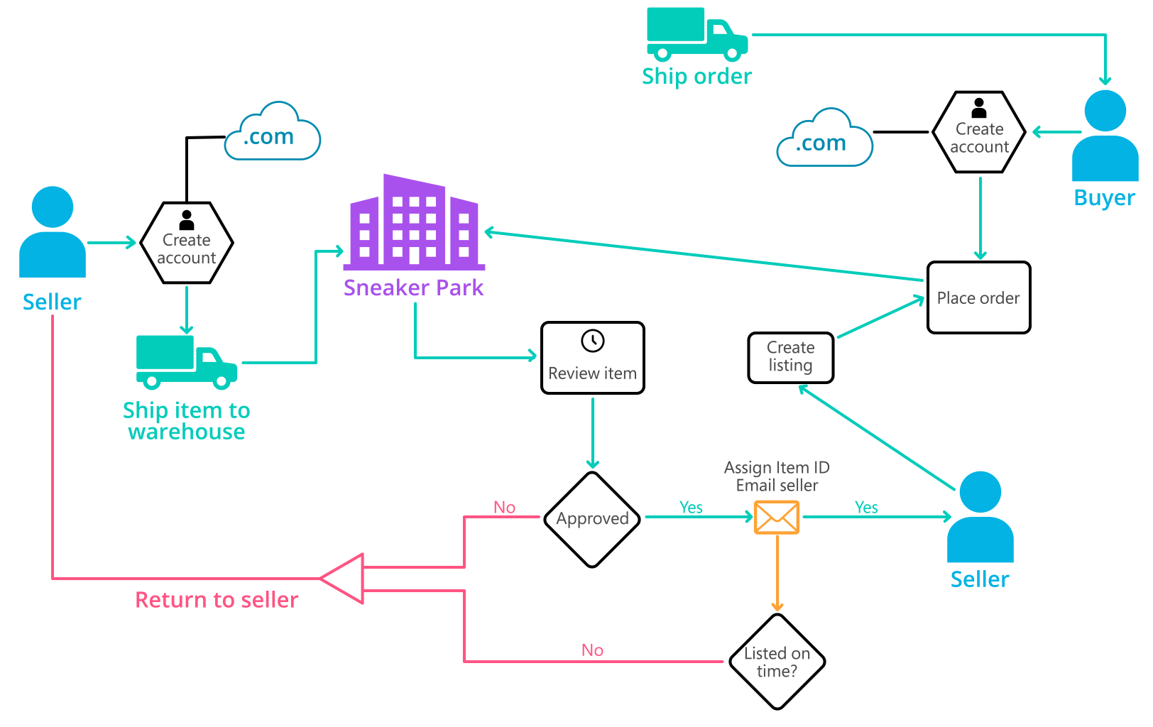
Background (cont’d)
Below you can see a diagram that will hopefully help you visualize some of SneakerPark's business processes. Keep in mind that it does not capture ALL processes and every nuance, but simply serves as another artifact to use in your project.

Slide 4
Step 1
Enterprise Data Catalog Part 1: Enterprise Data Model

Slide 5
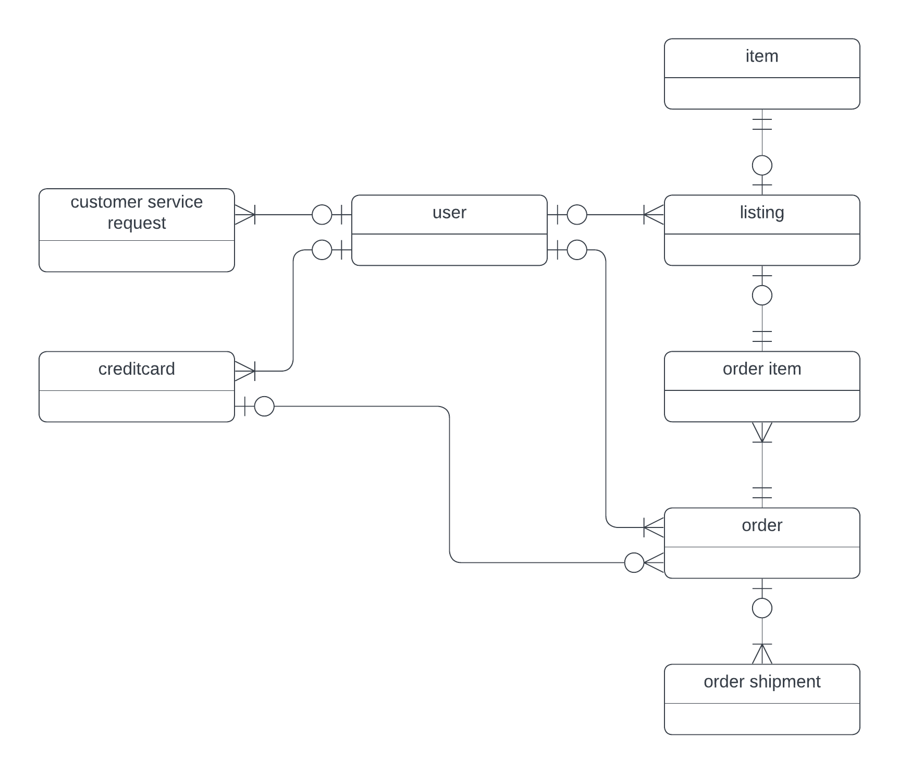
Create a conceptual data model that will provide SneakerPark with a holistic view of its data systems and help you grasp the organization's important entities and relationships, which will be instrumental as you move further in the project. You can use Lucidchart or any other diagramming tool of your choice, but please use the Crow’s Foot/IE Notation and please be sure to indicate both cardinality (the type of a relationship such as 1:N or N:N) and optionality (whether the relationship is optional or mandatory).

Slide 6
Step 2
Enterprise Data Catalog Part 2: Metadata

Slide 7
Create the first version of the Metadata Catalog by documenting the metadata from all systems in the "Data Dictionary" and the “Enterprise Data Catalog” tabs of the provided Sheets template.
Please note that you are required to fill out all fields in both tabs.

Slide 8
Step 3
Data Quality
Part 1: Profiling and Cleansing

Slide 9
Profile the data to identify at least 3 data quality issues you see in the data. Also provide at least 1 data quality issue that you haven’t yet seen in the data, but can foresee occurring in the future. Based on the issues you’ve identified, come up with the data quality rule for each data quality issue, including for the one that you foresee.
Make sure you fill out all columns in the "Data Quality Issues" tab with your answers in the provided Sheets template.

Slide 10
Step 4
Data Quality
Part 2: Monitoring

Slide 11
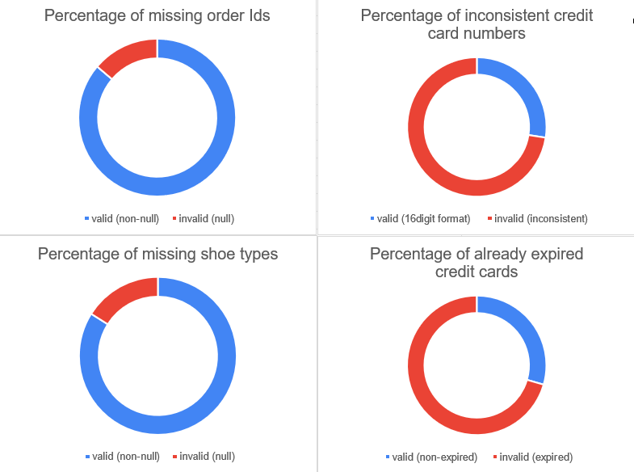
Using the metrics you've created in the last step, please create a mock-up of a data quality monitoring dashboard that will be used to monitor the data to ensure compliance with your data quality rules.
Please make sure to label your metrics clearly on your mock-up.
Replace the example dashboard below with your own. (obviously feel free to take more space).

Slide 12
Step 5
Master Data Management
Part 1: MDM Architecture

Slide 13
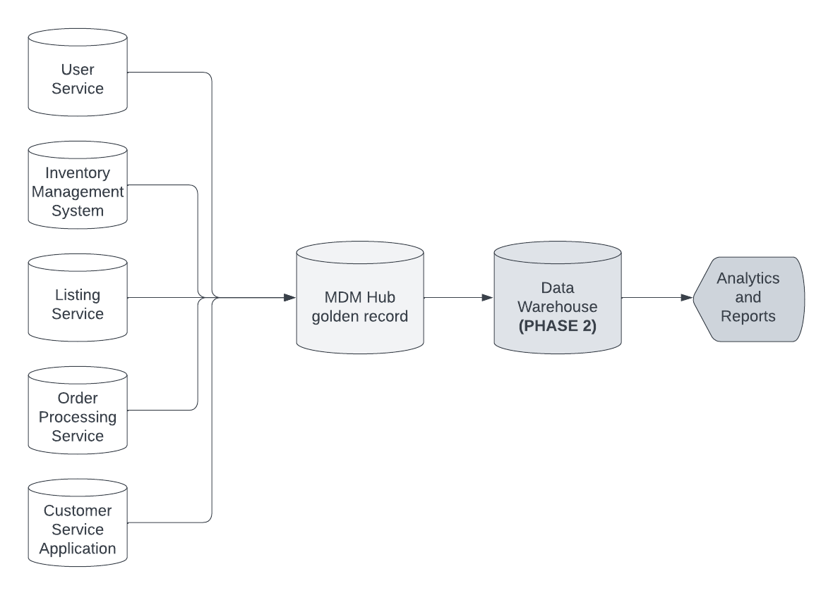
Based on what you’ve read about SneakerPark’s systems and business model, sketch out a proposed MDM implementation architecture, and write a detailed explanation of why you chose this specific approach.
Tip: Think about how your plan and its implementation might affect existing systems.
Replace example screenshot below with your own solutions (obviously feel free to take more space).
Next, please write at least a paragraph explaining your choice.

Slide 14
Explanation:
For SneakerPark's MDM implementation, I propose using a Consolidated MDM Hub, as shown in the provided architecture.
This approach effectively centralizes master data while minimizing disruption to SneakerPark’s existing systems.
Why Consolidated MDM?
Golden Record: All master data from systems like User Service, Inventory Management, and Listing Service is aggregated and cleansed in the MDM Hub to create a reliable, consistent "golden record”.
Batch Processing: Data is ingested into the MDM Hub at regular intervals without real-time sync, reducing system complexity.
Analytics and Reporting: Once consolidated, the data can flow into a Data Warehouse (which will come in Phase 2), ensuring that analytics and reporting use the most accurate and up-to-date information.
This architecture ensures that SneakerPark can address its current data quality issues while building a strong foundation for future growth and reporting needs.

Slide 15
Step 6
Master Data Management
Part 2: Master Record

Slide 16
In this step, you will define a set of matching rules that will be used by the SneakerPark's MDM Hub to match item and customer entities between the company's different systems.
Please come up with 4 rules - 2 for Items and 2 for Customers and list them below.
For Items:
Rule 1: Same Brand and Product Type
Match items from different systems based on the combination of the Brand (BrandName) and Product Type (Type). This will help to ensure that similar products are recognized as the same item.
Rule 2: Same Seller and Arrival Date
Match items based on the Seller ID (SellerID) and the Arrival Date (ArrivalDate). This rule helps track items handled by the same seller and received at the warehouse at the same time.
For Customers:
Rule 1: Same Email and Zip Code
Match customers based on their email address (Email) and zip code (ZipCode). This rule ensures customer records are consolidated across systems even if other data like names have minor variations.
Rule 2: Same First and Last Name and Phone
Match customers based on the combination of First Name (FirstName), Last Name (LastName), and Phone Number (Phone). This helps account for cases where a customer might use multiple email addresses but maintains the same contact information.

Slide 17
Step 7
Data Governance:
Roles and Responsibilities

Slide 18
Write 1-2 paragraphs discussing what data governance roles and responsibilities will be necessary to oversee this new Data Management initiative. Please be sure to discuss the responsibilities in the context of at least 3 different aspects of Data Governance (such as Data Quality Management, Metadata Management, MDM, etc). Based on what you know, do SneakerPark's current employees have the necessary skills for these roles or should the company make new hires?
For SneakerPark’s Data Management initiative, three key data governance roles will be essential. A Data Steward will ensure the quality and reliability of data across systems, handling data profiling, cleansing, and monitoring. A Metadata Manager will oversee metadata management, ensuring all data assets are properly documented and accessible. Lastly, a Master Data Manager will manage the MDM Hub, ensuring that golden records are matched, consolidated, and governed consistently.
While Jessica could handle the Data Steward role, the specialized skills needed for the Metadata and Master Data Manager roles may require SneakerPark to bring in new hires or provide additional training (Jake's background in IT support may not be sufficient).

Slide 19
Standout Suggestions

Slide 20
Create a Business Glossary for SneakerPark and define common terms such as Item, Buyer, etc. Think and discuss how SneakerPark can improve on the consistency of the terms that its systems currently use. (You can use the “Business Glossary” tab of the same Sheets template you’ve been using for the other parts of this project to get you started.)
Document SneakerPark’s current naming conventions. Can you think of any improvements? (You can use the “Standard Naming Conventions” tab of the same Sheets template you’ve been using for the other parts of this project to get you started.) Some examples of Naming Conventions include;
Do not use spaces or special characters.
Use only LOWERCASE.
All identifier fields should end in “_id”.
Avoid acronyms and abbreviations.
Write SQL scripts for the matching rules that you’ve created in Step 6.

