Slide 1
Design Patterns: -> Singleton Pattern -> Strategy Pattern -> Builder Pattern Mila Orujaliyev

Slide 2
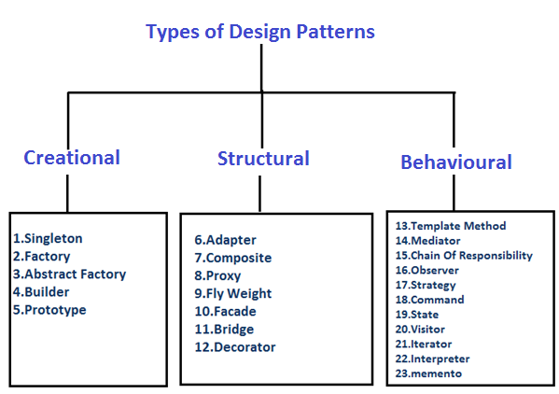
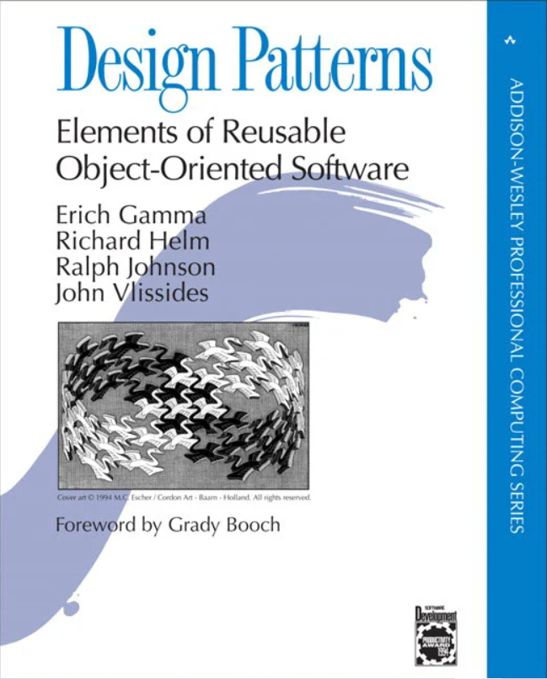
What is A design Pattern?
A design pattern is a general repeatable solution to a commonly occurring problem in software design.
A design pattern isn't a finished design that can be transformed directly into code. It is a description or template for how to solve a problem that can be used in many different situations.
Patterns are often confused with algorithms!
Design patterns are independent strategies for solving a common problem. That means a design pattern represents an idea, not a particular implementation.
By using design patterns, you can make your code
more flexible,
reusable, and
maintainable.
Gang of Four Design Patterns(GoF)

Slide 3

Why Should I Learn Design Patterns?
Not reinventing the wheel, using existing proven solutions
Creating a formal and common language
Improving object-oriented skills

Slide 4
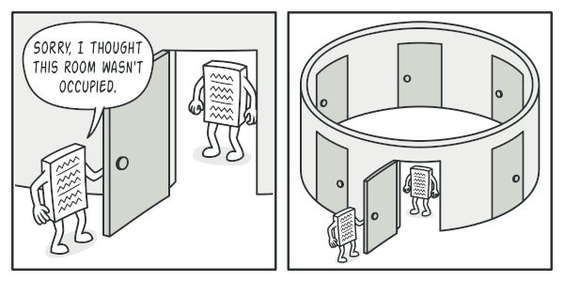
What is Singleton design Pattern?
Singleton pattern is one of the simplest design patterns.
This pattern involves a single class which is responsible to create an object while making sure that only single object gets created. This class provides a way to access its only object which can be accessed directly without need to instantiate the object of the class.

Slide 5

A Singleton candidate must satisfy three requirements:
controls concurrent access to a shared resource.
access to the resource will be requested from multiple, disparate parts of the system.
there can be only one object.

Slide 6
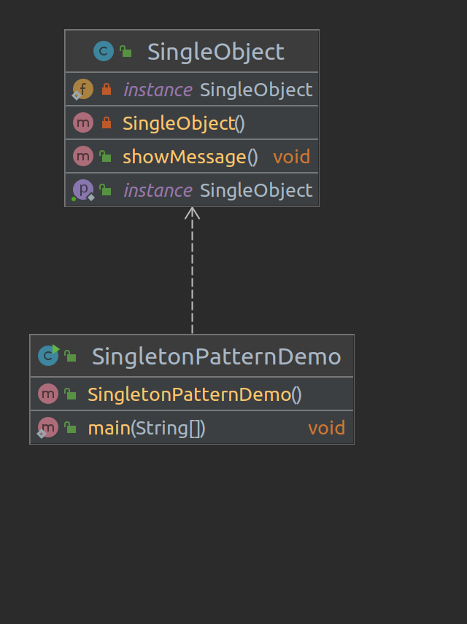
Implementation
We are going to create a SingleObject class. SingleObject class have its constructor as private and have a static instance of itself.
SingleObject class provides a static method to get its static instance to outside world.
SingletonPatternDemo, our demo class will use SingleObject class to get a SingleObject object.

Slide 7
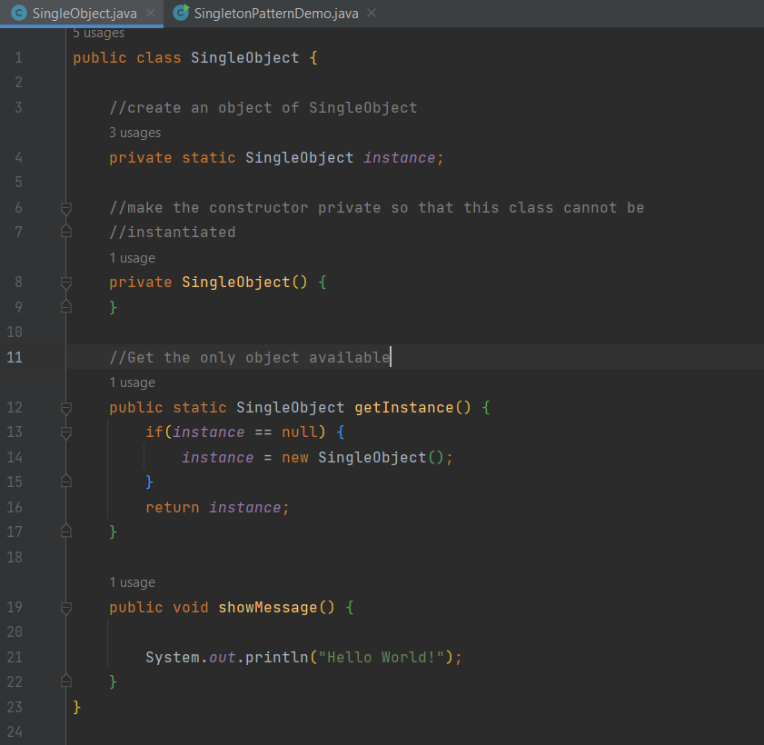
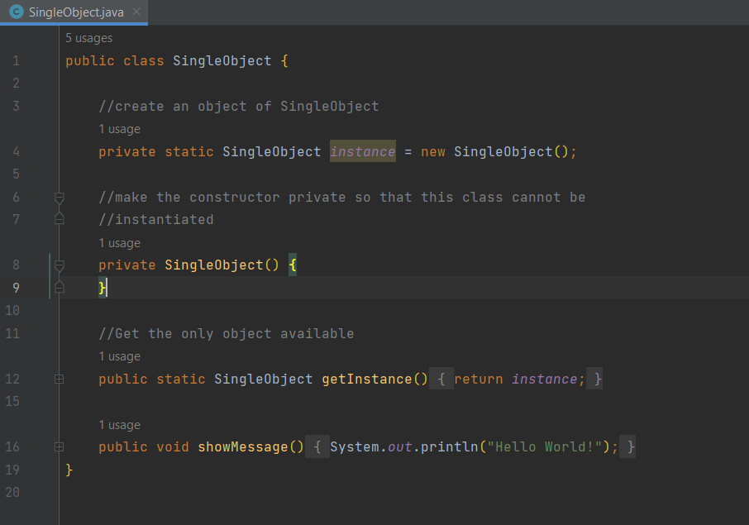
Step 1- Create a Singleton Class
Lazy Initialization
Eager Initialization

Slide 8
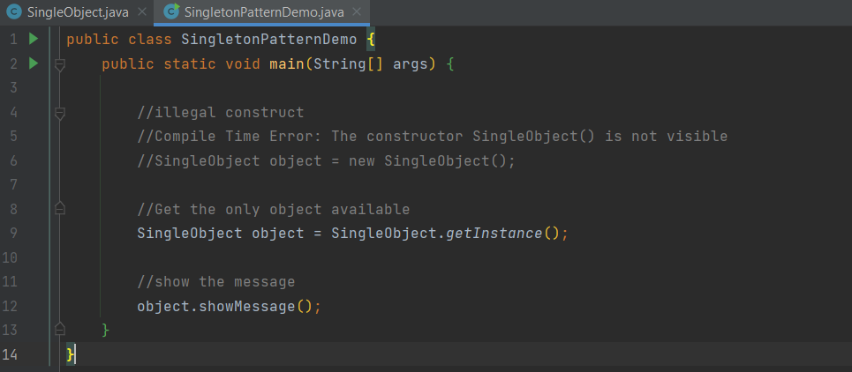
Step 2- Get the only object from the singleton class

Slide 9
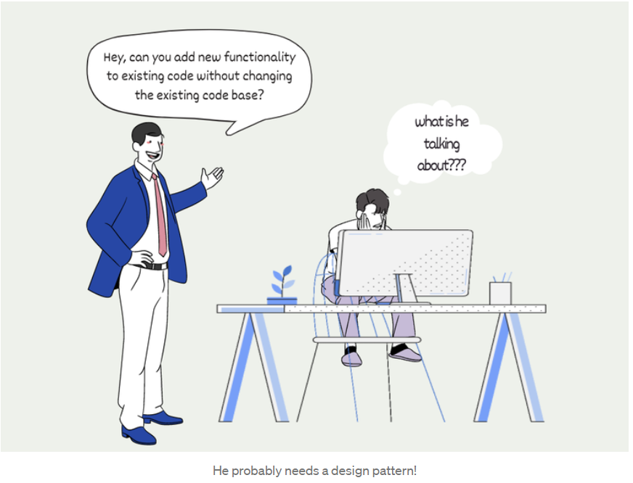
What is Strategy design Pattern?
Strategy design pattern is one of the behavioral design patterns.
It defines a set of algorithms, provides an interface for accessing these algorithms, and designs them as interchangeable while defining algorithms.
In addition, the client can choose any algorithm at runtime.
When should we use?
It is used when we have more than one algorithm(methods) for a particular job.

Slide 10
How to use?
First, an algorithm(Strategy ) interface is created.
Then Concrete algorithm classes are created to implement the created interface.
The Context class is created. This class contains a method for setting algorithms of the algorithm interface type. With this method, the Context class holds the algorithm object.
Finally, a Client class is created. This class produces objects from the Context class and algorithm classes, allowing operations to be performed.
What are the Benefits?
At runtime, we can choose any algorithms defined for a particular operation.

Slide 11
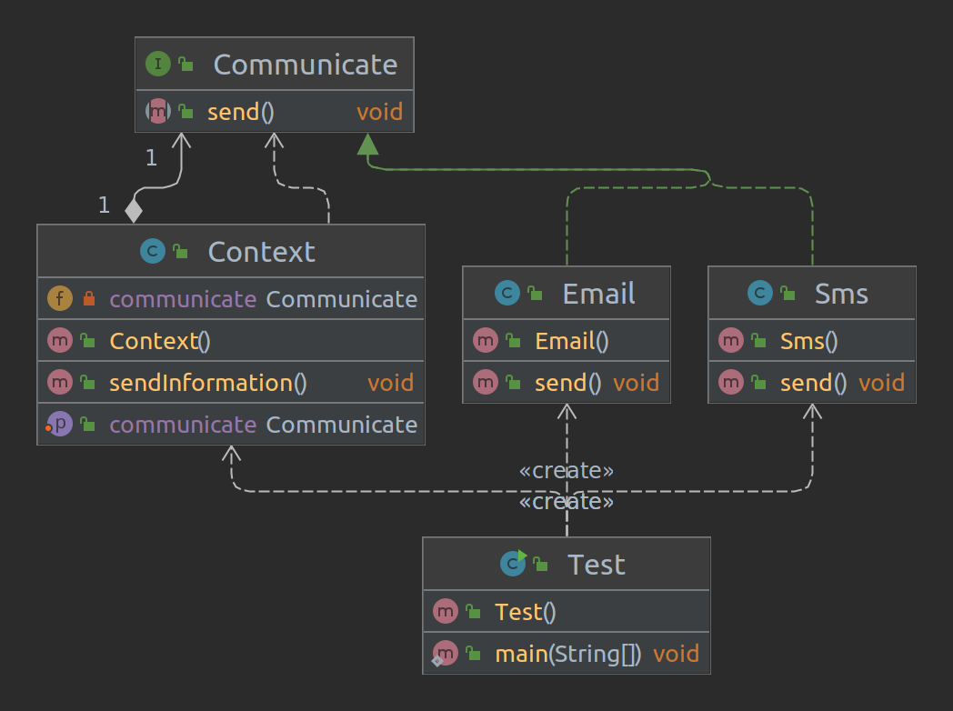
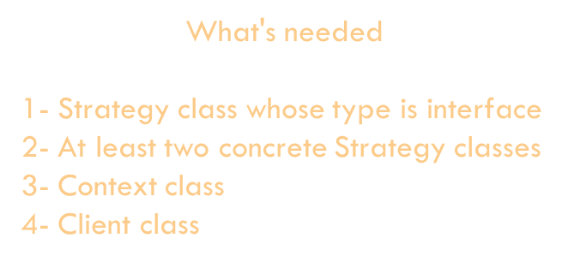
Sample Application
Scenario: Let's make an application that helps us to communicate. Let there be two different types of communication in it;
SMS
E-Mail
UML Diagram of the App

Slide 12
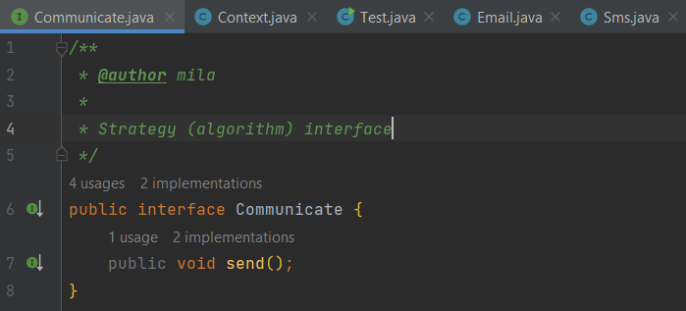
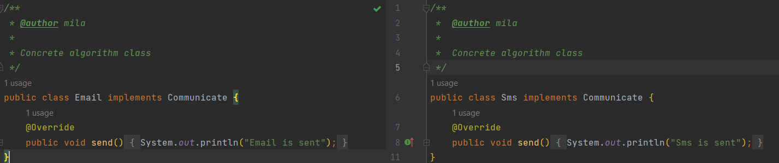
First, an algorithm(Strategy ) interface is created.
Then Concrete algorithm classes are created to implement the created interface.

Slide 13
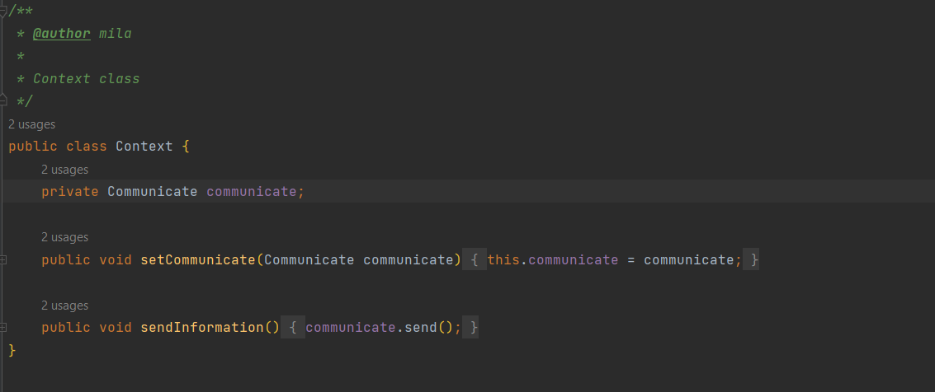
The Context class is created. This class contains a method for setting algorithms of the algorithm interface type. With this method, the Context class holds the algorithm object.

Slide 14
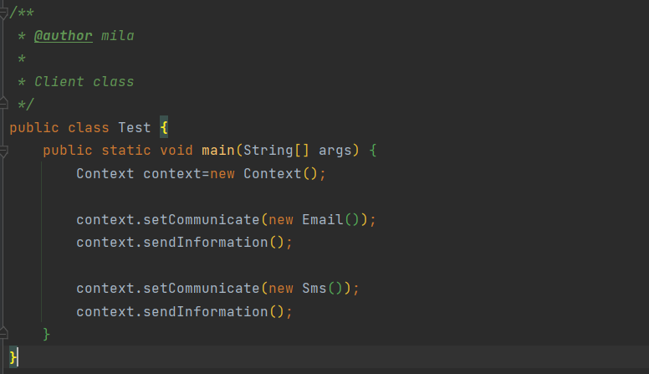
Finally, a Client class is created. This class produces objects from the Context class and algorithm classes, allowing operations to be performed.

Slide 15
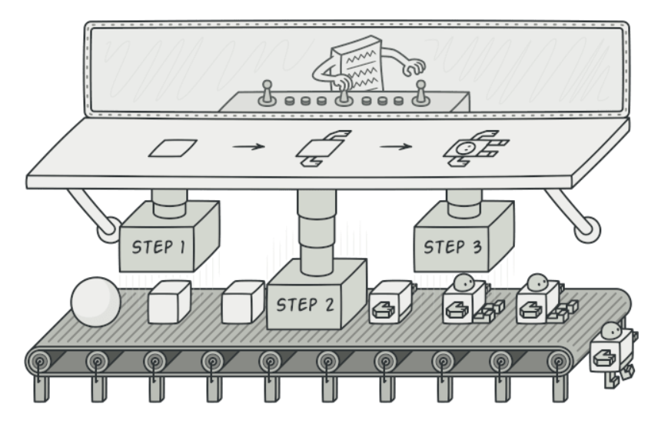
What is BUILDER design Pattern?
Builder is a creational design pattern that lets you construct complex objects step by step. The pattern allows you to produce different types and representations of an object using the same construction code.
The builder pattern is a design pattern designed to provide a flexible solution to various object creation problems in object-oriented programming.
The intent of the Builder design pattern is to separate the construction of a complex object from its representation.

Slide 16
When should we use the Builder Design Pattern?
Problem 1: If you have an object that takes too many parameters
If you have an object that takes too many parameters, you started passing many "null" parameters in its constructor while creating this object.
// constructor like that
public Pizza(int size, boolean cheese, boolean olive, boolean pepperoni, boolean bacon, boolean mushroom, boolean mozarella) {...}
// creating instance
Pizza myFavoritePizza = new Pizza(20, true, true, null, null,null,null) ;

Slide 17
When should we use the Builder Design Pattern?
Problem 2: If you have multiple constructors with different parameter combinations.
If your object has multiple constructors and it is not clear which one to use, if you are confused about which minimum fields you need to fill in to create this object.
public class Pizza {
public Pizza(int size) { … }
public Pizza(int size, boolean cheese) { … }
public Pizza(int size, boolean cheese, boolean pepperoni) { … }
public Pizza(int size, boolean cheese, boolean pepperoni, boolean bacon) { … }
public Pizza(int size, boolean cheese, boolean olive, boolean pepperoni, boolean bacon, boolean mushroom, boolean mozarella) { … }
}

Slide 18
When should we use the Builder Design Pattern?
Problem 3: If you want the object to be immutable after creation
In the following lines, the pizza object is created and then the properties of the object are changed. If the 2nd and 3rd lines are not written at this stage, a pizza object with no size and content is created, which is actually against the nature of the pizza object we designed.
Pizza myFavoritePizza = new Pizza();
myFavoritePizza.setSize(20);
myFavoritePizza.setCheese(true);
cook();
myFavoritePizza.setSize(10);
Moreover, the size can be changed even after the cook() method in line 4 is running. Worst of all, you do not know that the object has been changed.

Slide 19
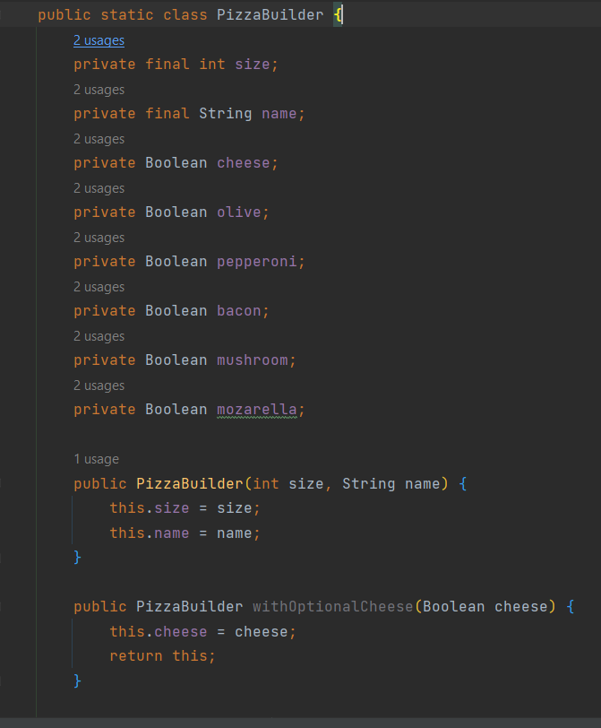
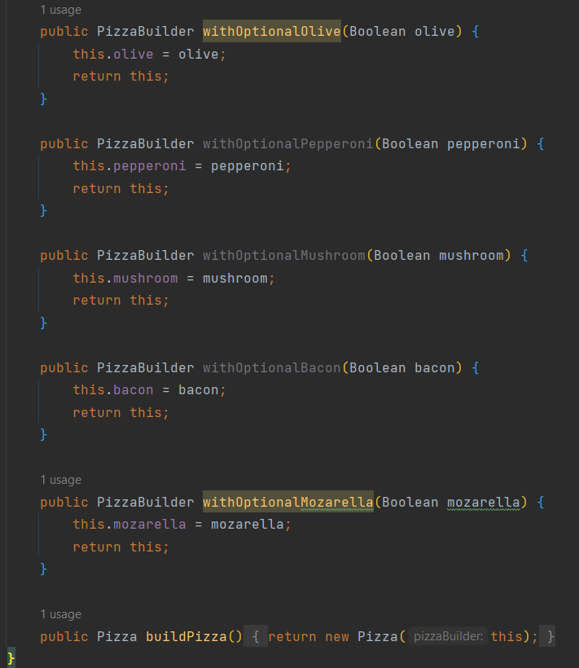
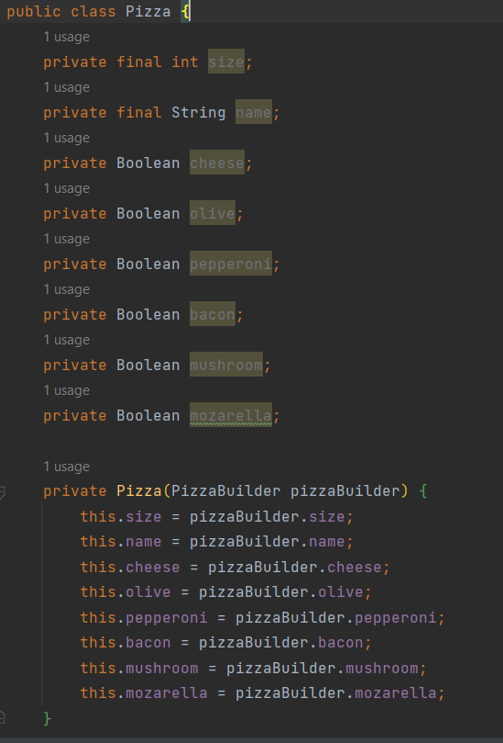
If you want to create an object with your minimum parameter set and keep these fields as they were created, you can use the Builder design pattern.
In the Pizza example, assuming that the pizza name and size are mandatory fields and we want to ensure that it is not changed later, we can implement it as follows.

Slide 20
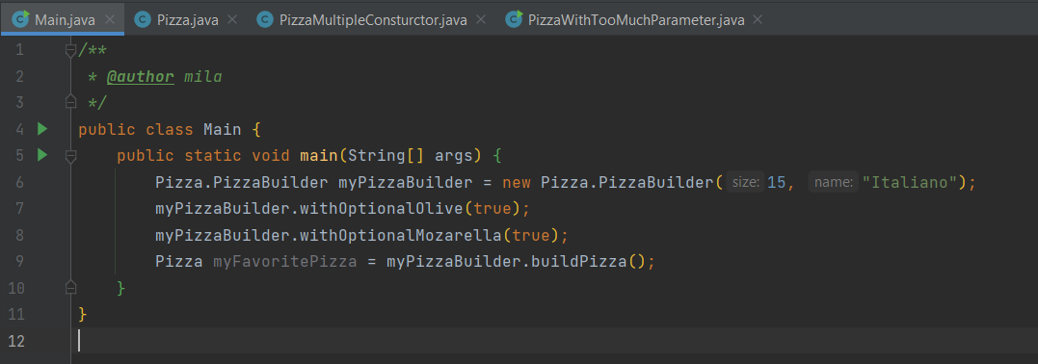
After making the arrangements, we can create the Pizza object as follows.
While creating the builder object in the 6th line, the mandatory fields must be set and created.
Optional parameters are created in the 7th and 8th lines.
In the 9th line, a new Pizza object is generated with the prepared builder object.

