Slide 1
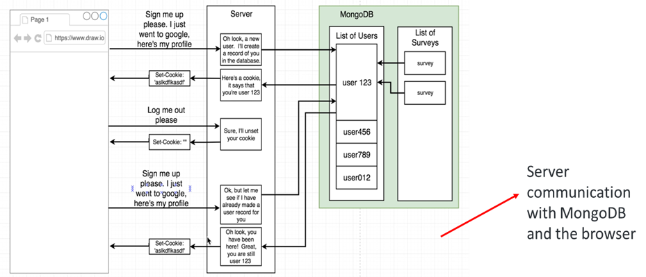

Slide 2
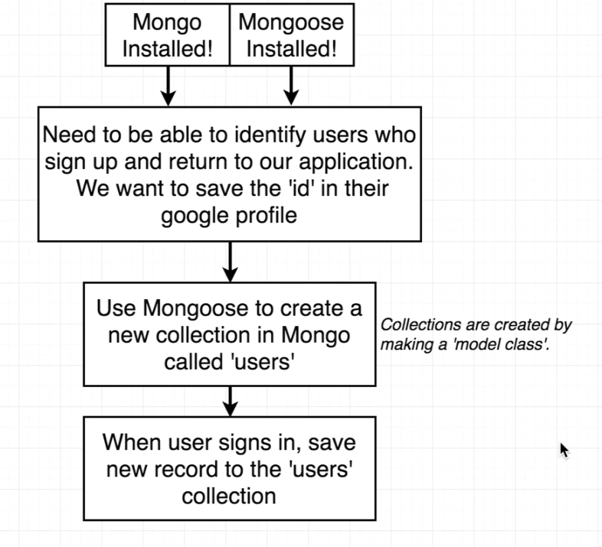
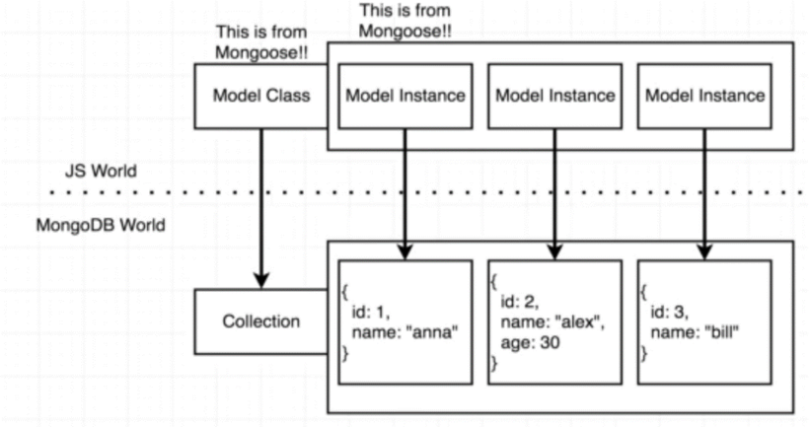
.save() method on model instance save the model as a record in MongoDB

Slide 3
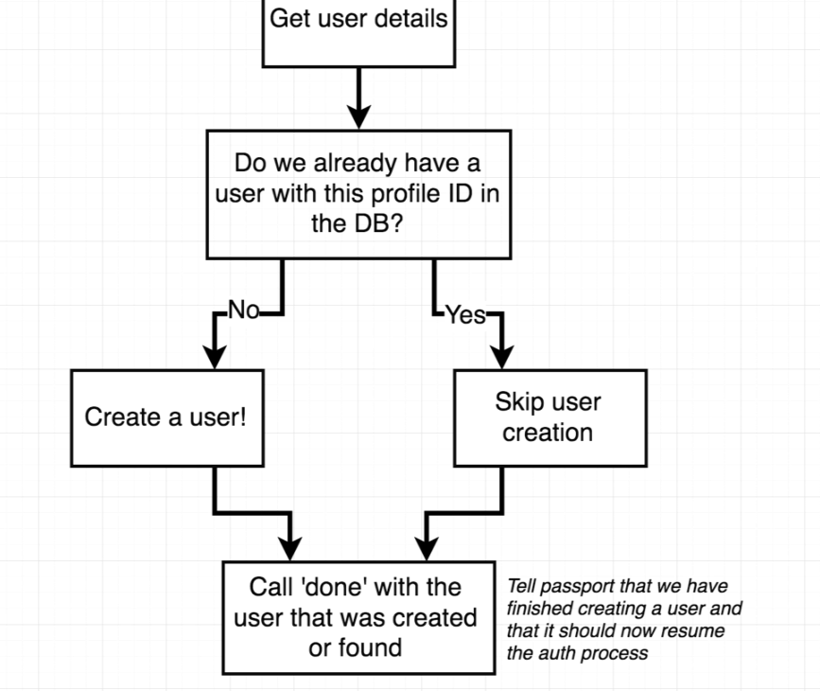
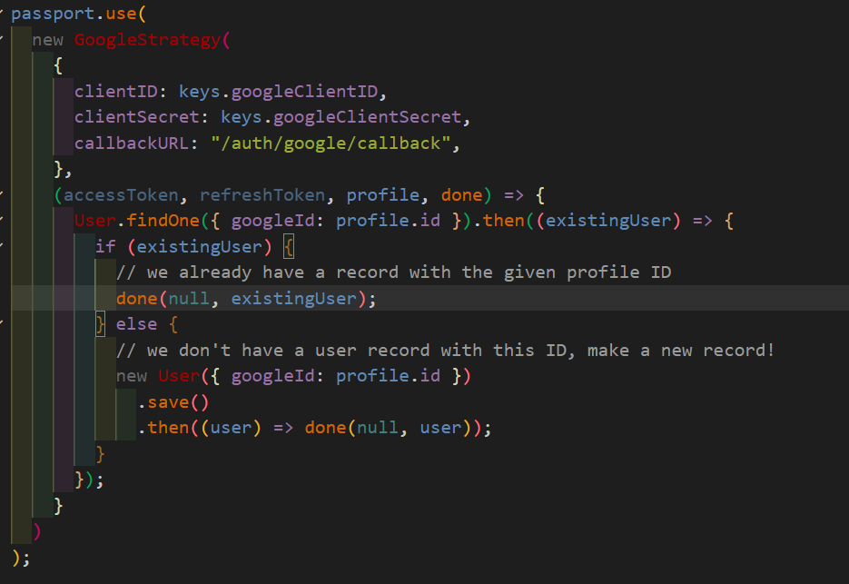
Anytime we reach out to the mongo database, in any shape or form (searching and existing collection or saving a new one) , an asynchronous action is initiated.

Slide 4
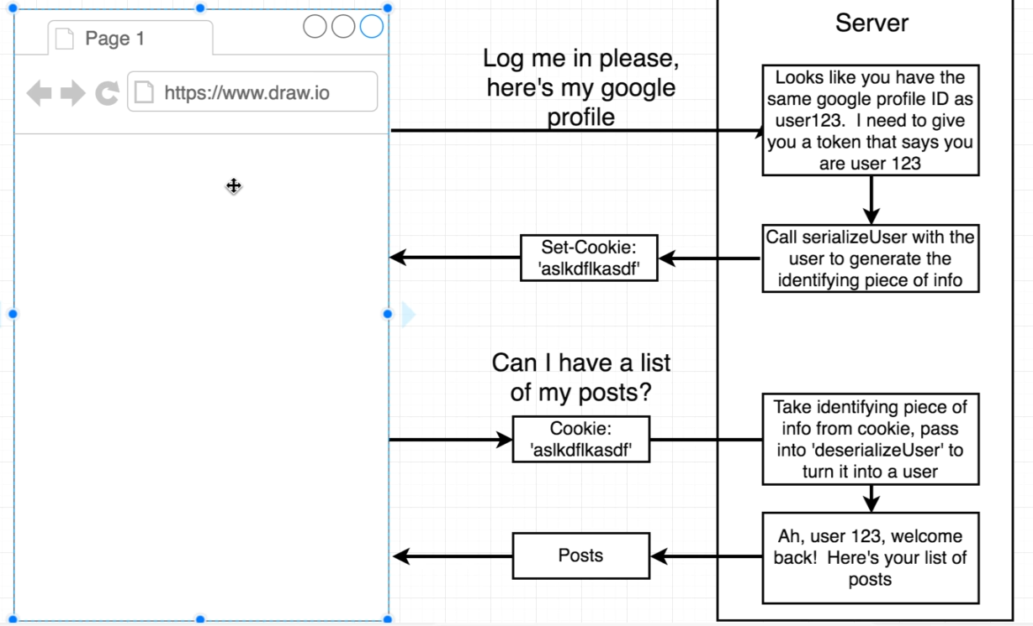
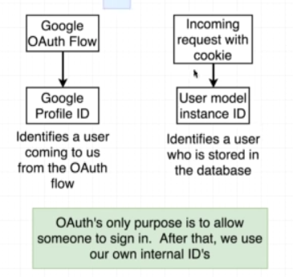

Cookie is set automatically by passport with identifying piece of id
serializeUser is automatically called by passport with user object (model) that has been fetched
Automatically done by passport
Automatically added by the browser

