Slide 1
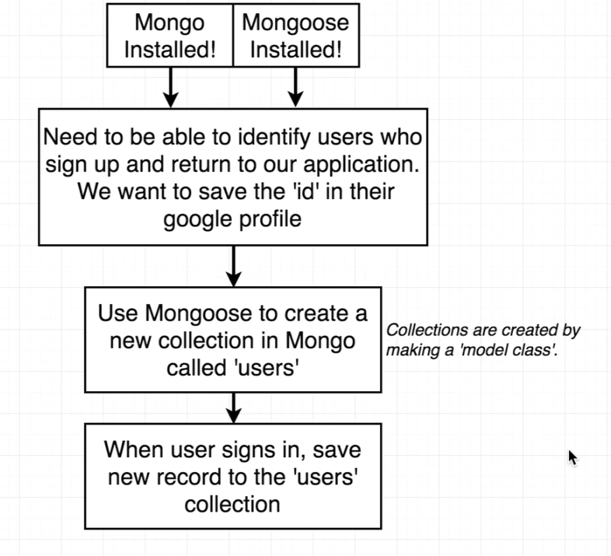

Slide 2
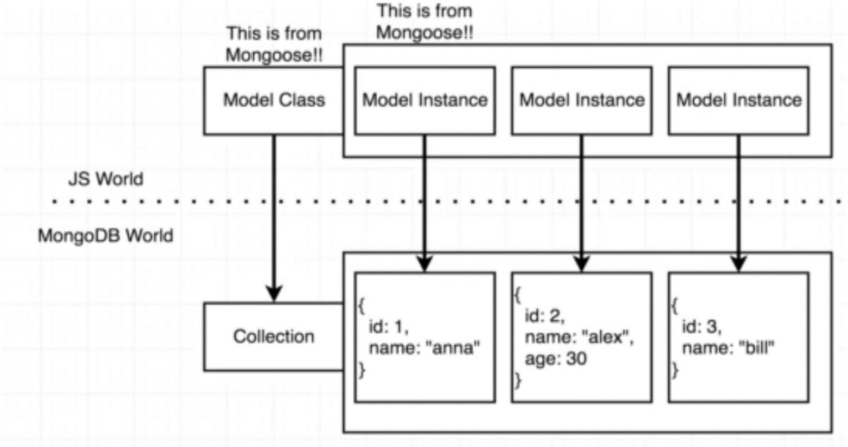
.save() method on model instance save the model as a record in MongoDB

