Slide 1

Project II: Fully encrypted two client communication through internetwork
Michael Jurek, Adam Varga, Antonín Vlasák, Táňa Novosadová

Slide 2
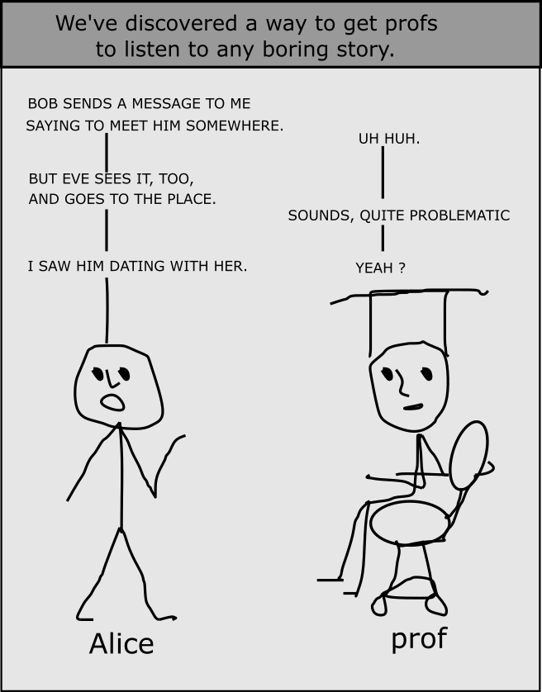
…SERIOUS RESEARCH

Slide 3
…TO THE POINT

Slide 4
Ok, I need to generate pair of keys
CA
Me too.
Me too.
A
B

Slide 5
CA
KprivCA
KpubCA
A
B
KprivB
KpubB
KprivA
KpubA

Slide 6
CA
KprivCA
KpubCA
Hey CA, I need CERTIFICATE
KpubB
Hey CA, I need CERTIFICATE
KpubA
A
B
KprivB
KpubB
KprivA
KpubA

Slide 7
Here it is.
CA
KprivCA
KpubCA
KpubA
KpubB
CA = sig(KprivCA, KpubA)
CB = sig(KprivCA, KpubB)
A
B
KprivB
KpubB
CB
KprivA
KpubA
CA

Slide 8
CA
Hm I need Kpub B.
I need Kpub A.
A
B
KprivB
KpubB
CB
KprivA
KpubA
CA

Slide 9
CA
CB, KpubB
A
B
KprivB
KpubB
CB
CA
KprivA
KpubA
CA
CB
CA, KpubA

Slide 10
CA
I need verify CB.
I need verify CA.
A
B
KprivB
KpubB
CB
CA
KprivA
KpubA
CA
CB

Slide 11
CA
req
req
Kpub CA
Kpub CA
A
B
KprivB
KpubB
CB
CA
KprivA
KpubA
CA
CB

Slide 12

CA
ver(KpubCA,CB)
ver(KpubCA,CA)
A
B
KprivB
KpubB
CB
CA
KpubA
KprivA
KpubA
CA
CB
KpubB

Slide 13
CA
Ok I can wait for key for AES.
Ok, now I can generate key for AES.
A
B
KprivB
KpubB
CB
CA
KpubA
KprivA
KpubA
CA
CB
KpubB
KAES
Here it is, I can send.

Slide 14
CA
dec(KprivB,KAES)
enc(KpubA, “OK”)
A
B
KprivB
KpubB
CB
CA
KpubA
KAES
KprivA
KpubA
CA
CB
KpubB
KAES
enc(KpubB,KAES)

Slide 15
CA
I can generate primes.txt
A
I want to send primes.enc
B
KprivB
KpubB
CB
CA
KpubA
KAES
KprivA
KpubA
CA
CB
KpubB
KAES

Slide 16
CA
dec(KAES,”primes.enc”) = primes.txt
I can verify primes.
A
B
KprivB
KpubB
CB
CA
KpubA
KAES
KprivA
KpubA
CA
CB
KpubB
KAES
enc(KAES,”primes.txt”) = primes.enc

Slide 17
CA
ver(KAES, ”result.enc”) = result.txt
enc(KAES, “result.txt”) = result.enc
A
B
KprivB
KpubB
CB
CA
KpubA
KAES
KprivA
KpubA
CA
CB
KpubB
KAES

Slide 18
CA
I am the happiest one in the World
A
XD
B

