Slide 1
IBM Watson Assistant

Slide 2

IBM Cloud
IBM Cloud is a collection of different cloud computing services that is offered by IBM. The comparison to IBM Cloud would be Amazon Web Services (AWS), Microsoft Azure, and Google Cloud Platform (GCP).
To sign up for IBM Cloud, follow these links:
https://www.ibm.com/academic/topic/cloud/
(Click on the Register Button)
Alternatively, here is a video: https://www.youtube.com/watch?v=fHsBcvcp60I

Slide 3
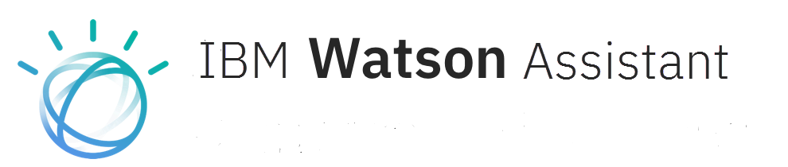
IBM Watson is a suite of advanced AI services such as Watson Assistant, Watson Natural Language Understanding, and Watson Discovery.
As there are many different services which can be overwhelming for newcomers, we will be focusing on Watson Assistant as it will allow us to create chatbots with no prior knowledge needed.
https://cloud.ibm.com/developer/watson/dashboard
https://www.ibm.com/products/watson-assistant
Here is an interactive demo to showcase the possibilities of using Watson Assistant and a tutorial on how to use Watson Assistant:
https://watson-assistant-demo.ng.bluemix.net
/https://developer.ibm.com/learningpaths/get-started-watson-assistant/

Slide 4
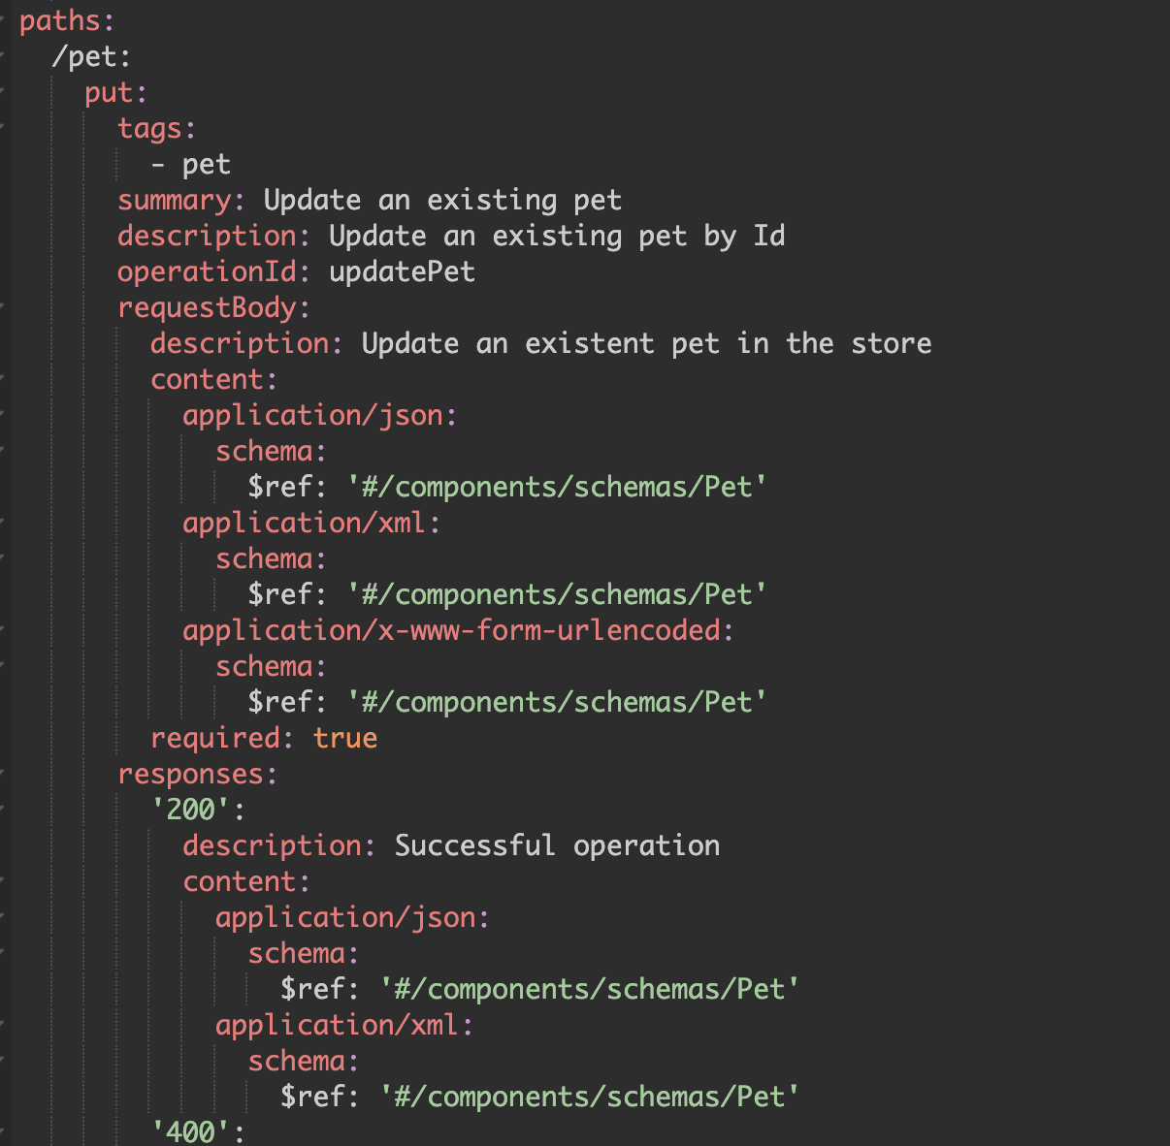
OpenAPI
OpenAPI is a specification for designing, documenting, and implementing APIs (Application Programming Interfaces).
It provides a standardized way to describe the capabilities and structure of an API, allowing developers to understand and interact with the API more effectively.
It would essentially create a set of rules for RESTful APIs so that programs can connect to APIs on another website.

Slide 5
Watson Assistant and OpenAPI
For Watson Assistant and Spotify to interact/”talk” to one another, we will be using an OpenAPI file that will “teach” Watson Assistant how to communicate with Spotify from the pre-defined rules.

Slide 6
Publications on the reliability of Watson Asssistant to rivals
https://doi.org/10.48550/arXiv.2012.03929
•https://www.ibm.com/industries/telecom-media-entertainment/resources/vodafone-ibm-chatbot/
https://www.ibm.com/case-studies/natwest-group-Watson/
https://www.ibm.com/blogs/watson/2020/12/how-glaxosmithkline-launched-16-virtual-assistants-in-10-months-with-watson-assistant/

