Slide 1
Design Pattern
Milad Abolhassani
tuxgeek.ir
milad@tuxgeek.ir
Slides:
http://slideshare.com/miladas
http://miladas.github.io/slides

Slide 2
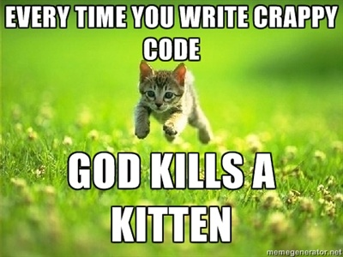
Attention

Slide 3
OOP
Class
Property
Method
Inheritance
Polymorphism
Interface
Abstract class
Encapsulation
Public/protected/private
Final
Notes:
Animal kashka = new Dog();
interfaces (is a concept)
How decide which class extends other class?
Is a?
Has a?

Slide 4


Where did all of these come from?
Notes:
James Gosling in 1991
cable television – No C++ - Oak
Sun – sell hardware
Microsoft did same Visual J#
Sun said it's our the change a little called it C#
- OOP invented in 1966
two guy – simulator (Simula I and Simula 67)
source code of ALGOL
block structure language
Function – local variables → stack
a( v1; b( work with v1 ) )
heap
C++ , declare class private, protected

Slide 5
SOLID
SOLID
Notes:
Single Responsibility
Open/Closed
Liskov substitution
Interface Segregation
Dependency Injection
Changing gui, database should not effect on program
You should be able to test program without gui
We should keep everything septate
change gui in the air
Plug-in – API – 2 company - interface

Slide 6
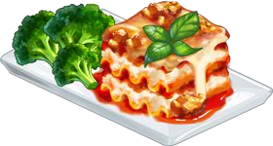
SOLID
Single Responsibility
Open/Closed
Liskov substitution
Interface Segregation
Dependency Injection

Slide 7
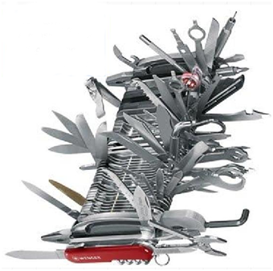
Single Responsibility
Notes:
every class – one responsibility which entirely encapsulated
one class one job
no one object 40 method
Unmaintainable
Code duplication
When boss give u a job

Slide 8
Open/Closed
Meyer's open/closed
  Once class completed, never should modified
Polymorphic open/closed principle
  Interface (public methods)
  The interface is open for extension but close for modification
Notes:
Software entities (classes, modules, functions, etc.)
Should be open for extensions, but closed for modification.
Meyer's open/closed
Class, once complete, never should modified
Can fix bug error
inheritance
Sub class
Polymorphic open/closed principle
The interface is open for extension but close for modification

Slide 9
Liskov substitution
Program to an interface rather than of it's implementation
Design by contract
Do not extend the interface
Notes:
Objects in a program should be replaceable with instance of their subtypes without altering the correctness of the program
(poly examle in loop)
If you have duck which looks like a duck
docbox

Slide 10
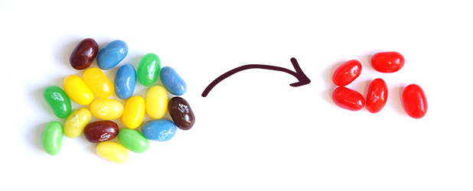
Interface Segregation
Notes:
No object should be forced to depend upon or implement methods that it doesn't use.
Xerox Example

Slide 11

Dependency injection
Notes:
High level module should not depend on low level modules.
Both should depend on abstraction.
Abstraction should not depend on details
Details should depend on abstraction.
Type Hint
Dependency Hell
reuse object
work individual with them

Slide 12
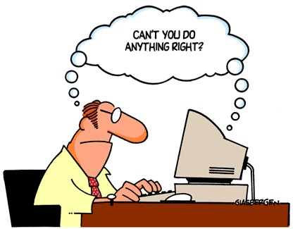
What is design pattern?
In software engineering, a design pattern is a general reusable solution to a commonly occurring problem.
Notes:
Design patterns represent the best practices used by experienced object-oriented software developers.
Best Practices

Slide 13
History
Patterns originated as an architectural concept by Christopher Alexander (1977/79).
Design patterns gained popularity in computer science after the book Design Patterns: Elements of Reusable Object-Oriented Software was published in 1994.
  Gang of Four
  Gamma, Erich; Helm, Richard; Johnson, Ralph; Vlissides, John
Notes:
We will cover the GOF concepts
Front Controller in Code Complete
Other in Clean Code

Slide 14
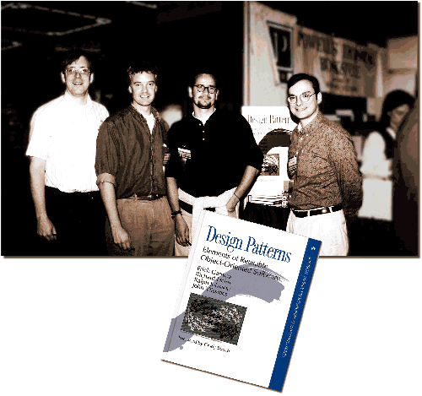
Gang of four

Slide 15
Why design pattern?
Clarity
Correctness
Same vocabularies
  Avoid miss communications
Reuse
Save time, trial and error
Can speed up the development process
  by providing tested, proven development paradigms
We are not reusing code, we are reusing experience
Notes:
documentation to explain the background
control system for a fighter jet, a Singleton is a Singleton

Slide 16
Category
Creational design patterns
Structural design patterns
Behavioral design patterns
Notes:
1.Create
2.Relation
3.Communication

Slide 17
Creational design patterns
These design patterns provide a way to create objects while hiding the creation logic.
Notes:
provides one of the best ways to create an object.

Slide 18
Creational design patterns
Factory method
Singleton
Prototype
Builder

Slide 19
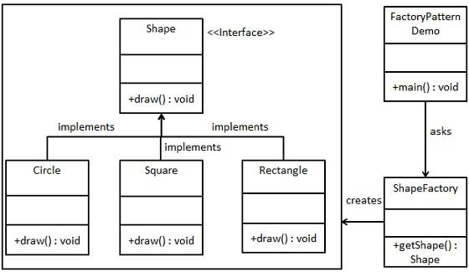
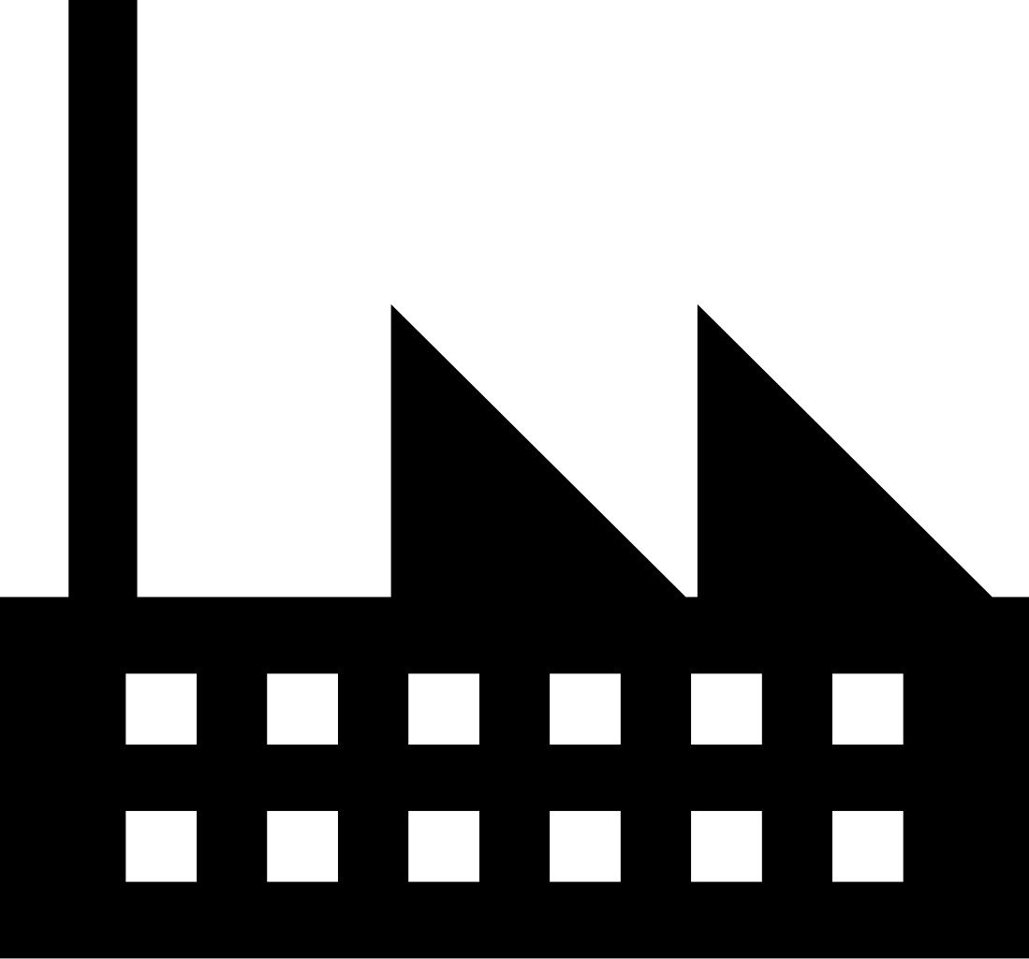
Factory Method
Factory Method lets a class defer instantiation to subclasses.
Notes:
One method can return several class that share common super class
on the air
access to the logic
Hide logic

Slide 20
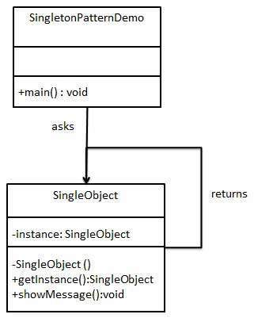
Singleton
This pattern involves a single class which is responsible to create an object while making sure that only single object gets created.
Notes:
SOLID
S → two job – create itself and something else

Slide 21

Prototype
Specify the kinds of objects to create using a prototypical instance, and create new objects by copying this prototype.
Notes:
Chess needs effort
Create copy of fully init instance

Slide 22

Builder
Separate the construction of a complex object from its representation so that the same construction process can create different representations.
Notes:
Separates object construction from its representations
A object made from a bunch of other objects
Dinner
Robot
Html page

Slide 23
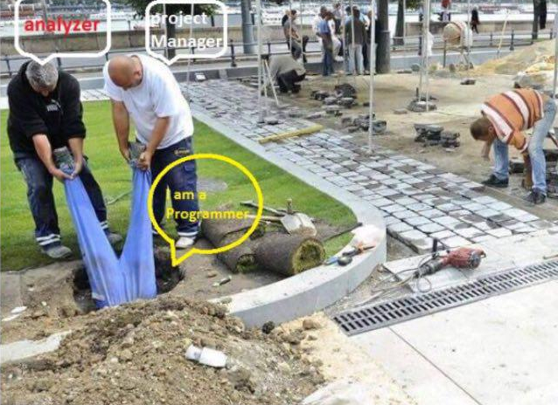
Programmer

Slide 24
Structural design patterns
These design patterns are all about Class and Object composition. Concept of inheritance is used to compose interfaces and define ways to compose objects to obtain new functionalities.
Notes:
It's about relation between objects

Slide 25
Structural design patterns
Adapter
Decorator
Facade
Flyweight
Proxy

Slide 26

Adapter
Convert the interface of a class into another interface clients expect. Adapter lets classes work together that couldn't otherwise because of incompatible interfaces.
Notes:
Match interfaces from different classes
Charger which works in other country
array to feed constructor to initial database initialize
tweak two component is bad idea

Slide 27
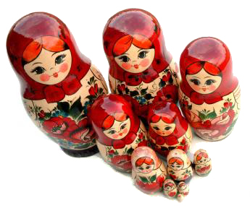
Decorator
Attach additional responsibilities to an object dynamically.
Notes:
Composition over inheritance
Object in object – trait php - duplicate
10 type of a object (car, food, etc) 3 sub class of them
Ex (color, vegetable pi, onion etc) inheritance and you have 30 object.
Order discount ex
def: attached additional responsibility to an object dynamically.

Slide 28
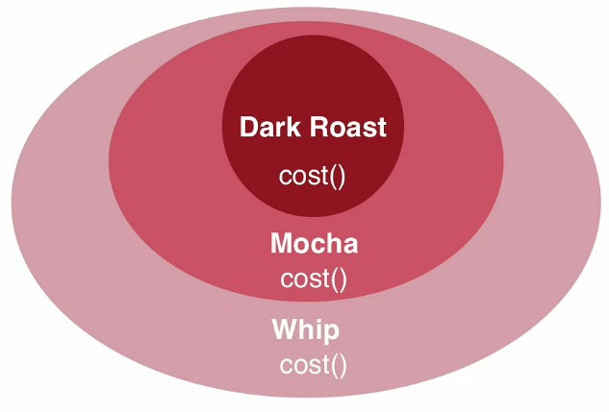
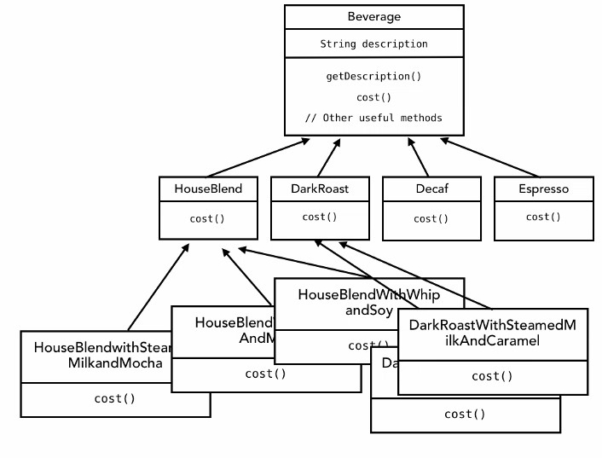
Decorator

Slide 29
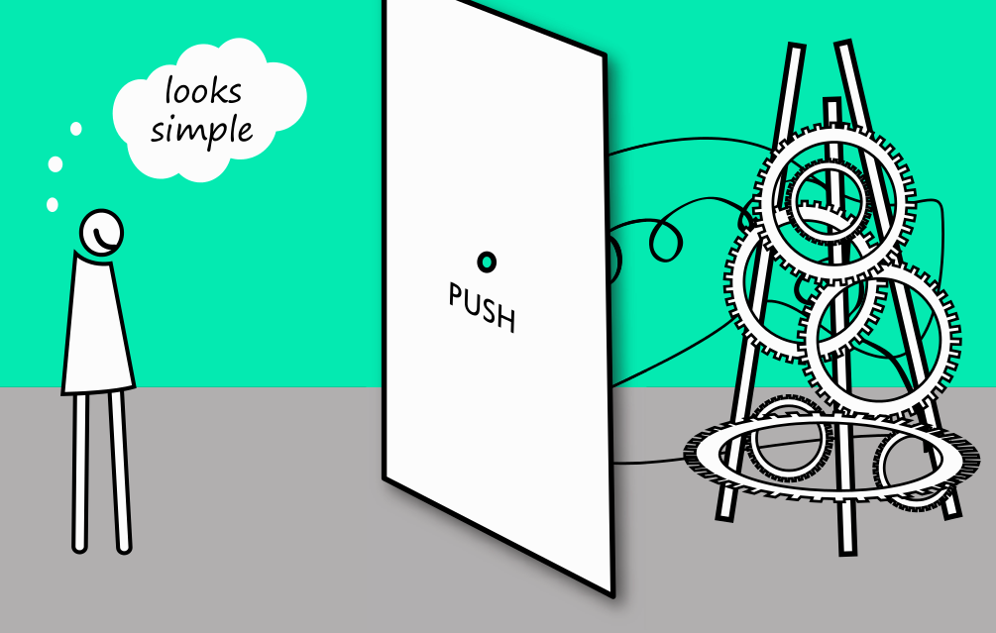
Facade
Wrap a complicated subsystem with a simpler interface.
Notes:
Create a interface between all little sub systems then a high level class can use it simple
Violation of Single Responsibility
Atm transaction a
Amazon one click buy
Graphic libraries
Adapter create a common interface of similar objects
Facade create for unrelated objects

Slide 30
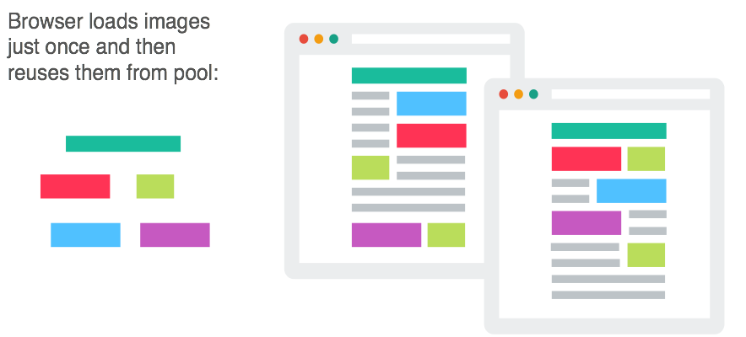
Flyweight
The Flyweight uses sharing to support large numbers of objects efficiently.
Notes:
PCM
Reuse object as possible, feed data get result, don't create new object
GIT example

Slide 31
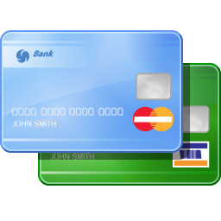
Proxy
Use an extra level of indirection to support distributed, controlled, or intelligent access.
Notes:
An object represent another object
Credit card
API to bank
Security

Slide 32
Behavioral design patterns
These design patterns are all about Class's objects communication. Behavioral patterns are those patterns that are most specifically concerned with communication between objects.
Notes:
It's about communication between objects.
These design patterns are specifically concerned with communication between objects.

Slide 33
Behavioral design patterns
Chain of responsibility
Mediator
Observer
State
Strategy
Template method

Slide 34
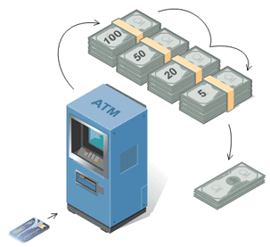
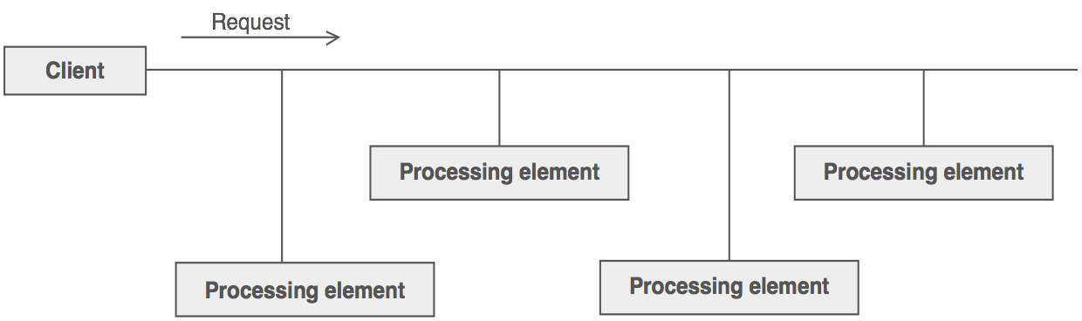
Chain of responsibility
The Chain of Responsibility pattern avoids coupling the sender of a request to the receiver by giving more than one object a chance to handle the request.
Notes:
Passing request between a chain of objects
Approval process
Error handling
End of the chain exception
Failure by design

Slide 35

Mediator
The Mediator defines an object that controls how a set of objects interact. Loose coupling between colleague objects is achieved by having colleagues communicate with the Mediator, rather than with each other.
Notes:
Too many object talk each other : tight coupling
Good for loose coupling,
Coupling
Tight coupling
Simplify communications – air traffic controller

Slide 36

Observer
Observer pattern is used when there is one-to-many relationship between objects such as if one object is modified, its depenedent objects are to be notified automatically.
Notes:
post office, publishing magazine, stock, fallow
if publisher stop working you stop receiving
Loose Coupling (observer and subject)
They interact but have little knowledge of each other
if we want add new observer we don't need to touch subject code

Slide 37
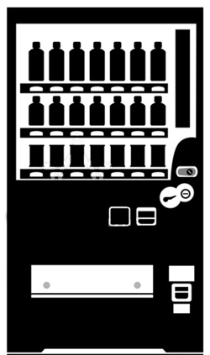
State
The State pattern allows an object to change its behavior when its internal state changes.
Notes:
allow an object to alter its behavior when its internal state changes
State of a fan
Vending machine
each state represented by a class

Slide 38
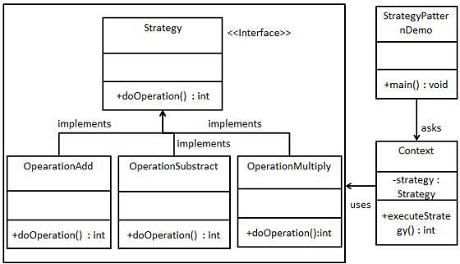
Strategy
In Strategy pattern, a class behavior or its algorithm can be changed at run time.
Notes:
Strategy pattern lets you swap new algorithms and processes into your program without altering the objects that use them
Animal fly (duck) ex
it can't fly but somehow it's can know!
Sub – add – multi – sent strategy run strategy execute ( $a = new strategy(add); $a->execute(1,2); )

Slide 39
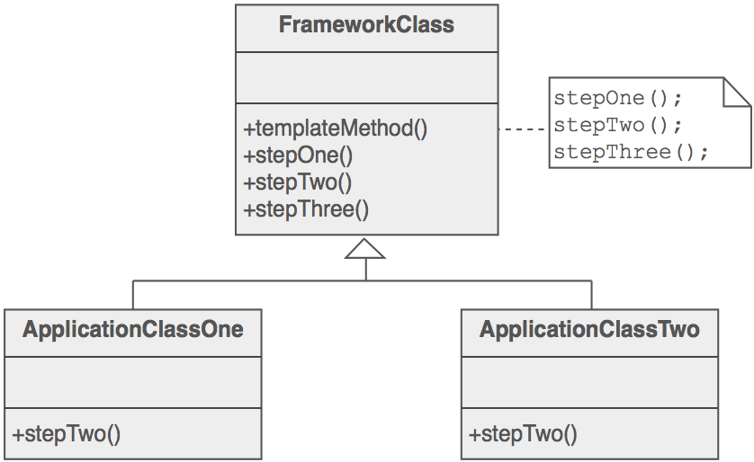
Template method
The Template Method defines a skeleton of an algorithm in an operation, and defers some steps to subclasses.
Notes:
Real world ex: house plan
extend that part

Slide 40
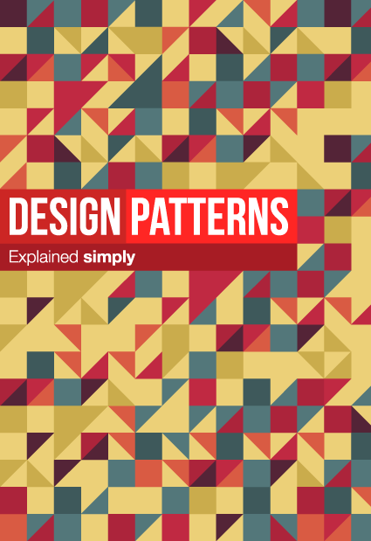
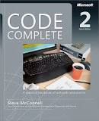
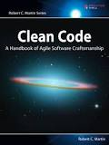

Thank you
Notes:
martin fowler

Slide 41
References
  JavaWorld
  SourceMaking
  TutorialsPoint
  Informit
  geekswitblogs
  Wikipedia [1] [2]

