Slide 1

From Bed Rest to Mars:
Development of a Literature-Derived Machine Learning Framework for Predicting Lower-Limb Muscle Atrophy in Spaceflight Analogues
Niloufar Ahmadymarzdashty¹, Milad Bahari Qaragoz²
¹ Independent researcher
² Master's candidate, Friedrich-Alexander-Universität Erlangen-Nürnberg (FAU)
64. Jahrestagung der DGLRM
Notes:
Intro (Niloufar). Placeholder: add the opening sentence.

Slide 2

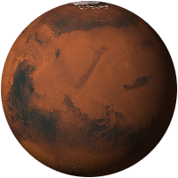
Agenda
Part 1: background and data
Niloufar Ahmadymarzdashty
Part 2: modelling and prediction
Milad Bahari Qaragoz
1
2
3
4
5
6
Intro and motivation
Why predict muscle loss; from bed rest to Mars
Literature research
Range of studies; search and screening
Data extraction and database
Dataset contents; loss per muscle group
ML framework
Testing on unseen campaigns
Models and results
Models, results, LLM robustness and validity checks
Conclusion
Findings, limitations, further work
The marker in the bottom-right corner of each slide shows where we are.
Notes:
Agenda. Part 1 (Niloufar): why this matters and why bed rest, how we searched the literature, and what the dataset contains, including which muscles lose most. Part 2 (Milad): how we tested the models, the models and their results with the validity checks of the LLM, and the conclusion.

Slide 3
Motivation: predicting lower-limb muscle atrophy
Why is this important?
Prevention: identify risk early and leave time to intervene
Countermeasures: match exercise and nutrition to the predicted risk
Vulnerable muscles: show which muscles need closer monitoring
Function: less muscle loss helps preserve strength and power
Mission planning: estimate muscle loss on long missions with limited exercise equipment
Figure 1. Unloading shrinks leg muscles
Weeks to months in bed; legs carry no body weight
Before bed rest
After unloading
Schematic calf cross-section; dashed line = size before unloading.
1 Intro and motivation
Notes:
Opening of part 1 (Niloufar), about forty-five seconds.
Muscle atrophy, especially in the legs, is one of the main problems of long-duration spaceflight. Our question, in the title, is whether the amount of atrophy can be predicted.
Why it matters: a prediction lets crews and planners act early, match exercise and nutrition to the expected loss, focus monitoring on the muscles that lose most, protect strength and function, and plan long missions where exercise equipment is limited.
On the right is the ground model we rely on: volunteers lie in bed tilted six degrees head-down for weeks to months. The circles show a calf cross-section before and after unloading; how much each muscle loses comes later, in the muscle section.

Slide 4

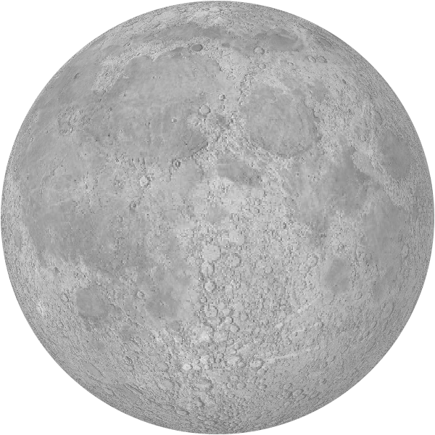
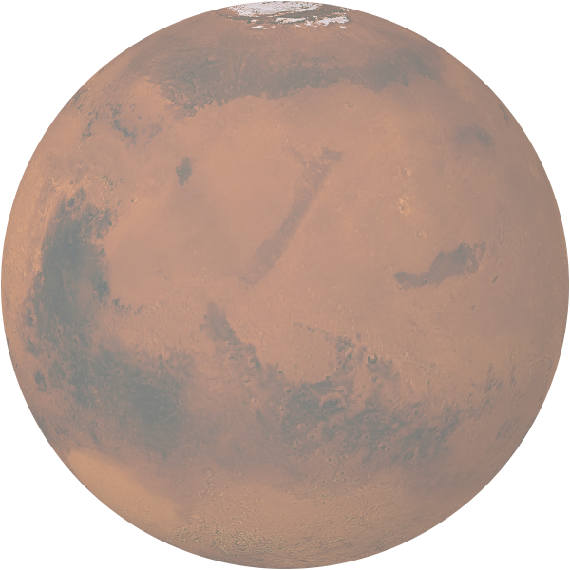
From bed rest to Mars: analogue and application
Bed rest: the ground analogue
Spaceflight data on muscle are scarce
Head-down bed rest unloads the legs under controlled conditions
Mars: the long-term application
No early return in an emergency: the crew depends on its own fitness
Figure 2. Moon mission vs Mars mission
3 days
about 6 months, one way
Earth
Moon
Mars
Moon mission
about 12 days
◄ the whole mission (Apollo 17)
Mars mission
about 2.5 years
to Mars
on Mars, about 500 days
home
arrival: 6 months weightless, then surface work
0
1 year
2 years
Bed-rest studies
ground analogue
Atrophy prediction
this work
+
Strength and power assessment
Operational readiness on arrival
Figure 3. From bed-rest data to crew readiness
Dashed: future use, which needs validation with spaceflight data
1 Intro and motivation
Notes:
Part 1 (Niloufar), about forty-five seconds.
Direct spaceflight data on muscle are scarce, so we use head-down bed rest, the standard ground analogue: volunteers lie tilted six degrees head-down and their legs carry no weight, under controlled conditions. Bed rest is not the same as spaceflight, but it is a sound starting point to build and test prediction models.
Mars in our title stands for the long-term application. The panel compares the two missions on one time scale. A Moon mission lasted about twelve days, and the crew could be home in three. A Mars mission takes about two and a half years: six months to get there, about five hundred days on the surface, six months back. There is no early return in an emergency, and after six months in weightlessness the crew must leave the spacecraft and work on the surface. Mission figures: Apollo 17, and NASA's Mars Design Reference Architecture 5.0.
The bottom row is the idea: atrophy prediction, together with strength and power testing, could one day help keep the crew ready for work on arrival. The dashed steps are future use, and applying the model on a real mission needs validation with spaceflight data first.

Slide 5
Range of unloading durations and studies
Figure 4. Unloading range in the abstract and in the final dataset
Abstract
15 bed-rest studies
14
119
Final dataset
52 studies
5
bed rest
spaceflight
180
Days of unloading
0
30
60
90
119
150
180
Figure 5. Studies published per year, by length of unloading
Years without studies omitted
Length of unloading
180 days (spaceflight)
61 to 119 days
31 to 60 days
15 to 30 days
5 to 14 days
2 Literature research
Notes:
Part 1 (Niloufar), about forty-five seconds.
When we submitted the abstract, our dataset held 15 bed-rest studies, covering 14 to 119 days of unloading. After submission we extended it. The final dataset has 52 studies, published from 1992 to 2026, and covers 5 to 180 days. The orange part of the lower bar is not bed rest: the stretch beyond 119 days comes from spaceflight, where three studies measured crews after about 180 days.
The chart below shows how many of these studies were published each year, and the colours show how long the unloading lasted. Most of the literature is recent: 37 of the 52 studies are from 2016 or later. Short studies of up to two weeks are the most common; long campaigns of two to four months are rarer.

Slide 6
Literature search and study selection
IDENTIFICATION
SCREENING
FULL TEXT
INCLUDED
FINAL DATASET
5,741
records found
PubMed, Scopus, Web of Science, NASA reports; 10 from other sources
3,600
records after removing duplicates
84
full texts sought
52
studies
36
campaigns
742 rows; papers on the same cohort merged
2,141 duplicates removed
2,493 excluded, mostly no unloading model or no muscle outcome
1,023 not screened in time
19 report muscle results only as charts, without a baseline value
4 full texts not available
11 excluded at full text
Figure 6. Flow of records, in the style of PRISMA 2020. Full-text counts as recorded; they are still being reconciled with the dataset.
2 Literature research
Notes:
Part 1 (Niloufar), about one minute.
We searched four databases, PubMed, Scopus, Web of Science and NASA's technical reports, and added older work we had collected before the search, nine studies from before 2013 and one campaign from NASA's open bed-rest data. In total, 5,741 records. After removing duplicates, 3,600 records remained. 2,493 were excluded, mostly because they did not use an unloading model or did not measure muscle, and 1,023 could not be screened in the time we had, so they did not go further.
We sought 84 full texts. The main loss at this step: 19 studies show their muscle results only as charts, without a baseline value, so we could not extract them; 4 full texts were not available and 11 were excluded. These full-text counts are as recorded in our screening log and are still being reconciled with the dataset, so do not claim they add up exactly. 52 studies were included.
Several papers often report the same bed-rest campaign, so we merged papers on the same cohort. The final dataset has 36 independent campaigns and 742 rows.

Slide 7
Dataset composition
Table 1. Final dataset at a glance
Table 2. Imaging method and size measure
Feature | n
Muscles or muscle groups | 51
Rows: control / countermeasure | 470 / 272
Rows: during bed rest / recovery | 478 / 264
Method | n | Size measure | n
MRI | 655 | Volume | 594
DXA | 37 | Cross-sectional area | 100
CT | 30 | Lean mass | 37
Ultrasound | 20 | Thickness | 11
Total | 742 | Total | 742
742 observations are not 742 independent participants: one campaign gives rows for several muscles, groups and scan days.
3 Data extraction and database
Notes:
Part 1 (Niloufar), about one minute.
The final dataset has 742 rows. Each row is one muscle outcome: one muscle, in one group, at one scan day. One campaign can therefore give many rows, for several muscles, time points or groups.
For each outcome we extracted the length of unloading, the day of the scan, the muscle, the participants (group size, share of women, age), whether the group had a countermeasure, the imaging method, and how muscle size was measured. Our prediction target is the percentage change in muscle size from baseline.
Left table: 742 rows from 52 studies and 36 independent campaigns, covering 51 muscles or muscle groups; 470 rows are control groups and 272 countermeasure groups; 478 were measured during bed rest and 264 in recovery. 742 rows does not mean 742 people: one campaign gives rows for several muscles, groups and scan days.
Right table: most rows are MRI volumes. CT gives cross-sectional area, DXA gives lean mass of the leg, and ultrasound gives thickness or area.

Slide 8
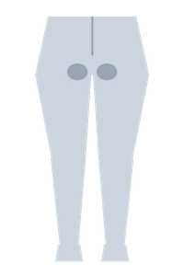
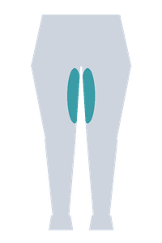
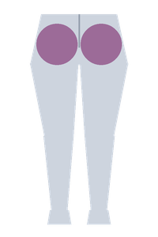
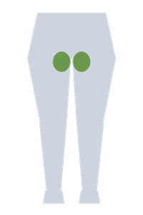
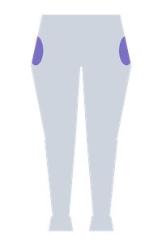
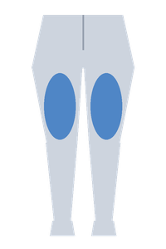
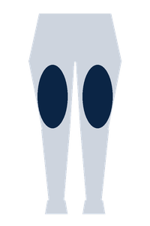
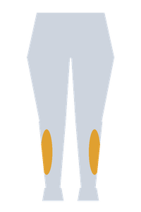
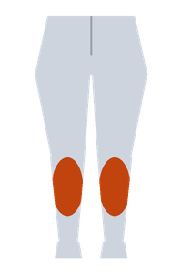
Muscle atrophy by muscle group
Change in muscle size
At day 60
0%
day 60
Deep hip rotators
−1.9%
Inner thigh (hip adductors)
−5.4%
−4%
Glutes (hip extensors)
−6.1%
−8%
Hip flexors
−6.8%
−12%
Outer hip (hip abductors)
−9.1%
−16%
Back thigh (knee flexors)
−9.8%
Front thigh (knee extensors)
−10.1%
−20%
Shin (dorsiflexors)
−10.2%
−24%
Calf (plantar flexors)
−15.8%
0
30
60
90
120
Day of unloading
Figure 7. Change in muscle size by muscle group: one shared time course (τ = 60 days) scaled to each group's day-60 estimate; control groups, days 5 to 119.
3 Data extraction and database
Notes:
Part 1 (Niloufar), about one minute.
No, muscles are not affected equally. Each line shows how much a muscle group shrinks over the days of bed rest, for groups without a countermeasure. The dashed line reads the values at day 60.
The calf, the plantar flexors, loses most: about 16 percent at day 60, almost 6 percentage points more than the front thigh. The shin, the front thigh and the back thigh lose about 10 percent. Hip muscles lose least.
How the lines are drawn: the day-60 values are the estimates of our meta-regression for each muscle group. The shape over time is the one curve the model fits to all muscles, rising fast in the first weeks and levelling off; time constant 60 days. Hip rotators and outer hip rest on a single campaign each, so treat those two with care.

Slide 9
Evaluation: leave-one-campaign-out validation
Input: one measurement
Day of bed rest when the scan was taken
Which muscle group (9, e.g. calf, front thigh)
Exercise group or no-exercise control
How it was scanned (MRI, CT, DXA, ultrasound)
One muscle or several combined
Model
Duration curve: uses the number of days only (the baseline)
4 standard ML models
TabPFN (pretrained network)
LLM classifier: returns a probability per range
Output
How much the muscle has shrunk, in % of its size before bed rest
Average over the group of volunteers, e.g. −10%
Figure 8. Testing: hold out one campaign, train on the rest, repeat 32 times
Grey: 31 training campaigns. Orange: the held-out test campaign. Each campaign is held out once.
Why campaigns, not measurements: the 346 rows used for modelling come from 32 of the 36 campaigns, and rows of one campaign share volunteers.
Score: average error in percentage points (pp), each campaign counted once. Predicted −10%, measured −13%: error 3 pp.
4 ML framework
Notes:
About one minute.
Each row in our data is one measurement: a group of volunteers, one muscle, one day of bed rest. The inputs are the day of the scan, the muscle family, whether the group did a countermeasure, how the muscle was imaged, and whether the value covers a group of muscles. The output is the percentage change in muscle size from before bed rest.
We have 346 rows, but they come from 32 independent campaigns, because several papers report the same volunteers. So we test by holding out one whole campaign, training on the other 31 and predicting the held-out one, 32 times. The code checks that no campaign appears on both sides of a split.
The score is the mean absolute error in percentage points, averaged so that each campaign counts once. Every model is compared with a duration-only curve, which uses the number of days and nothing else.

Slide 10
LLM-based probabilistic classifier: input and output
Request (one per measurement)
participants
men only, mean age 35, n = 11
protocol
head-down tilt bed rest, 21 days, control group
measurement
vastus lateralis, MRI cross-sectional area
target
day 21 of bed rest
typical_curve_other_campaigns
duration curve fitted on the other 31 campaigns
observations_other_campaigns
rows from the other 31 campaigns, most similar first, up to about 26,000 tokens
question
Which range will the change fall in? 19 options: below −30%, 2-point ranges up to +4%, +4% and above
LLM
classifier
fixed version
Not a chat model: it is built for classification and returns only a probability for each listed option, never free text.
Our code averages the range midpoints, weighted by probability (open ends count as −31% and +5%): −6.6%
Measured: −9.4%, an error of 2.8 pp, a typical row
Never sent (checked on every request): the held-out campaign's measurements, and any paper, author or campaign name. All 430 answers are saved, so every result can be rebuilt without calling the model again.
5 Models and results
Notes:
About a minute and a half.
The ML models only saw coded columns. Here we gave each measurement, written out in words, to a newly released language model built for probabilistic classification. It is not a chat model that writes text: you give it a described situation and a fixed list of options, and it returns a probability for each option, nothing else.
On the left is a real request from our cache. It describes the volunteers, the protocol, the muscle and how it was scanned, and the day. It also contains the duration curve fitted on the other 31 campaigns and as many rows from those campaigns as fit, most similar first. The question asks which of 19 ranges the change will fall in.
On the right is what came back for this row: a probability for each range. We never ask the model for a number. Our code turns the probabilities into a prediction, here minus 6.6 percent against an observed minus 9.4. We chose this row because its error is the model's median error.
The request never contains the held-out campaign's own data or any name that could identify a paper, and the code checks that on every request. Every answer is cached, so all our numbers can be rebuilt without calling the model again.

Slide 11
Model comparison on held-out campaigns
ML models explain more of the differences (R² 0.27 to 0.39), but none has lower error than the curve.
LLM vs curve, scored the same way: 2.71 vs 3.13 pp, so 0.42 pp smaller; closer in 20 of 32 campaigns.
95% confidence interval of that difference: 0.13 to 0.73 pp. The whole range is above zero, so it is unlikely to be luck.
The curve shows 3.13 pp here, not 3.16, because the comparison scores it exactly as it scores the LLM.
5 Models and results
Notes:
About a minute and a half.
We compared four standard models, ridge regression, random forest, support vector regression and gradient boosting, tuned inside each training fold, and later TabPFN, a neural network pretrained for small tables. On the left is the error on the held-out campaign. The duration curve scores 3.16 percentage points and the best ML model, the random forest, 3.18: none of them is lower than the curve. On the right, the ML models explain two to three times more variance, because they learn that the calf loses more than the hip. Most of the error left is a shift that applies to a whole campaign, from its scanner, its volunteers or its protocol, and none of our columns describes it. We had committed in advance to report this result whichever way it came out.
The language model is at the bottom. Its error is 2.71 percentage points, the lowest of all models, and it explains the most variance, 0.43.
Compared with the curve on the same rows and scored the same way, the error falls from 3.13 to 2.71, a gain of 0.42 points. The 95 percent confidence interval runs from 0.13 to 0.73, so even the most pessimistic estimate is an improvement. It is closer than the curve in 20 of the 32 campaigns. No other method has a gain whose interval stays above zero.
If asked about a target: we had set a 15 percent improvement target. The error improvement is 13.3 percent and the probabilistic score improvement 17.7 percent.

Slide 12
Robustness and validity checks of the LLM prediction
Gain = how much smaller the LLM's error is than the curve's, in pp (full result: 0.42). Each check and its pass rule were fixed before running it.
Does it recognise a known campaign?
Everything identifying a campaign removed: gain still 0.30 pp, interval above zero
Asked to choose the campaign's name from a list of options: right 19% of the time, where guessing gives 8%
Does it use the other campaigns' data?
Their values shuffled: worse than the curve (gain −1.25 pp)
None of their data given: error 5.85 vs 3.13 pp
Is it sensitive to presentation?
Other campaigns' rows in a different order: error changes 3%
Answer ranges moved by 1 point: error changes 1%
Is it reproducible?
20 identical requests resent: predictions differ by 0.17 pp on average, well below the 0.42 pp gain
Limitations of this result
Added after the ML result was known; not in the original plan
Overconfident ranges: its 80% ranges hold the measured value 62% of the time, so we report only its single-number prediction
Given a campaign's own earlier scans, it does not use them
5 Models and results
Notes:
About a minute and a quarter.
We wrote down each check and its pass rule, and committed them to the repository, before running it.
Language models have read many papers, so the model might recognise a published campaign and recall its result. With every identifying detail removed, the gain is 0.30 points and its interval stays above zero. When we asked the model to choose the campaign's name from a list of options, it was right 19 percent of the time, where guessing gives 8 percent. If asked: of the three campaigns behind most of the gain, it named only one.
When we shuffle the other campaigns' values, the gain turns into a loss of 1.25 points, and with no reference data the error rises to 5.85. The gain comes from reading those data.
Reordering the rows or shifting the range edges changes the error by 1 to 3 percent. Repeating 20 requests moves the predictions by 0.17 points on average, well under the 0.42 gain.
Three limitations: we added this model after the ML result; its 80 percent ranges contain the truth only 62 percent of the time, so we quote only point predictions; and when given a campaign's own earlier scans, it does not use them.

Slide 13
Conclusions, limitations and further work
Conclusions
ML models do not beat a duration-only curve (3.18 vs 3.16 pp)
The LLM classifier lowers the error to 2.71 pp (curve 3.13 pp)
Limitations
32 independent campaigns, mostly young men
No bed-rest data beyond day 119
Group averages, not individual astronauts
Bed rest is not spaceflight
Further work
Muscle-specific modelling: estimate each muscle's susceptibility and combine it with baseline volumes into total lower-limb volume loss
Individual and functional prediction: participant-level data over time, linked to strength and function
Validation on independent campaigns and spaceflight data before any personal risk-assessment tool
6 Conclusion
Notes:
About thirty seconds.
With 32 independent campaigns, standard ML models and TabPFN do not beat a curve that only knows the number of days. An LLM-based probabilistic classifier that reads each campaign's description and the other campaigns' data reduces the error from 3.13 to 2.71 points. The main limitation is the small sample of 32 campaigns, mostly young men, with no bed-rest data beyond day 119. Stress this: every row is a group average, so the model predicts the average loss of a group of volunteers. It cannot yet predict the risk for an individual astronaut.
Further work has three steps. First, estimate how susceptible each muscle is relative to a reference muscle, and combine those coefficients with baseline muscle volumes to estimate total lower-limb volume loss; the dataset has 30 group time points where three or more muscles were scanned together, across 14 campaigns, so this can be tested. Second, move from group averages to individuals with participant-level data over time, and link muscle loss to strength and function. Third, validate on independent campaigns and on spaceflight data before building any personal risk-assessment tool. These are plans, not results.

Slide 14
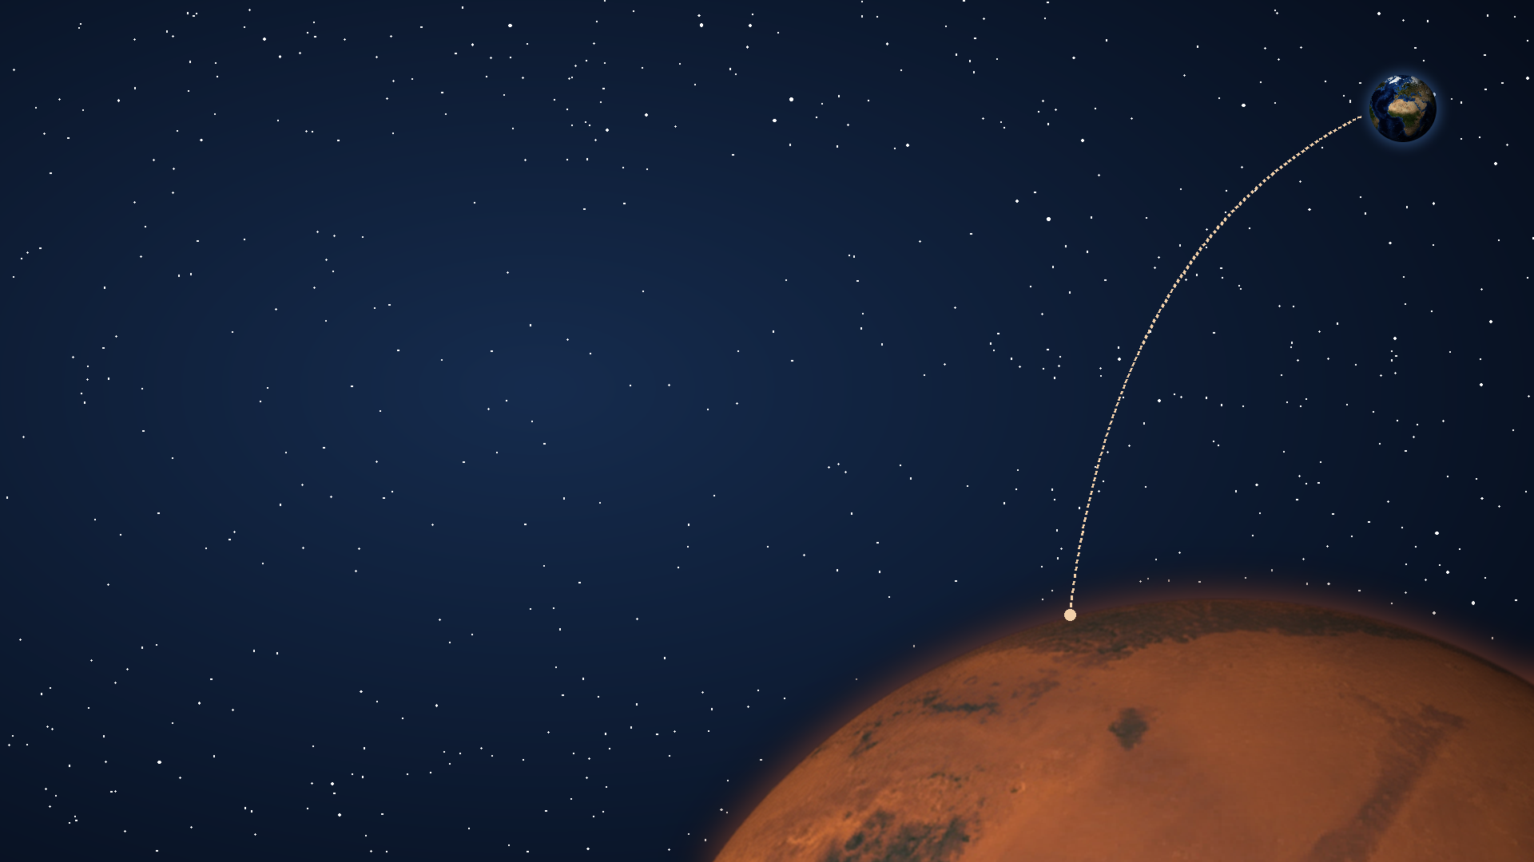
Thank you for listening
Questions are welcome
From Bed Rest to Mars | 64. Jahrestagung der DGLRM
Notes:
Close (Milad). Thank the audience and invite questions. The backup slides that follow answer the questions we expect: part 1 on slides 17 and 18, data and search on 15 and 16, part 2 on 19 to 21.

Slide 15
Backup: dataset coverage and limitations
Did you miss studies?
Four sources searched from 2013 on, plus 10 older or open-data studies (sources and queries on the next slide)
Not covered: Embase (no access); 1,023 records not screened in time (slide 6)
One campaign dominates the data
MEDES 90-day: 40% of all rows, a quarter of the modelling data
Scoring gives each campaign one vote; the re-run without it is still to do
Can MRI, CT, DXA and ultrasound be mixed?
Each method gets its own term: DXA and ultrasound thickness show 5 to 6 pp less loss than CT; MRI volume is within 0.5 pp
The MRI-only re-run is still to do
How reliable is the extraction?
Every value is traced to its paper and page, table or figure
674 of 742 rows high confidence; 19 read off figures; no independent second extraction
BACKUP
Notes:
Backup. Be direct that the three must-show sensitivity analyses (composite-first, without MEDES, MRI only) have not been run yet. Only the weighting check has, and it changed little.

Slide 16
Backup: literature search sources and query
Table 3. Sources (searched 4 September 2026)
Figure 12. Query: two required blocks
Source | Records
PubMed | 1,412
Scopus | 1,757
Web of Science Core Collection | 1,876
NASA Technical Reports Server | 686
Earlier studies and NASA open data | 10
Total | 5,741
Unloading model
bed rest, head-down tilt, dry immersion, limb suspension, simulated microgravity, disuse
AND
Muscle outcome
atrophy, muscle volume, mass, size, cross-sectional area, lean mass, thickness, main leg muscles
NOT
Excluded
rat, mouse, rodent, hindlimb
Web of Science string, verbatim
TS=(("bed rest" OR bedrest OR "head-down tilt" OR "head down bed rest" OR HDBR
OR antiorthostatic OR hypokinesia OR hypodynamia OR "dry immersion"
OR "limb suspension" OR ULLS OR "simulated microgravity"
OR "microgravity analog*" OR "spaceflight analog*" OR "mechanical unloading"
OR "muscle unloading" OR disuse)
AND
(atroph* OR "muscle volume" OR "muscle mass" OR "muscle size"
OR "cross-sectional area" OR PCSA OR "lean mass" OR "muscle thickness"
OR "muscle wasting" OR deconditioning OR soleus OR gastrocnemius
OR "triceps surae" OR quadriceps OR "vastus lateralis" OR "knee extensor"))
NOT TS=(rat OR rats OR mice OR mouse OR rodent OR hindlimb OR "hind limb")
Journal databases: publications from 2013 onwards
Older work enters through studies we held before the search (9) and one NASA open-data campaign
NASA reports: five short keyword queries, e.g. "bed rest" "muscle volume"
Not searched: Embase (no institutional access), Cochrane CENTRAL, trial registries, citation chasing
BACKUP
Notes:
Backup. All four strings are in the report appendix, copied from docs/literature-review/search_log.md. PubMed uses the same two blocks with MeSH terms and the humans filter; Scopus and Web of Science exclude animal studies in the query. The 2013 limit is the main weakness: only two of ten known modelling papers fall inside the window, and the known-item test without the limit was not run. Embase was not searched for lack of access; it indexes conference abstracts the other databases miss.

Slide 17
Backup: dataset expansion and composition
The abstract had 15 studies. Did adding 37 change the analysis after seeing data?
Eligibility criteria were fixed before screening; the dataset was frozen (14 and 19 September) before the final models
The curve shape was chosen by a rule declared before fitting
Slide 5 shows 180 days, but the model stops at day 119. Why?
The 14 spaceflight rows were measured after landing, so they leave the model with the 264 recovery rows
8 of the 14 are one back muscle (lumbar multifidus)
Mostly young men: does this apply to women and older crews?
Rows, not people: men only 567, mixed 113, women only 40 (35 of them WISE-2005), not reported 22
Healthy young 692, middle-aged 8, older 42: the results describe young men
What exactly is a row's percentage change?
Follow-up vs the same group's own baseline; negative means loss
Recomputed from the printed values; where a paper prints the mean of individual changes, that value is kept and labelled
Rows weighted by number of participants: only 8 of 32 campaigns report the spread of the change
BACKUP
Notes:
Backup, part 1 (Niloufar). Expansion: the eligibility criteria in the report's Table 2 were written before screening; dataset version 1.0 was frozen on 14 September and 1.1 on 19 September, and every result is fitted on 1.1. The rule for the curve: the saturating form is the headline unless another form beats it by at least 4 AIC points. Spaceflight: the dataset keeps the spaceflight rows, flagged, but they are post-flight measurements, so the during-unloading filter removes them. Weighting: inverse-variance weighting would need the spread of the change, which most papers do not print; the check that compares both weightings moved the duration effect by under 1 pp.

Slide 18
Backup: certainty of the muscle-group curves
Is each line fitted to its own muscle?
No. The day-60 values are fitted per muscle group (named muscles, 25 campaigns); the lines share one time course (τ = 60 days)
Separate shapes cannot be estimated: six of nine groups rest on four campaigns or fewer
Why a saturating curve?
Logarithmic, saturating and spline curves fit equally well (within 1.3 AIC points): the loss slows, but the data cannot say along which curve
By day 119 the curve reaches 86% of its plateau, −17.3% (95% CI −20.9 to −13.7)
How certain are the day-60 values?
Calf −15.8% (95% CI −18.9 to −12.7); front thigh −10.1% (−13.6 to −6.6); hip rotators −1.9% (−3.9 to 0.2)
Calf vs shin, the ankle's opposing pair: 5.6 pp more loss (2.1 to 9.1), p = 0.003
Hip rotators and outer hip: one campaign each
Is the calf result an artefact of how often it is scanned?
The order holds after adjusting for duration, countermeasure group and imaging method
Calf: 78 rows from 13 campaigns, the second best-covered group after the front thigh (86 rows, 22 campaigns)
BACKUP
Notes:
Backup, part 1 (Niloufar). Be precise about slide 8: the coloured dots at day 60 are the model's estimates for each muscle group, with the intervals shown here. The lines are drawn with one shared time course scaled to those values, so they show the shape the model assumes, not a separate fit per muscle. The intervals are 95% cluster-robust, which means they account for several rows coming from the same campaign. The calf-versus-shin contrast is reported on its own because it does not depend on which muscle is the reference.

Slide 19
Backup: significance and relevance of the LLM gain
Is 0.42 pp worth anything?
It is 13% lower error than the curve (3.13 to 2.71 pp)
Small; we present it as a secondary finding
20 of 32 campaigns is close to a coin flip
Counting wins only: p = 0.22 (sign test)*
Using the size of each win: mean gain 0.42 pp, 95% CI 0.13 to 0.73
Does it rest on a few campaigns?
3 long MRI campaigns (NASA SPRINT, Berlin BBR2-2, MEDES LTBR) give 56% of the gain; without them 0.20 pp, CI −0.01 to 0.43*
Only SPRINT is recognised, and with campaign details removed the LLM still wins there (3.79 vs 5.92 pp)
Did it read these papers in training? Was it added after the fact?
Training exposure cannot be ruled out by any test; hiding campaign details and the naming test are the strongest checks available
Added after the ML result, but every check and target was committed before the first answer
* Our calculation from the saved LLM predictions; not in the report.
BACKUP
Notes:
Backup. The two starred numbers are our own calculation from results/forecast_predictions.csv, not in the report. Without the three campaigns that carry most of the gain, the interval touches zero; say so if asked.

Slide 20
Backup: ML results and fairness of the comparison
Did the ML models get a fair chance?
Tuned inside each training fold, grouped by campaign; TabPFN needs no tuning
All models saw the same inputs, folds and scoring
Why not add age, sex or countermeasure type?
32 campaigns leave room for about 3 campaign-level inputs (about 10 campaigns per input)
Age and sex are fixed within a campaign (271 of the 346 modelling rows men-only), so they act as a campaign label; 100 countermeasure rows spread over 9 types
Is the duration curve a straw man?
Ridge regression uses days, muscle and every other input: 3.28 vs 3.16 pp
Knowing the muscle raises R² but not the error on a new campaign
Would a nearest-neighbour method match the LLM?
Not tested. If the gain comes from picking similar rows, this is the next control to run
BACKUP
Notes:
Backup. The honest gap here is the nearest-neighbour control: we cannot yet say whether a simple similarity method would match the LLM. The 271 men-only rows and 100 countermeasure rows are our count on the 346 modelling rows; the report gives the same point on the 425 lower-limb rows before duplicate composites were removed (347 men-only, 126 countermeasure).

Slide 21
Backup: applicability to Mars mission planning
A Mars transit is about 180 days; the data stop at 119
Only one campaign reaches 119 days
A 180-day estimate is planned from the duration curve only, with an uncertainty range, labelled as an assumption
Bed rest is not spaceflight
Only 14 spaceflight rows, 8 of them one back muscle: too few to test transfer
Which countermeasure works? What about individuals?
Countermeasure groups lose 3.7 pp less (95% CI 1.5 to 5.9), all types pooled
Every row is a group average; nothing about individual risk
Can anyone reproduce an LLM result?
Fixed model version; all 430 answers saved, so every number rebuilds without the model
Identical requests differ by 0.17 pp on average
BACKUP
Notes:
Backup. The supported planning statements, within 5 to 119 days and for groups: most loss happens in the first weeks, calf muscles need protecting first, and countermeasure groups lose less.

