Slide 1
MD5 Hash Generator - Digital Design Implementation Report
Executive Summary
This report documents the implementation of a complete MD5 hash generator system designed using Verilog HDL. The system features a modular architecture with separate controller and datapath components, implementing the MD5 cryptographic hash algorithm with 128-bit output. The design has been verified through simulation testing against known test vectors.

Slide 2
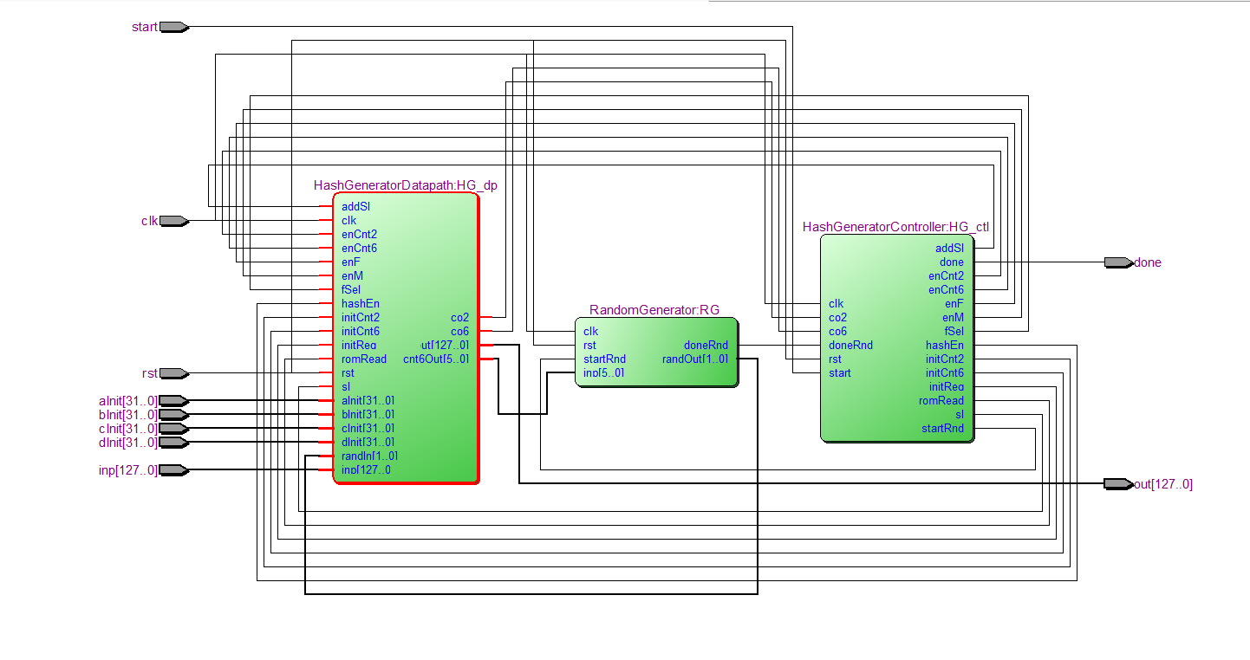
1. System Architecture

Slide 3
1.1 Top-Level Module: HashGenerator
Parameters: Configurable input size (default: 128-bit)
Inputs: Clock, reset, start signal, 128-bit input data, initial hash values (A, B, C, D)
Outputs: 128-bit hash output, completion signal
Submodules:
  HashGeneratorController (Finite State Machine)
  HashGeneratorDatapath (Computational pipeline)
  RandomGenerator (Random number generation for message scheduling)

Slide 4
Module Specifications

Slide 5
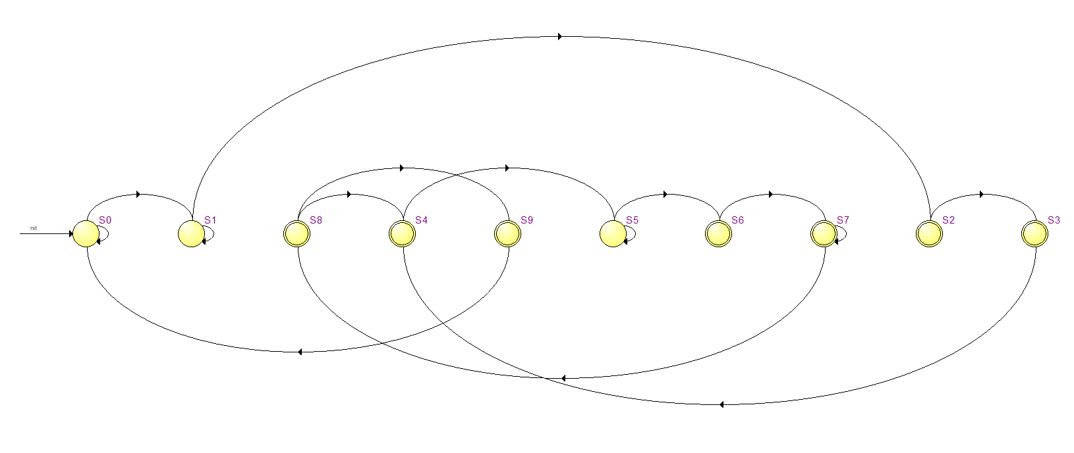
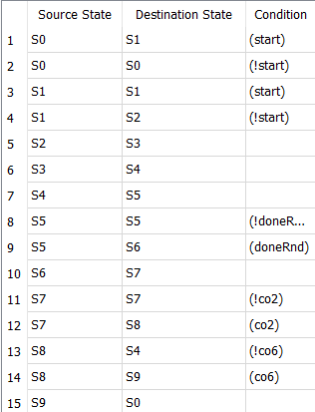
2.1 HashGeneratorController

Slide 6
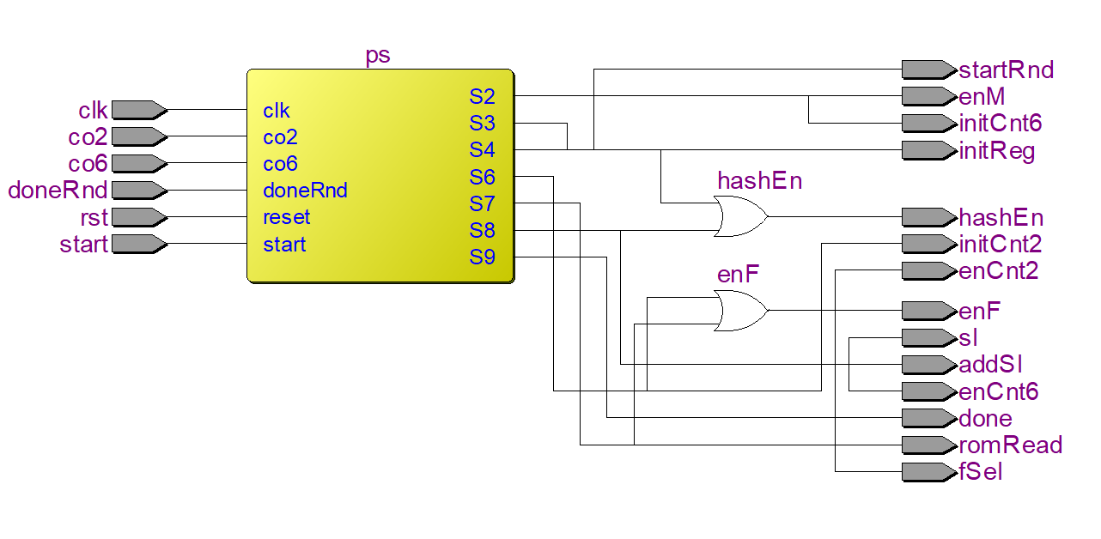
Function: Implements the main control FSM for MD5 computation
State Transitions:
S0: Idle state, waits for start signal
S1: Start acknowledgment
S2: Enable message registers, initialize counter
S3: Initialize hash registers
S4: Start random number generation
S5: Wait for random generation completion
S6: Initialize F function computation
S7: Process F function with counter
S8: Update hash values, check loop completion
S9: Output final hash, return to idle
Control Signals:
  enM: Enable message registers
  initCnt6: Initialize main loop counter (64 iterations)
  hashEn: Enable hash register updates
  startRnd: Start random number generation
  romRead: Enable ROM read operations
  And …

Slide 7
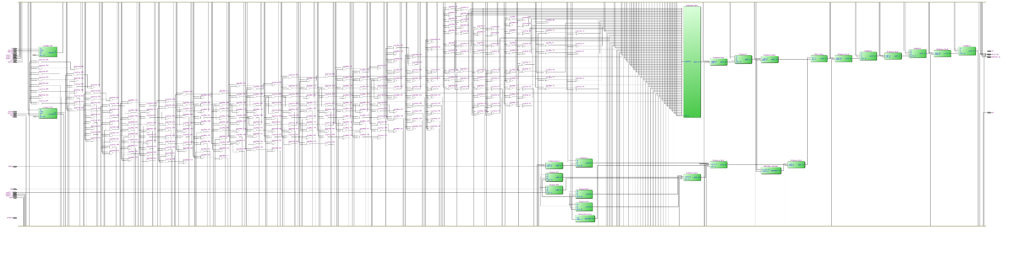
2.2 HashGeneratorDatapath

Slide 8
Function: Implements the computational pipeline for MD5 algorithm
Key Components:
Message Registers (M00-M11):
  Four 32-bit registers storing input message blocks
  Enabled by enM control signal
Hash Registers (A, B, C, D):
  Four 32-bit registers storing intermediate hash values
  Support initialization and iterative updates
F Function Logic:
  Four logical functions selected based on round number:
    Round 1-16: F(B,C,D) = (B & C) | (~B & D)
    Round 17-32: G(B,C,D) = (D & B) | (~D & C)
    Round 33-48: H(B,C,D) = B ^ C ^ D
    Round 49-64: I(B,C,D) = C ^ (B | ~D)
Rotation Unit:
  Implements variable left rotation based on MD5 specification
  Pre-programmed rotation amounts for each round
Constants ROM:
  Stores 64 32-bit constants for MD5 computation
  Addressable by main loop counter

Slide 9
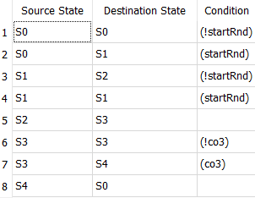
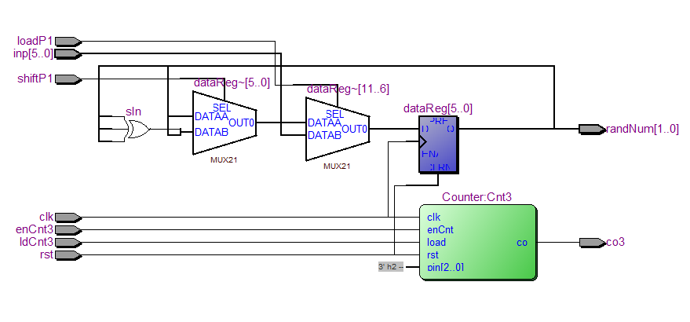
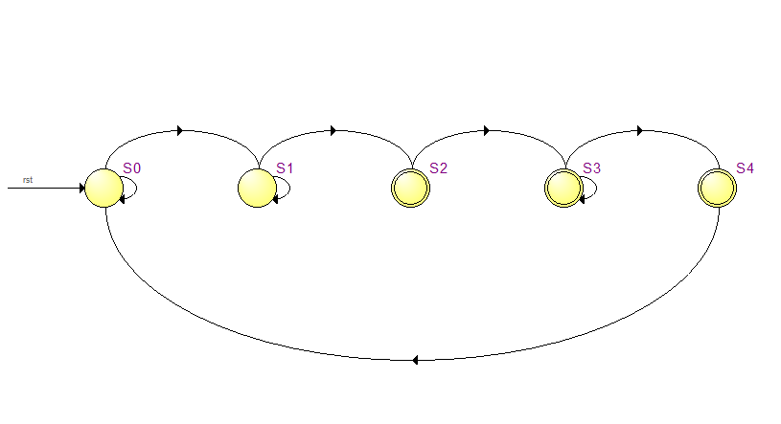
2.3 RandomGenerator
datapath
controller

Slide 10
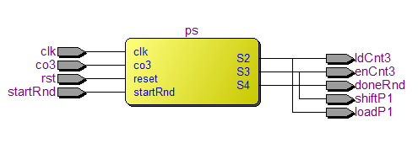
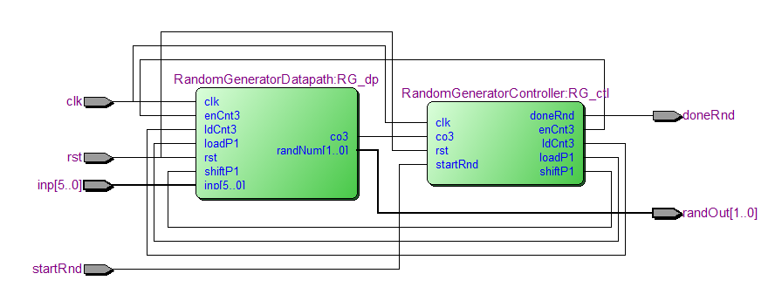
Function: Generates pseudo-random indices for message scheduling
Components:
Controller: 5-state FSM for random generation sequence
Datapath: Linear feedback shift register (LFSR) based implementation
Output: 2-bit random number for message word selection

Slide 11
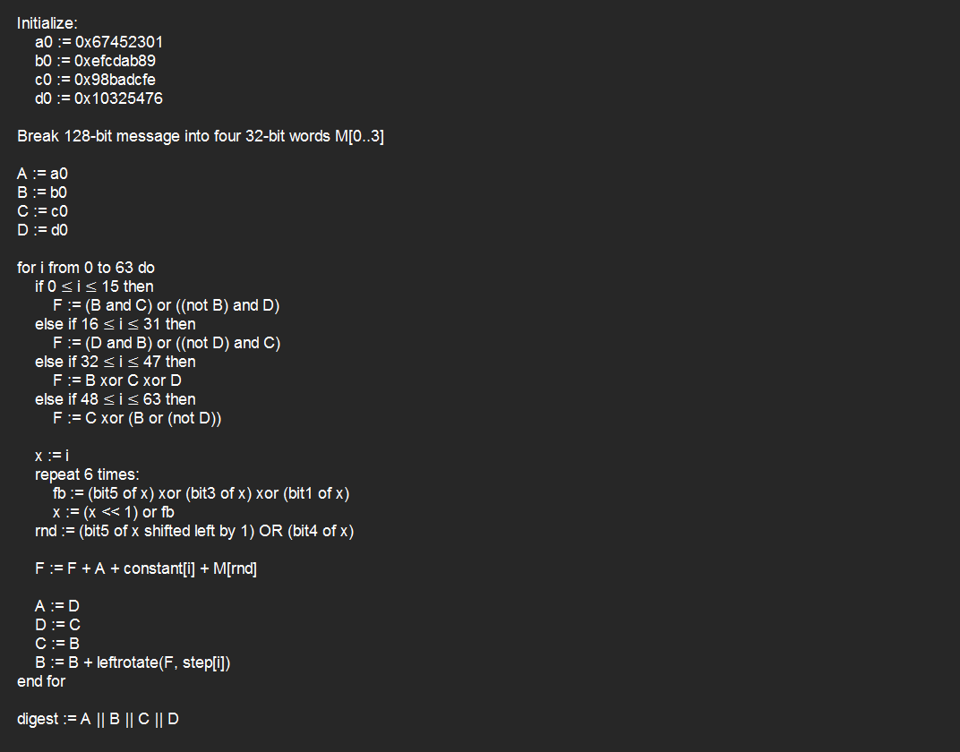
3. Algorithm Implementation

Slide 12
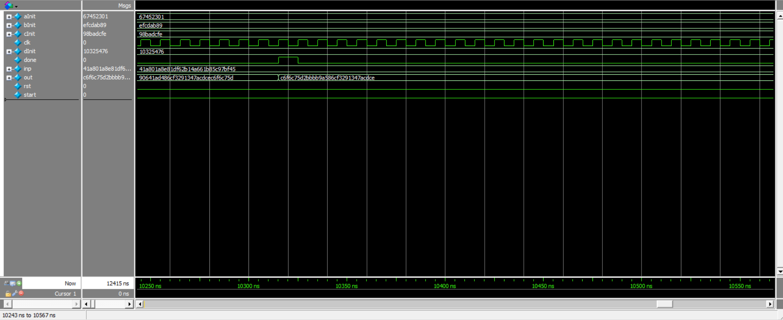
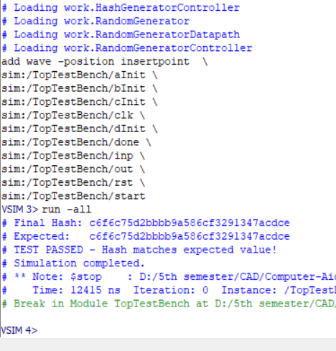
passes verification against standard test vectors

Slide 13
Conclusion
The implemented MD5 hash generator successfully demonstrates a complete cryptographic hash function in hardware. The modular design approach with separate controller and datapath components provides maintainability and scalability. The system correctly implements the MD5 algorithm specification and passes verification against standard test vectors, confirming functional correctness.
The design represents a balanced approach between performance and resource utilization, making it suitable for integration into larger cryptographic systems or as a standalone hash computation unit.

Slide 14


https://github.com/MiladMazaheri83
https://github.com/Parsa-Saeednia
Document Version: 1.0
Verification Status: Tested and Verified
Date: 2025/9/10
Designer: Milad Mazaheri , Parsa Saeednia

