Slide 1
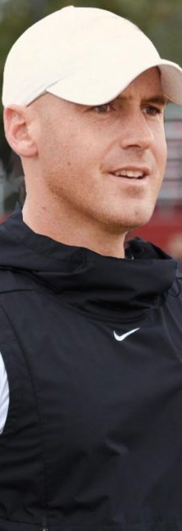
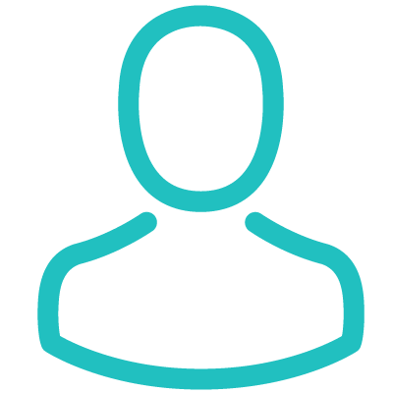







PERSONALITY
BIO
“I want to help my team deliver great user experiences”
E
Interviewing
Design Thinking
Empathy
Coding
I developed the passion for football through my idol, Pelé. Ever since I have been playing football almost everyday and I have recently diverted to a the head coach of my football club JKFF. I have dreamed about becoming as good as Pelé and the the biggest tournament I have won as a player is ECT (Europa Champions Tournament).
“
“
Behavior
Overseeing builds
Writing specs
Designing features
Motivations
Meetings
IMPACT
PROMOTION
User testing
TEAMWORK
USER NEEDS
Influences
Goals
Frustrations
· CREDIBILITY
· COLLEAGUES
· TECHNOLOGY
· BLOGS/ FORUMS
· PSYCHOLOGY
· UI TRENDS
Introduce user focused mentality and methods into traditional company landscape
Improve usability of bank’s customer facing interfaces
Grow the UX team
Getting buy-in for the new department’s activities
Dealing with more bureaucracy than in her old job
Communicating necessity for change to development team
Linus Alfonzo
35, Jönköping
Frequently used apps
Football coach
Justinmind
Google Calendar
PocketGuard

