Slide 1


Damascus University
2025- 2026
INFORMATION RETRIEVAL

Slide 2
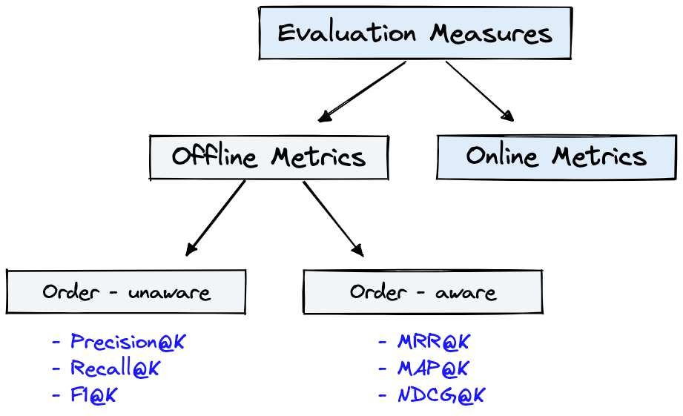
Online Metrics
are captured during actual usage of the IR system when it is online
Offline Metrics
are measured in an isolated environment before deploying a new IR system
Evaluation
Soulyma AlMahaeri – Marwa Aldaya
IR – Damascus University 2026

Slide 3
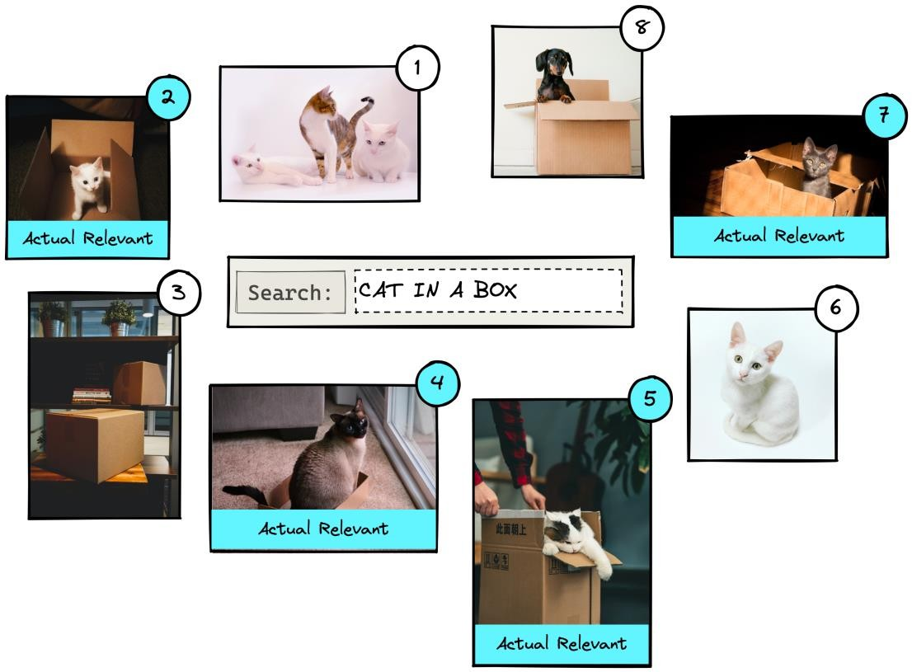
Actual Condition
refers to the true label of every item in the dataset
Predicted Condition
is the predicted label
returned by the IR system
Actual vs Predicted
Soulyma AlMahaeri – Marwa Aldaya
IR – Damascus University 2026

Slide 4
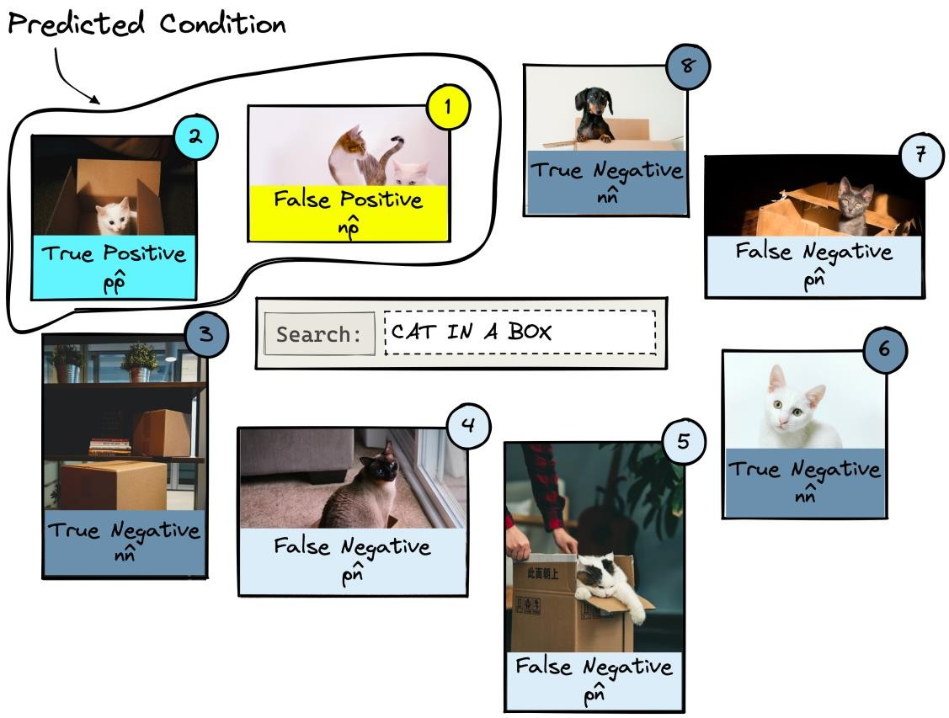
These are positive (pp^) or (pn^) if an item is relevant to a query
or negative (nn^) or (np^)if an item
is irrelevant to a query.
If an item is returned, it is predicted as being positive (𝑝^) and, if it is not returned, is predicted as a negative (𝑛^).
Output Set
Soulyma AlMahaeri – Marwa Aldaya
IR – Damascus University 2026

Slide 5
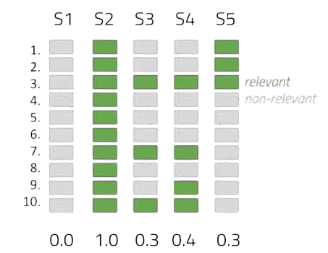
Five Systems, one query
Precision measures the proportion of retrieved documents that are relevant to the user query.
𝑁𝑢𝑚𝑏𝑒𝑟 𝑜𝑓 𝑟𝑒𝑙𝑒𝑣𝑎𝑛𝑡 𝑑𝑜𝑐𝑠 𝑟𝑒𝑡𝑟𝑖𝑒𝑣𝑒𝑑
𝑃𝑟𝑒𝑐𝑖𝑠𝑖𝑜𝑛 =
𝑇𝑜𝑡𝑎𝑙 𝑟𝑒𝑡𝑟𝑖𝑒𝑣𝑒𝑑 𝑑𝑜𝑐𝑢𝑚𝑒𝑛𝑡𝑠
Precision
Soulyma AlMahaeri – Marwa Aldaya
IR – Damascus University 2026

Slide 6
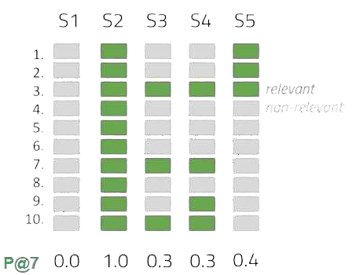
Five Systems, one query
Precision at K calculates precision for only K documents. It considers the top K recommendations.
𝑁𝑢𝑚𝑏𝑒𝑟 𝑜𝑓 𝑟𝑒𝑙𝑒𝑣𝑎𝑛𝑡 𝑑𝑜𝑐𝑠 𝑖𝑛 𝑡𝑜𝑝 𝐾
𝑃𝑟𝑒𝑐𝑖𝑠𝑖𝑜𝑛 =
𝐾
Precision@K
Soulyma AlMahaeri – Marwa Aldaya
IR – Damascus University 2026

Slide 7
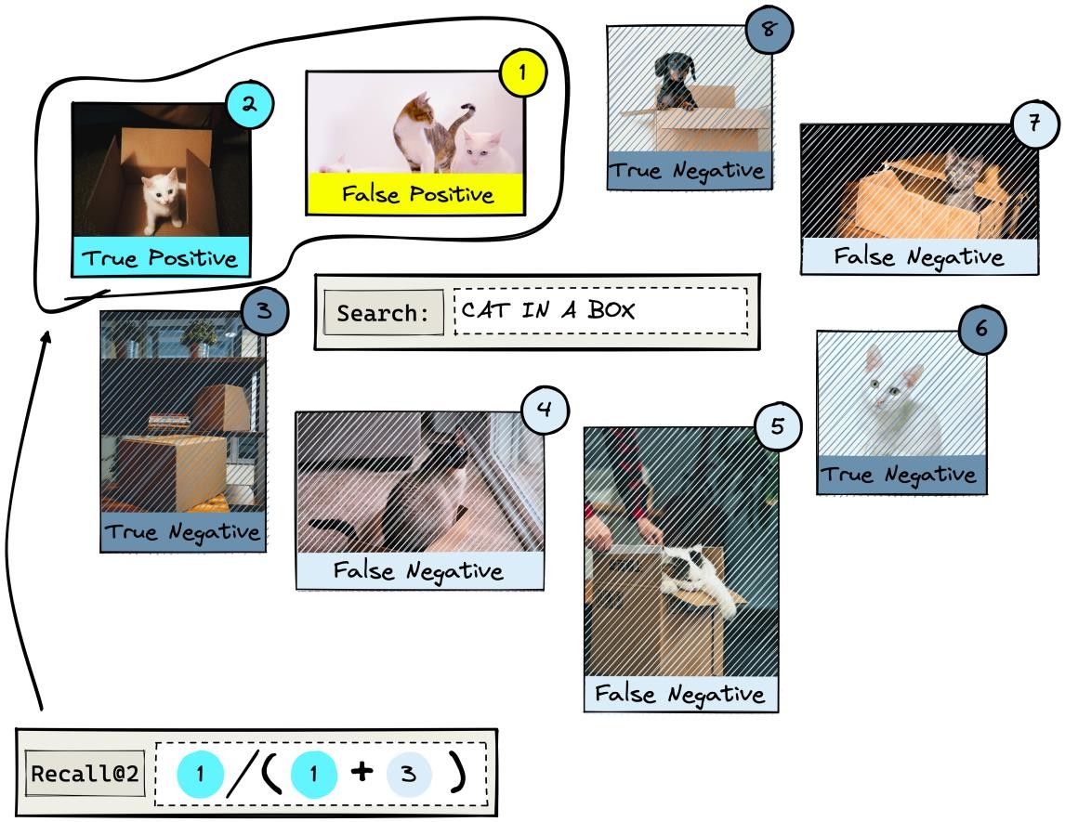
It measures how many relevant items were returned against how many relevant items exist in the entire dataset
𝑁𝑢𝑚𝑏𝑒𝑟 𝑜𝑓 𝑟𝑒𝑙𝑒𝑣𝑎𝑛𝑡 𝑑𝑜𝑐𝑠 𝑟𝑒𝑡𝑟𝑖𝑒𝑣𝑒𝑑
𝑅𝑒𝑐𝑎𝑙𝑙 =
𝑇𝑜𝑡𝑎𝑙 𝑛𝑢𝑚𝑏𝑒𝑟 𝑜𝑓 𝑟𝑒𝑙𝑒𝑣𝑎𝑛𝑡 𝑑𝑜𝑐𝑠
Recall
Soulyma AlMahaeri – Marwa Aldaya
IR – Damascus University 2026

Slide 8
With Recall@K, the score improves as K increases and the scope of returned items increases.
Recall
Soulyma AlMahaeri – Marwa Aldaya
IR – Damascus University 2026

Slide 9
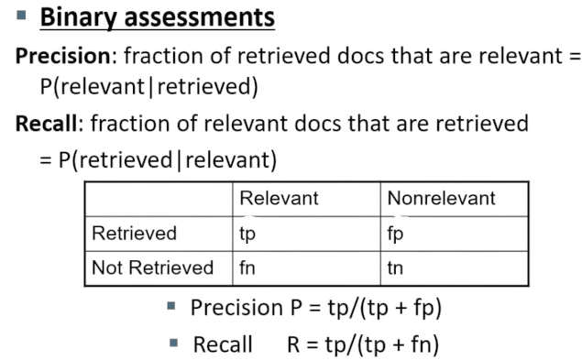
Soulyma AlMahaeri – Marwa Aldaya
IR – Damascus University 2026

Slide 10
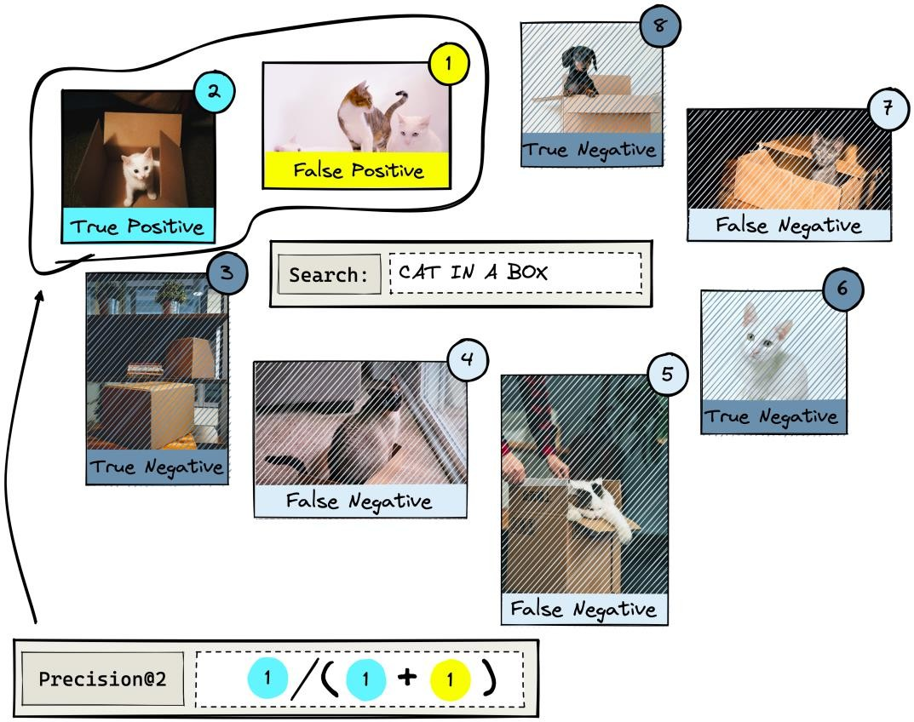
Mean average precision (MAP) for a set of queries is the mean of the average precision scores for each query.
_{σ}𝑄
𝐴𝑃@𝐾
𝑀𝐴𝑃 =
𝑞=1
𝑄
Mean Average Precision (MAP)
Soulyma AlMahaeri – Marwa Aldaya
IR – Damascus University 2026

Slide 11
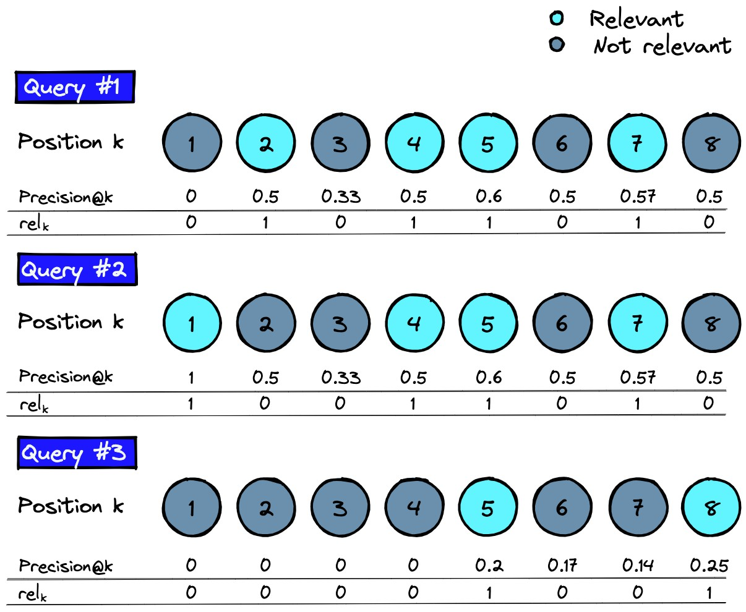
Mean average precision (MAP) for a set of queries is the mean of the average precision scores for each query.
_{σ}𝐾
𝑃@𝐾 ∗ 𝑟𝑒𝑙(𝑘)
A𝑃@𝐾 = ^{𝑘=1}
𝑁𝑢𝑚 𝑜𝑓 𝑟𝑒𝑙𝑒𝑣𝑎𝑛𝑡 𝑟𝑒𝑠𝑢𝑙𝑡
Average Precision @ K
Soulyma AlMahaeri – Marwa Aldaya
IR – Damascus University 2026

Slide 12
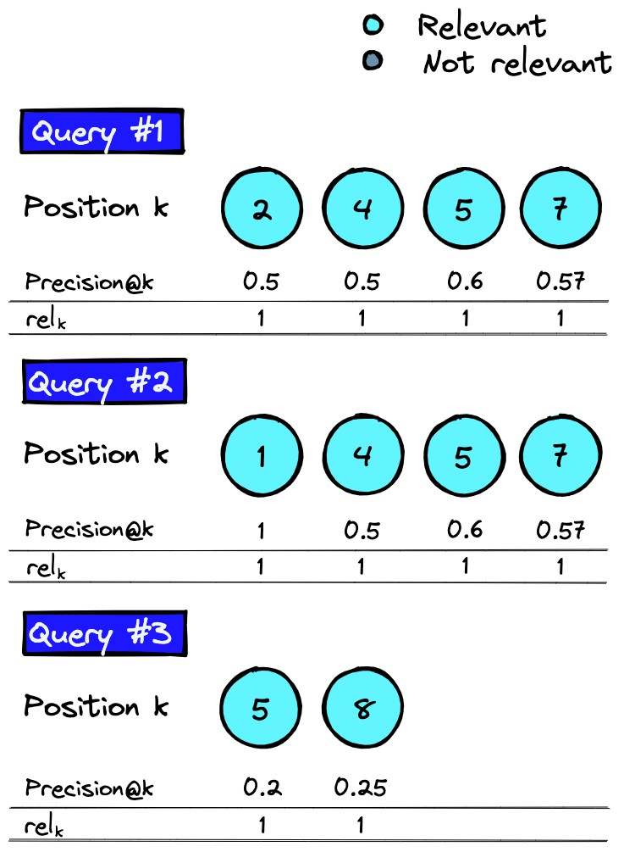
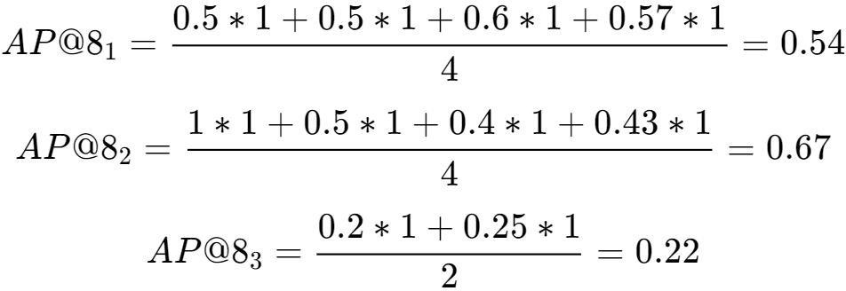
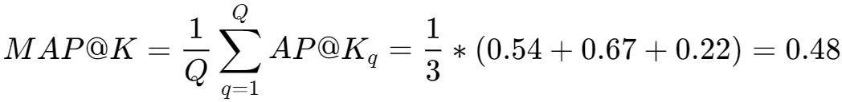
Mean Average Precision (MAP)
Soulyma AlMahaeri – Marwa Aldaya
IR – Damascus University 2026

Slide 13
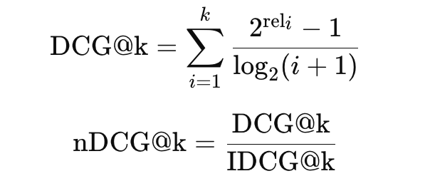
Why nDCG?
MAP assumes binary relevance (relevant or not).
In real IR systems, relevance is often graded (e.g., 0–2 or 0–3).
nDCG rewards relevant items at higher ranks more.
Formula:
Normalized Discounted Cumulative Gain (nDCG)

Slide 14
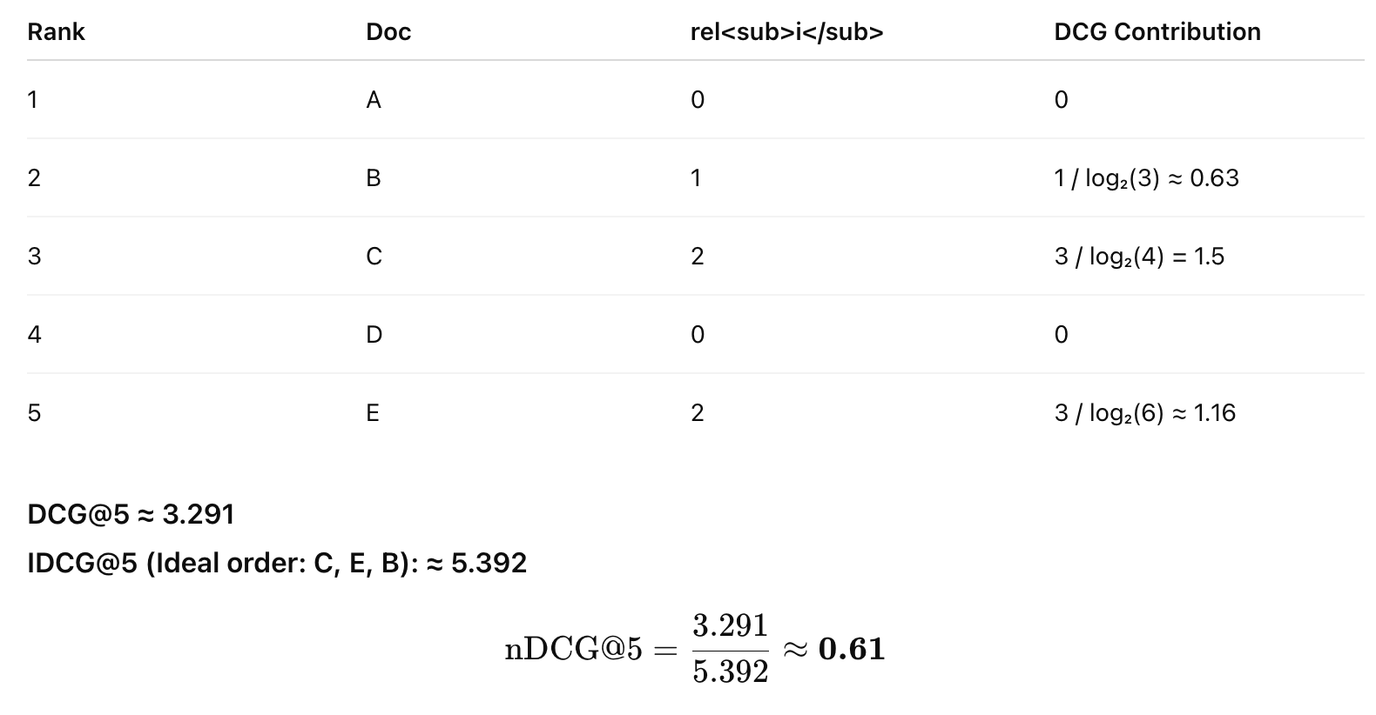
Normalized Discounted Cumulative Gain (nDCG)

Slide 15
Use MAP if relevance is binary and you want to consider all relevant results.
Use nDCG if:
You have graded relevance
You care more about top-ranked items
You want to simulate user experience
When Should You Use nDCG?

Slide 16
Which Metric Best Evaluates a Real IR System?
Is precision or recall enough to evaluate quality?
Should we consider ranking position or just relevance?
What happens if relevant results appear late in the list?
Which metric would YOU choose to evaluate a real IR engine — and why?
What to Use in Modern IR Evaluation

Slide 17
Precision and Recall :These are useful for simple IR systems or binary classification tasks,
but they are not suitable for evaluating ranked or graded IR results.
Metric | Best Use Case
nDCG | Best for ranked IR systems, graded relevance, and realistic user behavior
MAP | Good for binary relevance in ranked lists; commonly used in IR benchmarks
MRR | Best when only one correct result is expected (e.g., question answering)
What to Use in Modern IR Evaluation

Slide 18
Choose metrics that:
Reflect how users interact with ranked results
Support relevance levels
Penalize late-ranked relevant items
Good IR evaluation = Realistic + Ranked + Relevance-aware
What to Use in Modern IR Evaluation

Slide 19






PREPARED BY
Soulyma AlMahaeri
Marwa Aldaya
soulymamahaeri@gmail,com
marwaa200034@gmail.com
Soulyma Al-Mahaeri
Marwa Aldaya
Soulyma
Marwa Aldaya
Soulyma Mahaeri
Marwa Aldaya
Soulyma AlMahaeri – Marwa Aldaya
IR – Damascus University 2026
19

