Slide 1

Questions?
Github for Academic's
Milan McGraw
August 23, 2024

Slide 2
What is GIT and the difference with GitHub
Git is a free and open-source distributed version control system designed to handle everything from small to very large projects with speed and efficiency
Github is Git in cloud

Slide 3
GIT in Scrum Framework / User story workflow
Idea
Defined
In progress
Reviewed
Complete
Story created and assigned to a team member.
Story is ready to be worked on. Dev moves the story in progress when he picks up work.
Dev PULLs the master branch, creates a new BRANCH to work on his/her piece of work. The dev then COMMITs the changes and PUSHes the new code.
After the dev submits the PR, the Admin/Scrum Master reviews the code. If approved the story is moved to done. If not Dev moves back to step “In Progress”
Once PR is approved, including the test cases then the story is marked as complete

Slide 4
Terminology
Repository
Branch
Commit
Pull
Push
Pull request (PR)

Slide 5
Repository/Repo
Repositories in GIT contain a collection of files of various different versions of a Project/ Project deliverables for the customer
These files are imported from the repository into the local server of the user for further updates and modifications in the content of the file.

Slide 6
Branch
Branching means diverging from the mainline and continue to work separately without messing with the mainline.
When you make a commit, Git stores a commit object that contains a pointer to the snapshot of the content you staged. This object also contains: - The author’s name and email address - The message that you typed

Slide 7
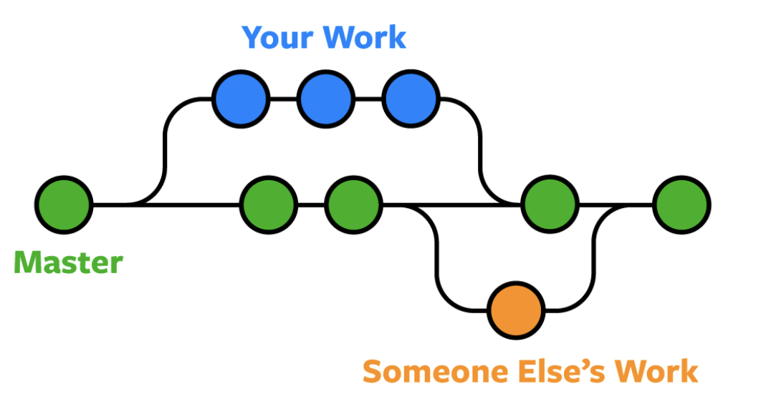

Slide 8
Commit
A commit is a point in git which is treated as a “Save point”. This keeps records of all save points, so if we want to go back to the previous save point we can switch back.
Commits are like a snapshot of all the files and folders present in the repository at a particular point in time.
Command: git commit -m "Commit_message" file_name

Slide 9
Pull/ Push
The git pull command is used to fetch and download content from a remote repository and immediately update the local repository to match that content.
git pull <remote>
The git push command is used to upload local repository content to a remote repository.
git push <remote> <branch>

Slide 10
Pull Request
Pull requests are a feature that makes it easier for developers to collaborate where they provide a user-friendly web interface for discussing proposed changes before integrating them into the official project.
When you file a pull request, all you’re doing is requesting that another developer (e.g., the project maintainer) pulls a branch from your repository into their repository.

Slide 11
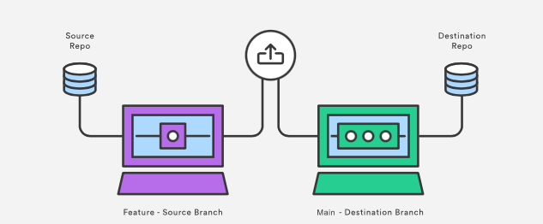
For a PR you need to to provide 4 pieces of information to file a pull request: the source repository, the source branch, the destination repository, and the destination branch.

Slide 12
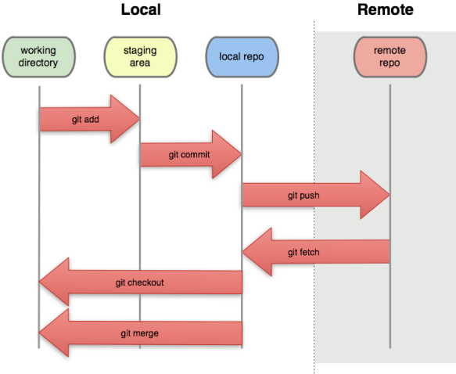
Legend:
Working area is like your scratch space
Staging area is files that are going to be a part of the next commit
The local repository is a Git repository that is stored on your computer.
The repository contains all of your commits

