Slide 1
COLLEGE FULL-STACK PROJECT PRESENTATION
Library Management System
A Full-Stack Web Platform for Automated Book Cataloging, Circulation & Fine Settlement
Tech Stack: React.js (Vite) • Redux Toolkit • Tailwind CSS • PHP REST API • MySQL (PDO)
Presented by: Jenish Rupavatiya / Parthiv Ramani
Department of Computer Science & Engineering
Academic Year: 2025–2026
Evaluation Mode: Final Year Project / Viva Voce
Architecture: 3-Tier Enterprise Web Model
Zero Page-Reload Redux State Synchronization
Default Admin Credentials: admin@library.com | Password: admin123

Slide 2
LIBRARY MANAGEMENT SYSTEM
Problem Statement & Motivation
Manual Paper Registers
Stock Discrepancies
Physical paper registers suffer from torn pages, missing loan records, illegible handwriting, and zero backup capabilities.
Librarians cannot track real-time physical copies available on shelves versus copies currently checked out by students.
Manual Fine Computation
Zero Self-Visibility
Staff manually calculate overdue days and penalty fees using calendars, creating friction, calculation errors, and audit disputes.
Students and faculty have no instant way to check borrow history, impending due dates, or catalog availability.
Library Management System — College Full-Stack Project | React • PHP • MySQL

Slide 3
LIBRARY MANAGEMENT SYSTEM
Project Objectives & Goals
01
Automated Catalog Management
Centralize book, author, and category CRUD operations with strict ISBN uniqueness and publisher details.
02
Real-Time Inventory Synchronization
Dynamically track physical copies: decrement available inventory on loan and restore upon return.
03
ACID Transactional Guarantees
Ensure zero database inconsistency during circulation operations through MySQL atomic transactions.
04
Automated Overdue Penalty Engine
Eliminate manual math: compute late fees at ₹5.00/day on the server and manage payment collection.
05
Zero Page-Reload SPA Experience
Leverage Redux Toolkit for seamless state updates and instantaneous UI re-renders without browser refresh.
Library Management System — College Full-Stack Project | React • PHP • MySQL

Slide 4
LIBRARY MANAGEMENT SYSTEM
Technology Stack Breakdown
Frontend Layer
Backend API Layer
Database Layer
Client SPA
REST Engine
Relational DB
• React 18
• Native PHP 8.2
• MySQL / MariaDB
Component-based UI architecture
High performance pure REST API
ACID relational database engine
• Vite 5
• Custom Router
• Foreign Keys
Modern development bundler & HMR
RESTful URI & query parameter routing
Enforces ON DELETE RESTRICT rules
• Redux Toolkit
• PDO Extension
• Row-Level Locks
Centralized global state & asyncThunks
Prepared statements with parameter binding
SELECT ... FOR UPDATE prevents race states
• Tailwind CSS
• Auth Middleware
• Indexed Tables
Responsive layout and color tokens
Cryptographic Bearer token verification
Fast searches by ISBN, Name, Code
• Axios Client
• Bcrypt Hash
• Port Fallback
HTTP client with Bearer interceptors
One-way salt password encryption
Auto-detects active port 3306 or 3307
• React Hot Toast
• JSON Protocol
• Seed Dataset
Interactive user feedback alerts
Standardized response envelope
21 books, 10 authors, 10 students
Library Management System — College Full-Stack Project | React • PHP • MySQL

Slide 5
LIBRARY MANAGEMENT SYSTEM
3-Tier System Architecture
Tier 1: Client Presentation Layer (SPA)
Runs in the user’s browser via React. Handles route transitions, user interactions, local validation, and Redux state caches.
React Router DOM
Redux Toolkit Slices
17 Common UI Components
Axios Bearer Interceptor
Tier 2: Business Logic & API Layer (PHP)
Gateway entry point handles CORS and dispatches to controllers. Validates permissions, enforces library rules, and calculates fines.
index.php REST Gateway
Auth Token Middleware
10 Domain Controllers
Input Validation Utility
Tier 3: Persistence Layer (MySQL Database)
Maintains long-term data integrity with strict constraints, indexes, and InnoDB transaction isolation for circulation checks.
InnoDB Relational Engine
ACID Transactions (COMMIT/ROLLBACK)
Foreign Keys (RESTRICT)
Auto Port 3306/3307 Fallback
Library Management System — College Full-Stack Project | React • PHP • MySQL

Slide 6
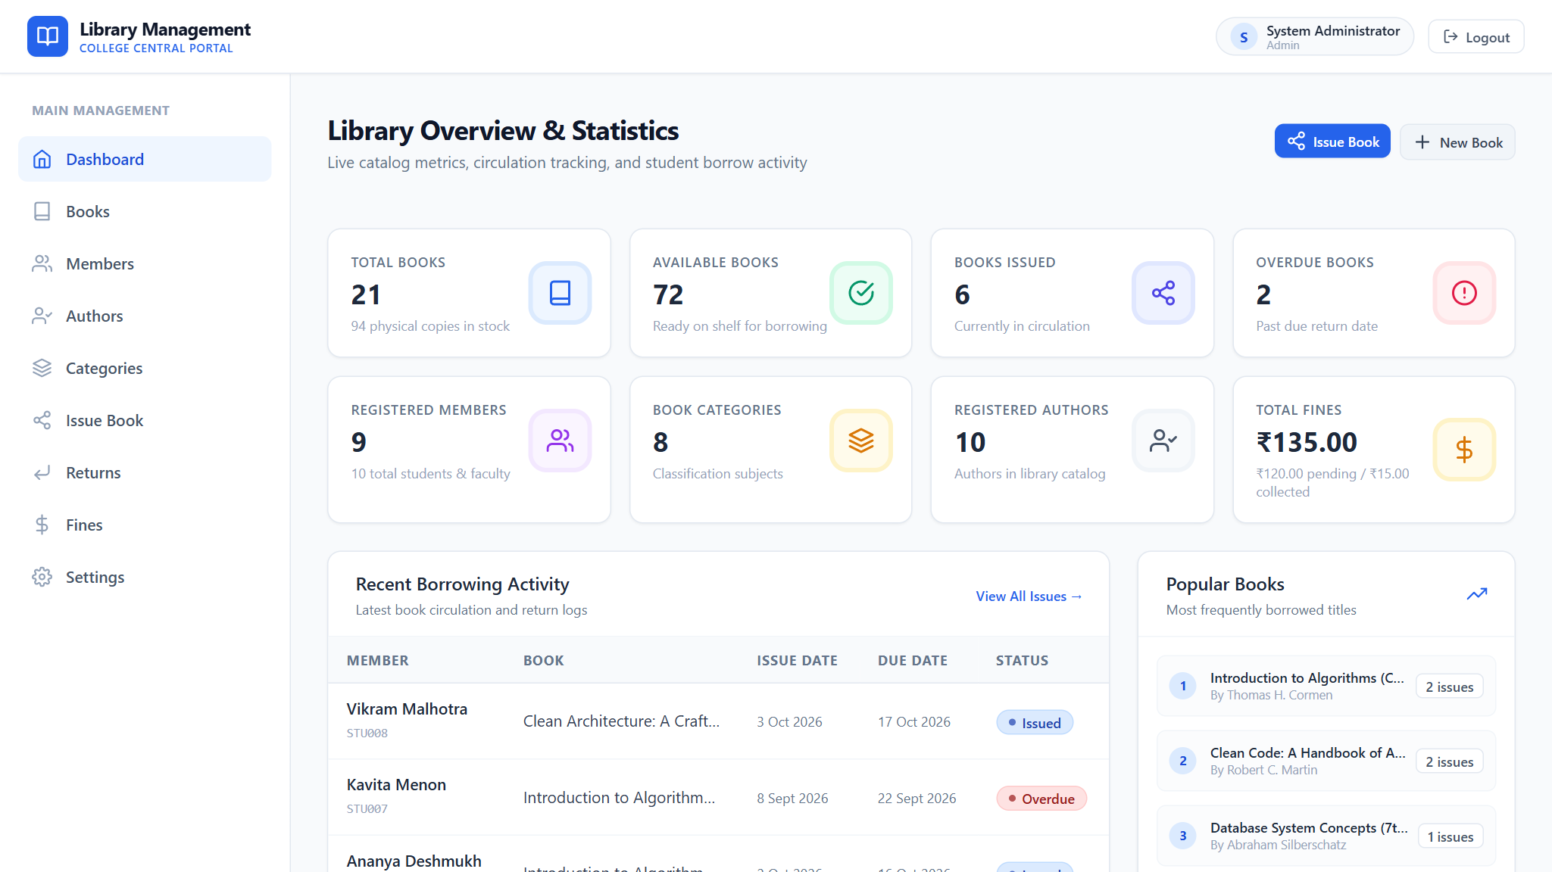
SYSTEM INTERFACE DEMONSTRATION
UI Demonstration: Live Analytics Dashboard
REAL-TIME ANALYTICS
Key System Features:
✓ 8 Real-Time Counter Cards
Instant visibility of Total Books, Total Inventory, Active Issues, and Overdue Returns.
✓ Recent Borrow Activity
Live circulation ledger showing who borrowed which book with timestamp badges.
✓ Overdue Attention Alert
Highlights students with pending overdue loans requiring immediate fine settlement.
✓ Zero Page-Reload Sync
Redux Toolkit synchronizes changes without full browser refresh cycles.
Figure 1: Real-time Admin Dashboard displaying 8 KPI stat cards, recent borrow logs, and overdue attention lists.
Library Management System — College Full-Stack Project | React • PHP • MySQL

Slide 7
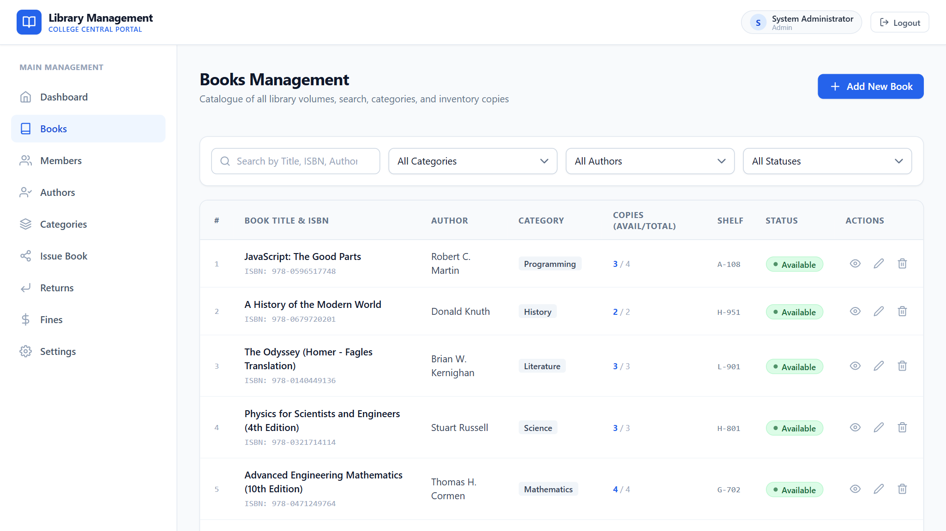
SYSTEM INTERFACE DEMONSTRATION
UI Demonstration: Book Catalog & Inventory Management
INVENTORY CONTROL
Key System Features:
✓ Instant Keyword Search
Filter through catalog by Title, Author, Category, or unique 13-digit ISBN.
✓ Real-Time Stock Ratio
Tracks Available Copies vs Total Physical Copies to prevent overselling on loans.
✓ Shelf & Rack Tagging
Guides librarians to physical bookshelf racks for rapid book location in library.
✓ Protected Actions
Edit, View Details, and Delete buttons with foreign-key restriction alerts.
Figure 2: Complete book catalog table with multi-attribute filtering, available stock counts, and CRUD action triggers.
Library Management System — College Full-Stack Project | React • PHP • MySQL

Slide 8
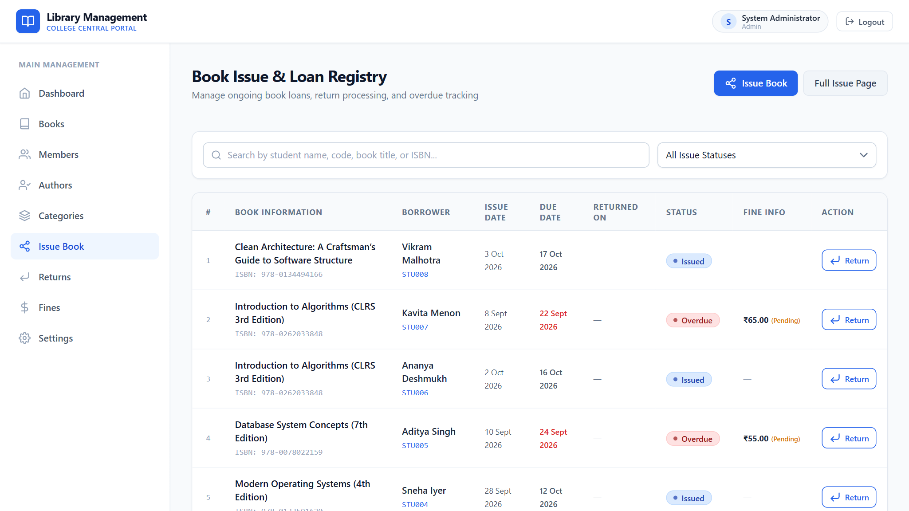
SYSTEM INTERFACE DEMONSTRATION
UI Demonstration: Circulation & Issue Verification
ACID CIRCULATION
Key System Features:
✓ Active Loan Guardrails
Verifies student borrowing quota (max 3 books) and active student status.
✓ Duplicate Loan Check
Prevents the same student from borrowing two identical copies simultaneously.
✓ 1-Click Return Trigger
Directly initiates the return modal with automatic overdue days estimation.
✓ Status Pill Badges
Color-coded visual indicators for "Issued", "Returned", and "Overdue".
Figure 3: Active book loan circulation ledger showing issue dates, return due dates, and return action buttons.
Library Management System — College Full-Stack Project | React • PHP • MySQL

Slide 9
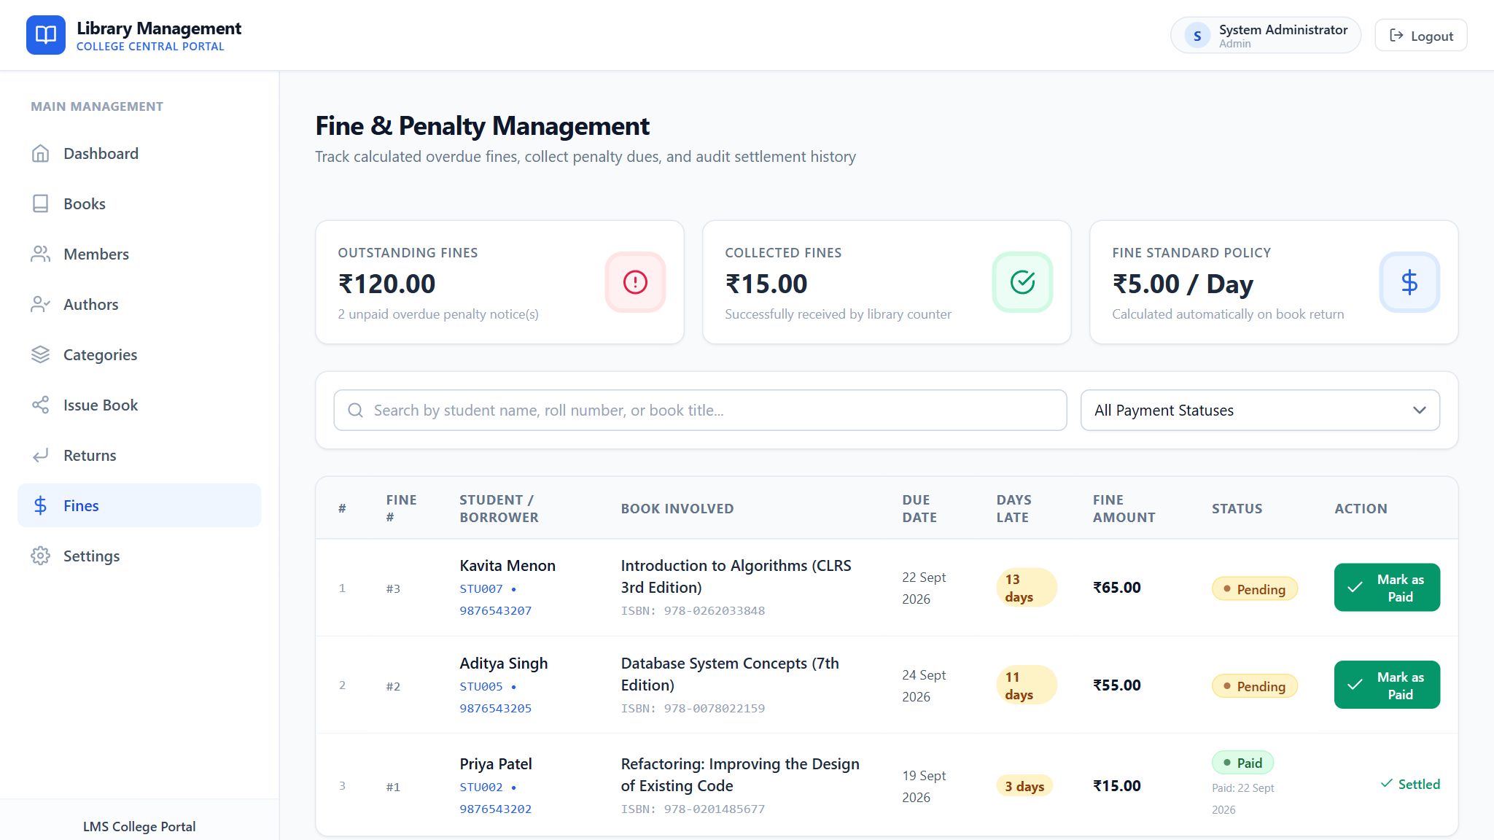
SYSTEM INTERFACE DEMONSTRATION
UI Demonstration: Overdue Fine Settlement Ledger
FINANCIAL AUDIT
Key System Features:
✓ Server-Calculated Math
Computed via ₹5.00/day rate multiplied by days past the designated due date.
✓ Settlement Status
Audited records tracked as "Unpaid" or "Paid" with payment date timestamps.
✓ Counter Cash Recording
Librarians can record student cash payments, instantly updating ledger.
✓ Export & Audit Ready
Complete financial accountability with linked Issue and Student records.
Figure 4: Financial ledger showing calculated late fees, payment statuses, and counter payment recording.
Library Management System — College Full-Stack Project | React • PHP • MySQL

Slide 10
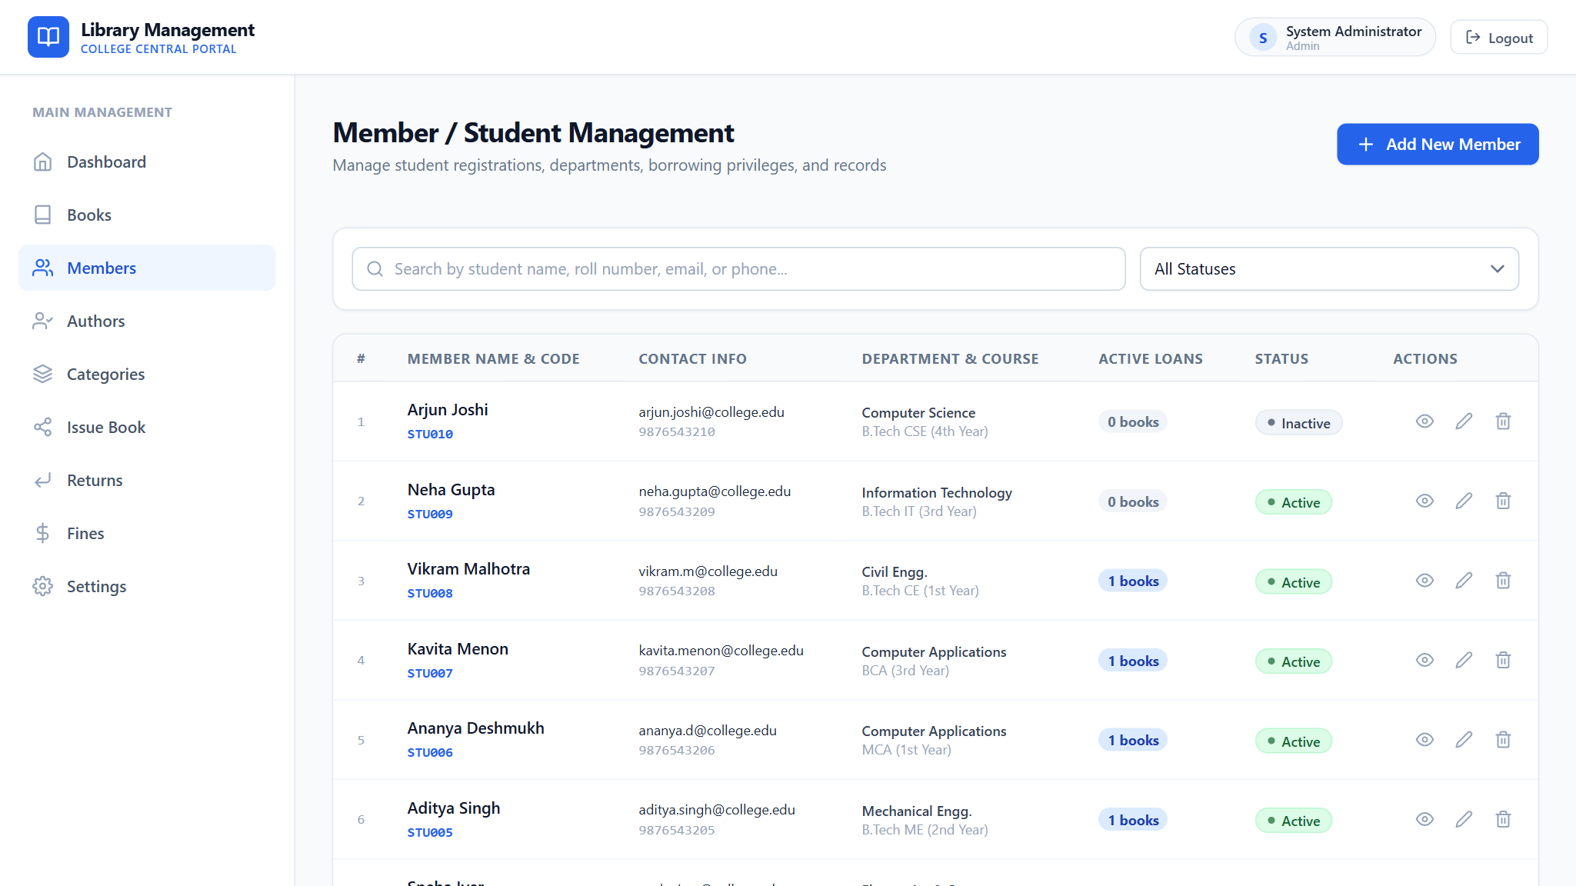
SYSTEM INTERFACE DEMONSTRATION
UI Demonstration: Student & Member Directory
MEMBER REGISTRY
Key System Features:
✓ Academic Profile Data
Captures Student Name, Roll Number, Branch (CSE, IT, ECE), and Semester.
✓ Contact Verification
Stores verified email address and phone number for overdue reminders.
✓ Status Guard
Suspended students are automatically blocked from borrowing any library assets.
✓ Borrowing History Link
Quick access to all past and present books checked out by the member.
Figure 5: Student and faculty registry tracking academic departments, contact info, and active loan allowances.
Library Management System — College Full-Stack Project | React • PHP • MySQL

Slide 11
LIBRARY MANAGEMENT SYSTEM
Core Functional Modules Summary
1. Authentication
2. Live Dashboard
3. Books Catalog
• Bcrypt encrypted login & register
• 8 Real-time KPI stat cards
• Complete inventory CRUD
• Bearer token session tracking
• Recent borrow transaction logs
• ISBN uniqueness verification
• Protected routes & role guards
• Overdue attention list with fines
• Dynamic available copies counter
4. Member Registry
5. Book Circulation
6. Returns & Fines
• Student & faculty cards
• Active loan issue modal
• Transactional return check-in
• Department & course tracking
• Zero stock issue prevention
• ₹5.00/day overdue math
• Active loan capacity protection
• Duplicate book loan blocking
• Payment settlement audit ledger
Library Management System — College Full-Stack Project | React • PHP • MySQL

Slide 12
LIBRARY MANAGEMENT SYSTEM
Working Mechanism: Redux Toolkit & REST Sync
1
User Action
2
Dispatch Thunk
3
Axios Interceptor
Staff initiates circulation action in React modal (e.g. clicks "Issue Book").
Component dispatches createAsyncThunk action with form payload.
Automatically appends Authorization Bearer token to request headers.
4
PHP API Gateway
5
Database Commit
6
Redux Mutation
Authenticates token against database and launches transactional controller.
MySQL locks rows, decrements stock, records issue, and commits.
Slice extraReducers update local store with zero page-reload.
Library Management System — College Full-Stack Project | React • PHP • MySQL

Slide 13
LIBRARY MANAGEMENT SYSTEM
Database Design & Relational Constraints
Core Schema Entities & Strict Relational Integrity Constraints:
Table: books
Relationship: N:1 with authors & categories
Constraint Guarantee: Restricts deletion of author or category while assigned to active titles.
Table: issues
Relationship: N:1 with books & members
Constraint Guarantee: Restricts deletion of student or book while an active loan is recorded.
Table: fines
Relationship: 1:1 with issues
Constraint Guarantee: Tied to specific loan record; tracks monetary settlement status (Unpaid/Paid).
Table: user_tokens
Relationship: N:1 with users
Constraint Guarantee: Cryptographic 64-char tokens revoked automatically upon logout.
Library Management System — College Full-Stack Project | React • PHP • MySQL

Slide 14
LIBRARY MANAGEMENT SYSTEM
ACID Transactions: Issue vs. Return
Issue Book Transaction (BEGIN ... COMMIT)
Return Book Transaction (BEGIN ... COMMIT)
1. Verify member status == "active"
1. Lock issue record & verify status == "issued"
2. Check student active loans count < 3 (loan limit)
2. Compute overdue days = max(0, Return Date - Due Date)
3. Verify student has no duplicate active loan of this title
3. Query fine_per_day setting (default ₹5.00/day)
4. Calculate fine amount = overdue_days * fine_rate
4. Lock book row (SELECT ... FOR UPDATE) & verify available > 0
5. UPDATE issues SET status = "returned", returned_at = NOW()
5. INSERT INTO issues (book_id, member_id, issue_date, due_date)
6. UPDATE books SET available_copies = available_copies + 1
6. UPDATE books SET available_copies = available_copies - 1
7. If fine > 0: INSERT INTO fines (payment_status="unpaid")
7. COMMIT TRANSACTION (or ROLLBACK on failure)
8. COMMIT TRANSACTION (zero inventory corruption)
Library Management System — College Full-Stack Project | React • PHP • MySQL

Slide 15
LIBRARY MANAGEMENT SYSTEM
Automated Overdue Fine Calculation Engine
MATHEMATICAL CALCULATION ENGINE (ENFORCED ON BACKEND)
Overdue Days = MAX( 0, Return Date − Due Date )
Fine Amount = Overdue Days × Fine Per Day (₹5.00)
1. Live UI Preview
2. Server Enforcement
3. Settlement Ledger
When selecting return date in the modal, the frontend calculates a real-time estimate so the librarian sees the penalty immediately before submitting.
The PHP backend re-calculates days and fines with PDO queries to prevent client-side manipulation or date tampering.
Fines are recorded as "unpaid". Once collected at the counter, staff mark it "paid", updating dashboard financial metrics in real-time.
Library Management System — College Full-Stack Project | React • PHP • MySQL

Slide 16
LIBRARY MANAGEMENT SYSTEM
Security & Data Protection Implementations
Bcrypt Password Hashing
SQL Injection Defense
Passwords are never stored in plain text. PHP password_hash($password, PASSWORD_BCRYPT) ensures strong one-way cryptographic encryption.
100% of queries use PDO prepared statements with parameter binding (:id, :isbn), neutralizing SQL injection attack vectors.
Session & Bearer Token Protocol
CORS & XSS Sanitization
Stateless 64-character hexadecimal tokens with 30-day expiration timestamps validate every protected API request.
Centralized CORS response headers in response.php and HTML entity escaping prevent cross-site scripting vulnerabilities.
Library Management System — College Full-Stack Project | React • PHP • MySQL

Slide 17
LIBRARY MANAGEMENT SYSTEM
Engineering Challenges Faced
CHALLENGE 1
CHALLENGE 2
Dual Port Environments (3306 vs 3307)
Concurrency & Stock Depletion
Developer and college machines often have both MySQL 8.0 and XAMPP MariaDB installed on ports 3306 and 3307, causing connection refused errors.
Preventing race conditions where multiple librarians issue the last physical copy of a book at the exact same second.
CHALLENGE 3
CHALLENGE 4
Zero Page-Reload Synchronization
Responsive Table Overflow
Ensuring inventory numbers, active borrow limits, and fine totals immediately reflect in Redux without requiring browser reloads.
Large tabular views (ISBN, Borrower, Status, Actions) breaking mobile viewports on smaller student phone screens.
Library Management System — College Full-Stack Project | React • PHP • MySQL

Slide 18
LIBRARY MANAGEMENT SYSTEM
Technical Solutions & Engineering Decisions
SOLUTION 1
SOLUTION 2
PDO Port Auto-Fallback Connector
Pessimistic Row Locking
Implemented a smart singleton in database.php that tests port 3306 and seamlessly falls back to 3307 if refused, guaranteeing zero setup configuration hassle.
Utilized SELECT ... FOR UPDATE within MySQL transactions to lock rows during issue and return queries, strictly avoiding overselling copies.
SOLUTION 3
SOLUTION 4
Optimistic Reducer Mutation
Responsive Table Architecture
Redux slice extraReducers locally mutate items in state upon fulfilled promises, synchronizing counts and badges with zero page reload.
Encapsulated data tables in overflow-x wrappers with collapsible navigation drawers for complete responsiveness across mobile, tablet, and desktop.
Library Management System — College Full-Stack Project | React • PHP • MySQL

Slide 19
LIBRARY MANAGEMENT SYSTEM
Future Scope & Enhancements
📷
Barcode & QR Scanner
📱
Student Portal
🔔
SMS & Email Alerts
Hardware scanner integration at checkout desk for instant student ID card and book ISBN barcode scanning.
Dedicated mobile view for students to search catalogs, check due dates, reserve books, and view reading logs.
Scheduled cron tasks alerting students 2 days prior to loan expiry to minimize fines.
💳
UPI Fine Payments
📡
RFID Security Gate
📊
AI Recommendations
Integration with Razorpay / UPI QR codes to allow direct digital settlement of overdue penalties.
Automated library entrance detection tracking walk-outs to prevent unissued books leaving premises.
Personalized book suggestions for students based on their course curriculum and previous borrow records.
Library Management System — College Full-Stack Project | React • PHP • MySQL

Slide 20
LIBRARY MANAGEMENT SYSTEM
Conclusion & Summary of Achievements
✓
Successfully engineered an enterprise-grade Library Management System suitable for university production deployment.
✓
Achieved zero discrepancy in inventory counts using atomic MySQL transactions for circulation check-out and check-in.
✓
Implemented full Redux Toolkit state architecture with 7 feature slices for an instantaneous zero page-reload experience.
✓
Enforced security standards: Bcrypt hashing, 64-character Bearer token sessions, and prepared PDO SQL queries.
✓
Supplied comprehensive realistic seed data (21 textbooks, 10 authors, 8 categories, 10 students, active loans, and fines).
Library Management System — College Full-Stack Project | React • PHP • MySQL

Slide 21
Thank You!
Library Management System — Full-Stack College Project
Demonstration & Questions Welcome

