Slide 1
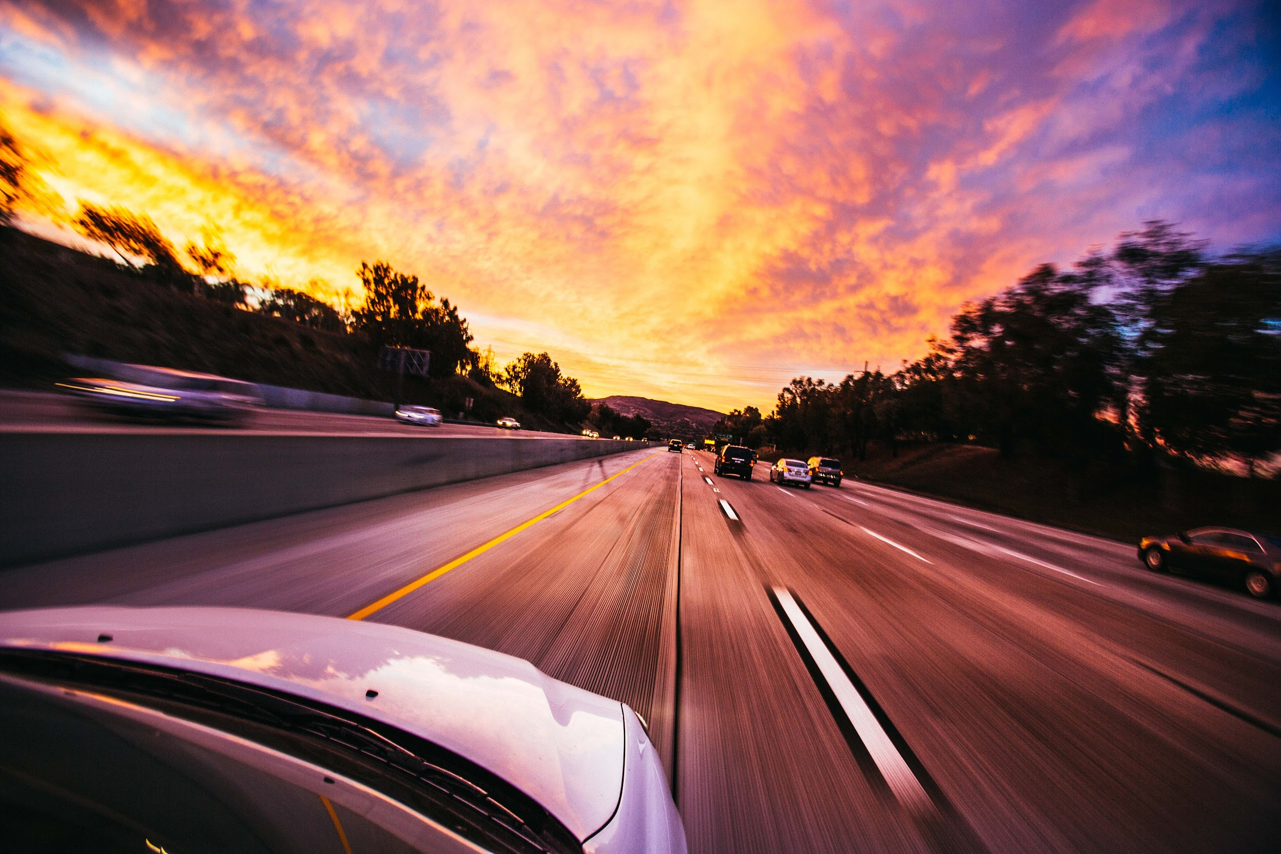
Automated Valet Parking using Optical Flow
Mini Project
Dr. Bibhas Ghoshal
Group ID - Bib548209823
IIT2021120 - Parmar Milan Hirabhai
IIT2021131 - Harsh Sharma
IIT2021153 - Aryan Pandey
IIT2021162 - Saransh Yadav
IIT2021191 - Kushagra Jain

Slide 2
Contents
Introduction
Literature Review
Methodology
Dataset
Implementation
Results and Conclusion
References

Slide 3
Introduction

Slide 4
Problem Statement
Develop a machine learning model to enable an autonomous driving system for valet parking, allowing vehicles to navigate and park efficiently within a designated parking area. However, the path training must be facilitated through images rather than explicit coordinates. Optical flow must be implemented when processing the training images for identifying obstacles and for calculation of steering angles.

Slide 5
Objectives
Develop a machine learning model to enable an autonomous driving system for valet parking which uses optical flow and predicts steering angles.
Test the machine learning model on a labelled dataset to measure performance.

Slide 6
Motivation
Improved Navigation: An autonomous system leveraging image-based path training can efficiently navigate parking areas, reducing time spent searching for parking spaces and executing parking maneuvers.
Convenient Parking: Automated valet parking offers convenience to drivers, allowing them to drop off vehicles at designated areas, letting the system handle parking tasks.
Adaptability to Conditions: Image-based path training and optical flow enable adaptability to different environmental conditions, such as varying lighting or weather conditions.

Slide 7
Assumptions
Controlled Parking Environment: Initially focusing on controlled parking areas or lots with predefined layouts and minimal dynamic changes.
Availability of Annotated Data: Availability of labeled or annotated training data, including images with associated steering angles.
System Reliability: System is assumed to be reliable, with minimal technical failures or malfunctions during operation.
Simulated Testing: Initial testing in simulated environments before real-world deployment to validate algorithms and system functionality.

Slide 8
Literature Review

Slide 9
Two-stream convolutional networks for end-to-end learning of self-driving cars
K. Simonyan and A. Zisserman, "Two-stream convolutional networks for action recognition in videos," in Advances in neural information processing systems, 2014, pp. 568-576
Two-stream CNN models are generated from the hypothesis that human brain uses two separate streams to perform object and motion recognition
The original work built a deep convolutional network architecture for video action recognition by combining two different streams, spatial stream and temporal stream
The spatial part, in the form of individual frame appearance, carries information about scenes and objects depicted in the video.
The temporal part, in the form of motion across the frames, conveys the movement of the observer (the camera) and the objects.

Slide 10
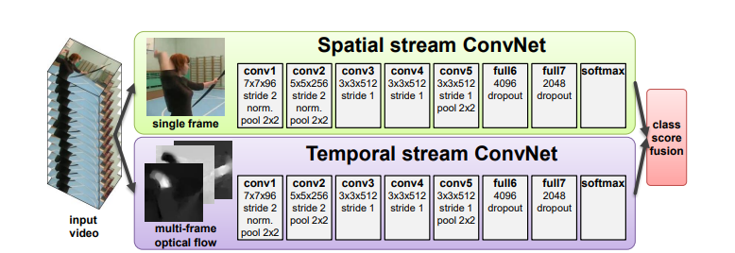
Two-stream architecture for video classification.

Slide 11
End-to-End Deep Learning for Steering Autonomous Vehicles Considering Temporal Dependencies
Hesham M. Eraqi, Mohamed N. Moustafa, Jens Honer-End-to-End Deep Learning for Steering Autonomous Vehicles Considering Temporal Dependencies
https://arxiv.org/abs/1710.03804
The system they investigated is comprised of a front-facing RGB camera and a composite neural network consisting of a CNN and LSTM network that estimate the steering wheel angle based on the camera input.
A front-facing RGB camera is used to capture the driving scene and ground-truth steering wheel angles due to a human driver are recorded. During the system deployment phase, a decoder is used to translate the classification layer activations into a steering angle. The blue and red paths represent training and deployment phases respectively
A filter to reduce the steering wheel sensor measurement noise. Then the smoothed signal is sampled to associate a ground-truth steering angle to each single camera frame.

Slide 12
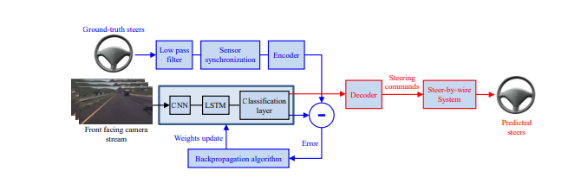
CNN and LSTM network

Slide 13
Dataset

Slide 14
Dataset (sully chen)
SullyChen/driving-datasets: A collection of labeled car driving datasets (github.com)
There are two subsets in this dataset: 2017 dataset and 2018 dataset. Both of them are made up with a number of image files and time-stamped car steering angle logs. The image data was recorded by a camera mounted on the Honda Civic front windshield at 20 frames per second.
2017 dataset contains 45567 frames and corresponding steering angle labels. The dataset records a trajectory of approximately 4km around the Rolling Hills in LA, USA.
2018 dataset contains 63825 frames and corresponding steering angle label as well as timestamps. This dataset records a trajectory of approximately 6km along the Palos Verdes Dr in LA, USA.
In the dataset, we incorporated Sully Chen 1 for the training of our model and we have taken 10,000 inital frames from Sully Chen 2 for testing our model.

Slide 15
Data Preprocessing
SullyChen/driving-datasets: A collection of labeled car driving datasets (github.com)
We use the OpenCV’s inbuild Farneback method to compute the optical flow. The 2 channel resulst is then encoded into HSV space to form a single 3 channels image. Direction of the optical flow is encoded by Hue and the magnitute is encoded by the V value.
Before feeding the images into the model, we resize the images as 40 × 160 to expand the road and shrink the background

Slide 16
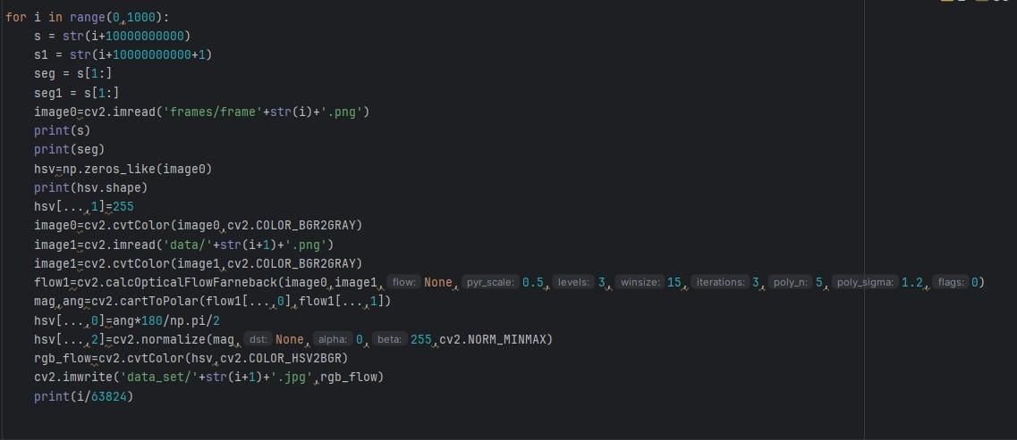
Methodology

Slide 17
Methodology

Slide 18
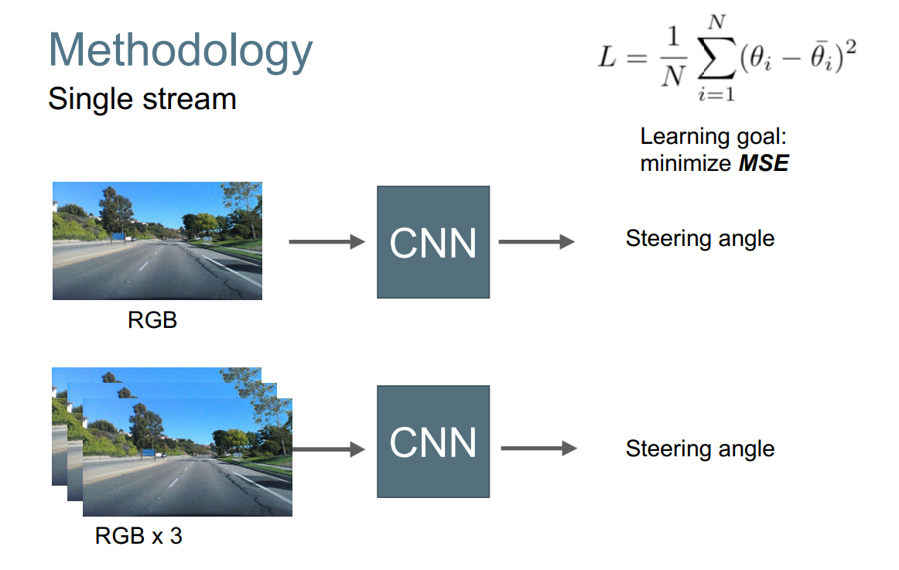

Slide 20
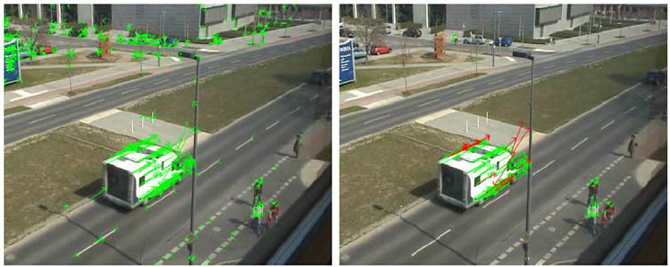
Mathematical notations
We first introduce the notations that will be used in the following context.
Frame at time t : It.
Optical-flow at time t : Ft = f({It−1, It}).
steering angle: θ.

Slide 21
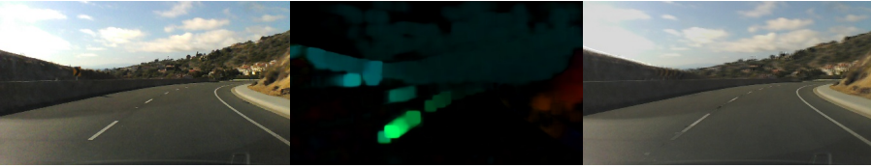
Left:Original frame. Middle: Optical flow. Right: next frame of original frame

Slide 22
Optical Flow

Slide 23
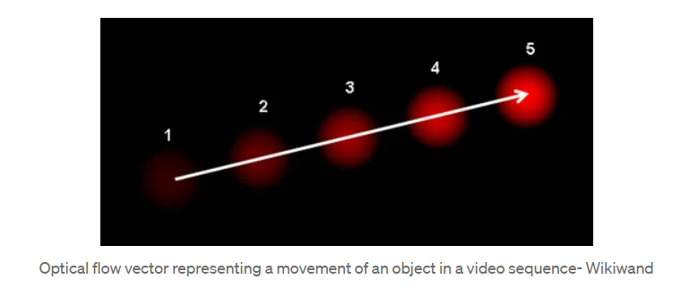
Optical Flow
It is the apparent motion of the objects due to the relative motion between the observer and the scene.
It gives us an important idea as to which direction is an object moving in an image despite not being present to view the moving object. This can be helpful to birds when they are navigating the skies and in robotic aerial vehicles

Slide 24
Optical Flow
Optical flow is a typical temporal representation in video streams, which captures the motion changes between two frames. The optical flow being used in our work is based on the implementation of the Farneback’s method in OpenCV. For the optical flow at time t, we can compute the optical flow value in both vertical and horizontal direction, which can be denoted as F x t = f x (It−1, It) and F y t = f y (It−1, It) . From the magnitudes in both direction, the overall magnitude and the direction can then be obtained. The optical flow will then be encoded into HSV space as an RGB image. The direction is represented by Hue and the magnitude is represented by V

Slide 25

Loss function and performance metrics
We use a supervised learning method to train the CNN to imitate human’s steering behaviour by using data with steering commands(labels).
The object is to enforce the predicted angle as close as possible to the ground truth steering angle. Thus, we use the mean square error (MSE) as the loss function:
where N is the batch size, θ and θi are the predicted angle and ground-truth respectively.We use the root mean square error to measure the performance of the model over the whole test dataset.

Slide 26
CNN Model
Implementation

Slide 27
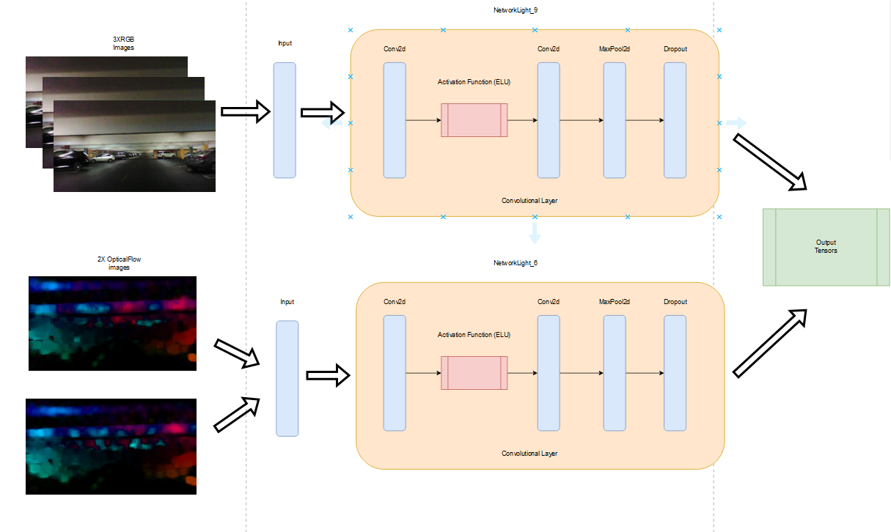

Slide 28
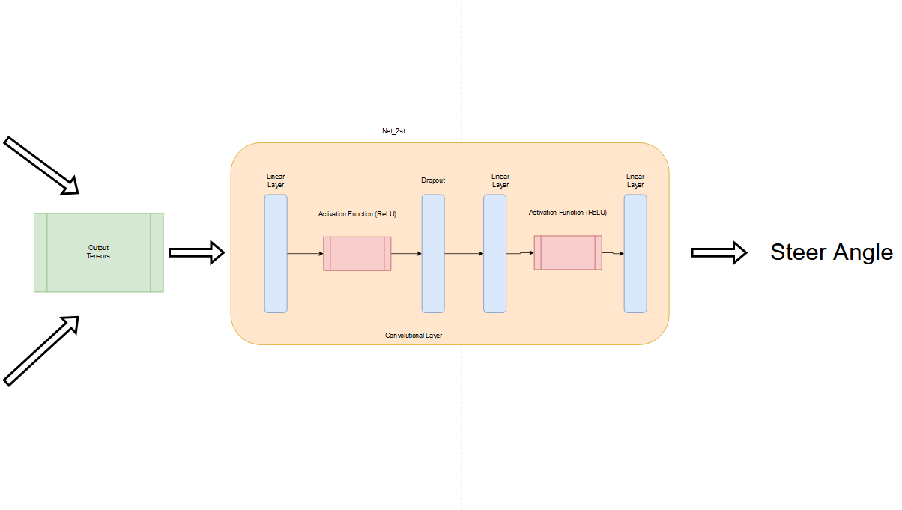

Slide 29
Two Stream Model
Two-stream CNN models are generated from the hypothesis that human brain uses two separate streams to perform object and motion recognition . The two-stream model that we used is work built on a deep convolutional network architecture for video action recognition by combining two different streams, spatial stream and temporal stream. Our two-stream model architecture is shown in Figure . Each stream has two convolutional blocks and a max-pooling layer. After dropout, the two streams are then concatenated to go through fully-connected (FC) layers. For the spatial stream, our model uses 3 frames of RGB images as input, which can be denoted as {It−2, It−1, It}. For the temporal stream, we use two different variations, optical flow . The optical flow is either single frame Ft = f({It−1, It}), or two consecutive frames Ft−1 = f({It−2, It−1}) and Ft = f({It−1, It}).

Slide 30
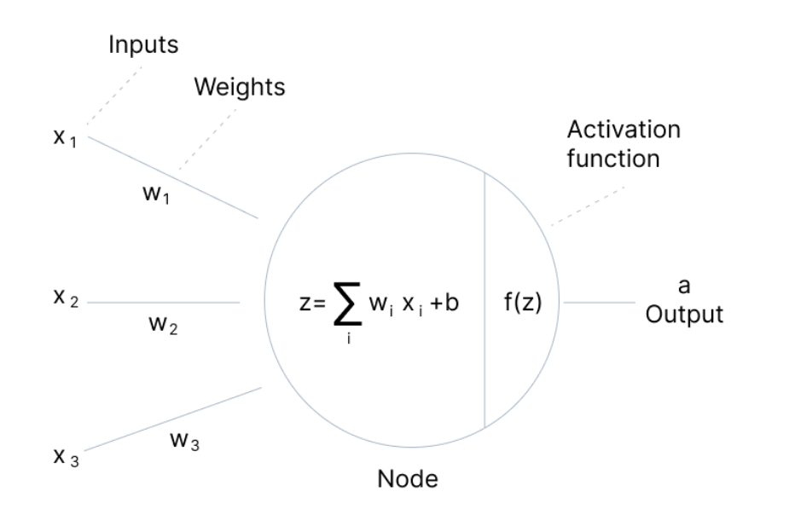
Activations functions
An Activation Function decides whether a neuron should be activated or not. This means that it will decide whether the neuron’s input to the network is important or not in the process of prediction using simpler mathematical operations.
The role of the Activation Function is to derive output from a set of input values fed to a node (or a layer).

Slide 31
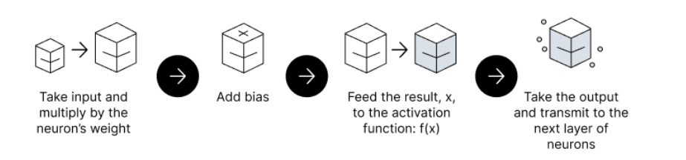
Feedforward vs. Backpropagation
Feedforward Propagation - the flow of information occurs in the forward direction. The input is used to calculate some intermediate function in the hidden layer, which is then used to calculate an output.
Backpropagation - the weights of the network connections are repeatedly adjusted to minimize the difference between the actual output vector of the net and the desired output vector.

Slide 32
Feedforward vs. Backpropagation
Feedforward Propagation - the flow of information occurs in the forward direction. The input is used to calculate some intermediate function in the hidden layer, which is then used to calculate an output.
Backpropagation - the weights of the network connections are repeatedly adjusted to minimize the difference between the actual output vector of the net and the desired output vector.

Slide 33
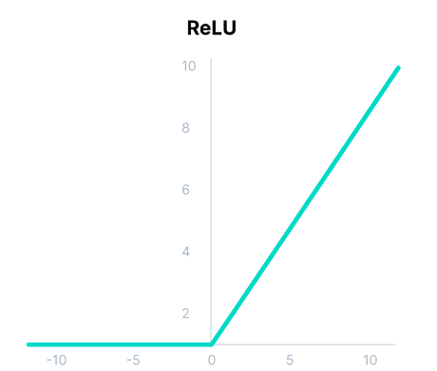
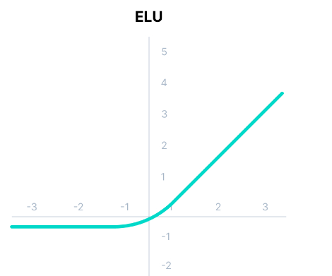
https://www.v7labs.com/blog/neural-networks-activation-functions
ReLU - Rectified Linear Function
F(x) = max(0,x)
ELU - Exponential Linear Unit
F(x) = if x>=0 then x else alpha*(e^x-1)

Slide 34
Visualisation
A graph was plotted with actual, predicted steering angle versus time.
Steering angles predicted are used to generate a rotating image of a steering wheel in order to simulate the experience of driving. A video is generated using the corresponding images.
A video is generated using the optical flow in order to gain a better understanding of it.

Slide 35
Results and Conclusion

Slide 36
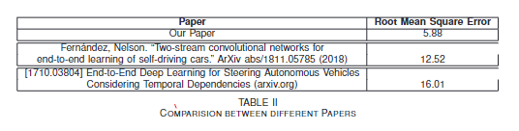

Slide 37
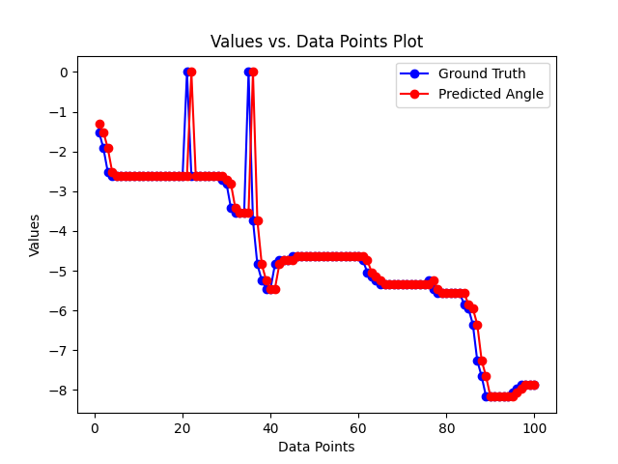

Slide 38
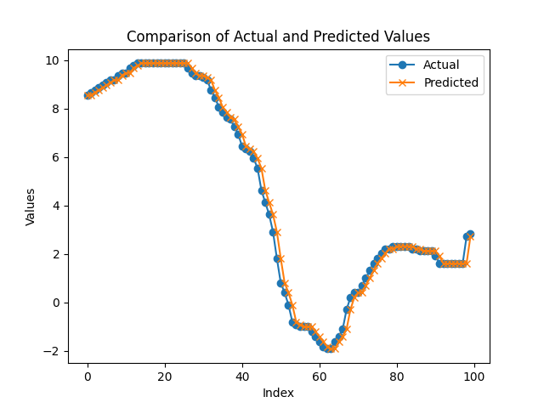

Slide 39
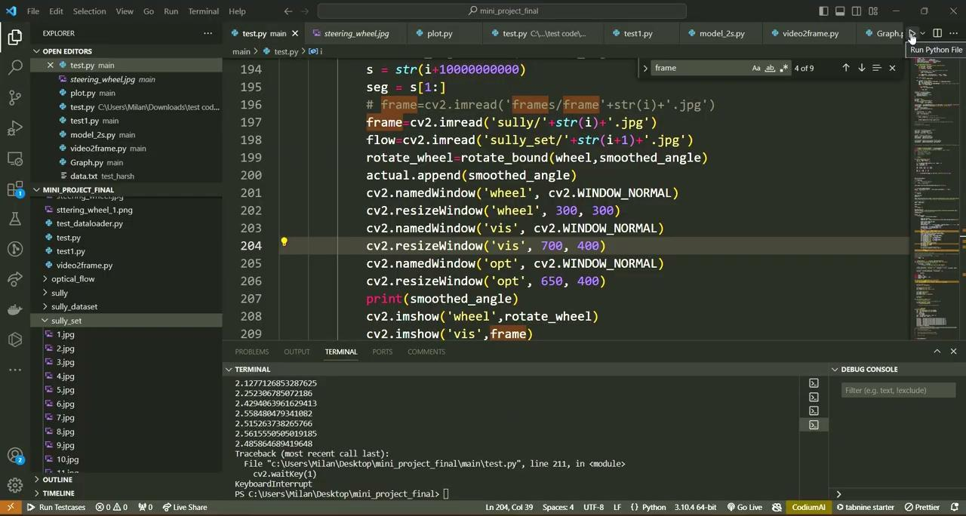

Slide 40
Future Scope
Develop the model to work in open environments.
Incorporate velocity and/or acceleration prediction into the model.
Create a dataset in which cars are getting parked with respect to context of our model.
Real World Testing.

Slide 41
References

Slide 42
References
Fernández, Nelson. “Two-stream convolutional networks for end-to-end learning of self-driving cars.” ArXiv abs/1811.05785 (2018)
[1710.03804] End-to-End Deep Learning for Steering Autonomous Vehicles Considering Temporal Dependencies (arxiv.org)
Shah, Syed & Xuezhi, Xiang. (2021). Traditional and modern strategies for optical flow: an investigation. SN Applied Sciences. 3. 10.1007/s42452-021-04227-x.
Shen, Shihao & Kerofsky, Louis & Yogamani, Senthil. (2023). Optical Flow for Autonomous Driving: Applications, Challenges and Improvements.
Smolyakov, M. & Frolov, A.I. & Volkov, V.N. & Stelmashchuk, I.V.. (2018). Self-Driving Car Steering Angle Prediction Based On Deep Neural Network An Example Of CarND Udacity Simulator. 1-5. 10.1109/ICAICT.2018.8747006.
Fathy, Mahmoud & Ashraf, Nada & Ismail, Omar & Fouad, Sarah & Shaheen, Lobna & Hamdy, Alaa. (2020). Design and implementation of self-driving car. Procedia Computer Science. 175. 165-172. 10.1016/j.procs.2020.07.026.
Mariusz Bojarski, Philip Yeres, Anna Choromanska, Krzysztof Choromanski, Bernhard Firner, Lawrence Jackel, Urs Muller.Explaining How a Deep Neural Network Trained with End-to-End Learning Steers a Car
https://github.com/SullyChen/driving-datasets/tree/master

