Slide 1


LAN connection using cisco packet tracer
Name: Milan R Bhimani
Roll no.: 111
Enrolment no.: 21002171210081
Batch: 4
Branch: CSE

Slide 2
Cisco packet tracer
Cisco Packet Tracer is one of the most popular system software for simulating network configurations.
With the help of this tool you can build your own network topology, and can practice different scenarios.
Before starting the setup of network(LANs) in Universities, Offices etc., devices are needed and ethernet cables are required.

Slide 3
About LAN (local area network)
A Local area network(LAN) is a collection of devices connected together in one physical location , such as a building, office or home.
A LAN can be small or large, ranging from a home network with one user to an enterprise network with thousands of users and devices in an office or school.
Regardless of size, a LAN's single defining characteristic is that it connects devices that are in a single, limited area. In contrast, a wide area network (WAN) or metropolitan area network (MAN) covers larger geographic areas. Some WANs and MANs connect many LANs together.

Slide 4
Office network
An office network is an implementation of LAN system in workplaces.
Two different departments can be connected with a router using the concept of LAN

Slide 5
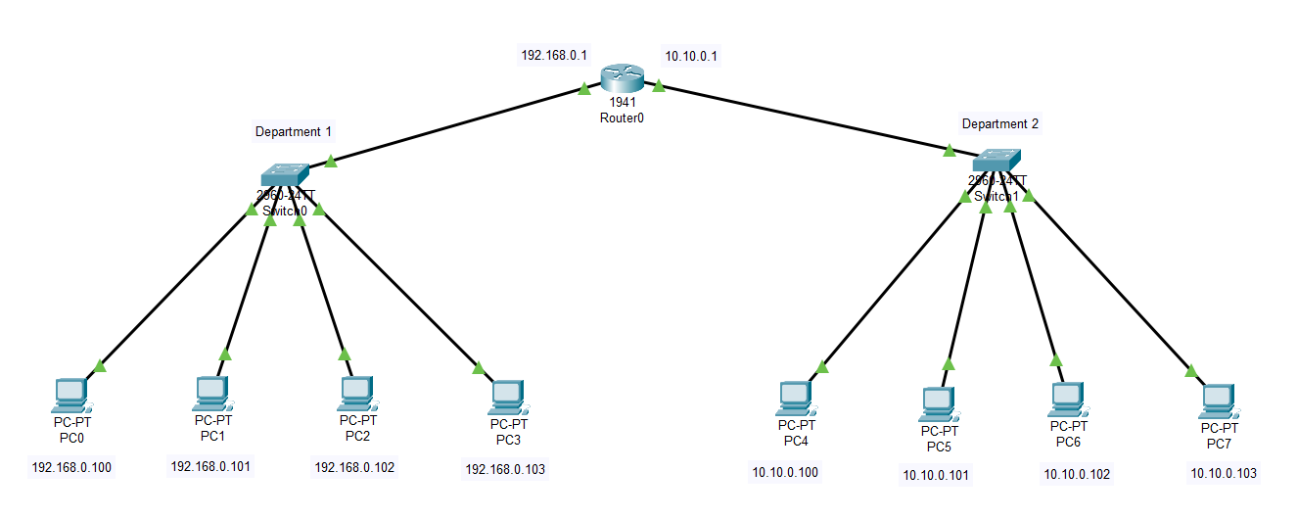
Structure

Slide 6

THANKYOUU!

