Slide 1


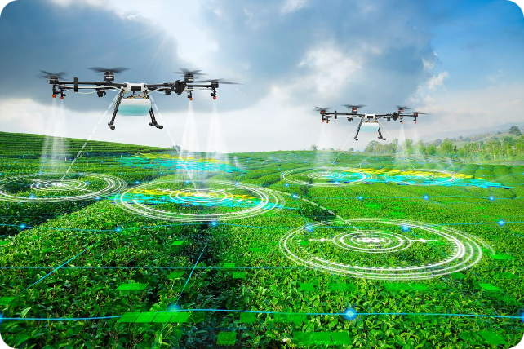
Precision Farming: Optimizing Growth and Yield
Precision farming leverages data-driven insights to enhance productivity and sustainability across the entire crop lifecycle. By carefully monitoring and adapting to key factors, growers can unlock the full potential of their land.

Slide 2

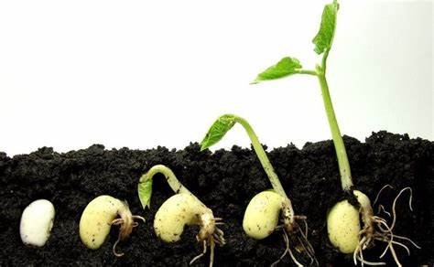
Tracking Growth and Predicting Stages
1
Planting
Meticulously record the date and conditions of each planting to establish a baseline for growth tracking.
2
Germination
Monitor seedling emergence and development to identify any delays or anomalies early on.
3
Maturation
Analyze growth patterns and compare to historical data to predict the optimal harvest window.

Slide 3
Optimizing Soil Health
Soil Analysis
Fertilizer Recommendations
Growth Predictions
Conduct comprehensive tests to determine the composition, nutrient levels, and pH of the soil.
Use soil data to forecast the impact on plant development, yield, and quality.
Prescribe the ideal blend of organic and synthetic fertilizers to address any deficiencies and support vigorous growth.

Slide 4

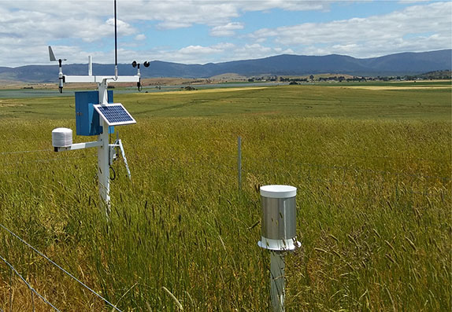



Adapting to Weather Conditions
Monitor
Continuously track local weather patterns, including temperature, precipitation, and storm events.
Analyze
Assess the potential impact of weather conditions on plant growth, disease, and pest activity.
Adjust
Proactively modify schedules and strategies to mitigate risks and optimize crop performance.

Slide 5
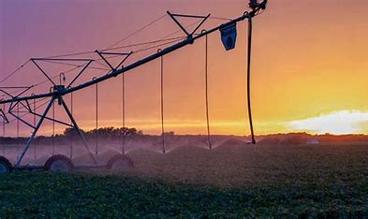
Optimizing Irrigation
1
Soil Moisture Monitoring
Utilize sensors to precisely measure soil moisture levels and avoid over or under-watering.
2
Tailored Schedules
Recommend watering frequencies that align with plant needs and environmental conditions.
3
Water Stress Prediction
Anticipate and address potential water-related challenges to maintain optimal plant health.

Slide 6


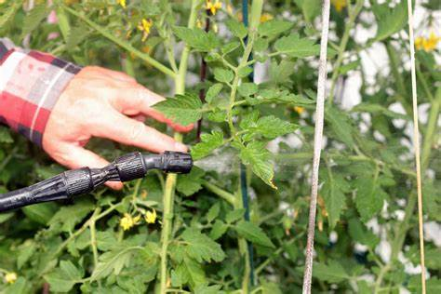


Integrated Pest Management
Scouting
Regularly monitor for pests and diseases to identify issues early.
Organic Controls
Recommend natural, eco-friendly pesticides and integrated pest management strategies.
Optimized Timing
Develop tailored spraying schedules for maximum effectiveness and minimal impact.

Slide 7
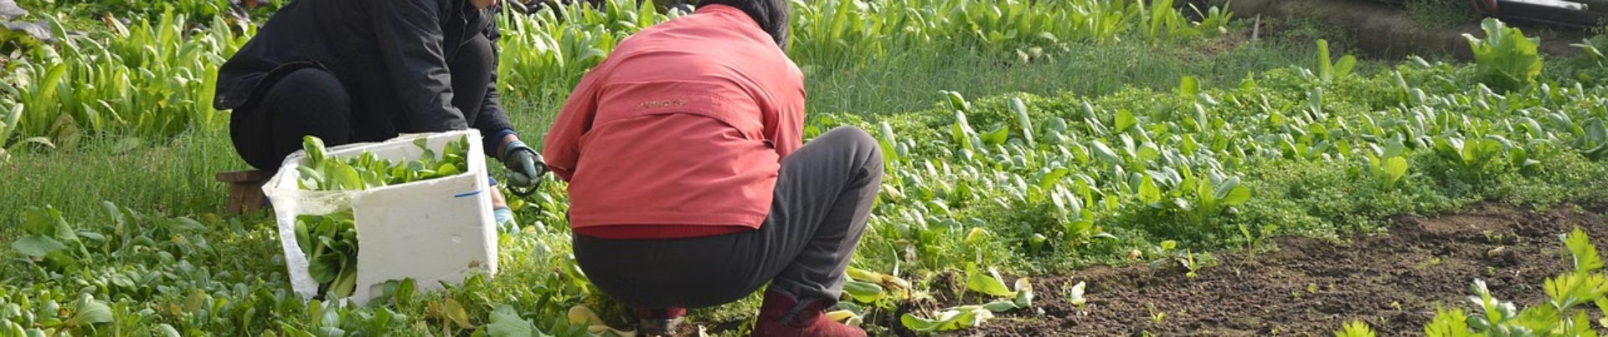
Boosting Productivity
Intercropping
Precision Seeding
Weed Management
Strategically plant complementary crops to enhance nutrient cycling and natural pest control.
Use advanced technologies to optimize seed placement and spacing for maximum yield.
Establish effective schedules and methods for timely weed removal to minimize competition.

