Slide 1

Notes:
Visual assets used / placeholders:
- assets/figures/bitcoin_market_cover.png

Slide 2
Introduction: problem framing
BTCUSDT 15m · no final test access
From price direction to economically usable signals
h4 · h16 · h96
31.9744 bp
0
No Trade
prediction horizons
round-trip cost
final test access
research decision
Problem
Task
Decision Rule
Directional accuracy alone is not enough. A signal must survive realistic transaction costs, spread and slippage.
Binary classification of future direction, plus forward returns for cost-aware economic evaluation.
A model is only relevant if it beats No Trade under a predefined Economic Gate.
Core question: can 15-minute BTCUSDT data yield a robust signal after realistic costs?
02

Slide 3
Literature review: related solutions
BTCUSDT 15m · no final test access
What prior work implies for design choices
Reference | Relevant idea | Adopted design choice
Zhang et al. (1998) | Forecasting models need careful validation; raw prediction accuracy can mislead. | Use baselines and transparent evaluation.
Fischer & Krauss (2018) | Deep learning can identify statistical signals in financial series. | Compare ML signals against strict validation.
Ke et al. (2017) | Gradient boosting handles wide tabular feature spaces efficiently. | Use LightGBM for feature-rich classification.
Prokhorenkova et al. (2018) | Ordered boosting reduces leakage-like target statistics bias. | Use CatBoost as leakage-aware comparison.
Lopez de Prado (2018) | Financial ML needs purging, embargo and backtest discipline. | Walk-forward validation and locked final test.
Takeaway: this project evaluates signals as trading candidates, not only as classifiers.
03

Slide 4
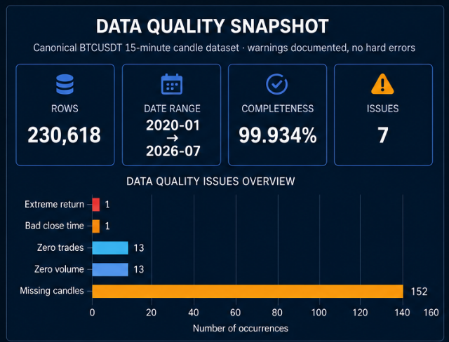
Dataset characteristics
BTCUSDT 15m · no final test access
Canonical BTCUSDT 15-minute candles with documented data-quality warnings
Coverage
2020-01-01 to 2026-07-31 · 230,618 rows · 15 OHLCV / metadata columns.
Quality status
No hard schema errors; warnings retained and documented instead of silently cleaned away.
Modeling impact
Missing candles and anomalous close times required horizon-aware targets and strict alignment.
04
Notes:
Visual assets used / placeholders:
- assets/figures/data_quality_snapshot.png

Slide 5
Dataset preprocessing and feature engineering
BTCUSDT 15m · no final test access
From raw candles to leakage-safe modeling rows
333 retained predictors
no target leakage
multi-horizon targets
Validate
Clean
Engineer
Target
Split
schema, gaps, OHLC logic
deduplicate, align timestamps
rolling stats, TA indicators
h4 / h16 / h96 forward returns
purged walk-forward folds
Feature group | Examples | Purpose
Returns / momentum | log returns, lagged momentum | trend direction
Volatility / risk | rolling std., ranges, downside moves | market regime
Volume / trades | volume changes, number of trades | liquidity & activity
Candle structure | body, wicks, relative position | microstructure
05

Slide 6
Baseline model
BTCUSDT 15m · no final test access
A meaningful baseline must include the no-trade alternative
No Trade
50/50 Direction
Naive Trading
Economic reference: zero trades, zero costs, zero return. Any candidate must beat inactivity after costs.
Statistical reference for a hard binary forecasting task. CV log loss near 0.693 is close to random.
Always trading is rejected as a deployment baseline because it ignores fees, spread and slippage.
Baseline logic used in this project
Criterion | Required implication
Statistical performance | must improve on simple probability baselines
Economic performance | must remain positive after round-trip costs
Robustness | must work across folds, not only in one period
06

Slide 7
Model definition
BTCUSDT 15m · no final test access
Tree ensembles with calibrated probabilities and horizon-specific targets
LightGBM
CatBoost
Calibration
Gradient boosted trees for wide tabular feature matrices and efficient fold training.
Ordered boosting comparison for leakage-sensitive tabular classification.
Raw and sigmoid probabilities were evaluated before threshold optimization.
Features
Classifier
Calibration
Threshold
Gate
333 predictors
P(up)
raw / sigmoid
candidate rules
No Trade or reject
Important separation: model training, calibration, threshold selection and economic approval are separate stages.
07

Slide 8
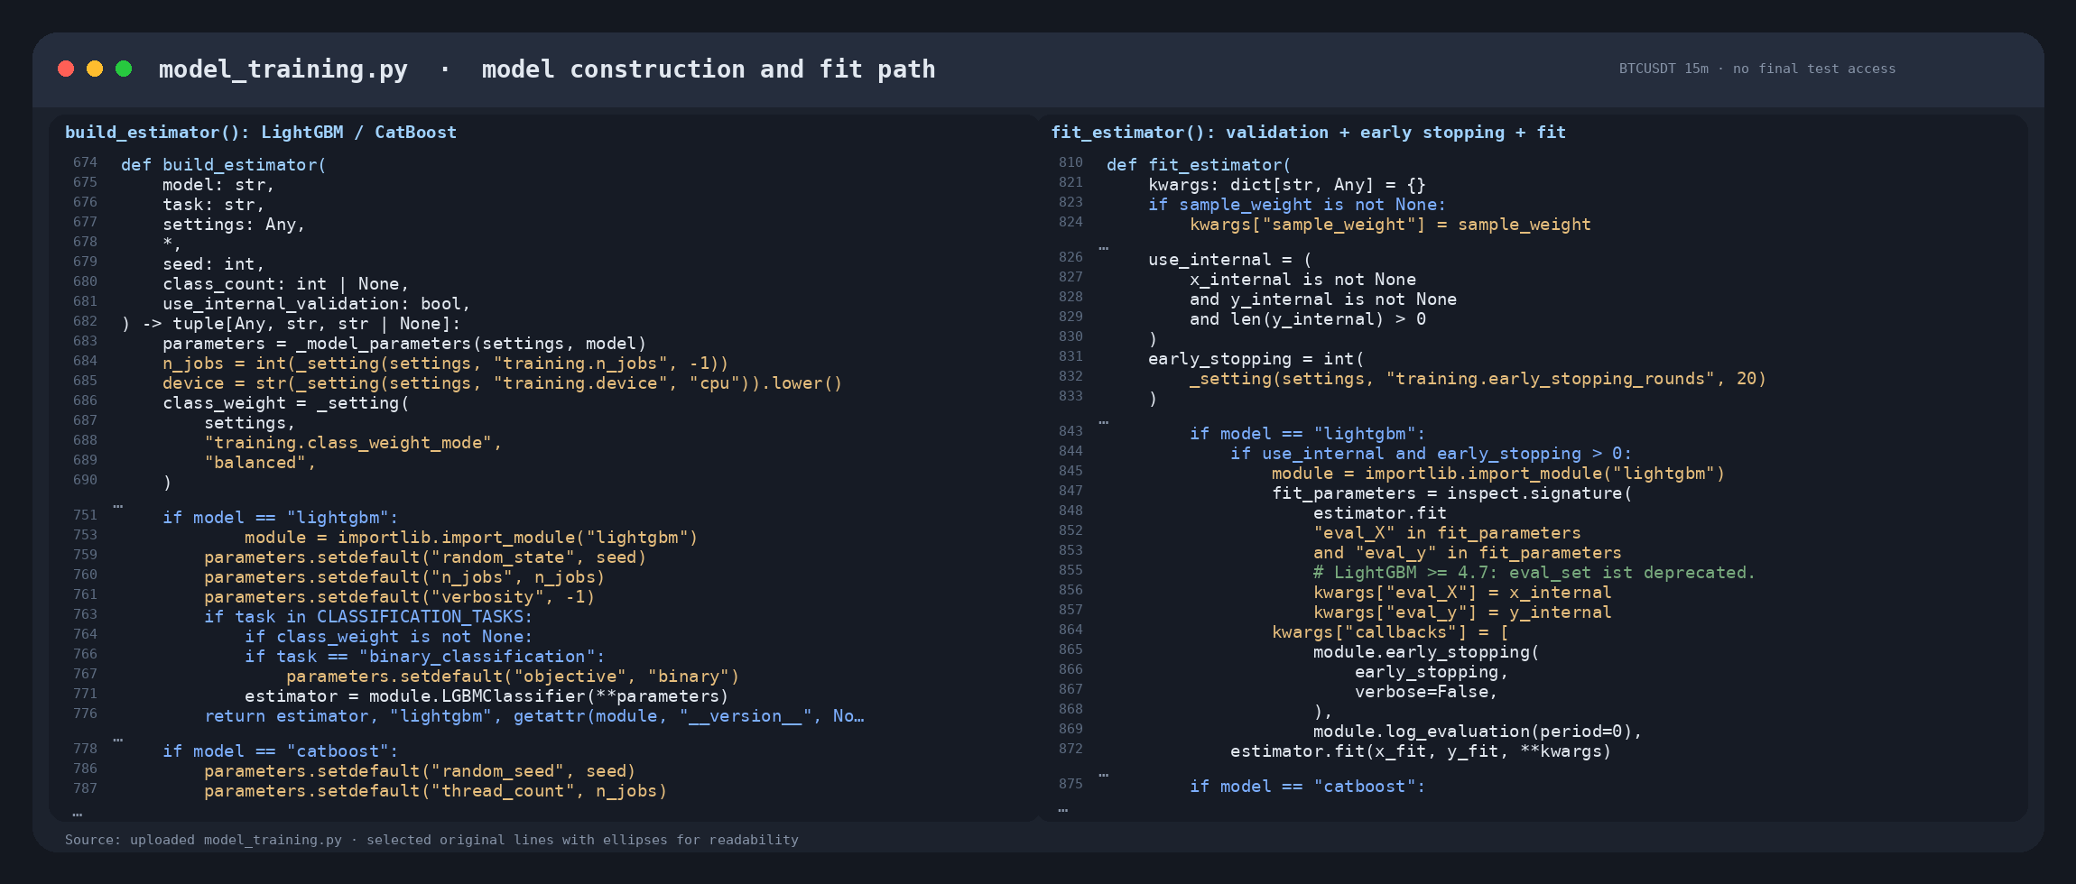
Model implementation
BTCUSDT 15m · no final test access
Code path and reproducibility
08
Notes:
Visual assets used / placeholders:
- assets/screenshots/model_definition_code.png

Slide 9
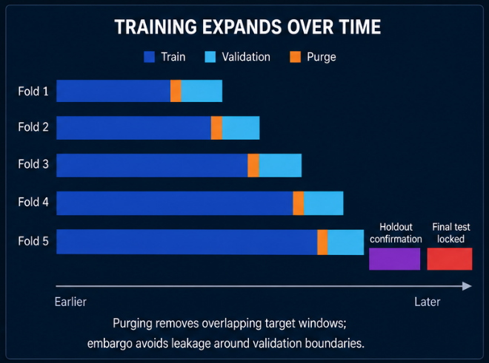
Model evaluation
BTCUSDT 15m · no final test access
Temporal validation with purging, embargo and locked final test
Layer | Purpose
Walk-forward CV | model comparison and stability
Purging / embargo | prevent target-window leakage
Holdout | one-time confirmation only
Final test | locked because no candidate passed the gate
Key rule
The final test cannot become another validation set. No approval → no final-test opening.
09
Notes:
Visual assets used / placeholders:
- assets/figures/walk_forward_split_diagram.png

Slide 10
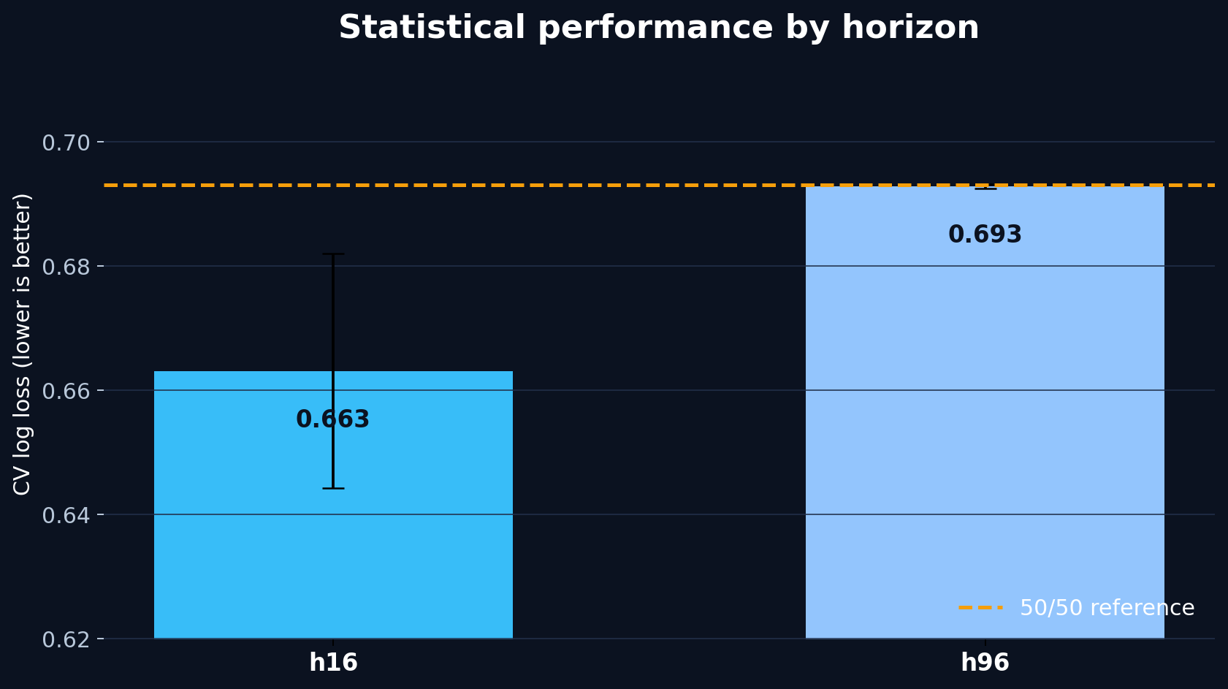
Results: statistical model performance
BTCUSDT 15m · no final test access
CV performance alone does not imply economic feasibility
Horizon | Selection | CV log loss | Interpretation
h4 | LightGBM + Sigmoid | legacy | economic decision available
h16 | CatBoost + Sigmoid | 0.663 ± 0.019 | strongest candidate
h96 | LightGBM + Raw | 0.693 ± 0.000 | near 50/50
Interpretation
h16 was strongest statistically, but still had to pass the economic gate under realistic costs.
10
Notes:
Visual assets used / placeholders:
- assets/figures/cv_log_loss_by_horizon.png

Slide 11
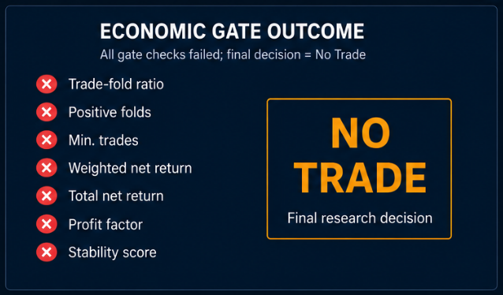
From probabilities to trading decisions
BTCUSDT 15m · no final test access
Economic approval is stricter than statistical model selection
Gate criterion | Meaning
Trade-fold ratio | signal must not occur only in isolated periods
Positive folds | returns must generalize over time
Minimum trades | avoid tiny-sample illusions
Profit factor | profits must exceed losses
Stability score | penalizes fold dispersion
Gate outcome
For every horizon: all outer signals failed the required trade and return checks.
11
Notes:
Visual assets used / placeholders:
- assets/figures/economic_gate_checklist.png

Slide 12
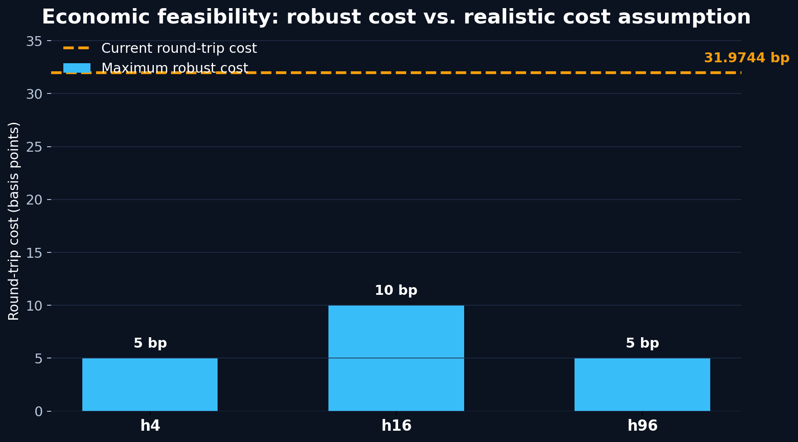
Results: economic feasibility
BTCUSDT 15m · no final test access
All horizons failed the Economic Gate under current cost assumptions
Horizon | Decision | Max. robust cost | Current cost viable?
h4 | No Trade | 5 bp | No
h16 | No Trade | 10 bp | No
h96 | No Trade | 5 bp | No
Main result
Even the strongest horizon covered only 10 bp, far below the 31.9744 bp round-trip cost assumption.
12
Notes:
Visual assets used / placeholders:
- assets/figures/robust_cost_vs_actual.png

Slide 13
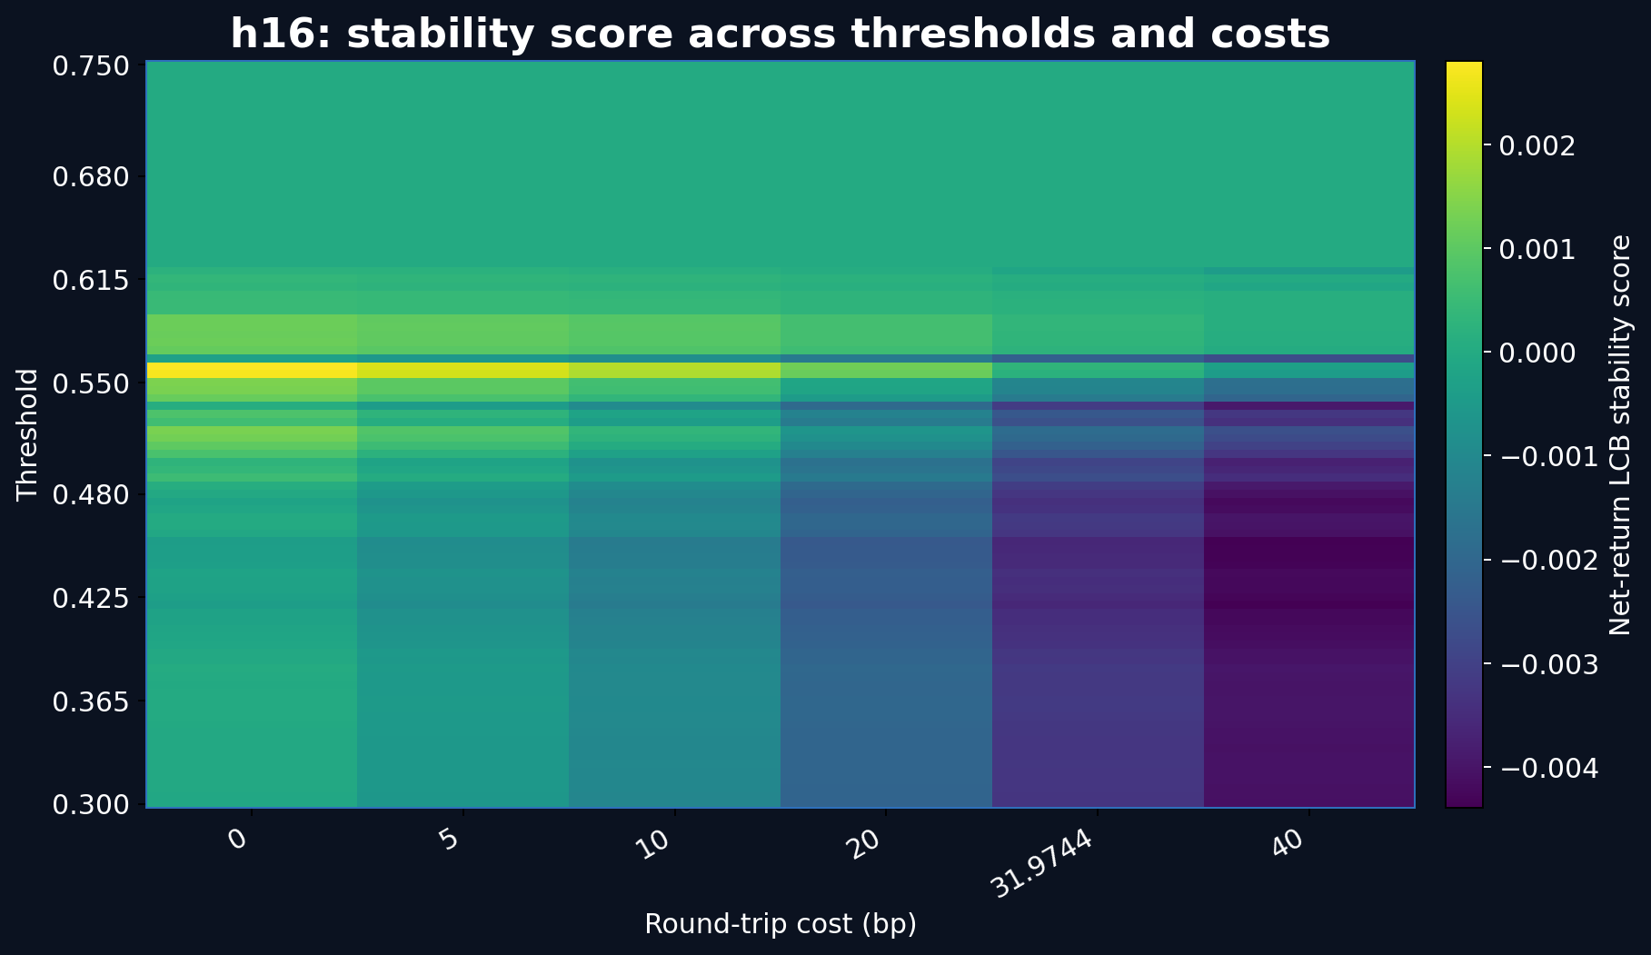
Results: cost-threshold surface
BTCUSDT 15m · no final test access
h16 showed the strongest exploratory region but not enough cost coverage
Reading the surface
Brighter areas indicate better net-return LCB stability for a threshold / cost pair.
Observed pattern
Robust regions exist only at lower transaction costs, then vanish as costs approach reality.
Decision
Exploratory signal ≠ approved strategy. No final test was opened.
13
Notes:
Visual assets used / placeholders:
- assets/figures/h16_cost_surface_english.png

Slide 14
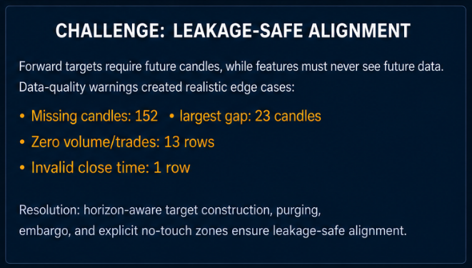
Challenges and errors
BTCUSDT 15m · no final test access
Most difficult issue: leakage-safe alignment across data, targets and returns
Challenge
Forward targets need future candles, but features must never include future information.
Observed issues
Missing candles, warm-up windows and h4 legacy reports caused alignment and reporting edge cases.
Resolution
Horizon-aware targets, purging, embargo, read-only final aggregation and explicit warnings.
14
Notes:
Visual assets used / placeholders:
- assets/screenshots/feature_target_alignment_error.png

Slide 15
Discussion and limitations
BTCUSDT 15m · no final test access
Statistical signal is not the same as a deployable trading strategy
What worked
What failed
Why it matters
The pipeline found limited statistical and low-cost signal regions, especially for h16.
No candidate provided enough margin to overcome the predefined cost model.
Rejecting weak signals protects the final test and avoids overclaiming a trading edge.
Limitation | Future work
Spot OHLCV only | add order-book, futures, funding and liquidity features
Static cost model | test maker/taker and execution-aware costs
Binary direction target | evaluate cost-aware long/no-trade or return-distribution targets
No live confirmation | pre-register a paper-trading confirmatory protocol
15

Slide 16
Conclusion and Q&A
BTCUSDT 15m · no final test access
A rigorous No Trade result closes the current research phase
NO TRADE
Questions to defend
Why was the final test not opened?
No model was approved for final test evaluation or production use.
Why is No Trade a valid result?
Why did h16 look best but still fail?
Which data would be most useful next?
How would a confirmatory paper-trading phase be specified?
Key takeaway
A conservative rejection is stronger than an overfit trading claim.
Thank you · Questions?
16

