Slide 1

EVEREST ENGINNERING COLLEGE
(AFFILIATED TO POKHARA UNIVERSITY)
SANEPA-2, LALITPUR
[SUBJECT CODE: CMP 490]
A FINAL REPORTS ON
“GROCERY DEMANDS PREDICTION”
SUBMITTED BY:
DIPESH MAGAR [19120054]
JHAK PRASAD PUN [19120056]
MANISH RAI [19120060]
MILAN BHATTARAI [19120063]
SUPERVISED BY:SANTA BASNET
SUBMITTED TO:
DEPARTMENT OF COMPUTER ENGINEERING AND IT
July 2023

Slide 2
TABLE OF CONTENTS
CHAPTER 1 : INTRODUCTION
CHAPTER 2 : STATEMENT OF WORK
2.1 : Related work
2.2 : Aims and Objectives
2.2.1 : Aims
2.2.2 : Objectives
CHAPTER 3 :EVALUATION PLAN
CHAPTER 4: CONCLUSION
CHATPTER 5:RESULT AND OUTPUTS
CHAPTER 6: REFERENCE

Slide 3
CHAPTER 1: INTRODUCTION
The grocery industry is constantly evolving.
Important for retailer to relevant forecasting for quantity.
The goal of our project is to be deliver the product to customer and come up relevant prediction for the user and display the patterns for business.
This model predicting the grocery items to find which item is most demand by customers or which item is less demand.

Slide 4
CHAPTER 2: STATEMENT OF WORK
2.1 Related Work
“Predicting sales in a food store department using machine learning”.
In this paper they deal with the SVM (Support Vector Machines) they likewise utilize two more calculation is Multilayer Perceptron and Radial Basis Capacity Networks.
There is a measurably huge distinction between the SVM, MLP and RFBN while foreseeing the deals in a food store division. The SVM performed lower mistake measures than the other two techniques.
“Predicting online Grocery Ordering Intention”
In this model they work on the E-Commerce, Grocery, Recommendation System, Neural Networks.
The recommendation System which has been proposed, is based upon neural networks
This system able to provide suitable predictions about the future orders of the customer.

Slide 5
“Applied Machine Learning for Supermarket Sales Prediction”.
In this model, they used three machine learning algorithms (K-Nearest Neighbor, Random Forest and Gradient Boosting) for sales forecasting.
RF performed better, as it had a lower mean absolute error than the other two model.
“A Review on Grocery Management System Using Machine Learning Algorithms”
This model Analyzed the proper requirement of the consumer and suggesting him products accordingly.
Max-Miner Algorithm showed more accuracy than Apriori Algorithm.
Random forest and support vector machine Algorithm can be used to classified the products based on purchased product and not purchased product in the grocery list.
Comparing both the algorithm Support vector machine showed more accuracy than random forest algorithm.

Slide 6
2.2 Aims and Objectives
2.2.1 Aims
To analyze Business Growth by knowing the future values of quantity and price.
2.2.2 Objectives
Forecasting the future average value of quantity and price per month.
Predicting next month's quantity, which product is needed in what amount.

Slide 7
CHAPTER 3: Evaluation PLAN
At first, we had collected 40k grocery data in csv format.
We splitted them based on ordered date and customer ID, and we got around 292k data.
We analyzed data and then we sliced into 5 chunks such as customer id, order amount, order date, product id, quantity and price. After that we obtained nearly 291k data.
We cleaned unmanaged data and then we analyzed data by using aggregate queries.

Slide 8
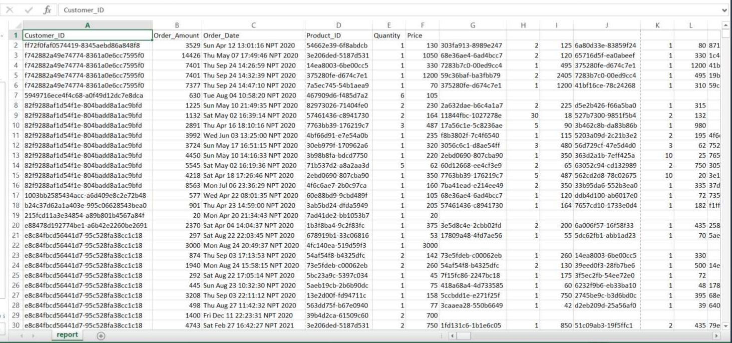

Slide 9
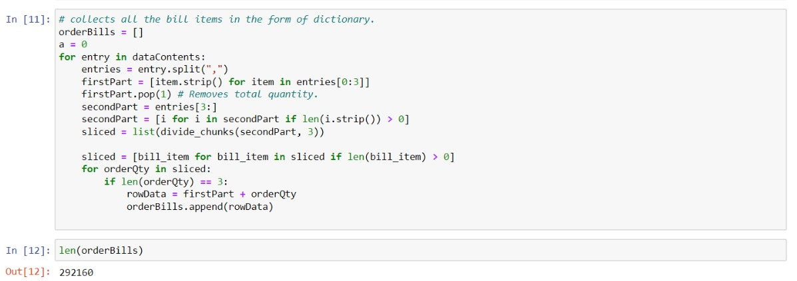

Slide 10
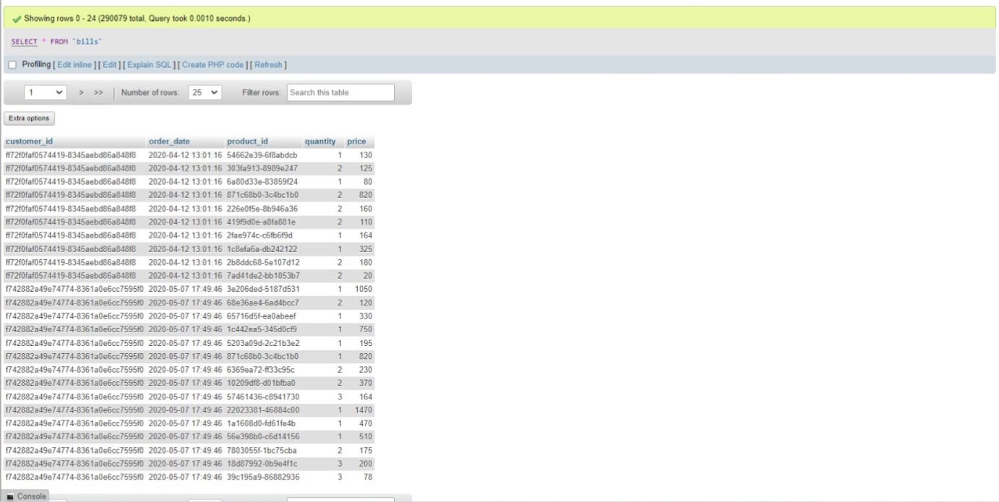

Slide 11
CHAPTER 4: CONCLUSION
Grocery Demand Prediction is very crucial for every company, especially big ones and this process is overly complex because there are a lot of factors. In this study, we used three machine learning algorithms (Linear Regression, Naive Regression, Exponential Smoothing) for quantity forecasts, Exponential Smoothing performed better, as it had a lower MAPE value than the other two models.
The Grocery Demand Prediction which has been proposed is based upon ARIMA model and is able to provide suitable predictions about the future quantity of the customer.

Slide 12
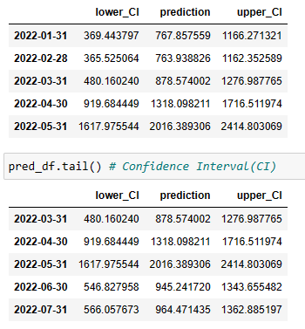
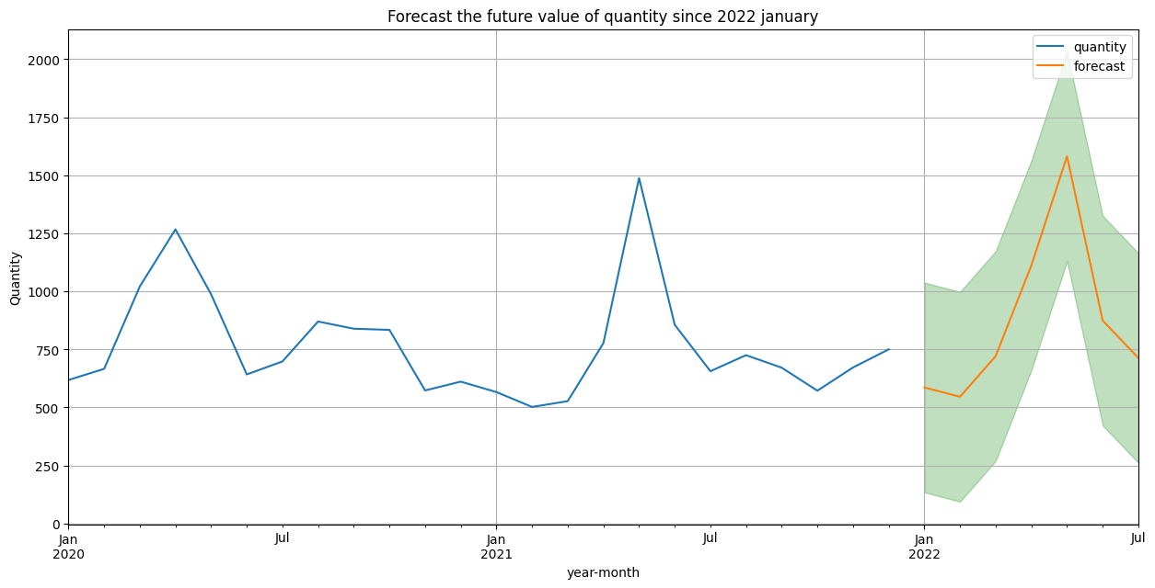
CHAPTER 5: RESULT AND OUTPUTS
[A] Forecasting the average value of quantity and price per month since 2022

Slide 13
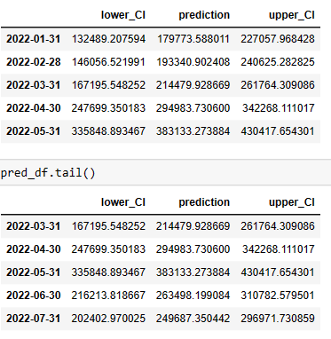
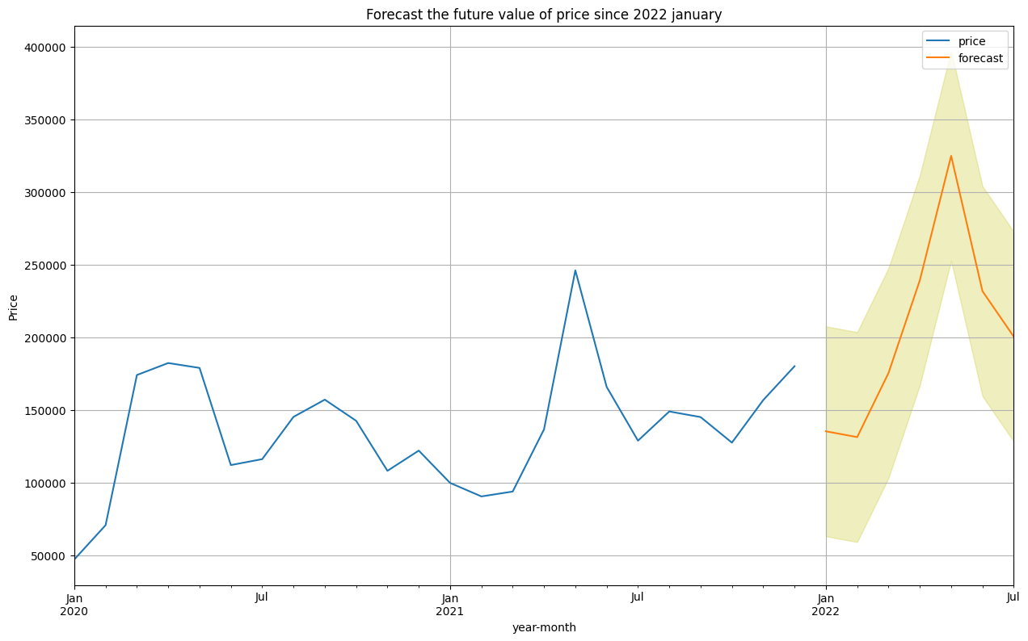

Slide 14
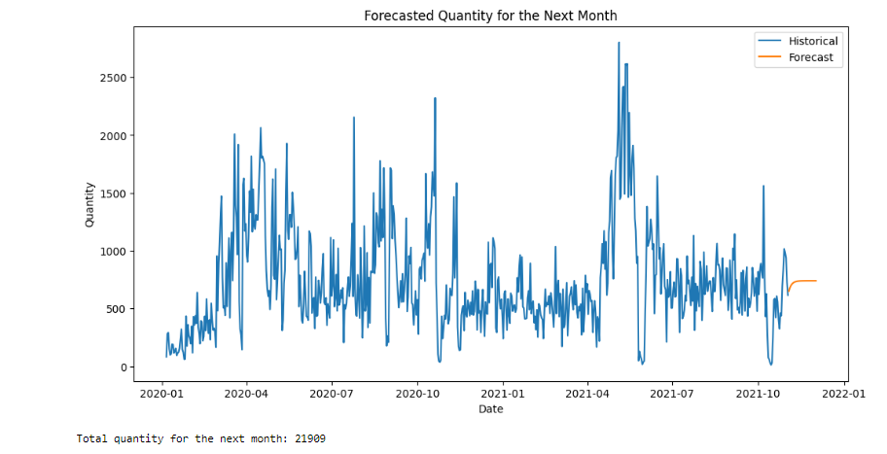
[B] Predicting which quantity is required in what amount using ARIMA model.

Slide 15
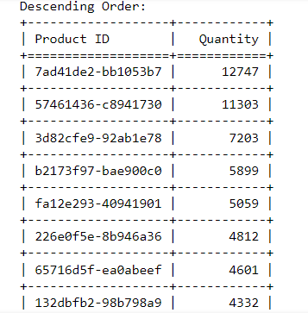

Slide 16
CHAPTER 6: REFERENCES
[1]Dahlen, R. S. (2016 6th). Predicting sales in a food store department Using machine learning. International Conference On Information and Communication Technology for Muslim World.
[2] Jahagirdar, R. R. (2017). Predicting Online Grocery Ordering Intention. International Journal of Engineering Research and Technology(IJERT).
[3] Odegua, R. (n.d.). Applied Machine Learning for Supermarket Sales Prediction. Ekpoma, Edo state, Nigeria: Department of Computer Science Ambrose Alli University.
[4] Pro Mr.Atul Pawar, Sushank Dehankar, Akshay Dandawate, Omkar Bansode, Avishkar Gawade.2021.A Review on Grocery Management System Using Machine Learning Algorithms.

Slide 17
Thank you

