Slide 1

EVEREST ENGINEERING COLLEGE
A
PROPOSAL DEFENCE
ON
“MCQ QUIZ FOR ENTRANCE PREPARATION OF PU”
Project Group Member
Manish Rai [19120060]
Milan Bhattarai [19120063]
Prakash Thedi Magar [19120074]
DATE:

Slide 2
content
1. Introduction
2. Problem statement
3. Objectives
4. Application
5.Project Features
6. Literature Review
6.Feasibility Study
7. System Requirement
8.Methodology
9.Expected Output
9.Reference

Slide 3
INTRODUCTION
This is a web-based multiple-choice-question examination system for accessing students. It is the system which students can appear in exam from anywhere and there is no interaction between pencil and paper rather interaction between computer and human being. The ‘MCQ QUIZ EXAM’ project will be developed to overcome the time consuming problem of manual system. This web application will check the correct answer and save the examiner time and carry the examination in an effective manner. Any university, college, school or educational institute can use this system to take quiz/exam. One of the benefits of our system is automated marking, that is teacher do not need to check the answer script as they do in manual quiz/exam. The users which are use this system don’t need to high computing knowledge and also system will inform them while entering invalid data. The project will reduce the manual process in managing examinations and all issues regarding that.

Slide 4
STATEMENT OF PROBLEM
The aim of this project is to computerized the existing manual system and help the examiners to save their valuable time and important data. It is essentially required to assist students for the learning and preparation of different tests. This project helps the examiners to manage their services in a good way and provide a better service to their users.

Slide 5
OBJECTIVES
The main objective of the project MCQ QUIZ EXAM is to manage the details of examinations, marks, courses and papers.

Slide 6
APPLICATION
To create an appropriate platform for best managing of MCQ test;
To overcome the time consuming issues and taking MCQ tests;
To release the marks of the test taker .

Slide 7
PROJECT FEATURES
Physical presence is not necessary.
Can be timed allow Y minutes to answer X number of Questions.
Student should complete all the question within the limited time.
Admin can edit/delete questions, subjects and view the result of student.
The type of questions is only multiple choice.
Result are available instantly.

Slide 8
Literature review
This project is inspired from Pathsala Nepal which provides medical quiz for various governmental and medical examination. Pathsala Nepal has hundreds of important GK questions with explanation on computers. These questions are important for governmental examination (like Loksewa) ponit of view and order crucial exams. Maths questions and answer are also available for Loksewa preparation. It includes interesting mathematics puzzles of algebra, arithmetic and geometric questions.
We also have refrence the MCQ web application Fantasia#2. This web application gives the general knowledge to children. Many random questions are present with randoms answers. The one important feature is that user gives the answer of one question within 30 second which is new features found found in this application.
MCQ web application named Trivia quiz by Wald Disney and others is our another refrence. This web application is about the movie Quiz, which name was “Fantasia”. Wald Disney released the experimental movie “Fantasia” to select the number of outlets in 1940, with disappointing results but it has since become a classic. It is the quiz about the movie “Fantasia”.
The Quizopedia is about the Nepal Quizzes and questions for students. The Quizopedia has a large question answer bank for kids for competitive exams. It boost up the student who are preparing the quiz contest competation about general knowledge. The quiz question are about Nepal history for general studies and others GK preparation are also available.

Slide 9
FEASIBILITY STUDY
Economic Feasibility
The project must be cost effective so that its users can purchase it, sometime the selling of large copy of a software product in low price will be more beneficial than that of high cost selling in the prospective of popularity and benefit.
Economic analysis is the most frequently used method for evaluating the effectiveness of the new system.
More commonly known as cost/benefit analysis.
The development cost of the proposed system is affordable for any organization and it needs no operating cost as to implement the system, we don’t need to purchase any extra equipment.
Technical Feasibility
It means that the project must be technically feasible by the use of present and near future hardware and techniques. Also it must be feasible to afford the technical person for new techniques or features required on the software project.
Familiarity with Web Application.
Familiarity with technology.
The application is built in Microsoft word which MCQ QUIZ WEB APPLICATION, project members have extensive experience with.
User have virtually experience using Microsoft word and all are comfortable using PCs.

Slide 10
Operational Feasibility
The user must know about the operation of software product to use it in the efficient way. Thus the process of operation must be pre-defined in many ways. Such as training, meeting, presentation demo etc. An example of an operational feasibility study would follow this path:
Time Feasibility
The user must know about the operation of software product to use it in the efficient way. Thus the process of operation must be pre-defined in many ways. Such as training, meeting, presentation demo etc. An example of an operational feasibility study would follow this path:

Slide 11
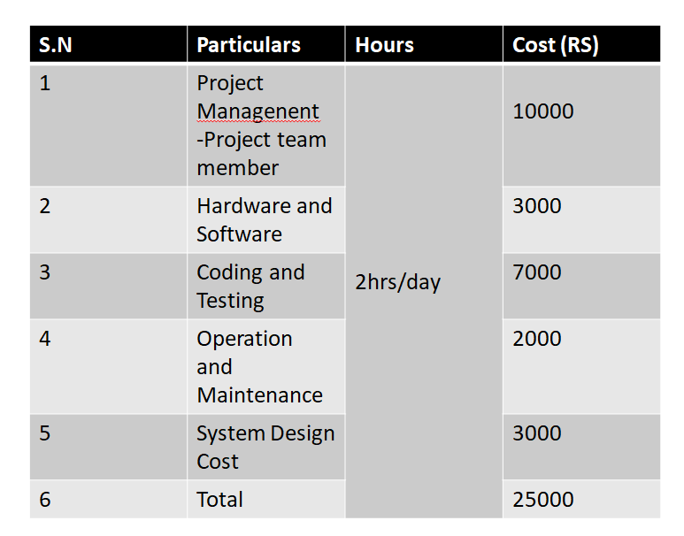
Cost estimation

Slide 12
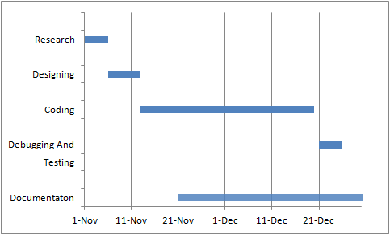
GANTT CHART

Slide 13
SYSTEM REQUIREMENT
Hardware Requirement:
PC
Software Requirement:
Sublime text 3 compiler
Microsoft visio
In this project we use Html, CSS, JavaScript and php programming language. And for compilation of this language we use sublime text 3 compiler. And to make flow chart and the block diagram we use the Microsoft Power Point software. We displayed the result by using desktop.
To search the needed data’s, we use the following browsers.
Mozilla Firefox
Google chrome
Internet explorer
Safari
Finally, we displayed the result by using desktop.

Slide 14
METHODOLOGY
This chapter starts on the discussion about the project research, design and methodology. The second part presents the development of the system. The third part tells the operation process and testing. The last part, discuss the evaluation procedure.
Proposed system analysis
The fundamental idea in our project is to make a product that would offer new aspect of learning and attend in exam.
Physical presence at a given location is absolutely not necessary.
No time is spent on evaluation question paper.
Being an integrated system it will reduce the paper work.
The result will be shown immediately to the participating students.
Results are also seen by teachers.

Slide 15
Expected output
The main purpose of our project is that offers new aspects of learning and improving knowledge in educational area. We have focused on the automated system, which replaces the manual quiz system. In this system, an educational institute can make their examination procedure automated.

Slide 16
REFERENCES
[1] Jalote, P. (n.d.). An Integrated Approach to Software Engineering. Narosa Publication.
[2] Langanier, T. C.-L. (n.d.). Object-Oriented Software Engineering.
[3] Maxim, R. S. (2019). Software Engineering.
[4] Villa, I. S. (n.d.). Software Engineering. Pearson Education.
.

Slide 17
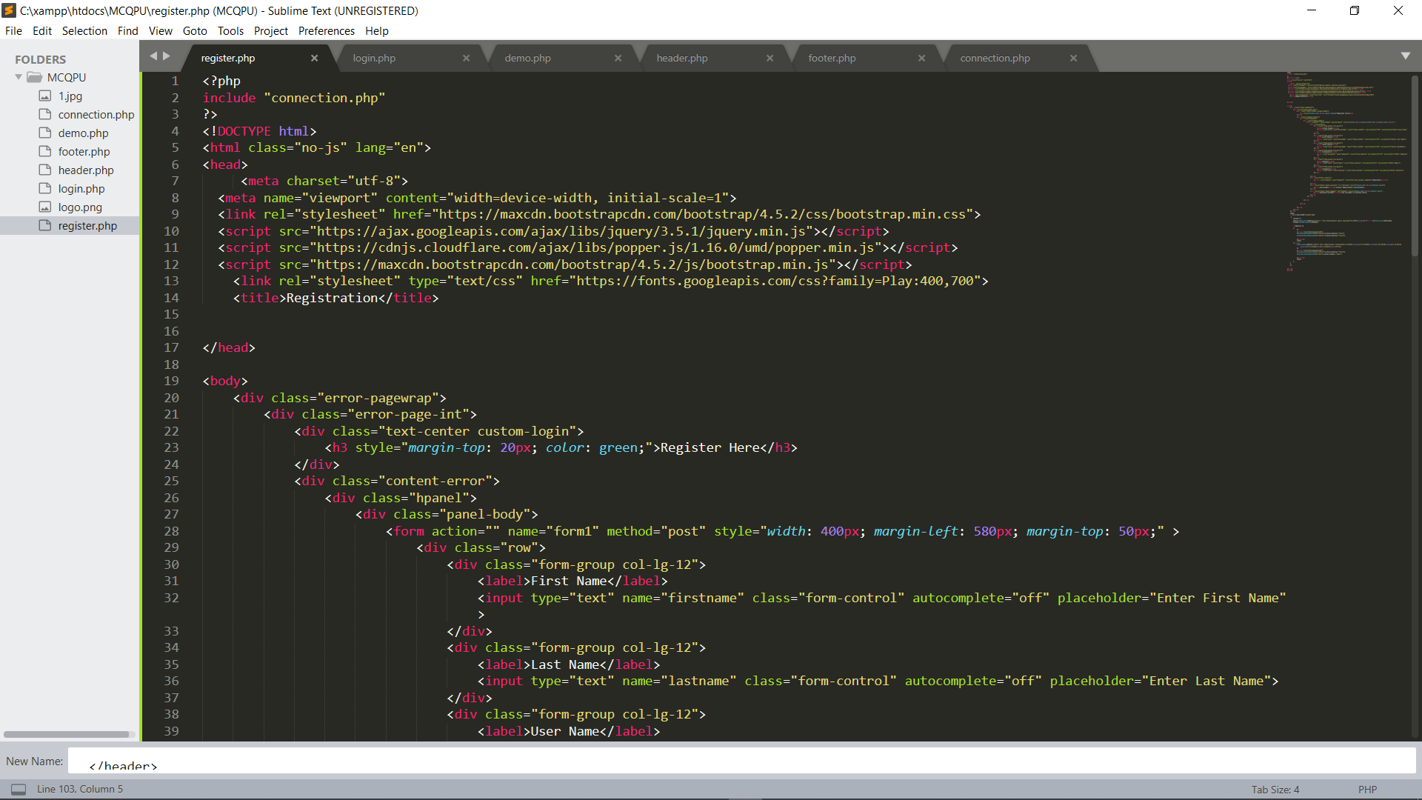
APPENDIX

Slide 18
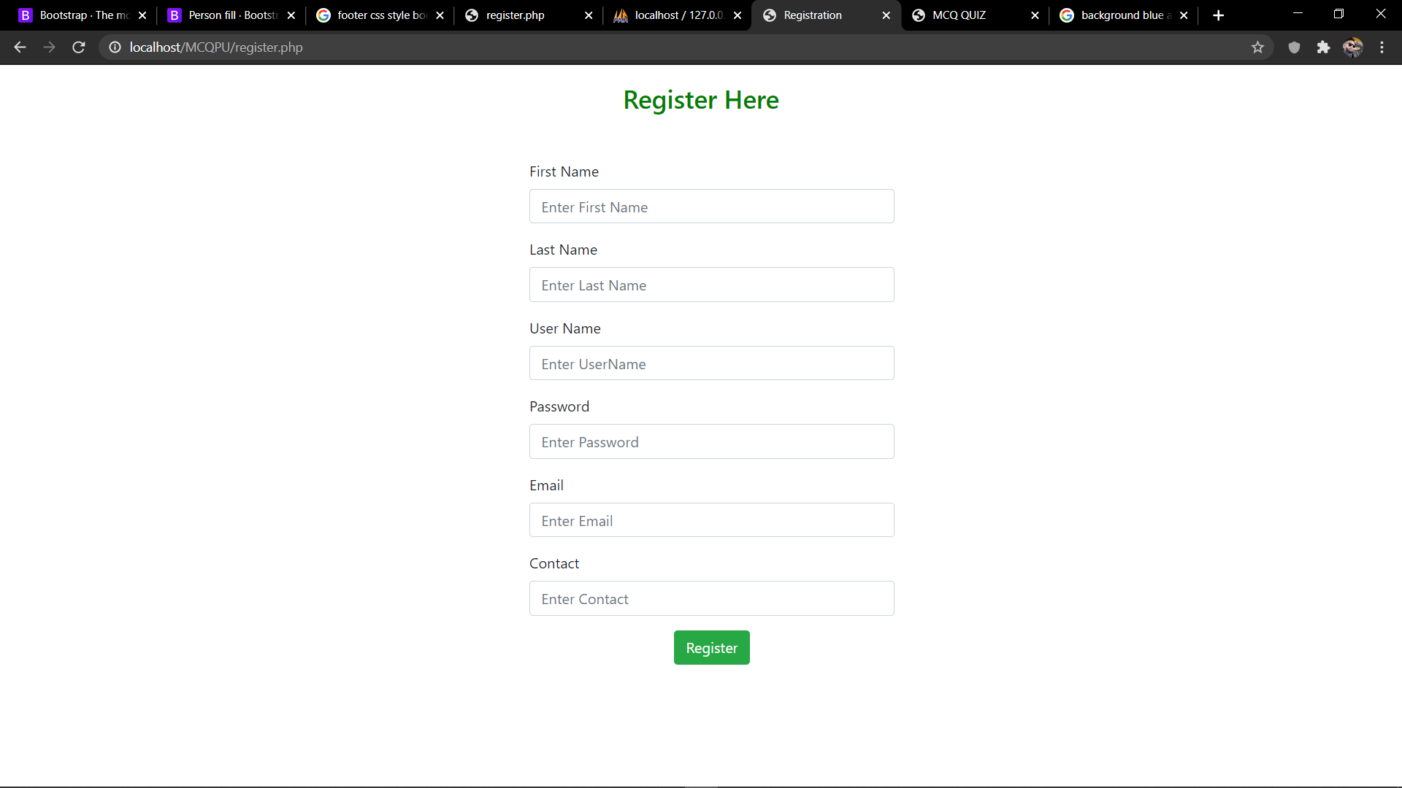

Slide 19
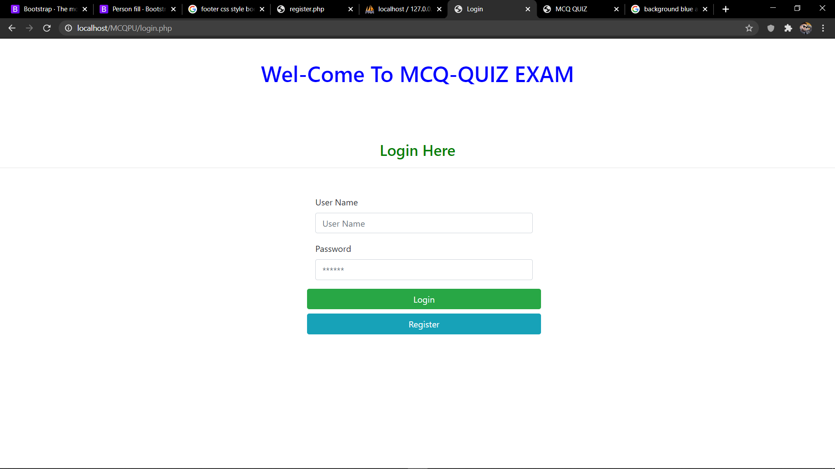

Slide 20
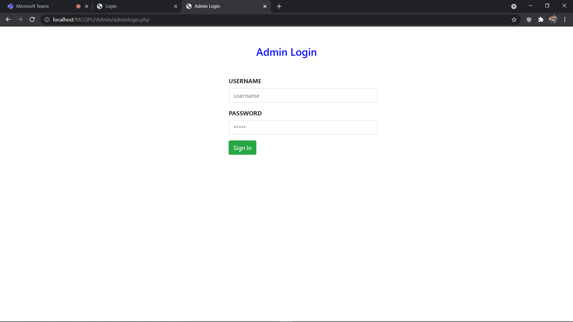

Slide 21
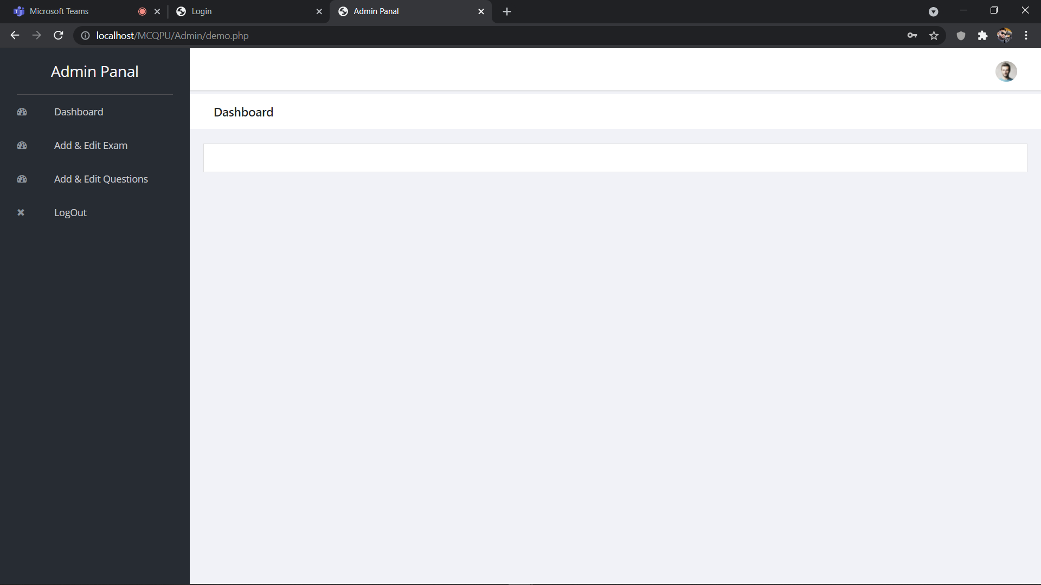

Slide 22
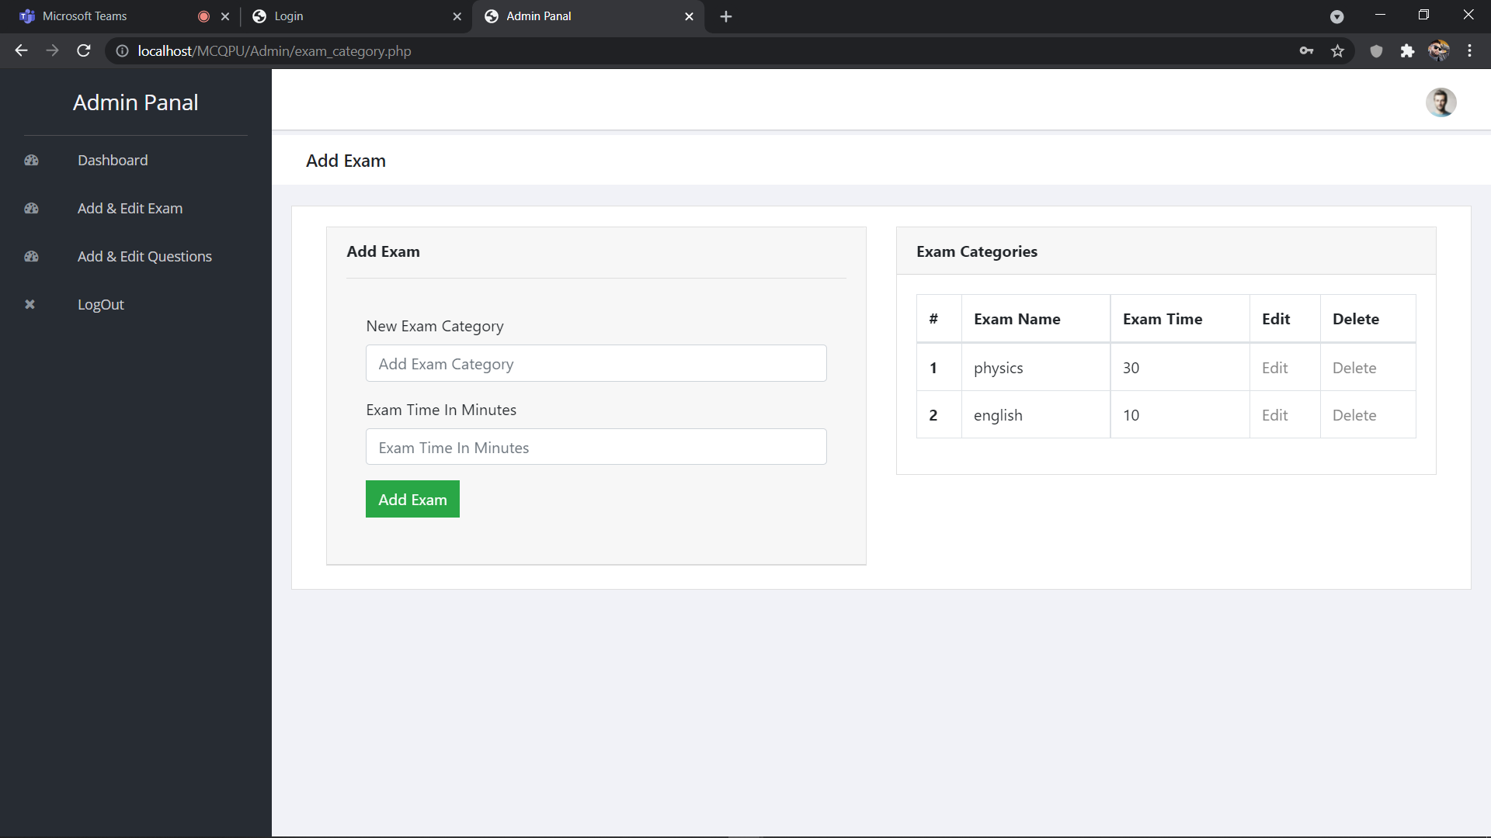

Slide 23
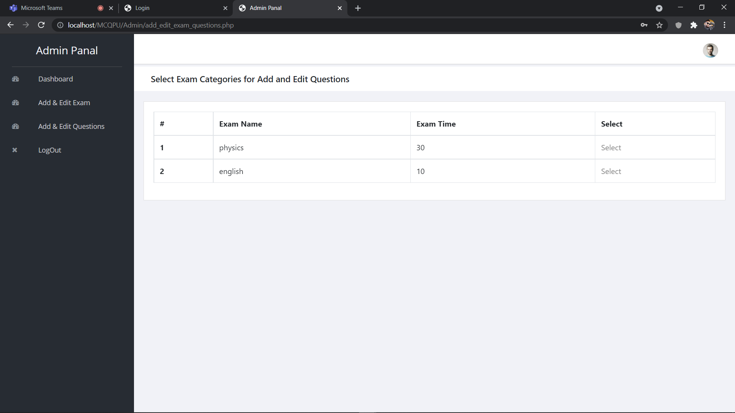

Slide 24
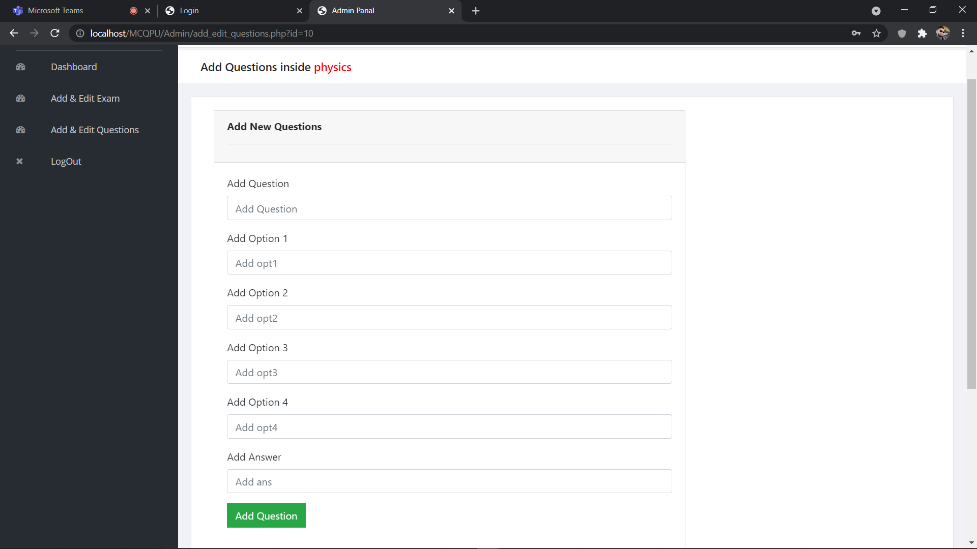

Slide 25
Thank you
Any Question?

