Slide 1
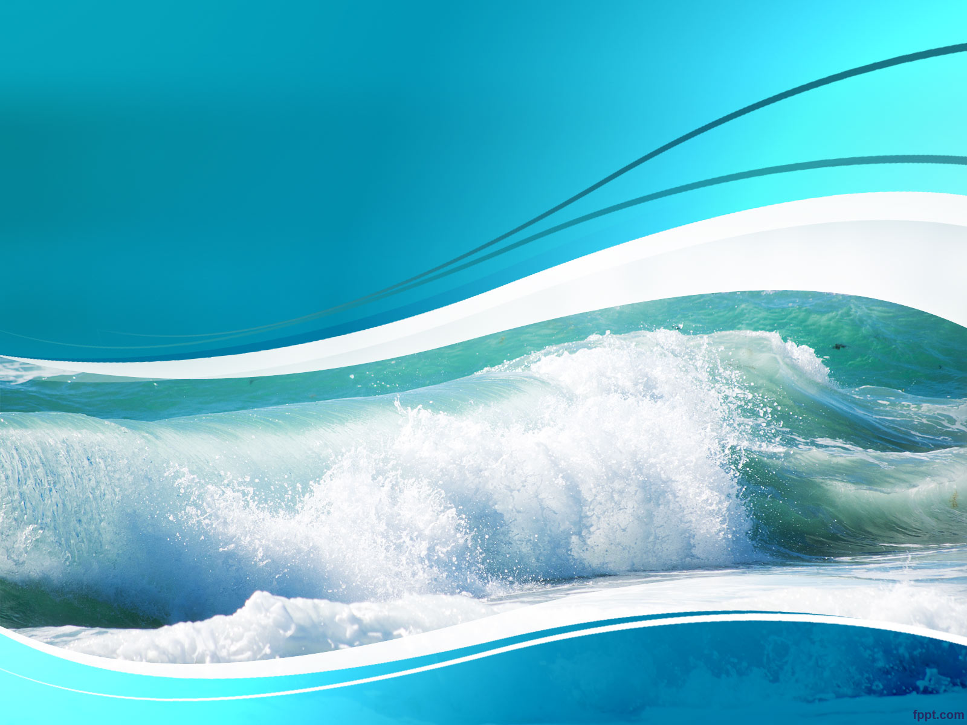
Pitch ClockWave
Milan Posman

Slide 2
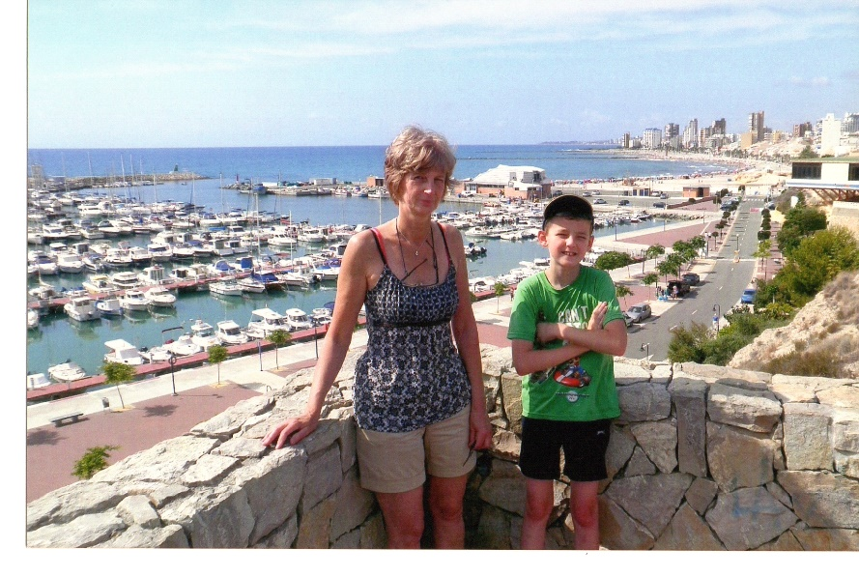
Do you like beaches ?
El Campello, Spain
Sound of gentle waves
Warm sun
Local markets
Swimming
No stress
Notes:
Every year, I visit a small beach town called El Campello, in Spain.
There, I wake up to the sound of gentle waves, the warm sun rising over the sea. We visit local markets, i swim in the ocean/pool …
No stress, Just peace.

Slide 3

Do you miss the beaches ?
When you come home …
Cold, humid weather
Stress
Aggressive sounds
Notes:
But when I came home — and reality hit fast.
Cold, humid mornings
Stress
& worst of all: all those aggressive sounds wake you up like a punch in the face.

Slide 4


Introducing … ClockWave !
Alarm Clock
Custom - designed hardware
Accurate real time clock
Relaxing ocean waves
Notes:
That’s why I created ClockWave, an alarm clock that:
Is custom designed hardware
With an accurate real time clock
That wakes you up gently with an speaker plays the ocean waves at alarm time

Slide 5
Demo ClockWave
Milan Posman

Slide 6
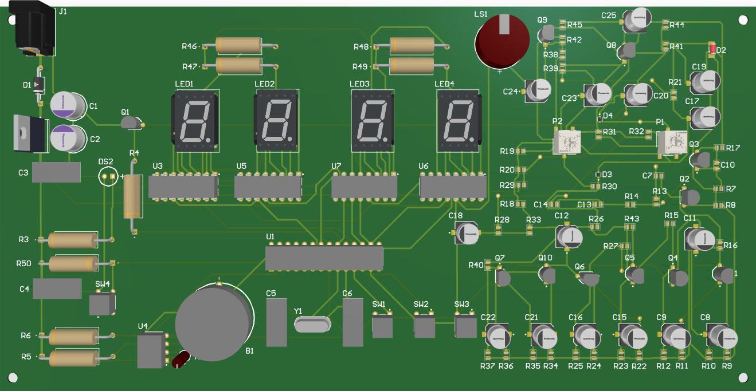
3 parts
Power supply
Clock
Wave (alarm)

Slide 7
User Interactions
Power supply
MODE, + & - button
Wave interaction

