Slide 1
DoubledMNIST
Developing an offline handwritten dataset

Slide 2
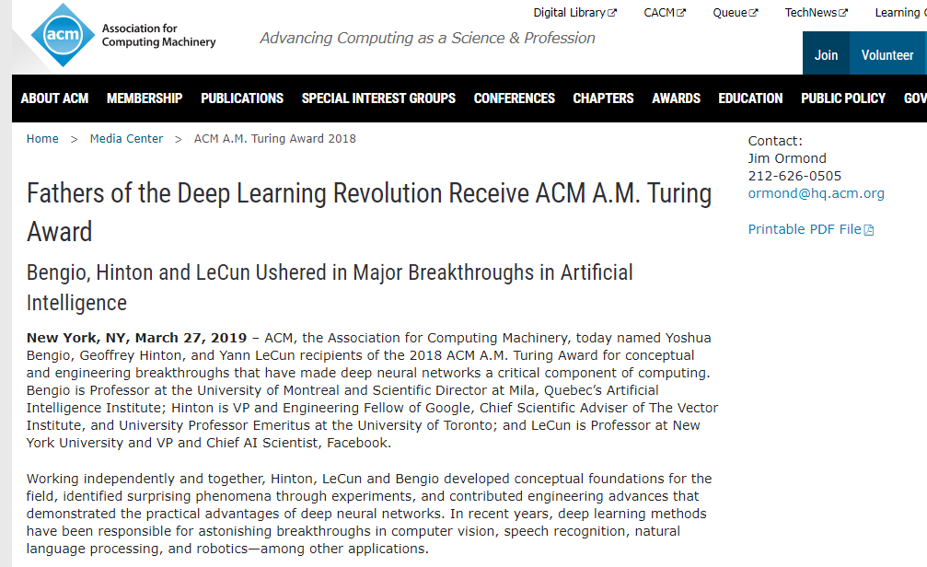
ACM Turing award 2019

Slide 3
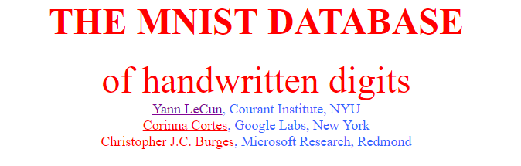
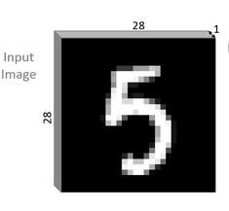
Father of Deep Learning is also MNIST’s father

Slide 4
MNIST’s grandfather?
NIST Special Database 19, American National Institute of Standards and Tehnology
Handprinted sample data
Separate digit, upper and lower case, and free text fields
~3600 writers
~800,000 images with hand checked classification
March 1995

Slide 5
NIST -> MNIST, NIST -> DoubledMNIST?
800k x (128, 128, 1) -> 70k x (28, 28, 1)
800k x (128, 128, 1) -> 140k x (56, 56, 1)
Why to duplicate?
Teaching motivation
How to duplicate?
Cousin influence (EMNIST)

Slide 6
Image Processing
Crop image
Manually
Add Noise
scipy
Square Image
Manually
Resize image
Image Interpolation
cv2

Slide 7
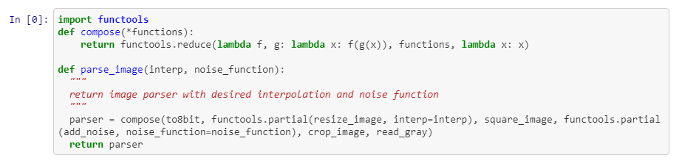
Stylish coding AKA Functional programming in Data Science

Slide 8
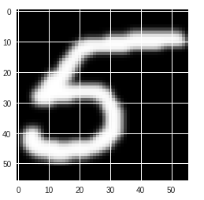
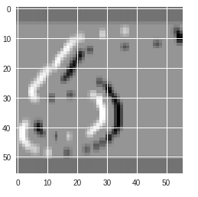
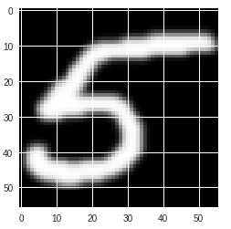
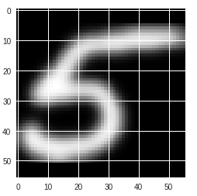
Choose best params
interp = interp
noise_function = noise_function
Gaussian + Bicubic
Sobel + Bicubic ?
Laplace + Bicubic
Sigma = 3 ?

Slide 9
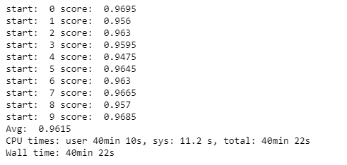
Evaluation heuristics
KNeighbours Classifier
12k x 2k? (Lazy)
~95% / 77%?

Slide 10

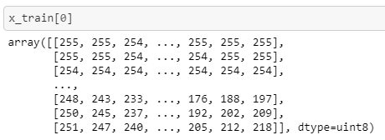
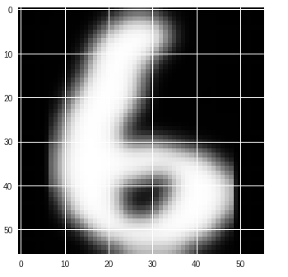
Utils and Challenges
extract_dataset
Time complexity
Scoring

Slide 11
Milan Čugurović
milan_cugurovic@matf.bg.ac.rs

